Slide 1

Year 5
Meet the Teacher

Slide 2
Class Teacher
Mrs Robinson
Meet our Team
Teaching Assistant
Miss Stephenson
PPA
Mrs Loynton

Slide 3
The Year 5 Classroom Routine
On arrival to school, children are invited into school by a member of staff, children put coats, bags and water bottles away in cloakroom.
On entry to the classroom, children enter quietly and start their "Strong Start" activity. This is usually a maths, grammar or reading activity designed to practice previously learnt skills.
In the morning, the day often starts with collective worship or an
Assembly where the whole school congregates.
Break time is at 10.30-10.45
Lunch time 12.15-13.15
Home time 15.25

Slide 4
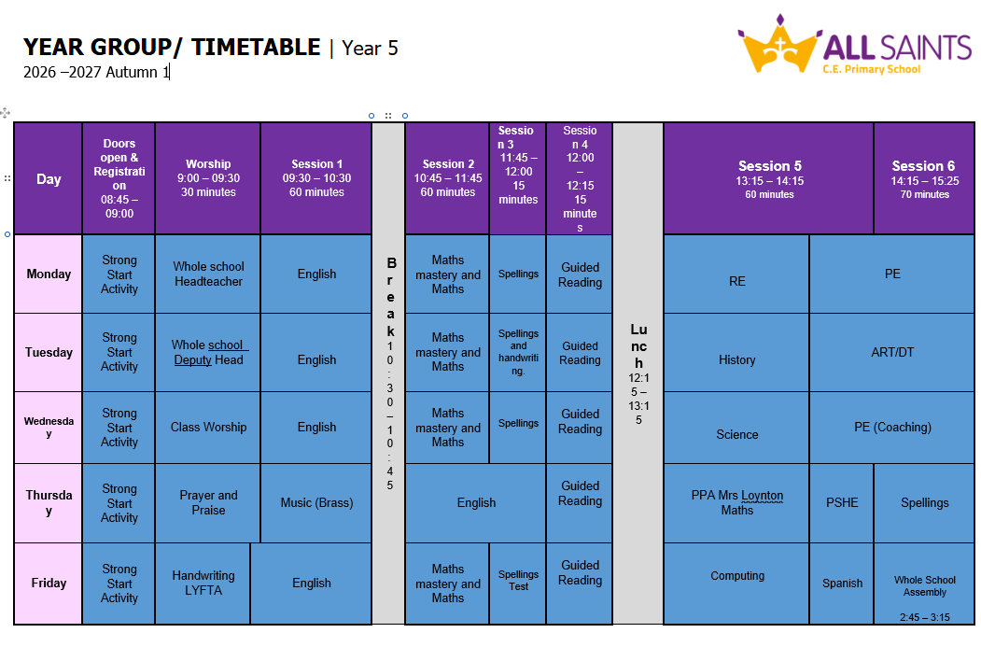
The Timetable

Slide 5

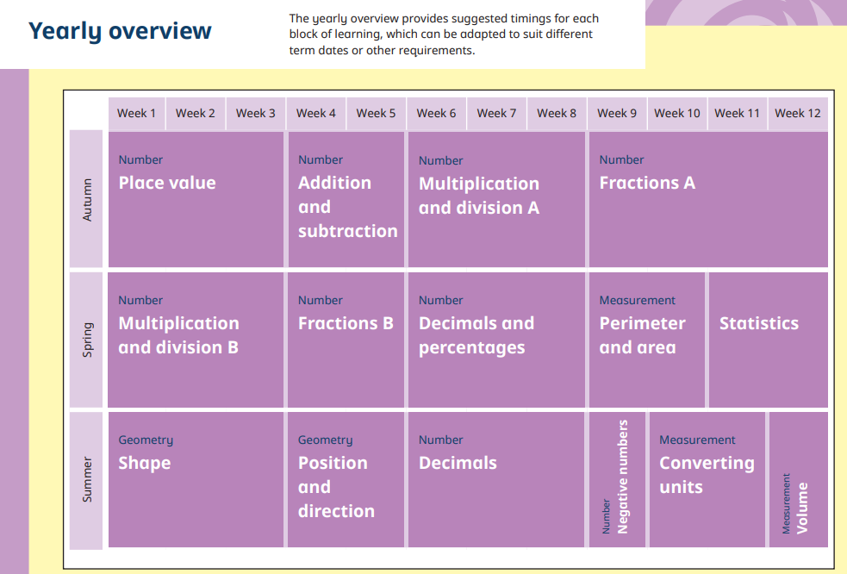
The Year 5 Curriculum

Slide 6




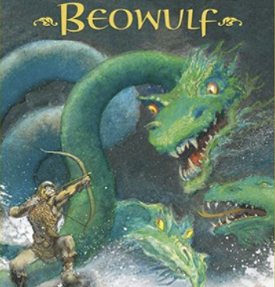

The Year 5 Curriculum
English
Autumn 1
Text: Beowulf
Autumn 2
Text: Stanley in Space
Spring 1
Text: Hugo Cabret
Spring 2
Text: The Kapok Tree
Summer 1
Text: The Orchard book of Greek Myths
Summer 2
Text: Oliver Twist

Slide 7
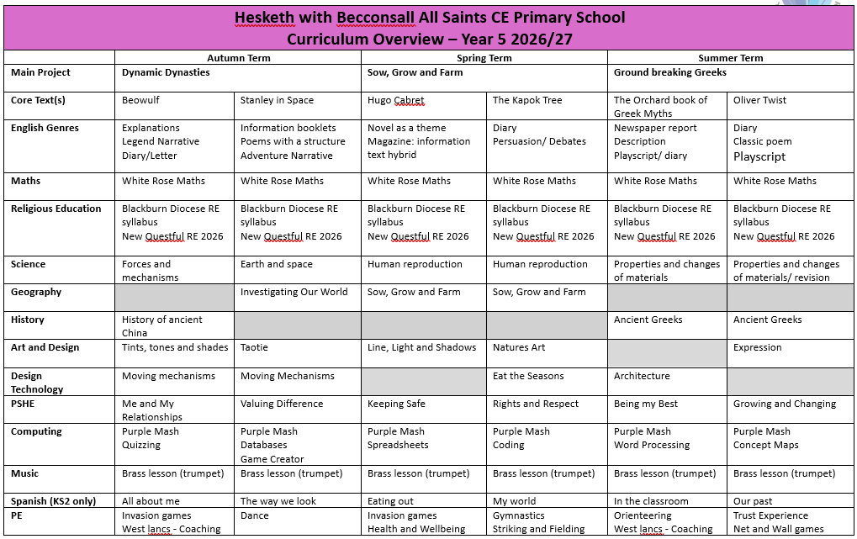
The year 5 Curriculum

Slide 8
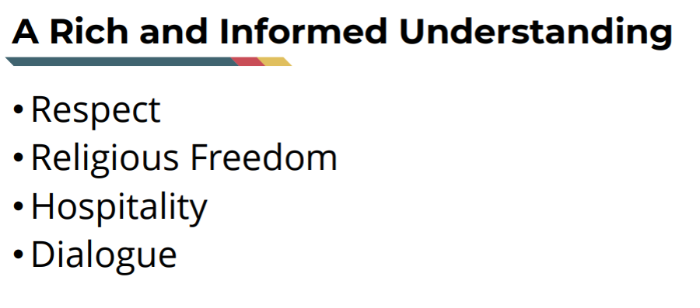

New Questful RE 2026

Slide 9
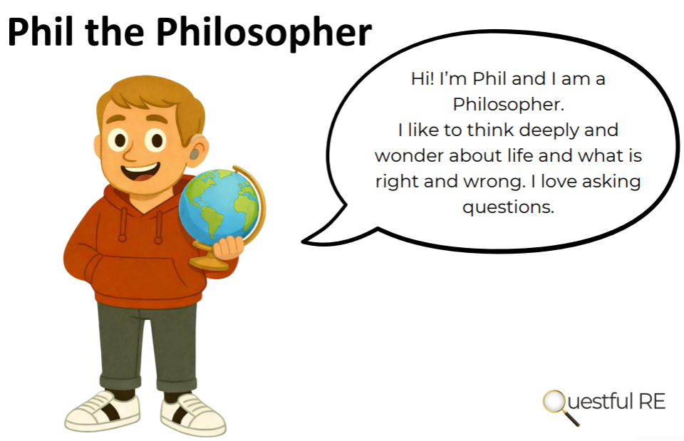
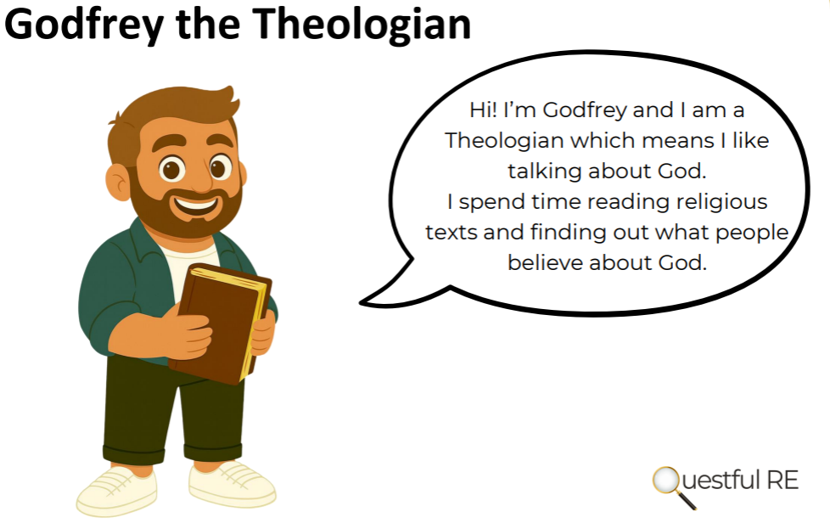

New Questful RE 2026

Slide 10

Reading
Please listen to your child read for at least 10 minutes, at least 3 times per week as a bare minimum, preferably every day.
Children get stickers every time they read, not just for completed books, so please keep a record in their yellow reading diaries.
Please read to your child as well, read for enjoyment and interest. Be a reading role model.
In school children read during daily guided reading sessions in small groups.
Reading books are changed when needed.
Notes:
Evidence suggests that there is a positive relationship between reading frequency, reading enjoyment and attainment.
Reading enjoyment has been reported as more important for children’s educational success, rather than their family’s socio-economic status.
There is a positive link between positive attitudes towards reading and scoring well on reading assessments.
Regularly reading stories or novels outside of school is associated with higher scores in reading assessments.
International evidence supports these findings’; US research reports that independent reading is the best predictor of reading achievement.
Other benefits to reading for pleasure include: text comprehension and grammar, positive reading attitudes, pleasure in reading in later life, increased general knowledge.

Slide 11
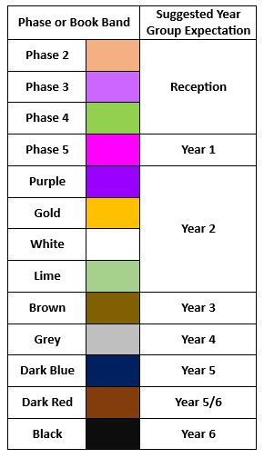
Reading Phase & Book Bands
In the infants, children are given reading books which are phonetically decodable aligned to the Red Rose Letters and Sounds phonics scheme trajectory. It may be that in order for gaps in your child’s phonic knowledge to be bridged a books with the focus grapheme will be sent home from a previous phase to ensure confidence and fluency in word reading.
They may be reading a more challenging book in school during guided reading and when I feel they are confident at this in school, I will then move them up at home too.
When children are more fluent readers, they are able to recognise many words on sight and are able to use their phonic knowledge to segment and blend more complex words. The focus now becomes more on understanding of a text and comprehension. When listening to your child read, please also focus on discussion of the text, new vocabulary and understanding of characters thoughts and feelings.

Slide 12




Home Learning
Home learning will be given out on a Friday and home learning books are to be given back in on a Wednesday. Each week there will be spelling, maths and times table homework. There may also be a challenge every half-term.
Children are expected to read at least three times a week as part of their home learning.
Spelling lists will be sent home on a Friday and tested on a Wednesday. Short, sharp bursts of regular practise will help spellings to “stick” better.
All log-in details for our on-line subscriptions are found in the front of your yellow reading diaries.

Slide 13
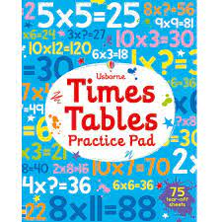
Times tables
Year 5
Revision of all multiplication and division
facts up to 12 x 12

Slide 14

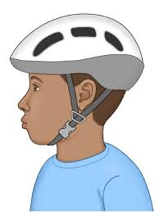
Bikeability
Year 5 pupils will have the opportunity to participate in the Bikeability programme in November. To take part children must be able to ride a bike unaided.
Bikeability is the government’s national cycle training programme. It helps children learn practical skills and understand how to cycle on today’s roads.
Pupils bikes must be in working order with fully functional brakes and must be of an appropriate size. Please note that all bikes are acceptable (BMX, Mountain, Racing or Hybrid)
All participants must wear a helmet at all times during the course.
More information will be provided in the next few weeks

Slide 15
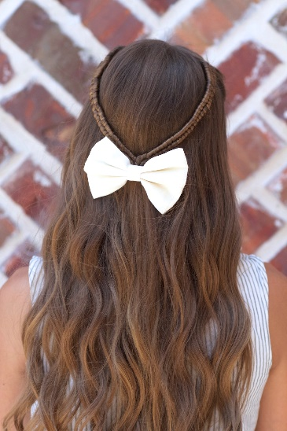

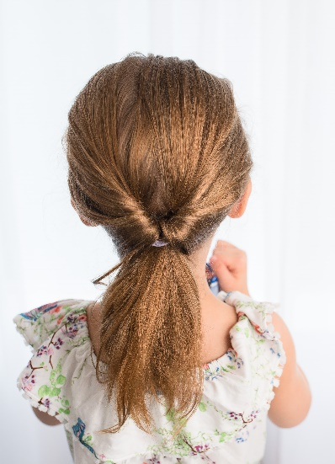

School Uniform
Please ensure that full uniform is worn except on PE days, this includes black shoes. Trainers should not be worn unless it is a PE day.
Please make sure that long hair is always fully tied back.
Children are allowed to wear small earrings and a watch – Not a Smart Watch.
On PE days (Monday and Wednesday) children should wear their P.E. kit (purple shorts and white T-Shirt); they may wear plain black tracksuit top/bottoms. On these days earrings should be removed.

Slide 16

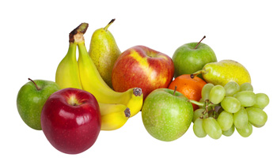
Healthy School
We will do our best to ensure the healthy growth and development of our learners. We will do all that we can to build healthy eating and drinking patterns so that our learners thrive and lead healthy active lives.
We provide healthy and balanced school meals that, where possible, contain sustainable and locally sourced produce.
Children in the Infants are provided with a snack through the School Fruit & Vegetable Scheme.
All children can bring in a healthy snack e.g. fruit for morning play or parents can pay for toast through Parent Pay.
Please note that we are a “nut free” school.
All children should bring a drinks bottle to school which contains water.
Milk is available to order for Infants and for under 5’s it is free.

Slide 17
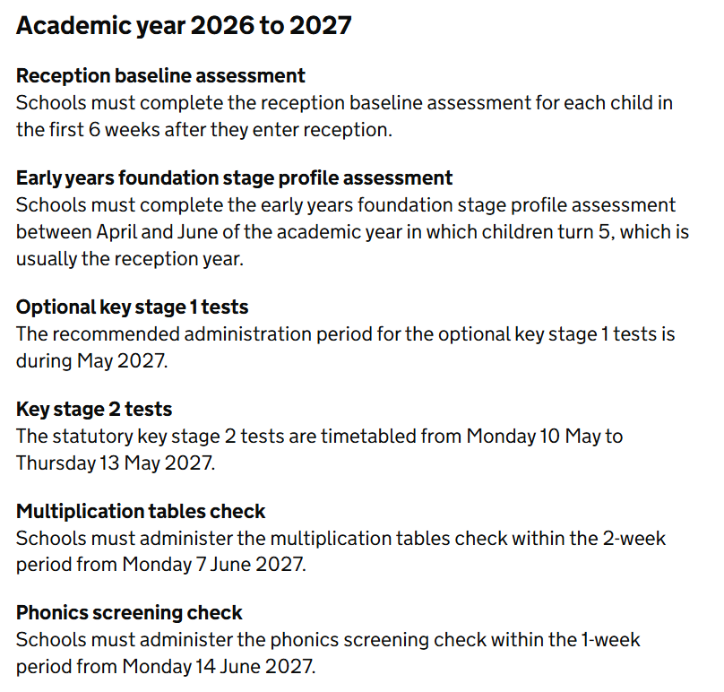
National Statutory Assessments

Slide 18

School Assessments
At Hesketh-with-Becconsall All Saints Church of England Primary School, we believe that assessment should place the child at the centre of their learning, encouraging them to let their light shine and that it should raise achievement for all. We focus on the progress of each individual child. We believe that assessment should be thorough, manageable and relevant. Assessment for learning (AfL) is embedded throughout the school.
“AfL is the single most powerful tool we have for both raising standards and empowering lifelong learners.”Assessment Reform Group
Assessment at Hesketh-with-Becconsall All Saints Church of England Primary School involves:
Setting Targets – sharing achievable but challenging targets, objectives and success criteria with children, and allowing children to set their own targets with guidance.
Tracking – teacher and children evaluating progress in relation to these targets over the course of a lesson, unit of work, term, year or key stage.
Active Interventions – teacher (with involvement of SLT, SENCO, TAs and parents where relevant) planning appropriate learning to support children in meeting these targets based on information gained from tracking.
Reviewing – teacher, child and other adults reviewing whether targets have been met and progress has been made.
The most valuable form of assessment is formative and is determined by daily interactions and questioning of pupils and marking of books to ascertain their starting points and next steps.
Teachers adapt teaching according to their assessment of pupils and to meet pupil needs, even if this means deviating from a planned lesson.
Three more formal assessment cycles take place during the year, at the end of each term.

Slide 19
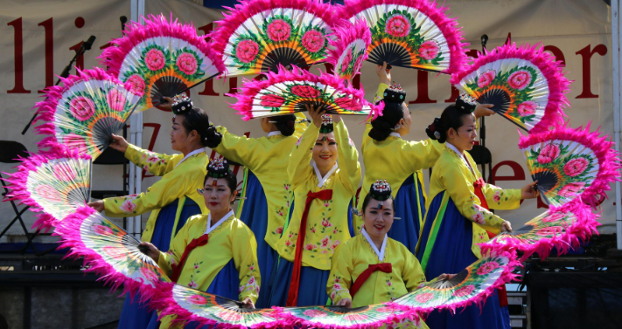

Special events
Dance Festival year – July
Let's Go Sing - March

Slide 20

Any Questions?
Website: https://www.allsaintshwb.co.uk/
Email: s.robinson@hesketh-with-becconsall.lancs.sch.uk

