Slide 1

Meet the Teacher

Slide 2
Class Teacher Mr Maguire
Meet our Team
PPA
Tuesday
10:00 – 12:15
Mrs Loynton
covering History/Geography

Slide 3
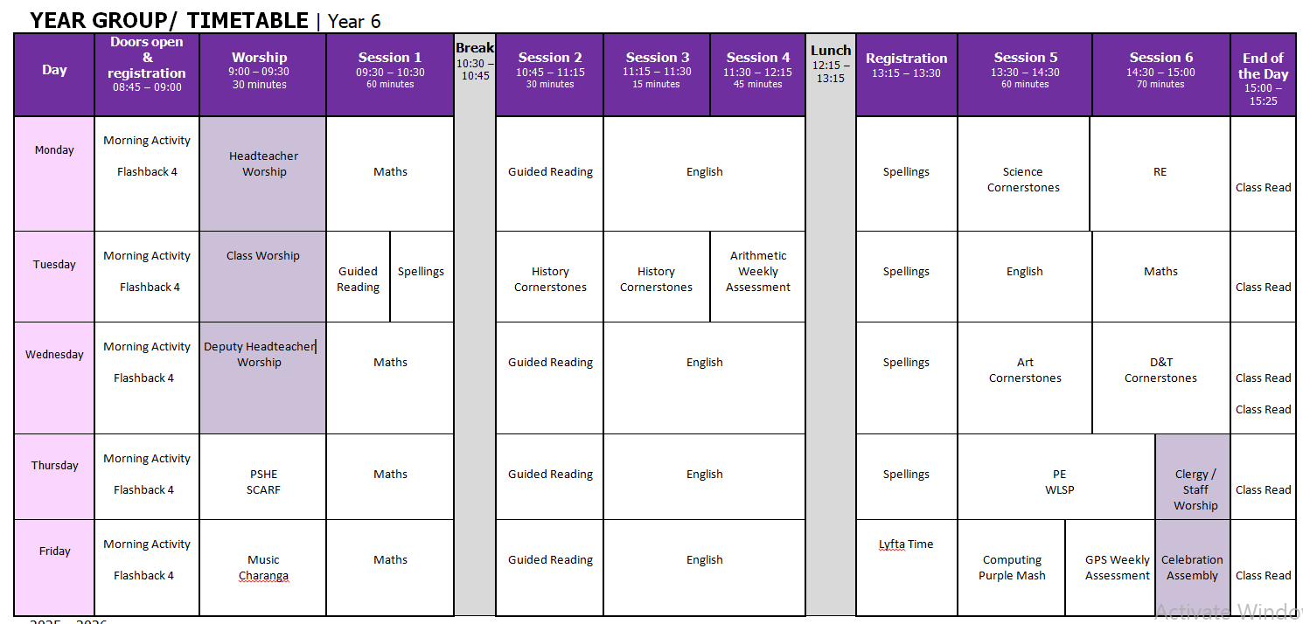
Timetable

Slide 4
Year 5/6 Classroom Routine
Morning
Hang up coats and bags
Morning Activity – Flashback 4
Worship (Mon - Wed) PSHE (Thurs) Music (Fri)
Maths (White Rose Mathematics)
Break – 10:15 – 10:30
Morning (After Break)
Guided Reading
English (Lancashire Planning)
Lunch – 12:15 – 13:15
Afternoon
Spellings
Foundation Lesson (Cornerstones / Questful RE / SCARF / Charanga / WLSP)
Worship (Thurs) Celebration Assembly (Fri)
Class Novel
Home time – 15:25
Children leave from the Year 6 classroom door

Slide 5
PE Day
Thursday
Year 6 will have a double PE slot on a Thursday afternoon.
Notes:
Evidence suggests that there is a positive relationship between reading frequency, reading enjoyment and attainment.
Reading enjoyment has been reported as more important for children’s educational success, rather than their family’s socio-economic status.
There is a positive link between positive attitudes towards reading and scoring well on reading assessments.
Regularly reading stories or novels outside of school is associated with higher scores in reading assessments.
International evidence supports these findings’; US research reports that independent reading is the best predictor of reading achievement.
Other benefits to reading for pleasure include: text comprehension and grammar, positive reading attitudes, pleasure in reading in later life, increased general knowledge.

Slide 6
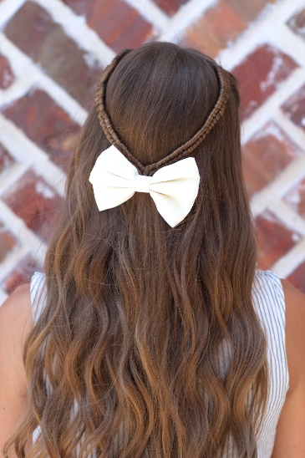

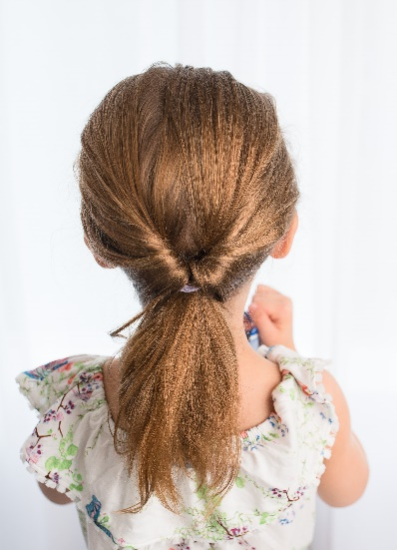

School Uniform
Please make sure that long hair is always fully tied back.
Children are allowed to wear small earrings and an analogue watch – no fitbits or technological watches
On PE day (Thursday) children should wear their P.E. kit (purple shorts and white T-Shirt); they may wear plain black tracksuit top/bottoms.
On PE days earrings should be removed.

Slide 7

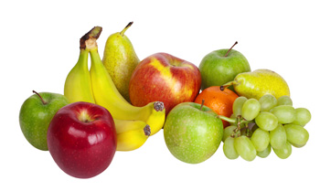
Healthy School
We will do our best to ensure the healthy growth and development of our learners. We will do all that we can to build healthy eating and drinking patterns so that our learners thrive and lead healthy active lives.
We provide healthy and balanced school meals that, where possible, contain sustainable and locally sourced produce.
Children in the Infants are provided with a snack through the School Fruit & Vegetable Scheme.
All children can bring in a healthy snack e.g. fruit for morning play or parents can pay for toast through Parent Pay.
All children should bring a drinks bottle to school which contains water.
Milk is available to order for Infants and for under 5’s it is free.

Slide 8
The Year 6 Curriculum
English and Guided Reading
For English and Guided Reading we use Lancashire Learning and Progression Steps, designed to scaffold the learning required in order to meet the expectations of the National Curriculum
Maths
For Maths, we primarily use White Rose. White Rose offer a vast bank of clear, practical resources. We also use NCETM, a scheme that provide planning and assessment resources, as children’s chances of success are maximised if they develop deep and lasting understanding of mathematical procedures and concepts.
RE
For RE, we use Questful RE. By embracing the explicit teaching of Christian concepts and God’s big salvation story, it is hoped that the content of this syllabus will give pupils a deeper understanding of Christianity.
Music
For Music, we use Charanga; a music education and technology company that provides pupils with the help and resources they need to achieve their musical ambitions.
PSHE
For PSHE, we use SCARF: Safety, Caring, Achievement, Resilience, Friendship. Their vision is for all children to acquire the life skills needed to thrive.
PE
For PE, we use West Lancashire Sports Partnership’s platform which offers well planned and progressive sessions to improved levels of attainment across the whole PE curriculum.
Science, History, Art and Design and Technology
For Science, History, Art and Design and Technology, we use Curriculum Maestro to implement and easily manage an ambitious primary curriculum. From sequenced, resourced curriculum projects to teaching and assessment tools, Maestro is the online curriculum and assessment platform with everything you need, all in one place.

Slide 9
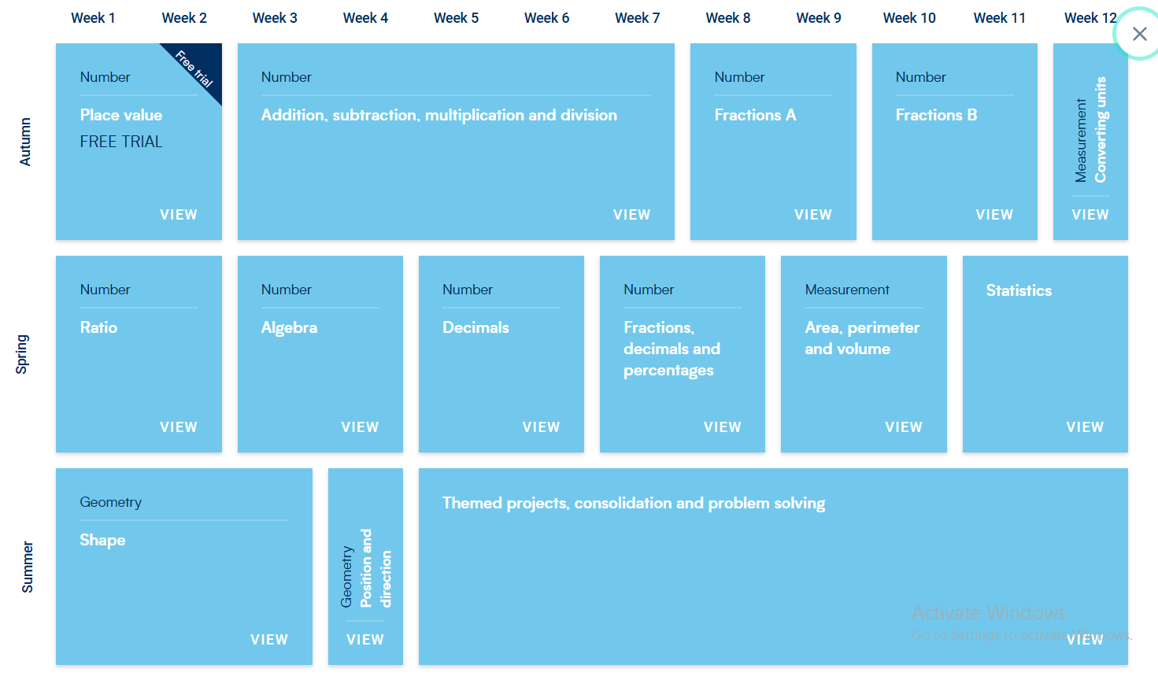
WhiteRose Maths

Slide 10

Reading
Please listen to your child read for at least 10 minutes, 3 times per week, preferably every day.
Reading records must be in school everyday, as they are collected and written in when the children read in school.
100 club certificates are provided
Please read to your child as well, read for enjoyment and interest. Be a reading role model.
In school children read during daily guided reading sessions in small groups.
Reading books are changed when they have finished their books.
We recommend that the children persist through the book they have chosen.
Notes:
Evidence suggests that there is a positive relationship between reading frequency, reading enjoyment and attainment.
Reading enjoyment has been reported as more important for children’s educational success, rather than their family’s socio-economic status.
There is a positive link between positive attitudes towards reading and scoring well on reading assessments.
Regularly reading stories or novels outside of school is associated with higher scores in reading assessments.
International evidence supports these findings’; US research reports that independent reading is the best predictor of reading achievement.
Other benefits to reading for pleasure include: text comprehension and grammar, positive reading attitudes, pleasure in reading in later life, increased general knowledge.

Slide 11
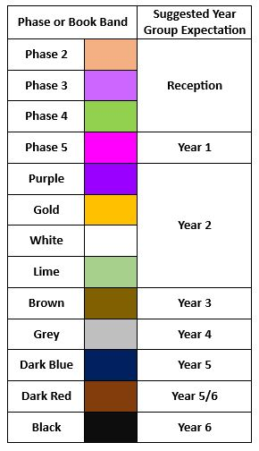
Reading Phase & Book Bands
In the infants, children are given reading books which are phonetically decodable aligned to the Red Rose Letters and Sounds phonics scheme trajectory. It may be that in order for gaps in your child’s phonic knowledge to be bridged a books with the focus grapheme will be sent home from a previous phase to ensure confidence and fluency in word reading.
Children may be reading a more challenging book in school during guided reading and when I feel they are confident at this in school, I will then move them up at home too.
When children are more fluent readers, they are able to recognise many words on sight and are able to use their phonic knowledge to segment and blend more complex words. The focus now becomes more on understanding of a text and comprehension. When listening to your child read, please also focus on discussion of the text, new vocabulary and understanding of characters thoughts and feelings.

Slide 12




Home Learning
Independent spelling lists will be sent home and tested throughout the term. Do not complete in one go! Short, sharp bursts of regular practise will help spellings to “stick” better.
All log-in details for our on-line subscriptions are found in the front of your green reading diaries.
Maths and English homework will be sent out each week, based on what the children have learnt in school.

Slide 13
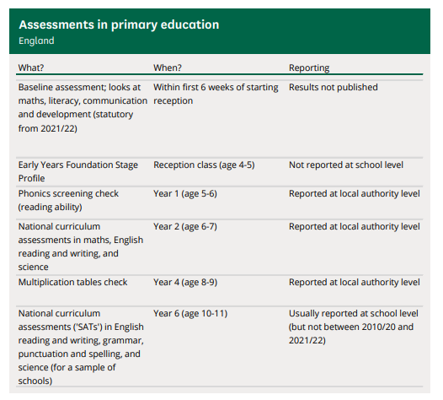
National Statutory Assessments
Optional from 2024

Slide 14
School Assessments
At Hesketh-with-Becconsall All Saints Church of England Primary School, we believe that assessment should place the child at the centre of their learning, encouraging them to let their light shine and that it should raise achievement for all. We focus on the progress of each individual child. We believe that assessment should be thorough, manageable and relevant. Assessment for learning (AfL) is embedded throughout the school.
“Assement for Learning is the single most powerful tool we have for both raising standards and empowering lifelong learners.”Assessment Reform Group
Assessment at Hesketh-with-Becconsall All Saints Church of England Primary School involves:
Setting Targets – sharing achievable but challenging targets, objectives and success criteria with children, and allowing children to set their own targets with guidance.
Tracking – teacher and children evaluating progress in relation to these targets over the course of a lesson, unit of work, term, year or key stage.
Active Interventions – teacher (with involvement of SLT, SENCO, TAs and parents where relevant) planning appropriate learning to support children in meeting these targets based on information gained from tracking.
Reviewing – teacher, child and other adults reviewing whether targets have been met and progress has been made.
The most valuable form of assessment is formative and is determined by daily interactions and questioning of pupils and marking of books to ascertain their starting points and next steps.
Teachers adapt teaching according to their assessment of pupils and to meet pupil needs, even if this means deviating from a planned lesson.
Three more formal assessment cycles take place during the year, at the end of each term.

Slide 15
SEND (Special Educational Needs & Disability)
SEND covers those children with SEN (Special Educational Needs) & AEN (Additional Educational Needs), examples of need are shown below:
SEN
Cognition and Learning
Communication and Interaction
Social, Emotional and Mental Health difficulties
Sensory and Physical
AEN
Medical needs
FSM eligibility
EAL
Behaviour
Children Looked After
Attendance
Disabilities
Children with AEN may have SEN however a large number of children who have AEN do not have SEN e.g., a child with poor attendance requiring catch-up doesn’t necessarily have SEN i.e., an inability to catch up.
Likewise, a child with SEN e.g., dyslexia may not have any AEN.
SEND children are supported appropriately and their progress is tracked regularly in consultation with parents.
We call this a graduated response.

Slide 16
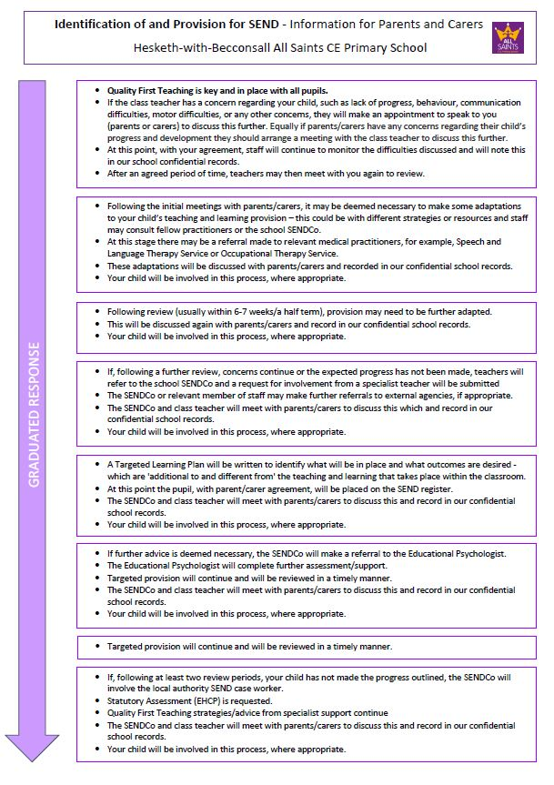
SEND

Slide 17

Any Questions?
Website: https://www.allsaintshwb.co.uk/
Email: maguireb@hesketh-with-becconsall.lancs.sch.uk

