Slide 1


Year 5
Meet the Teacher

Slide 2
The Year 5 Classroom Routine
On arrival to school, invited into school by a member of staff, children put coats and water away into cloakroom.
On entry to the classroom, children enter quietly and start there morning activity.
In the morning the day often starts with collective worship or an
Assembly where the whole school congregates.
Break time is at 10.30-10.45
Lunch time 12.15-13.15
Home time 15.25

Slide 3
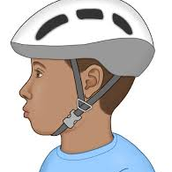

Bikeability
Year 5 pupils will have the opportunity to participate in the Bikeability programme in November. To take part children must be able to ride a bike unaided.
Bikeability is the government’s national cycle training programme. It helps children learn practical skills and understand how to cycle on today’s roads.
Pupils bikes must be in working order with fully functional brakes and must be of an appropriate size. Please note that all bikes are acceptable (BMX, Mountain, Racing or Hybrid)
All participants must wear a helmet at all times during the course.

Slide 4
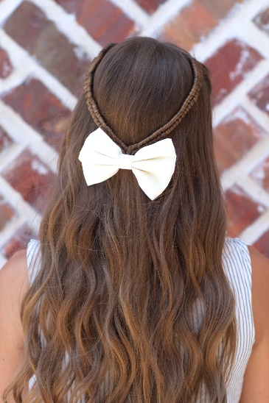

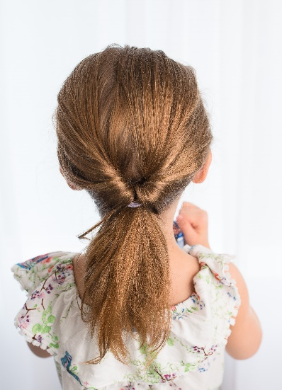


School Uniform
Please make sure that long hair is always fully tied back.
Children are allowed to wear small earrings (studs) and a watch (not a smart watch
Hair bobbles/ clips should be school colours
Black shoes
On PE days (Monday and Wednesday) children should wear their P.E. kit (purple shorts and white T-Shirt); they may wear plain black tracksuit top/bottoms. ( items must not have huge logs on the)
On PE days earrings must be removed.
Water bottles would be better if they are sports caps

Slide 5
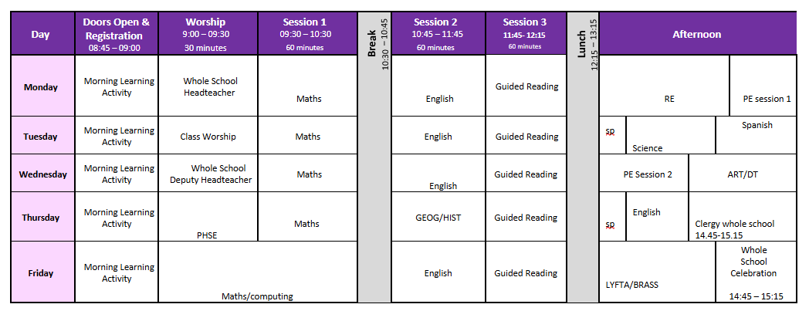
The Timetable

Slide 6

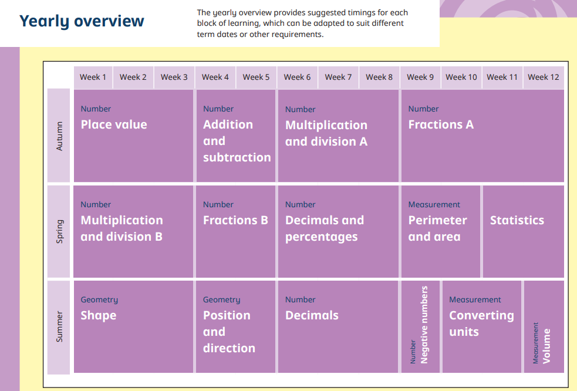
The Year 5 Curriculum

Slide 7
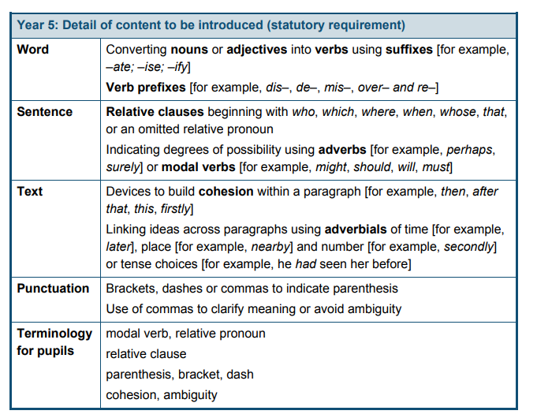
The Year 5 Curriculum
English

Slide 8



The Year 5 Curriculum
English
Autumn 1
Legends and persuasion
Autumn 2
Stories with historical settings
Film and play scripts
Classic narrative poetry
Book: Street Child and Oliver Twist
Spring 1
Science fiction stories
Information booklets
Poems with a structure
Spring 2
Novel as a theme
Magazine: information text
Book: Hugo Cabret – Brian Selznick
Summer 1
TBC
Summer 2
Myths
Reports
Poems with figurative language
Book: The Fire Thief – Terry Deary

Slide 9
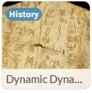
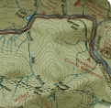





The Year 5 Curriculum
Autumn 1 Autumn 2
Geography- Investigating
Our world. Time zones, climate zones and vegetation biomes
Focus Shang Dynasty
Forces and Mechanisms
Friction, gravitational force, air resistance, water resistance, levers, pulleys and gears
Earth and Space
Taotie
DT Moving mechanisms – create toy linked to pneumatics
ART Tints, Tones and shades. Lanscape artwork

Slide 10
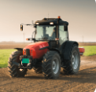
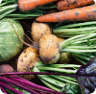
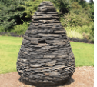
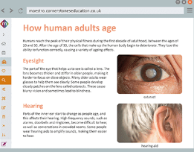

The Year 5 Curriculum
Spring 1
DT – Eat the seasons
Create soup or fruit pastry
Geography Sow, Grow and Fram
Natures art
Human ageing and lifecycles
Art – Line, light and shadows

Slide 11

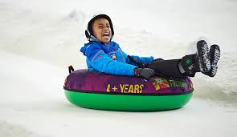
The Year 5 Trust Experience
November

Slide 12
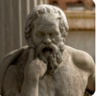
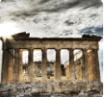
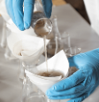


The Year 5 Curriculum
Summer
DT -Architecture
Ancient Greece
Science – Properties and
Changes of materials
Art - Expression
Art – Mixed Media

Slide 13
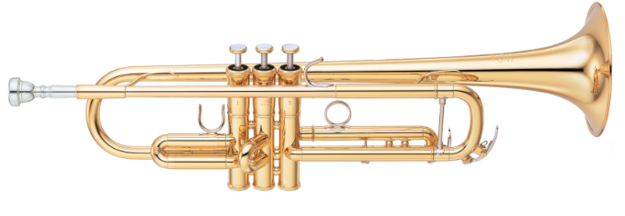

The Year 5 Curriculum
Music
Lyfta Time – Stories which connect us

Slide 14
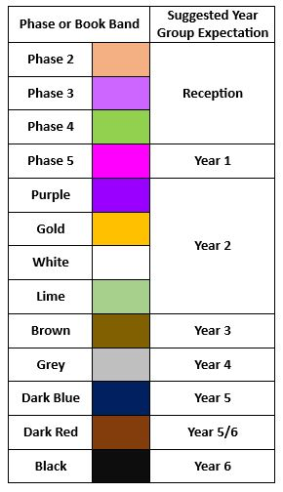
Reading Phase & Book Bands
In the infants, children are given reading books which are phonetically decodable aligned to the Red Rose Letters and Sounds phonics scheme trajectory. It may be that in order for gaps in your child’s phonic knowledge to be bridged a books with the focus grapheme will be sent home from a previous phase to ensure confidence and fluency in word reading.
They may be reading a more challenging book in school during guided reading and when I feel they are confident at this in school, I will then move them up at home too.
When children are more fluent readers, they are able to recognise many words on sight and are able to use their phonic knowledge to segment and blend more complex words. The focus now becomes more on understanding of a text and comprehension. When listening to your child read, please also focus on discussion of the text, new vocabulary and understanding of characters thoughts and feelings.

Slide 15




Home Learning
Home learning will be given out on a Friday and home learning books are to be given back in on a Wednesday. Each week there will be spelling, maths and times table homework. There may also be a challenge every half-term.
Children are expected to read three times a week as part of their home learning.
Spelling lists will be sent home on a Friday and tested on a Wednesday. Short, sharp bursts of regular practise will help spellings to “stick” better.
All log-in details for our on-line subscriptions are found in the front of your yellow reading diaries.

Slide 16
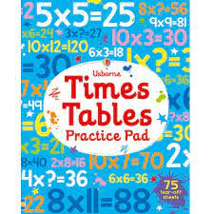
Times tables
Year 5
Revision of all multiplication and division
facts up to 12 x 12

Slide 17


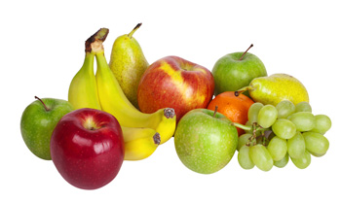
Healthy School
We will do our best to ensure the healthy growth and development of our learners. We will do all that we can to build healthy eating and drinking patterns so that our learners thrive and lead healthy active lives.
We provide healthy and balanced school meals that, where possible, contain sustainable and locally sourced produce.
Children in the Infants are provided with a snack through the School Fruit & Vegetable Scheme.
All children can bring in a healthy snack e.g. fruit for morning play or parents can pay for toast through Parent Pay.
All children should bring a drinks bottle to school which contains water.
Milk is available to order for Infants and for under 5’s it is free.

Slide 18

Any Questions?
Website: Under construction
Email: t.byrne@hesketh-with-becconsall.lancs.sch.uk

