Slide 1

Meet the Teacher

Slide 2
Class Teacher
Mrs Priestman
Meet our Team
PPA
Mrs Loynton
Teaching Assistant
Mrs Odgers
Mrs Wrigley

Slide 3
The Year 1 Classroom Routine
Key Points
Arrive and put book bags in the box (to be brought in every day), water bottles/pack lunches and school bags/coats away.
Focused whole-class inputs, followed by guided or independent tasks. Some continuous provision may take place throughout afternoon sessions, and will be phased out as the year progresses.
Year 1 children can have toast mid-morning and fruit mid-afternoon. If you would like your child to receive milk, please speak with the office.
Reading books will be changed every Thursday, but should be brought in daily so that readers can be listened to. Home learning will also be handed out on Thursday.
As phonic assessments take place, individual phonics targets will be sent home to be practised and learnt, in preparation for the Phonics Screening Test at the end of Year 1.
Any important parent communication will be sent via School Spider, such as any special events, trips or activities planned.
PE Days: Monday and Friday

Slide 4
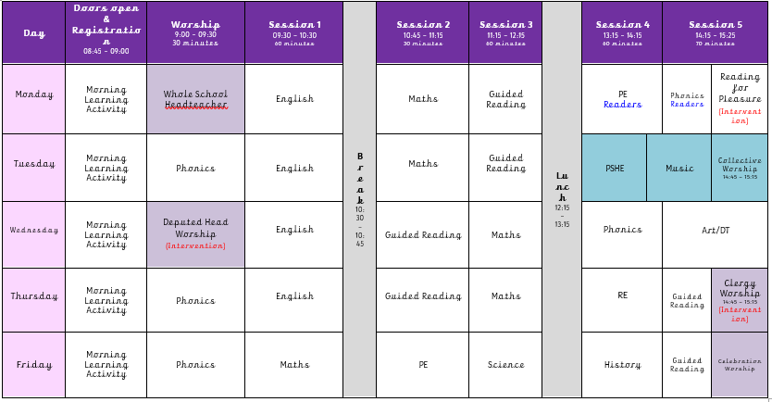
The Year 1 Timetable

Slide 5
The Year 1 Curriculum
 | Term One |  | Term Two |  | Term Three
Driver Project | Childhood History |  | Bright Lights, Big City |  | School Days
English | Stories by the Same Author Non-Chronological Reports Poems on a Theme | Repetitive Patterned Stories Non Fiction Texts | Classic Stories Instructions Traditional Rhymes | Traditional Tales Recounts | Familiar Settings Traditional Rhymes Non-Fiction Booklets | Stories with Fantasy Settings Poems (by heart) Recounts
Science | Everyday Materials Human Senses |  | Seasonal Changes |  | Plant Parts Animal Parts
Art & Design | Mix It! Funny Faces and Fabulous Features |  | Rain and Sunrays |  | Street View
D&T | Shade and Shelter |  | Taxi! |  | Chop, Slice and Mash
Maths | Place Value (to 10) Addition and Subtraction Geometry |  | Place Value (to 20) Addition and Subtraction Place Value (to 50) Length and Height Mass and Volume |  | Multiplication & Division Fractions Geometry Place Value (to 100) Measurement Time
RE | Harvest, God and Creation, Christmas |  | Jesus was Special Easter: New Life |  | Baptism, Joseph, My World

Slide 6

Reading
Please listen to your child read for at least 10 minutes, 5 times per week, preferably every day.
Children get stickers every time they read, not just for completed books, so please keep a record in their yellow reading diaries.
Please read to your child as well, read for enjoyment and interest. Be a reading role model.
In school children read during daily guided reading sessions in small groups.
Reading books are changed on ??
Notes:
Evidence suggests that there is a positive relationship between reading frequency, reading enjoyment and attainment.
Reading enjoyment has been reported as more important for children’s educational success, rather than their family’s socio-economic status.
There is a positive link between positive attitudes towards reading and scoring well on reading assessments.
Regularly reading stories or novels outside of school is associated with higher scores in reading assessments.
International evidence supports these findings’; US research reports that independent reading is the best predictor of reading achievement.
Other benefits to reading for pleasure include: text comprehension and grammar, positive reading attitudes, pleasure in reading in later life, increased general knowledge.

Slide 7
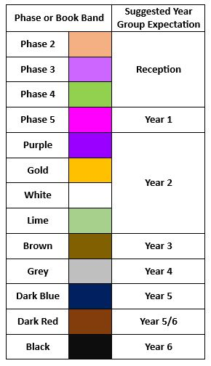
Reading Phase & Book Bands
In the infants, children are given reading books which are phonetically decodable aligned to the Red Rose Letters and Sounds phonics scheme trajectory. It may be that in order for gaps in your child’s phonic knowledge to be bridged a books with the focus grapheme will be sent home from a previous phase to ensure confidence and fluency in word reading.
They may be reading a more challenging book in school during guided reading and when I feel they are confident at this in school, I will then move them up at home too.
When children are more fluent readers, they are able to recognise many words on sight and are able to use their phonic knowledge to segment and blend more complex words. The focus now becomes more on understanding of a text and comprehension. When listening to your child read, please also focus on discussion of the text, new vocabulary and understanding of characters thoughts and feelings.

Slide 8
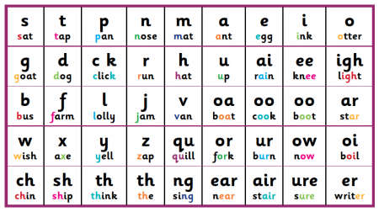
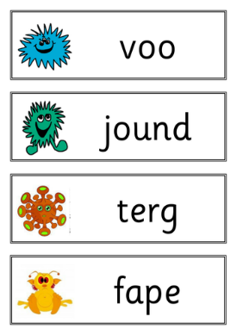
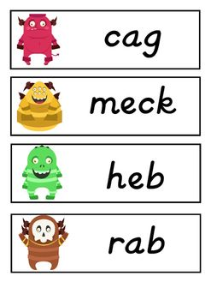
Phonics Screening
Children in Year 1 will take this test in June 2026.
Phonics The test consists of reading 40 words, 20 real words and 20 “alien” words. This assesses children’s ability to segment and blend in order to read words containing phase 3-5 phonemes.
We complete phonics daily and provide extra opportunities through early bird work, intervention and through continuous provision.

Slide 9


Home Learning
Alongside regular reading at home, Year 1 will be handed an electronic phonics sheet as part of their homework, specifying the phonemes taught the previous week, along with some helpful and engaging games. In addition to this, short pieces of homework (linked to our topics) may be sent home on occasion, along with personalised phonics targets.
All log-in details for our on-line subscriptions will be found in the front of your yellow reading diaries, once finalised.

Slide 10
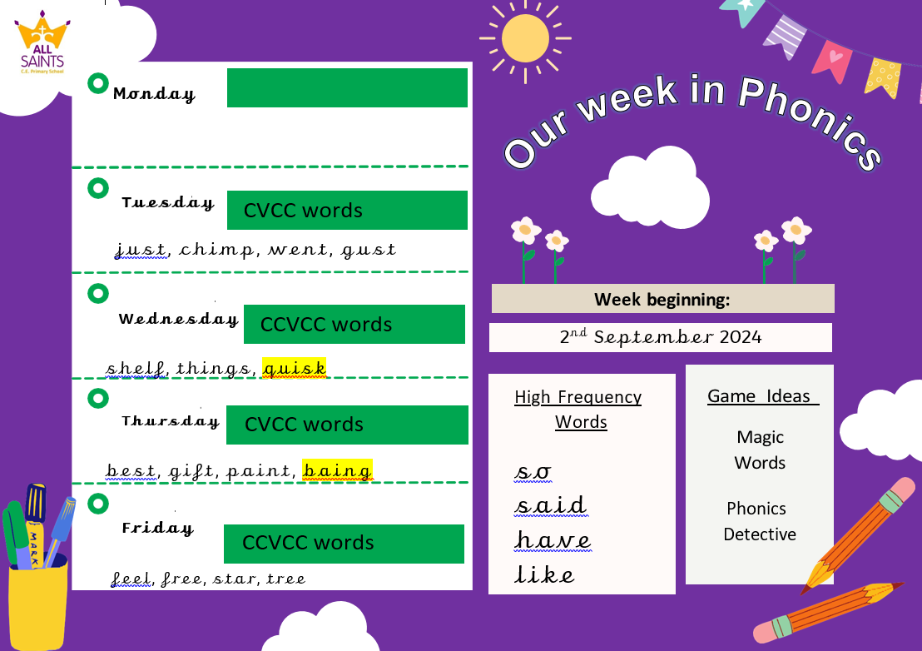

Slide 11


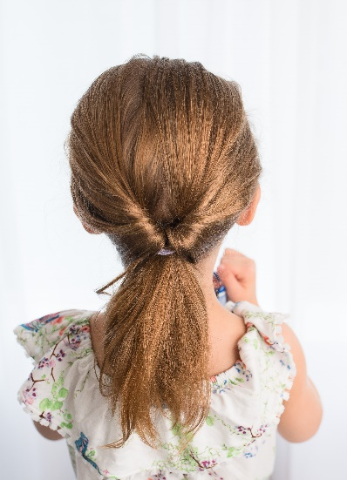

School Uniform
Please make sure that long hair is always fully tied back.
Children are allowed to wear small earrings and a watch
On PE days (Monday and Friday) children should wear their P.E. kit (purple shorts and white T-Shirt); they may wear plain black tracksuit top/bottoms. On these days earrings should be removed.

Slide 12

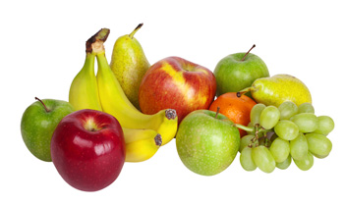
Healthy School
We will do our best to ensure the healthy growth and development of our learners. We will do all that we can to build healthy eating and drinking patterns so that our learners thrive and lead healthy active lives.
We provide healthy and balanced school meals that, where possible, contain sustainable and locally sourced produce.
Children in the Infants are provided with a snack through the School Fruit & Vegetable Scheme.
All children can bring in a healthy snack e.g. fruit for morning play or parents can pay for toast through Parent Pay.
All children should bring a drinks bottle to school which contains water.
Milk is available to order for Infants and for under 5s it is free.

Slide 13
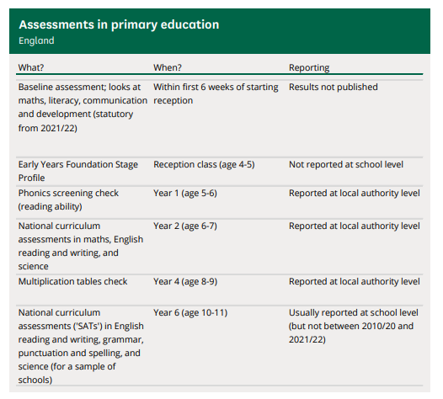
National Statutory Assessments
Optional in 2024

Slide 14
School Assessments
At Hesketh-with-Becconsall All Saints Church of England Primary School, we believe that assessment should place the child at the centre of their learning, encouraging them to let their light shine and that it should raise achievement for all. We focus on the progress of each individual child. We believe that assessment should be thorough, manageable and relevant. Assessment for learning (AfL) is embedded throughout the school.
“AfL is the single most powerful tool we have for both raising standards and empowering lifelong learners.”Assessment Reform Group
Assessment at Hesketh-with-Becconsall All Saints Church of England Primary School involves:
Setting Targets – sharing achievable but challenging targets, objectives and success criteria with children, and allowing children to set their own targets with guidance.
Tracking – teacher and children evaluating progress in relation to these targets over the course of a lesson, unit of work, term, year or key stage.
Active Interventions – teacher (with involvement of SLT, SENCO, TAs and parents where relevant) planning appropriate learning to support children in meeting these targets based on information gained from tracking.
Reviewing – teacher, child and other adults reviewing whether targets have been met and progress has been made.
The most valuable form of assessment is formative and is determined by daily interactions and questioning of pupils and marking of books to ascertain their starting points and next steps.
Teachers adapt teaching according to their assessment of pupils and to meet pupil needs, even if this means deviating from a planned lesson.
Three more formal assessment cycles take place during the year, at the end of each term.

Slide 15
SEND (Special Educational Needs & Disability)
SEND covers those children with SEN (Special Educational Needs) & AEN (Additional Educational Needs), examples of need are shown below:
SEN
Cognition and Learning
Communication and Interaction
Social, Emotional and Mental Health difficulties
Sensory and Physical
AEN
Medical needs
FSM eligibility
EAL
Behaviour
Children Looked After
Attendance
Disabilities
Children with AEN may have SEN however a large number of children who have AEN do not have SEN e.g., a child with poor attendance requiring catch-up doesn’t necessarily have SEN i.e., an inability to catch up.
Likewise, a child with SEN e.g., dyslexia may not have any AEN.
SEND children are supported appropriately and their progress is tracked regularly in consultation with parents.
We call this a graduated response.

Slide 16
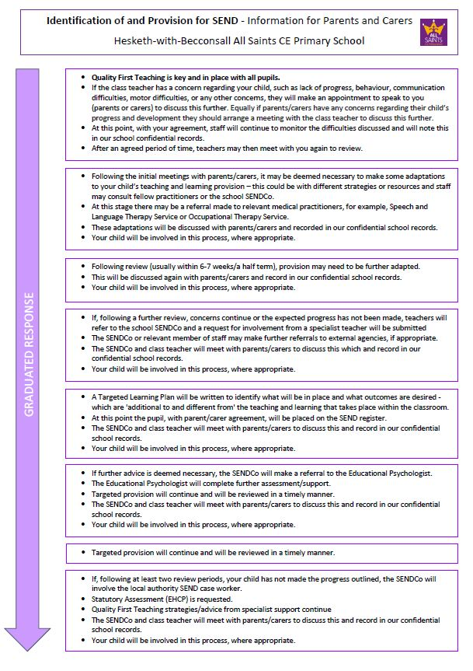
SEND

Slide 17

Any Questions?
Website: https://www.allsaintshwb.co.uk/
Email: priestmanh@hesketh-with-becconsall.lancs.sch.uk

