Slide 1
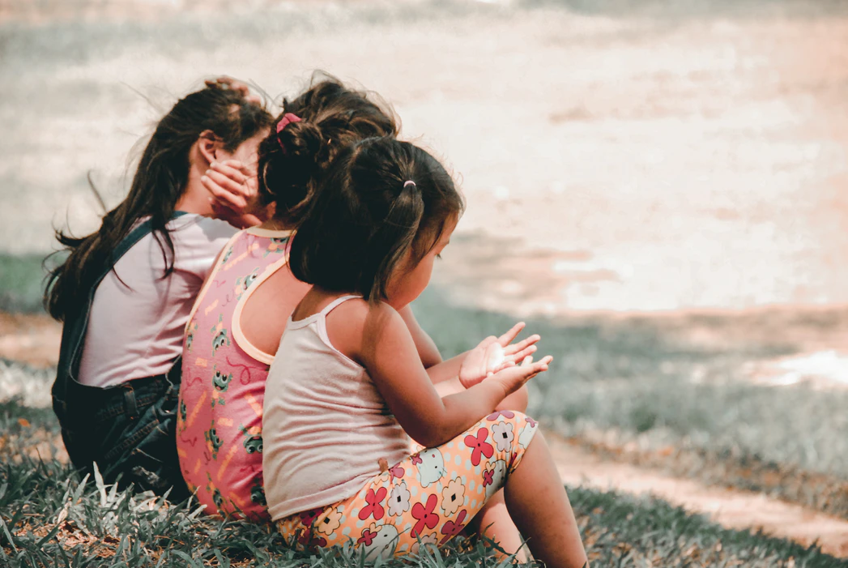
Think about your friends and family.
Talk about the different ways friends and family show they care for each other.

Slide 2
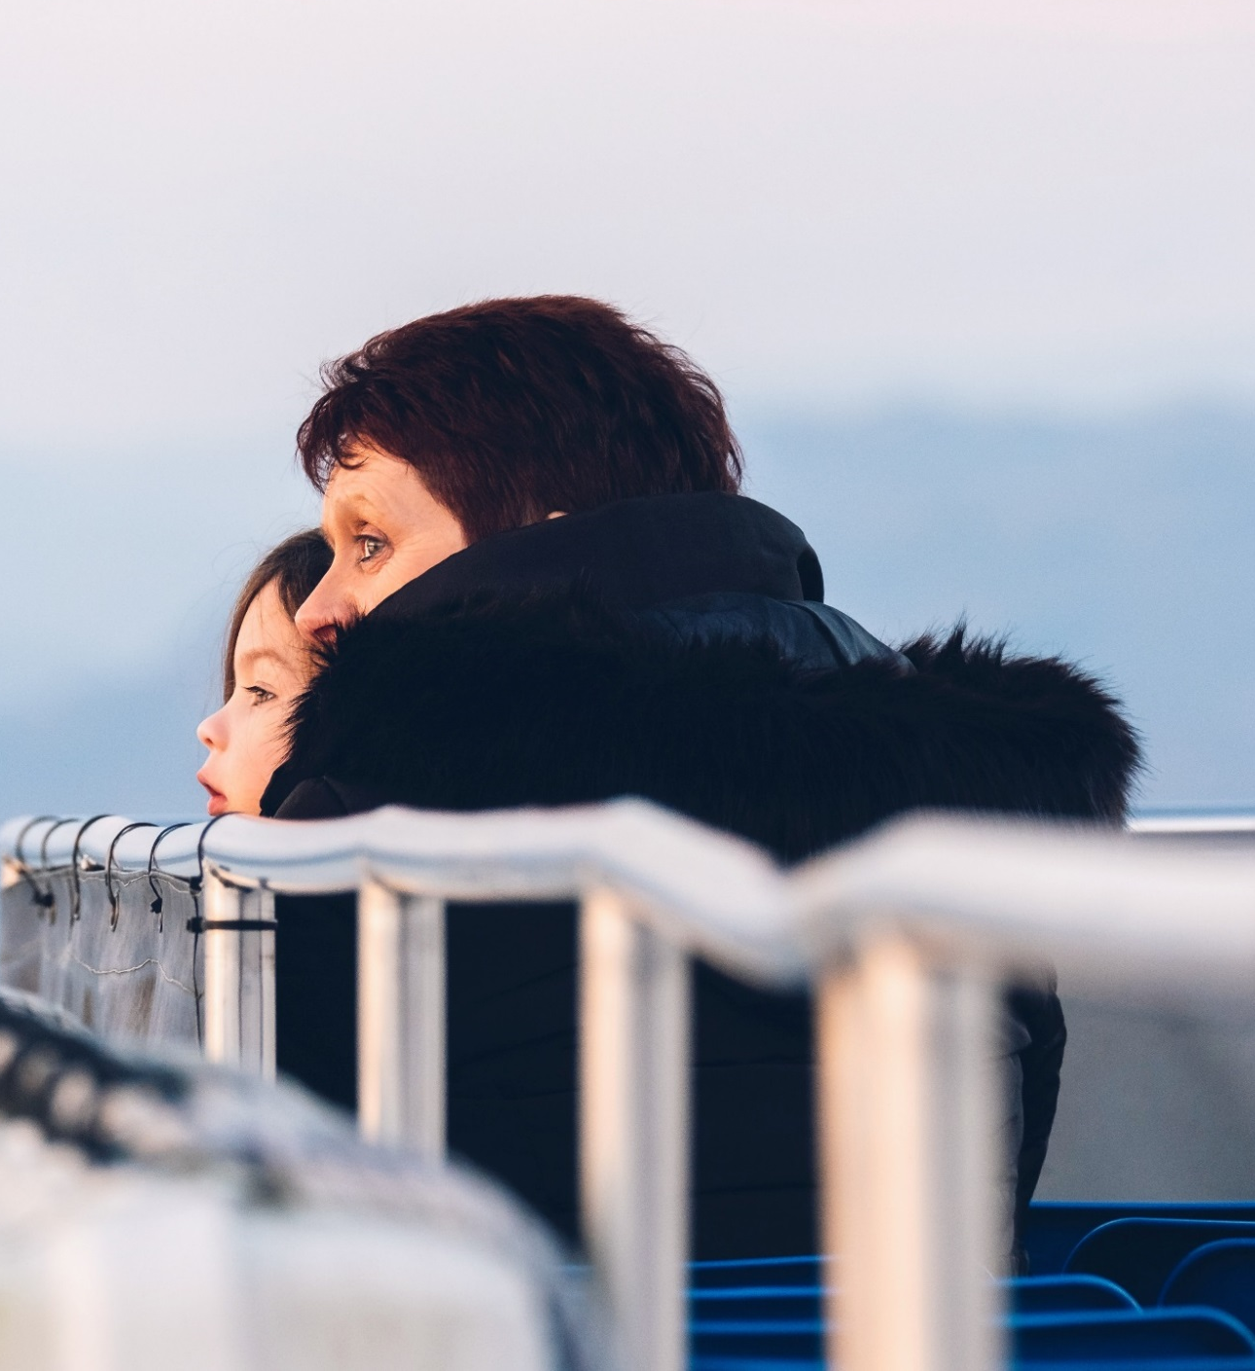
Suri and Gran
Suri is thinking about her special people. She is writing about Gran.
Suri thinks Gran is a really special person. Gran always wears big earrings and she loves red lipstick. Gran says it makes her feel bright and happy.
When Suri is at school, Gran picks her up. Last summer they went to the park all the time. Suri loved the roundabout when Gran swung her round so fast! Suri also liked it when Gran used to come over to babysit, because Gran always told the funniest bedtime stories.
© PSHE Association 2020

Slide 3
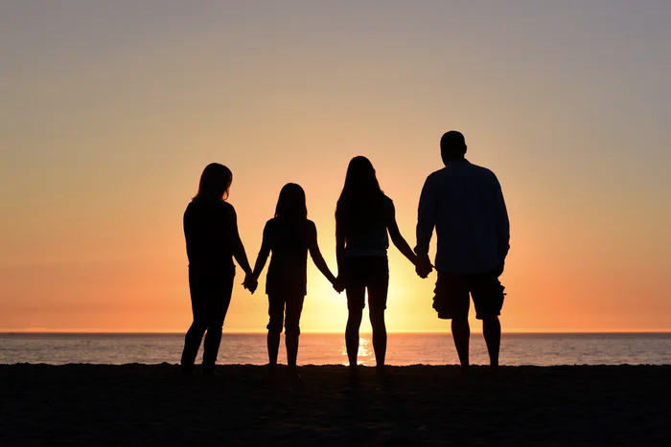
Your special people
Think about people who are special to you. It might include your friends or people in your family.
© PSHE Association 2020

Slide 4

A special person
With a grown up write a letter or make a thank you card to send to a person who is special to you.
Tell them things you have been doing.
Tell them that they are special to you.
Tell them of the things you are looking forward to doing when you see them again.
© PSHE Association 2020

Slide 5
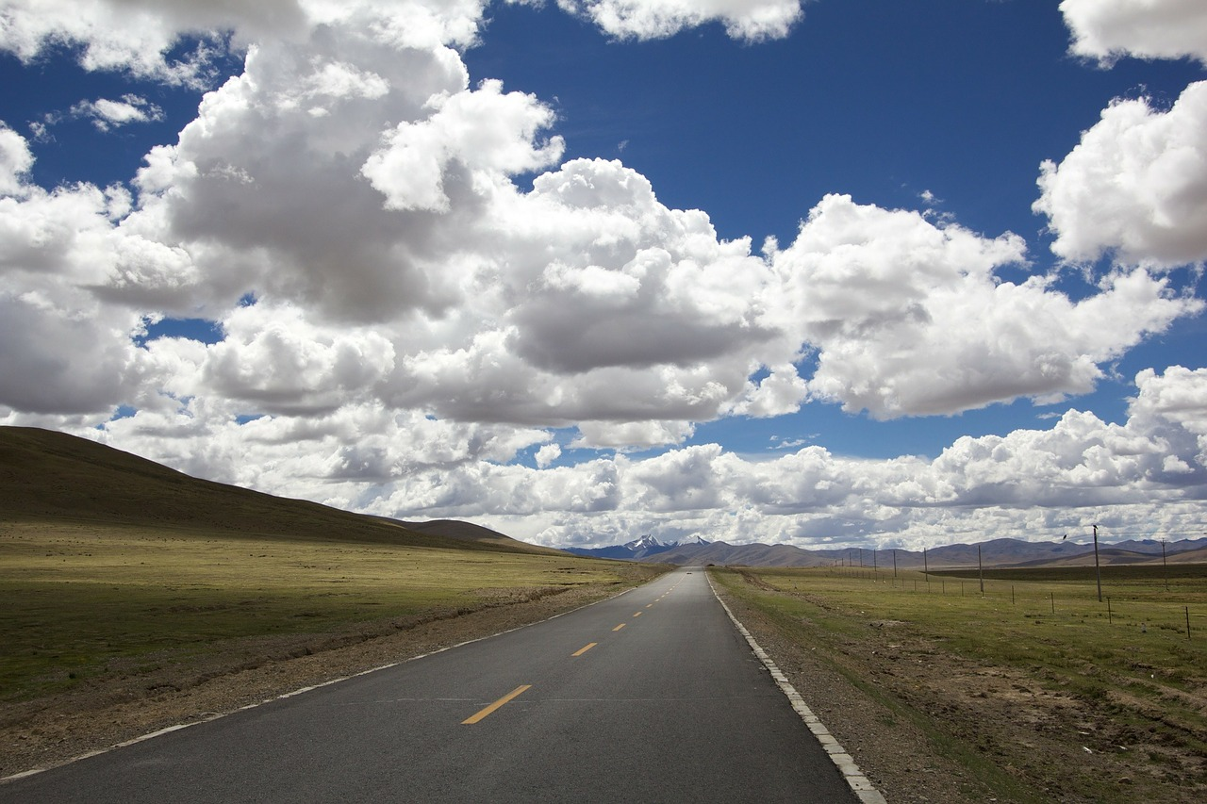
Special people
Near and far…
We may not be with our special people all the time. Maybe they live far away from us, or can’t come and visit often. There might be lots of reasons why we can’t see our special people when we want to.
But it’s still important to let them know we care.
© PSHE Association 2020

Slide 6
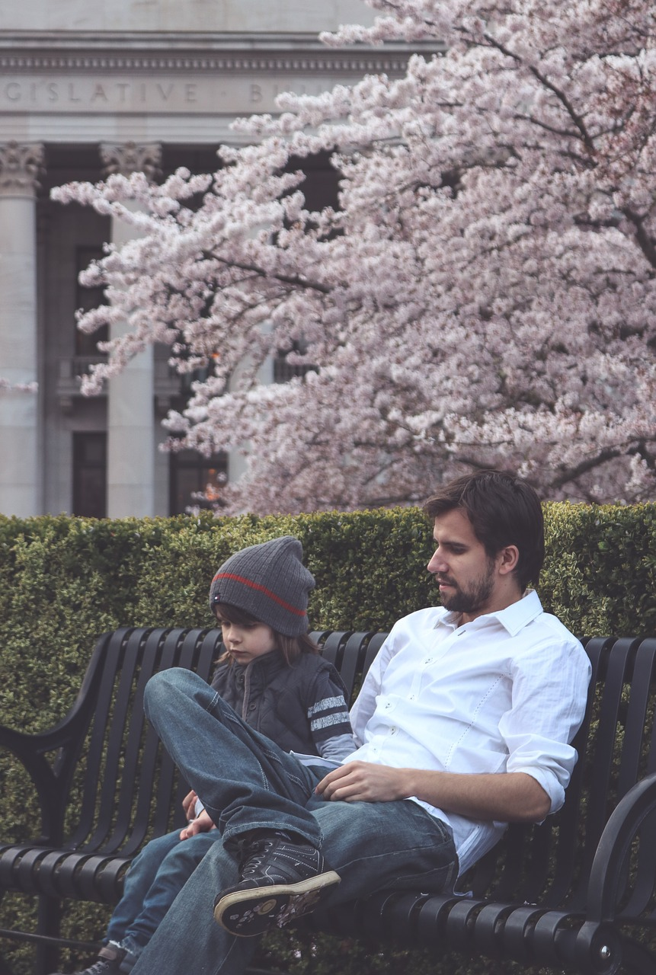
Missing our special people
When we can’t see our special people as often as we’d like, it can sometimes make us feel sad.
If you miss seeing someone special a lot and feel worried about them, remember to talk to an adult you trust — your mum, dad or the person who looks after you.
They can help you catch up with your special people.
© PSHE Association 2020

