Slide 2


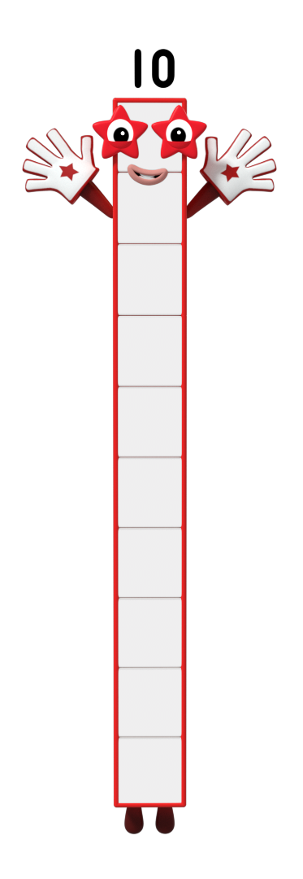
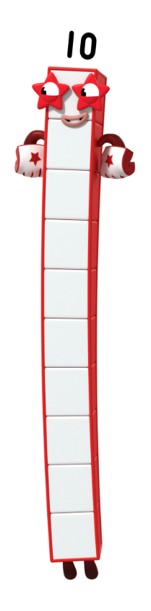



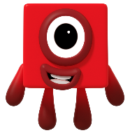






next
I’m Ten. I am made up of 10 ones. Can you click me and count my blocks?

Slide 3
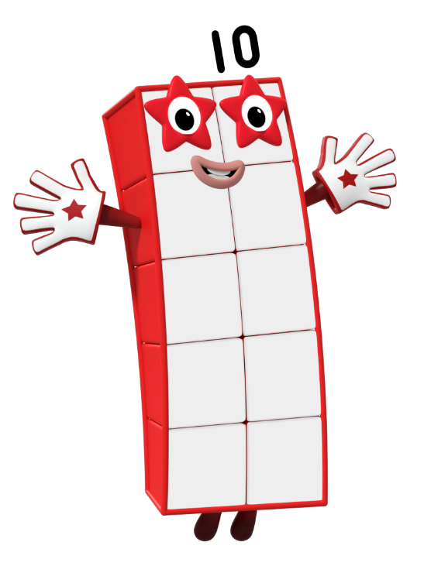
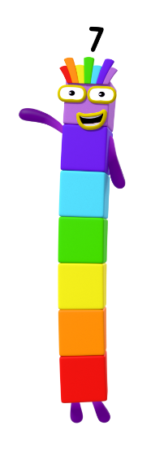
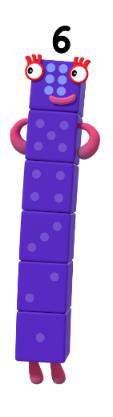
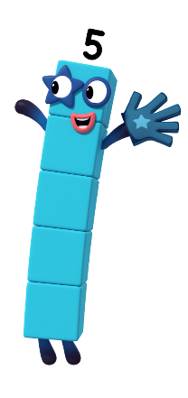
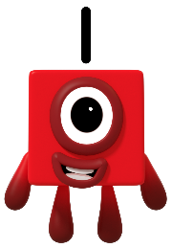
Can you count how many ones you can see?
Which Numberblock do
you think this will make?

Slide 4
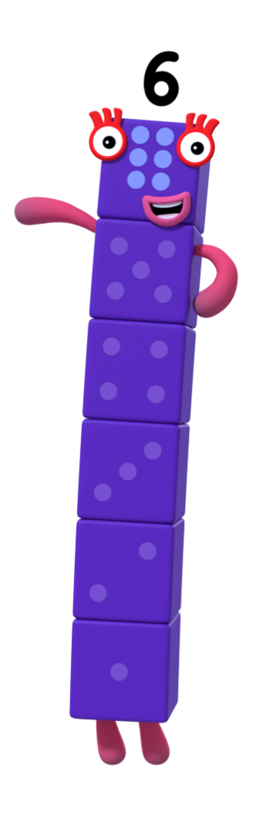
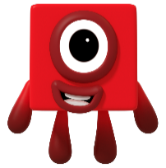
next
Can you count how many ones you can see?
Which Numberblock do
you think this will make?
That’s right! I’m made of 6 ones. Can you count them with me?

Slide 5
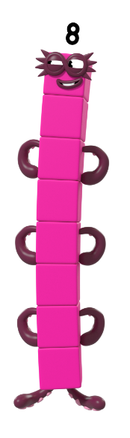
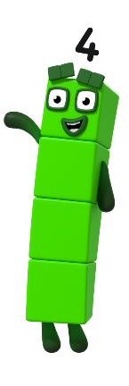
Can you count how many ones you can see?
Which Numberblock do
you think this will make?

Slide 6
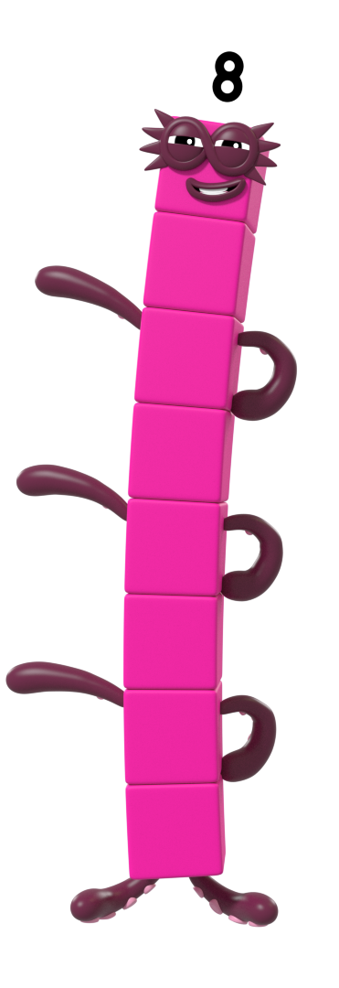

next
That’s right! I’m made of 8 ones. Can you count them with me?
Can you count how many ones you can see?
Which Numberblock do
you think this will make?

Slide 7
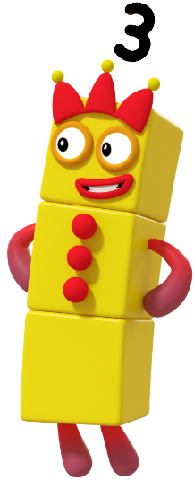
Can you count how many ones you can see?
Which Numberblock do
you think this will make?

Slide 8
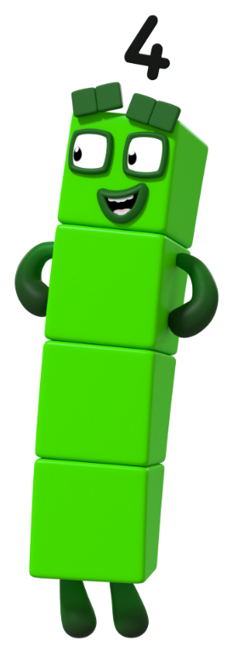
next
Can you count how many ones you can see?
Which Numberblock do
you think this will make?
That’s right! I’m made of 4 ones. Can you count them with me?

Slide 9

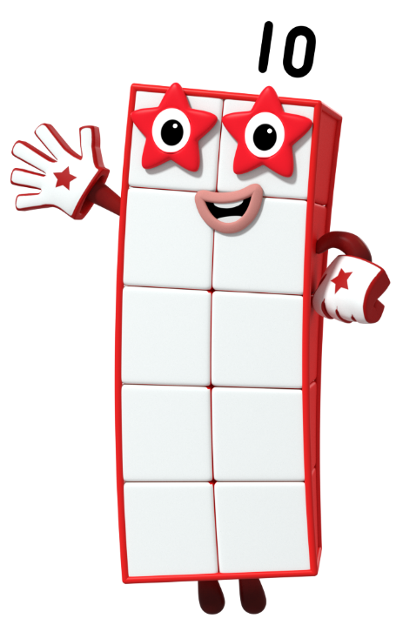

next
Can you count how many ones you can see? Which Numberblock do you think this will make? Let’s check!

Slide 10
next
That’s right! I’m made of 3 ones. Can you click me and count my ones?

Slide 11

next
Can you count how many ones you can see? Which Numberblock do you think this will make? Let’s check!

Slide 12
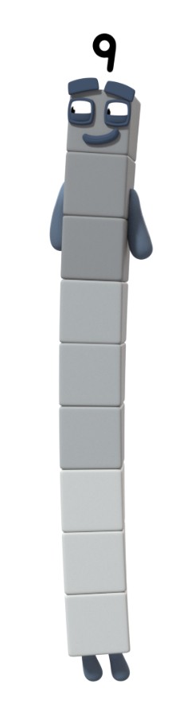
next
That’s right! It’s me, Nine!
I’m made of 9 ones.
Can you click me and count my ones?

Slide 13

Oops! Shall we try again?
Help me count the blocks. I think that these ones will make the number 5. Am I right?
yes
no

Slide 14

next
That’s right! I’m made of
5 ones. Can you count them with me?

Slide 15

Help me count the blocks. I think that these ones will make the number 7. Am I right?
Oops! Shall we try again?
yes
no

Slide 16
next
That’s right! It’s me, Eight. Can you tell a partner how you worked it out?

Slide 17

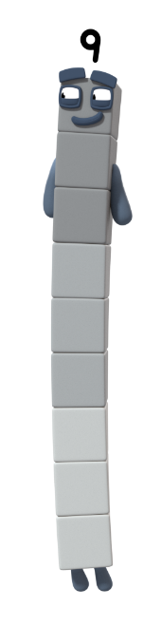


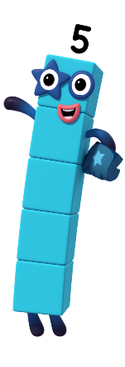


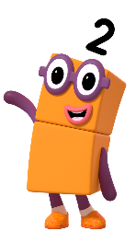
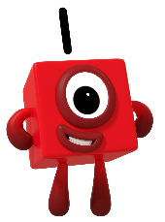

Let’s count to 10!

Slide 18
Goodbye!
For more number fun, head on down to learningblocks.tv!

