Slide 2

Meet Number Nine
Hello, I am Number Nine. I went on an adventure to the jungle. Would you like to hear about my adventure?
What do you notice about Number Nine?

Slide 3


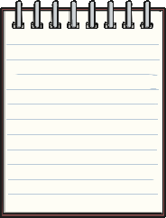

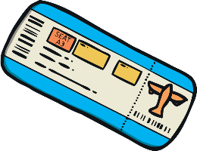




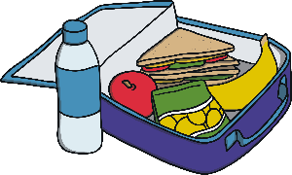
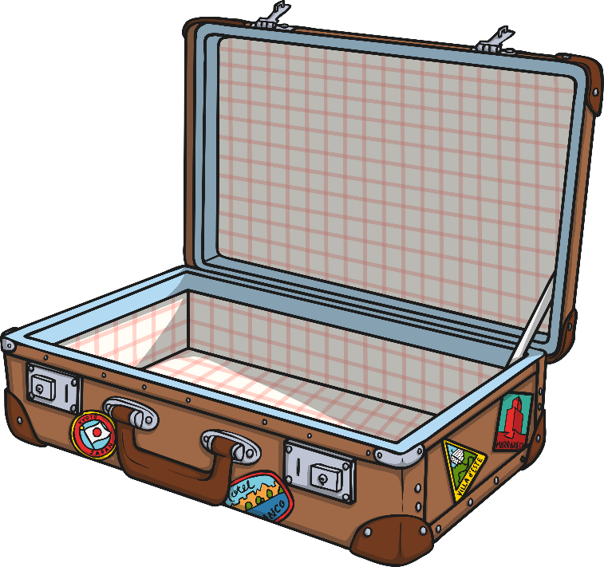

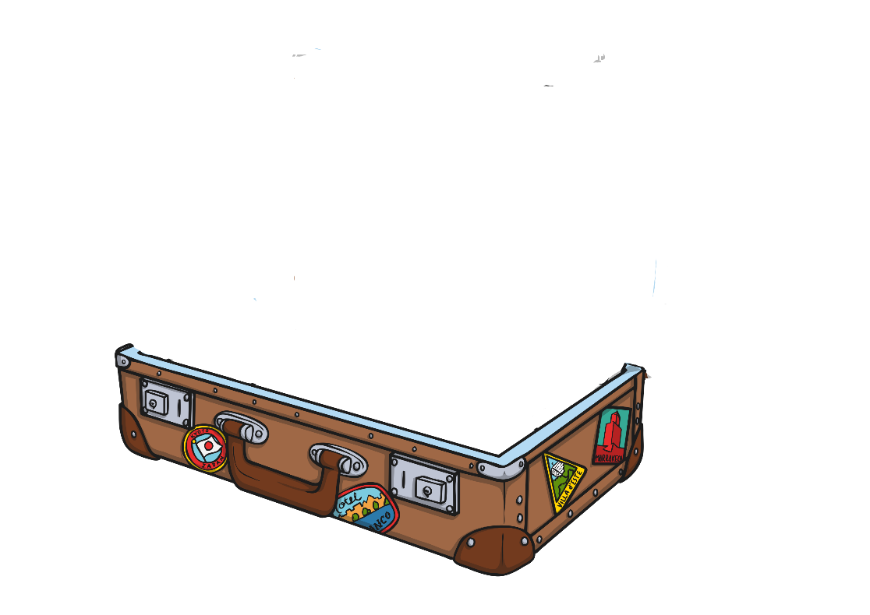
Number Nine was very excited about her jungle adventure! She rushed around the room putting everything she needed into her suitcase.
I need to take 9 things with me on my adventure. Can you help me count them as I put them into my case?

Slide 4
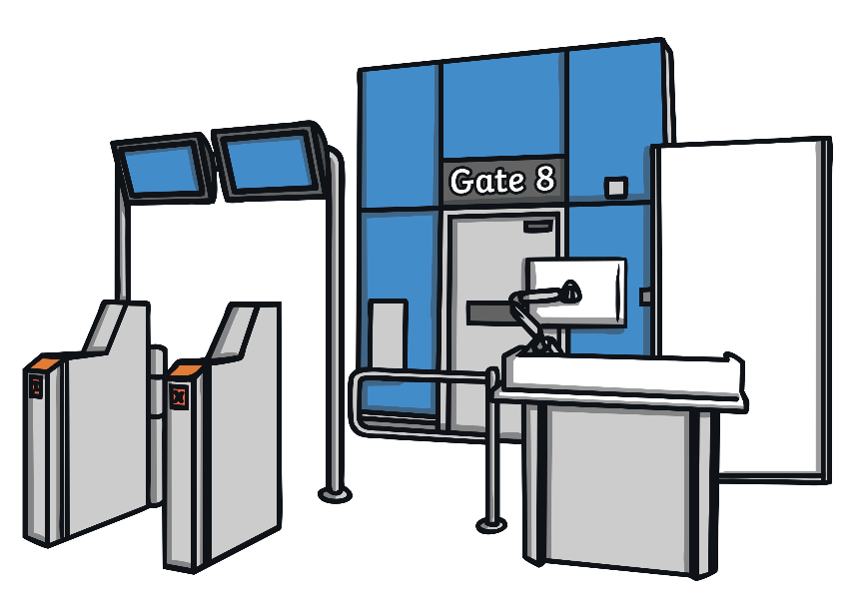


Next stop was the airport. Can you help Number Nine find gate number 9?
Great work, you found gate number 9! Which gate comes before number 9?
Try again!
Try again!

Slide 5




Number Nine looked around. There were lots of different clocks showing times around the world. The plane was going to leave at 9 o’clock. Which clock shows 9 o’clock?
Well done! That clock shows 9 o’clock. How did you know?
Try again!
Try again!

Slide 6
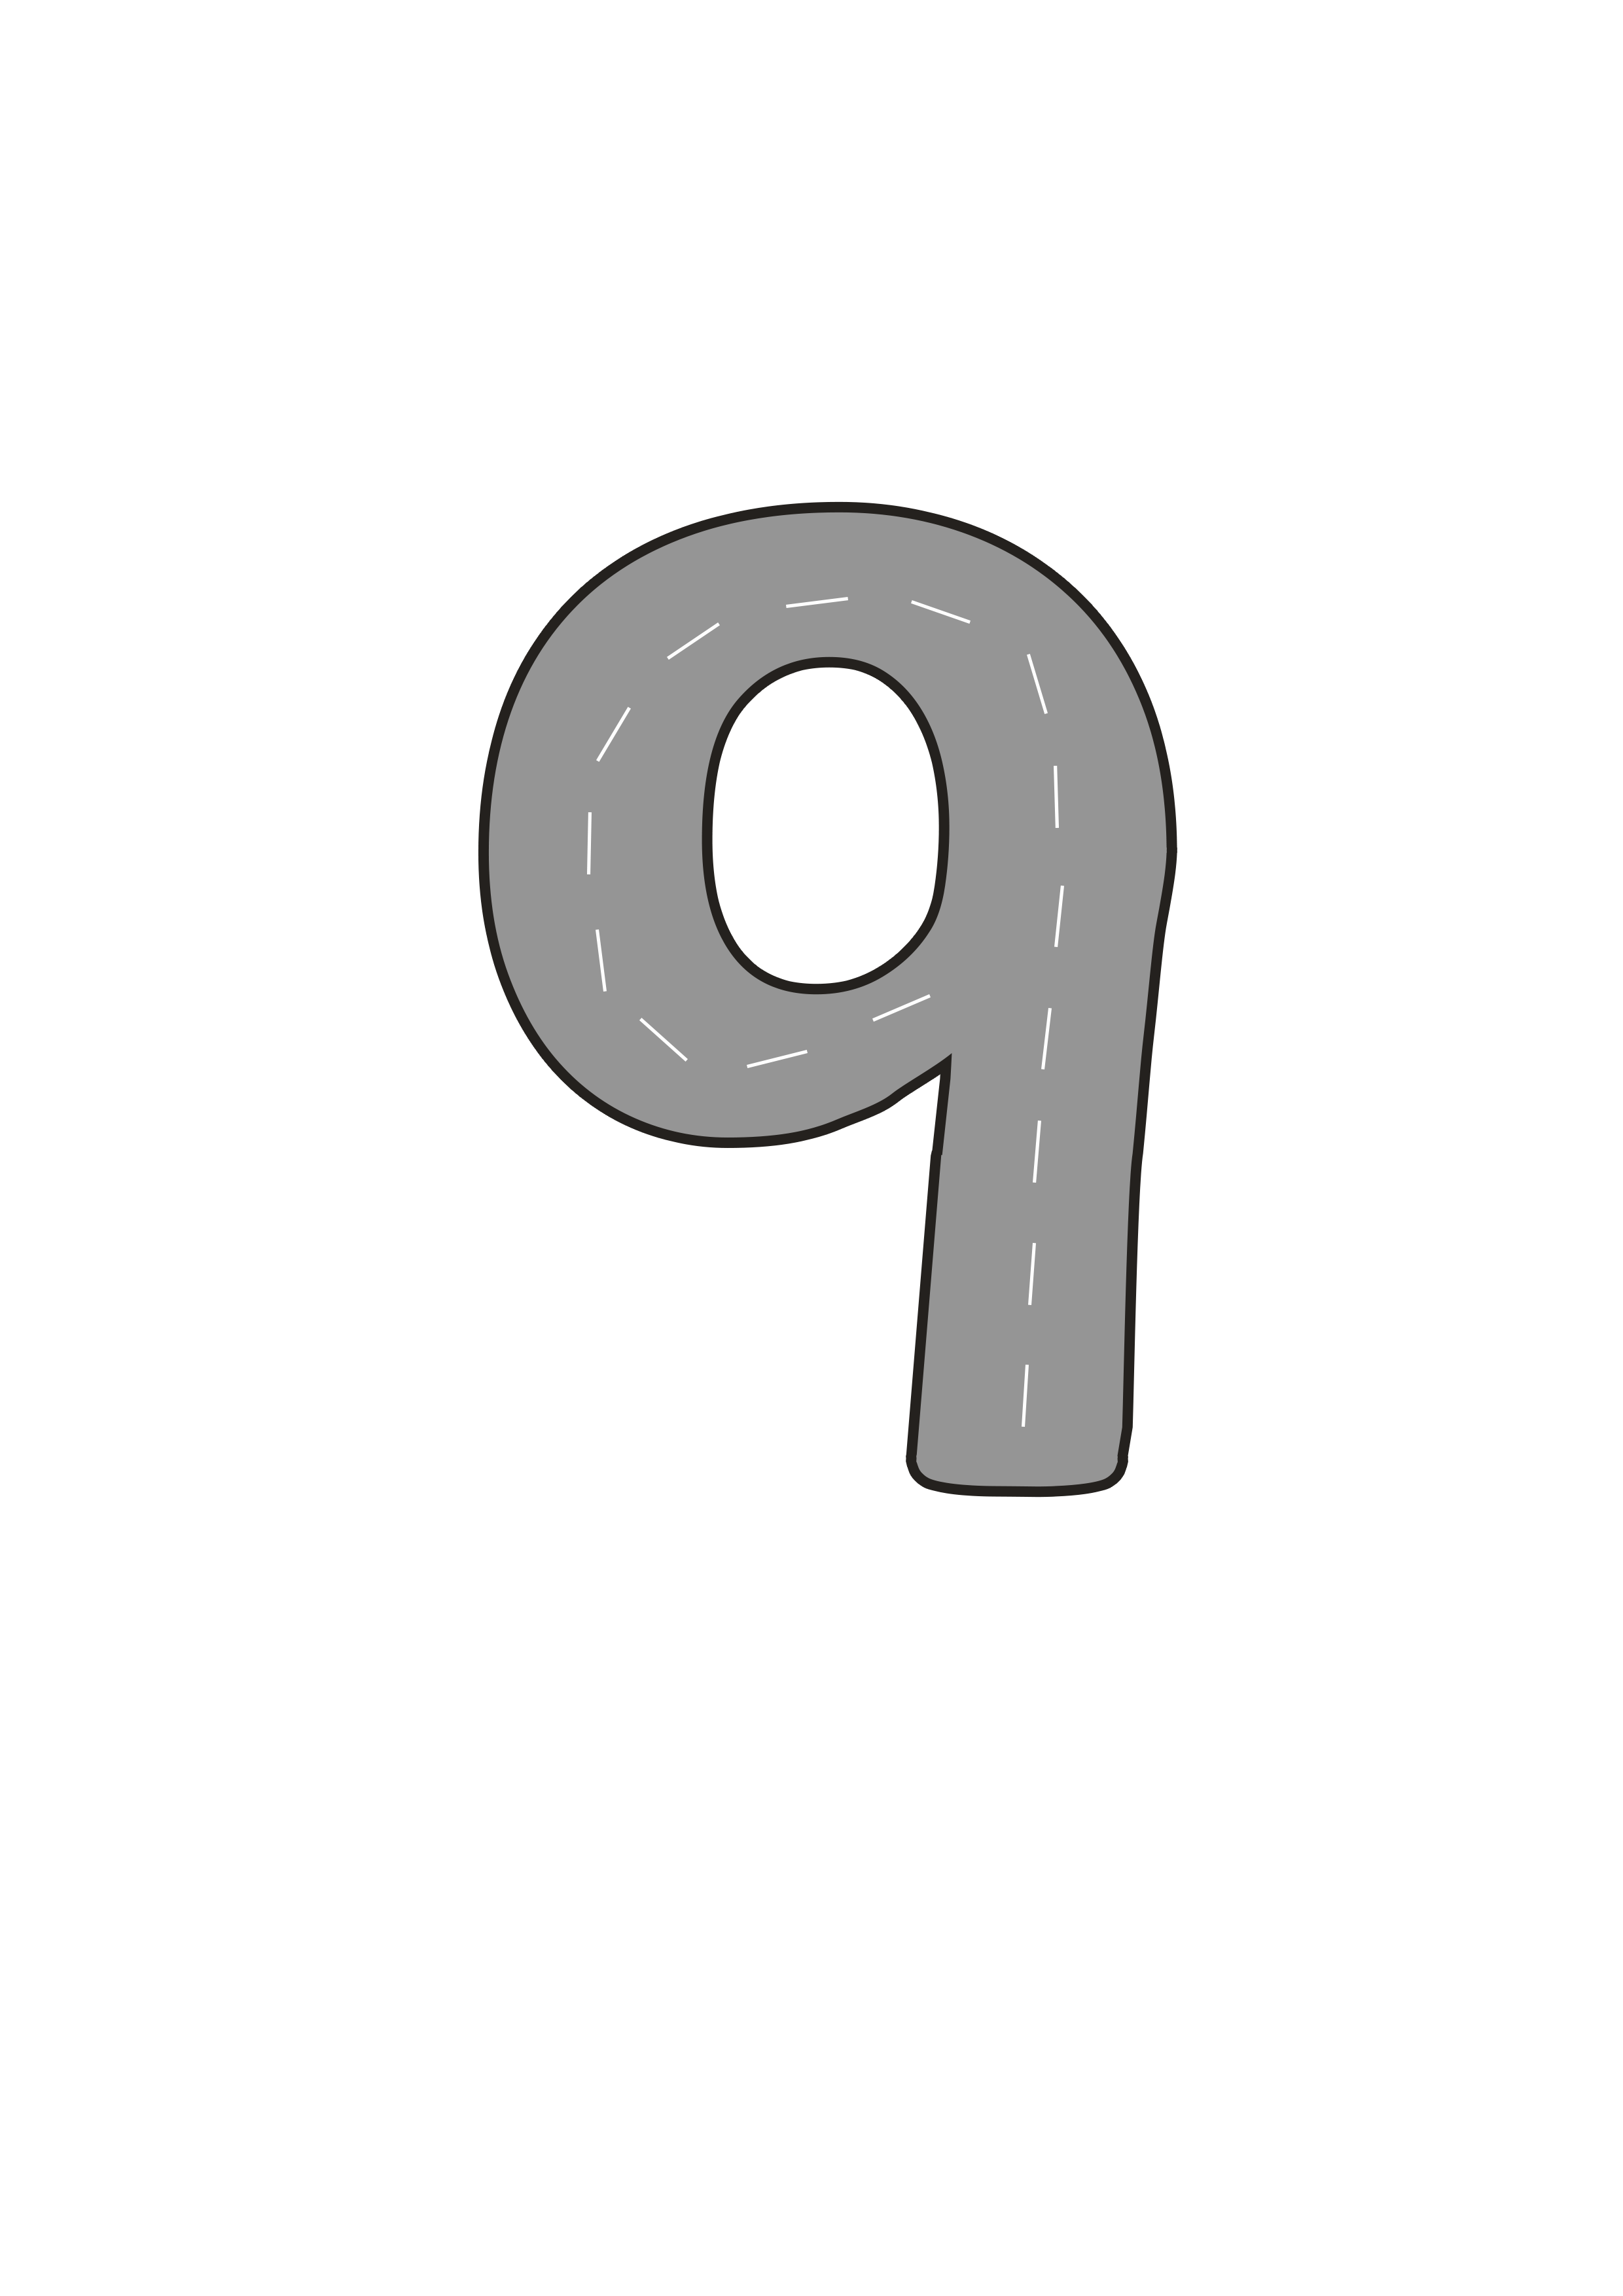

Number Nine landed near the jungle but she had to take a taxi to get a little closer. As she drove along, Number Nine sang a song...
Make an oval and a line, now I’ve made the number nine.

Slide 7

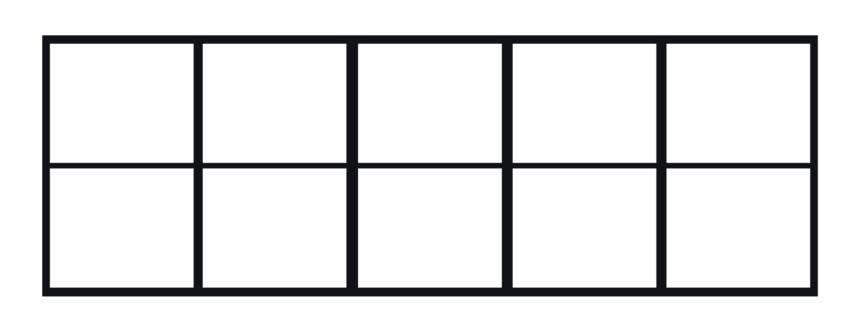


Finally, when she reached the jungle, Number Nine began to look around for some animals. She spied some little monkeys eating some bananas.
Which monkey has 9 bananas? How can you tell?
Try again!
Try again!

Slide 8



Number Nine took a photo of the monkey and hurried on through the jungle.
Yes, this hungry monkey has 9 bananas for lunch. Can you tell a friend how you knew this monkey had 9 bananas?

Slide 9



Next, Number Nine climbed to the top of a tall tree. She swung from vine to vine until she found some parrots.
How many parrots can you see? Can you tell a friend how you worked out how many parrots there are?

Slide 10

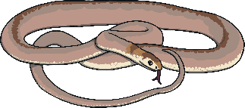








Number Nine took a photo of the parrots and hurried on her way. Suddenly, she heard a hissing sound. She looked around and saw some colourful snakes!
Can you count the snakes as they slither through the jungle? Can you use your fingers to help you count the snakes?

Slide 11



Number Nine quickly took out her notepad and drew a picture of each snake as they slithered past her.
Can you count my snake pictures? How many snakes did we see?
We saw 9 snakes!

Slide 12
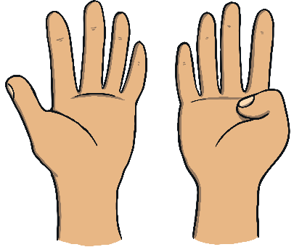
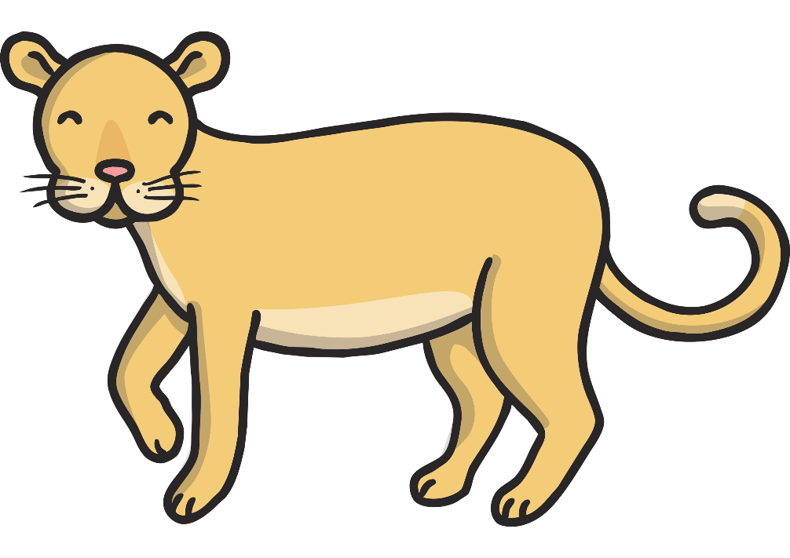
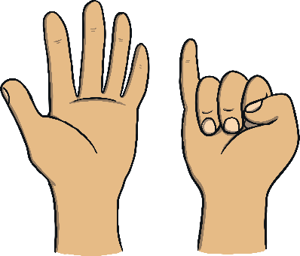
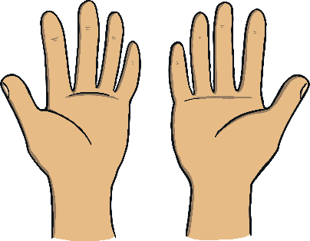
Number Nine decided to head home after a busy day in the jungle. As she was leaving the jungle, she saw a spotty leopard!
I can see 9 spots on this leopard. Which set of hands shows 9 fingers?
That's right, this set of hands shows
9 fingers!
Try again!
Try again!

Slide 13










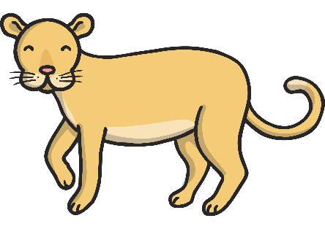




Can you remember all of the ways that we saw 9 on my jungle adventure?
9 o’clock
gate 9
9 bananas
9 parrots
9 snakes
9 spots

Slide 14
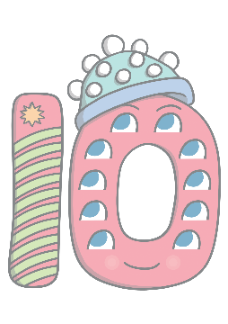



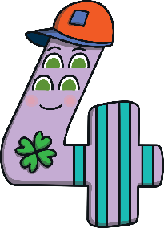

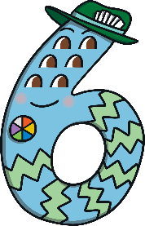




Can you find 9 on the number track? Click on Number Nine to move her onto the number track.
1
2
3
4
5
6
7
8
9
10
Which number comes before 9? Which number comes after number 9? Can you count along the number line from 1 to 9?

