Slide 2
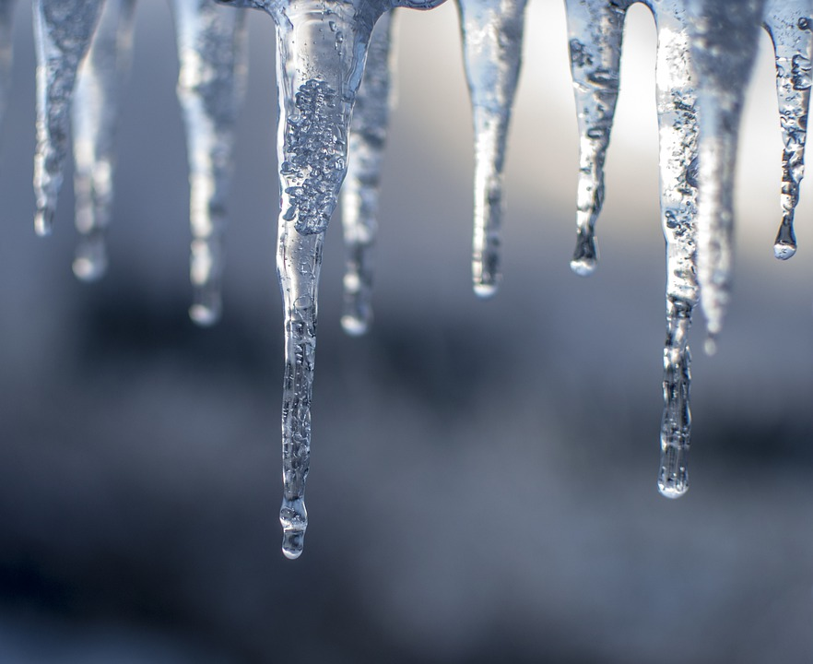
It is really cold in the winter…

Slide 3
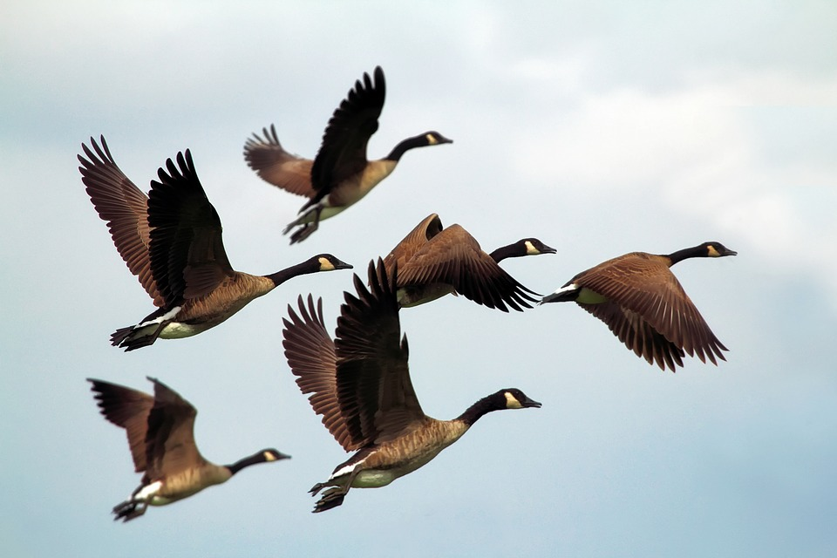
It is too cold for some birds so they fly away to warmer countries!

Slide 4
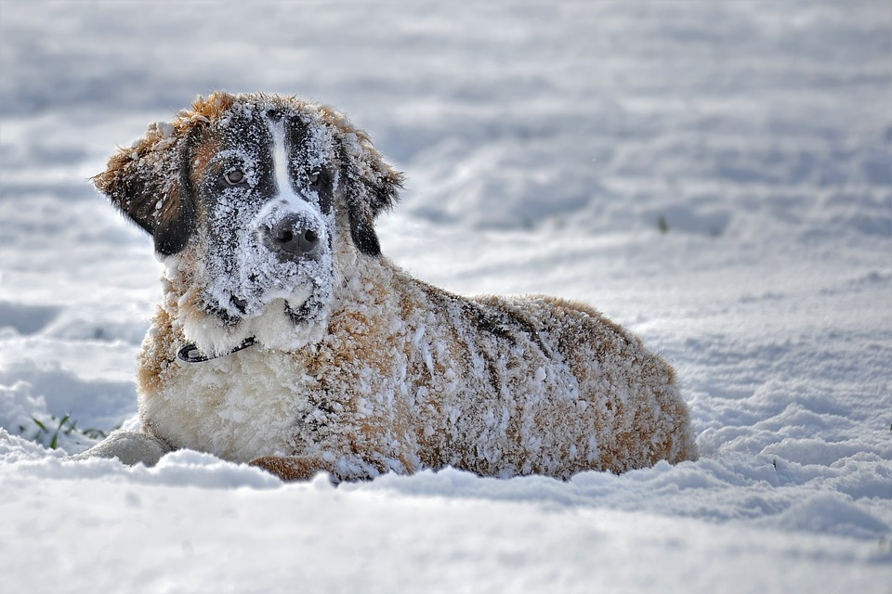
Cats and dogs grow extra fur so they can stay warm…

Slide 5
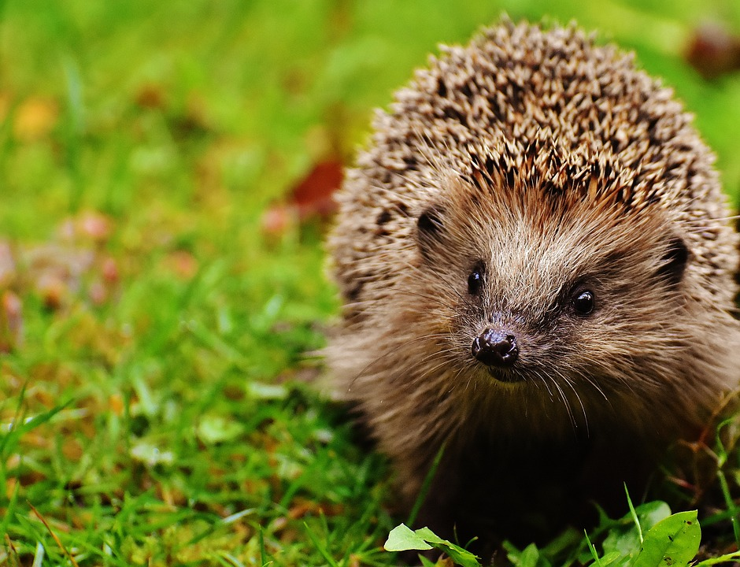
Some animals even sleep throughout the whole of winter and then wake up once it is warm again!

Slide 6
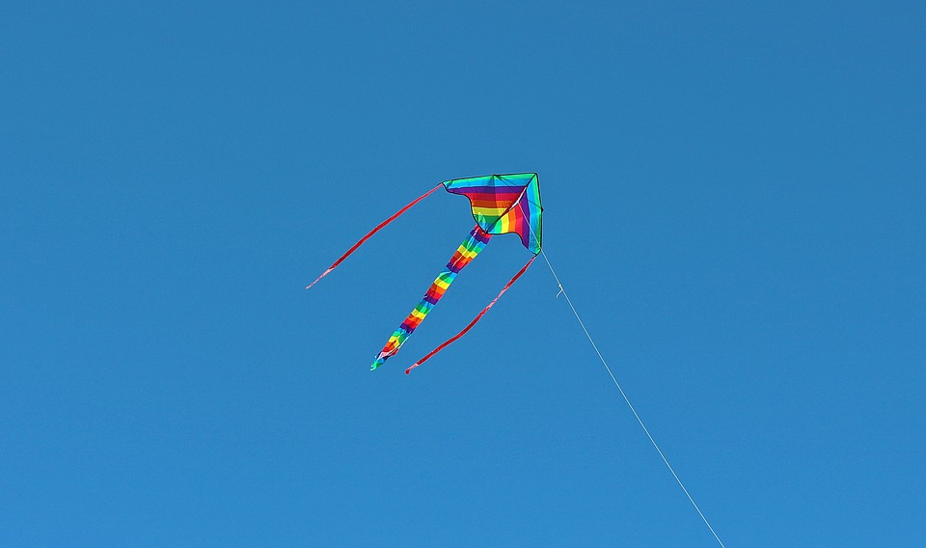
In the winter is can be very windy…

Slide 7
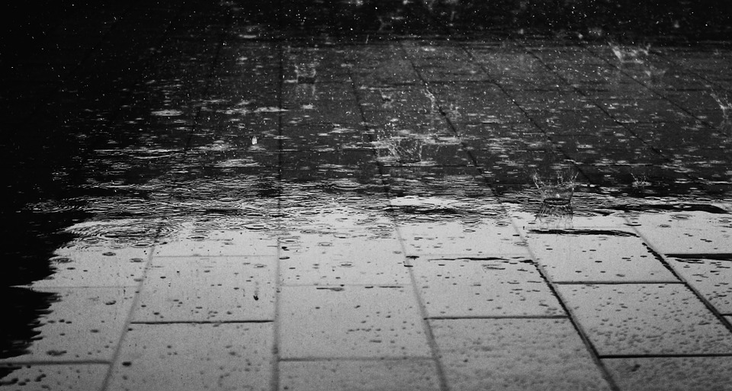
and very rainy!

Slide 8
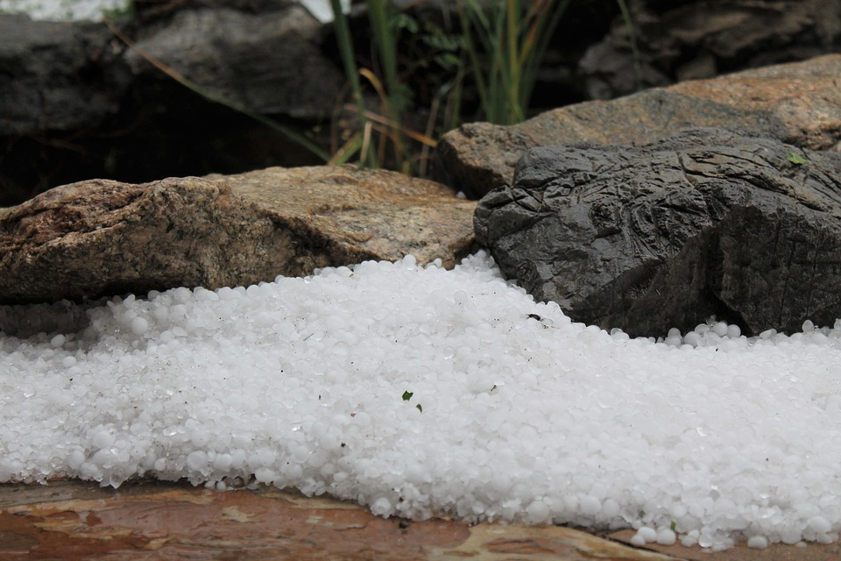
Sometimes hailstones can fall from the sky…

Slide 9
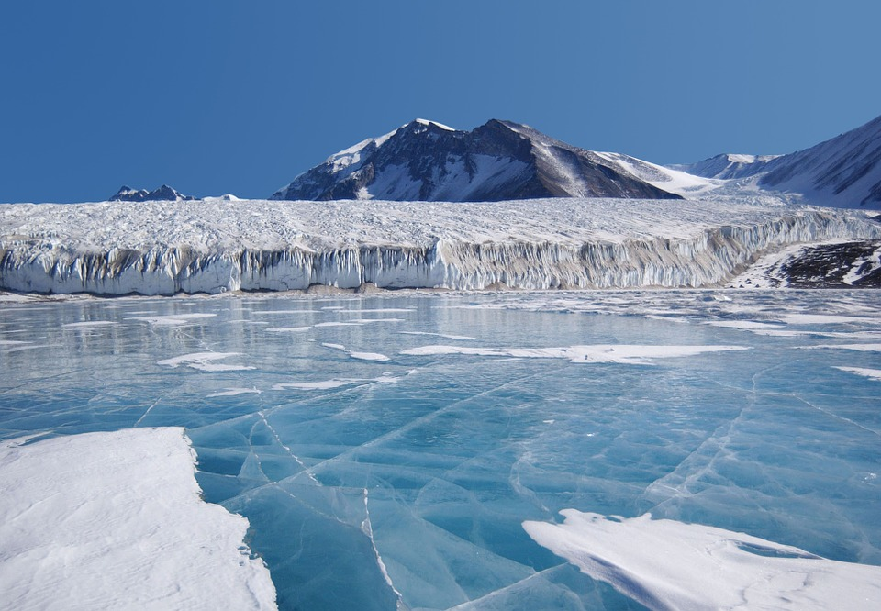
and sometimes it’s icy.

Slide 10
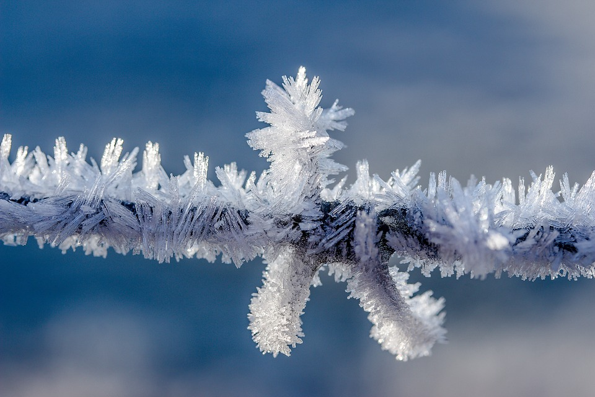
Sometimes it’s frosty in the morning...

Slide 11
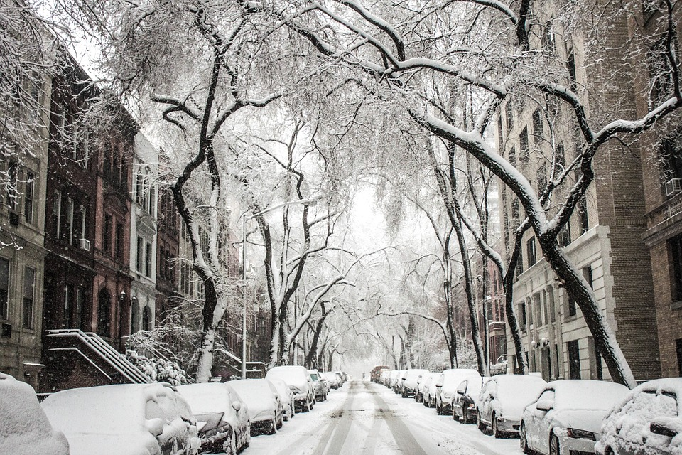
and sometimes it snows!

Slide 12

To keep ourselves warm we wear thick clothes.

Slide 13
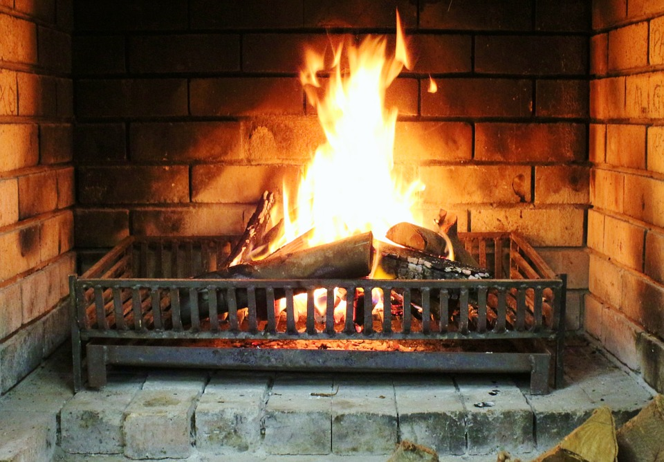
To keep houses warm we light the fire or turn on the heating system.

Slide 14
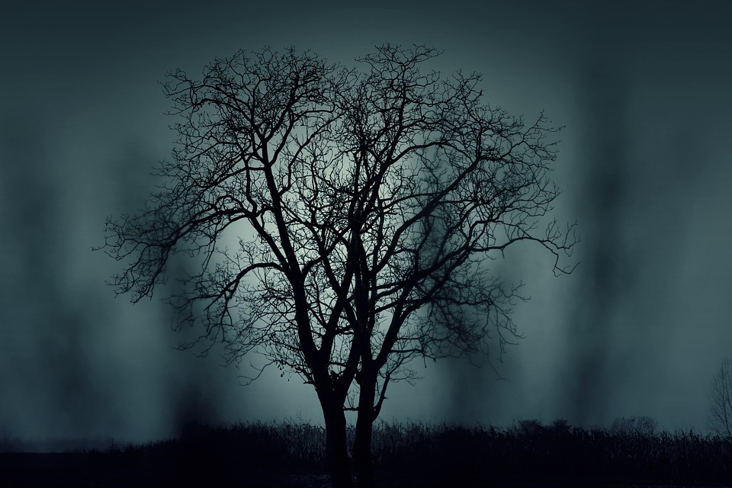
In the winter it is dark because the sun rises later and also sets earlier.

Slide 15
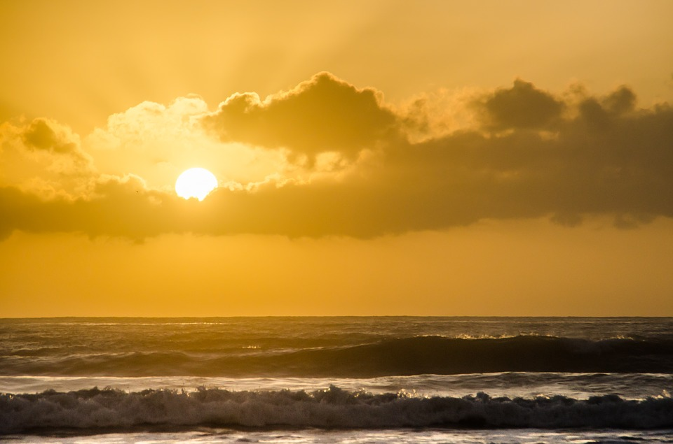
In the summer, the sun rises earlier and sets a lot later.

