Slide 1
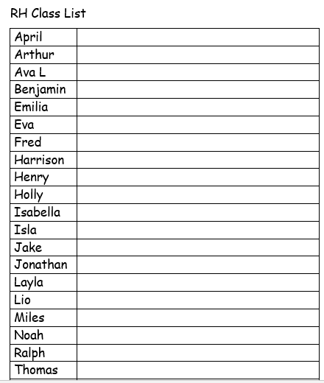


Slide 2



St Luke's C of E Primary School
to learn, to succeed, to value one another
Getting Ready for School
Welcome meeting for Parents/Carers
Thursday 1st July 2021 6.30pm

Slide 3
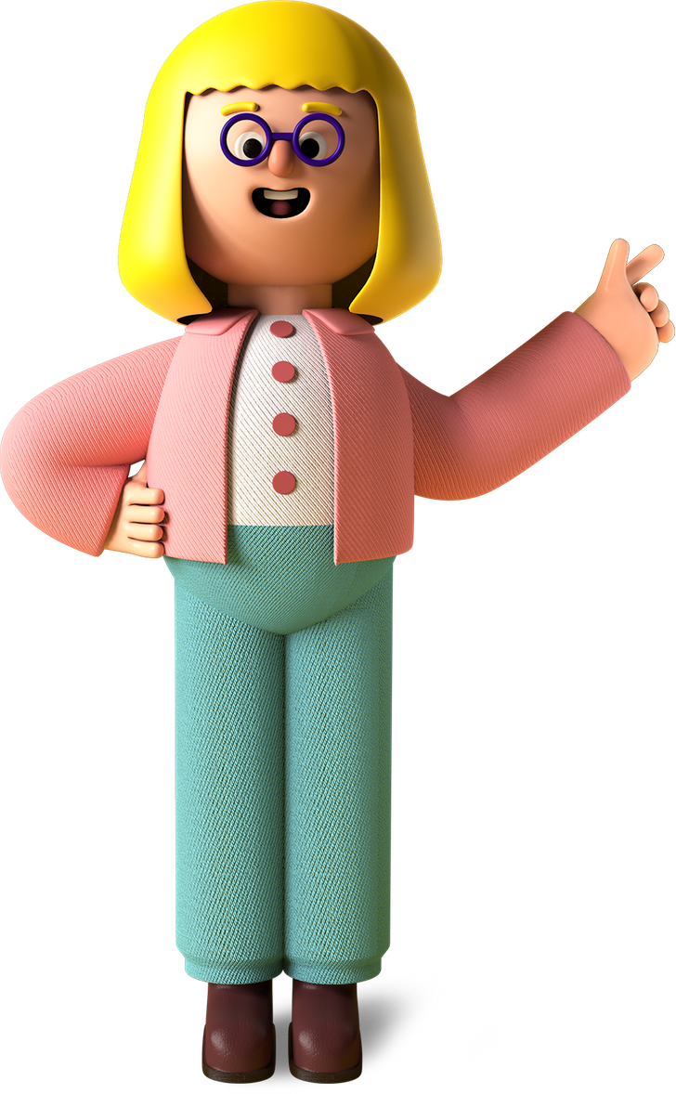

Welcome to
St. Luke’s
Head Teacher: Mrs. S Cowey
Class Teacher RH: Miss Hesketh
Class Teacher RP: Miss Pooley
Teaching Assistants: Mrs. B Pearson
Mrs. T McGill

Slide 4
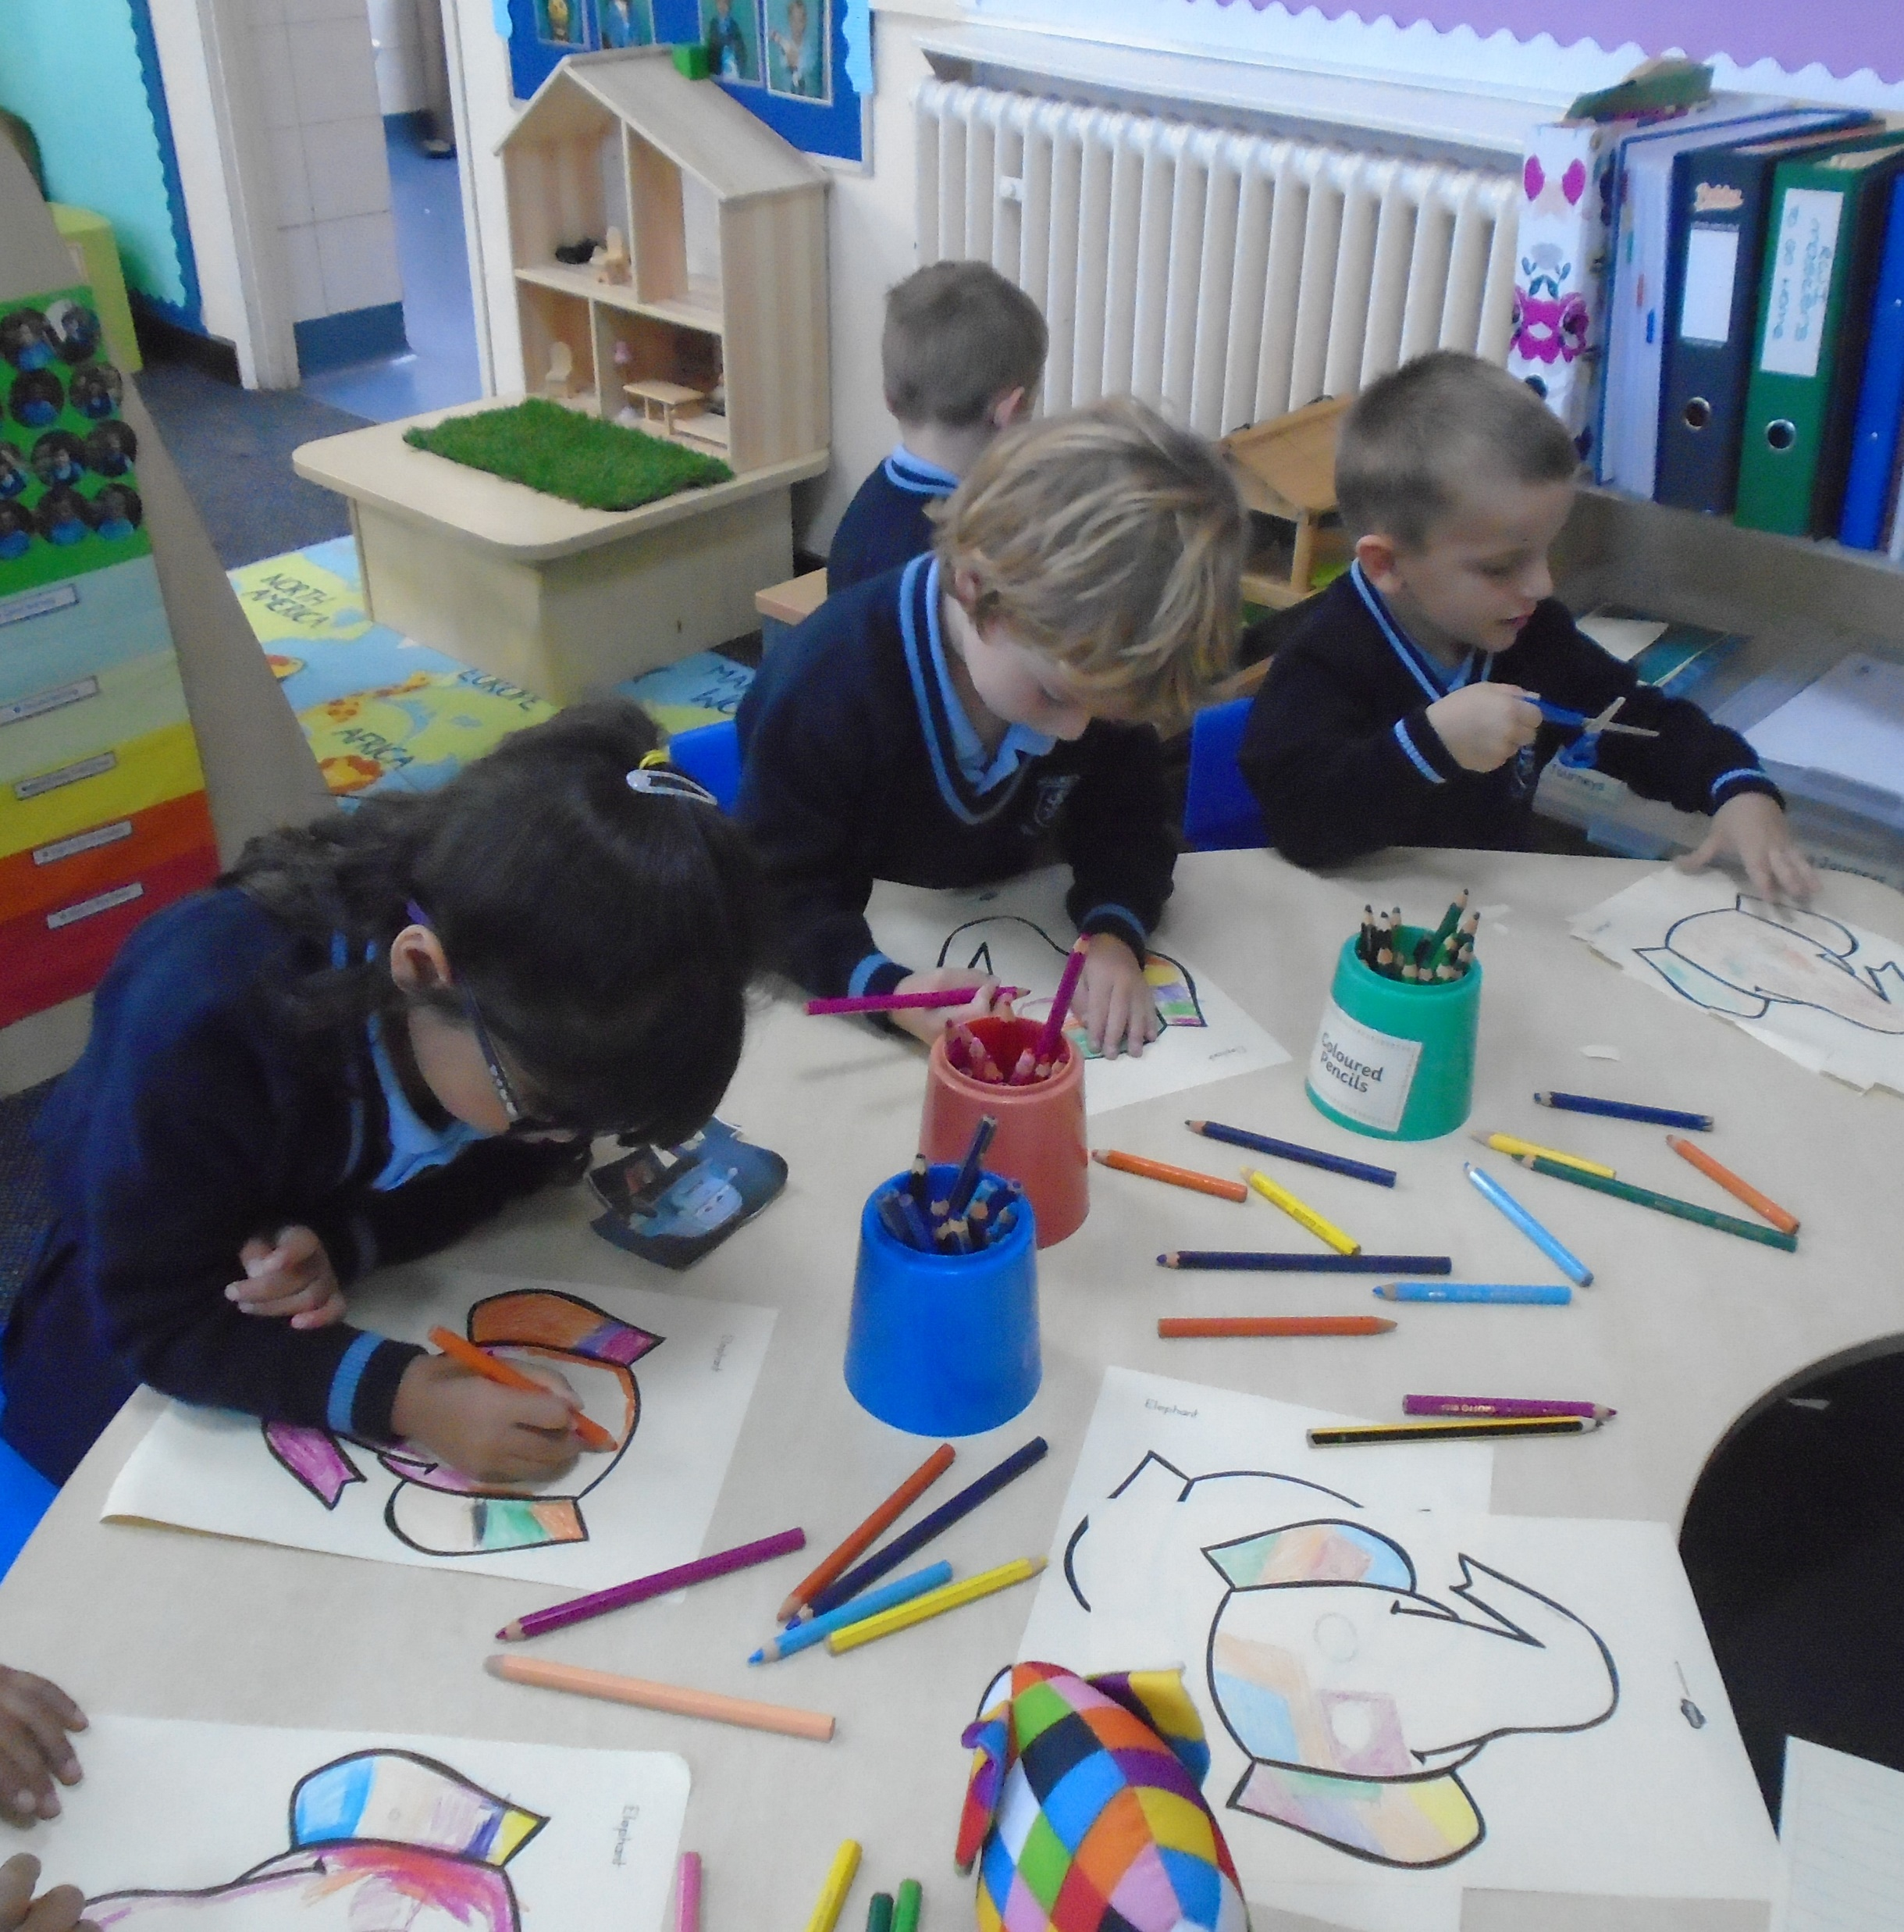
Introducing School life...
It is our aim to make starting school a happy and enjoyable time for you and your child.

Slide 5
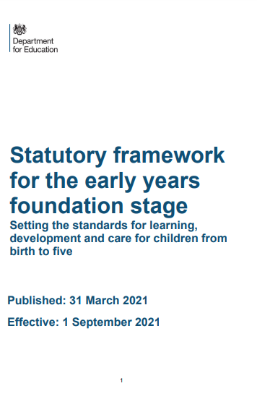

How does my child learn in Reception?
The Early Years Foundation Stage (EYFS) is the stage of education for children from birth to the end of the Reception Year.
It is based on the recognition that children learn best through play and active learning.

Slide 6


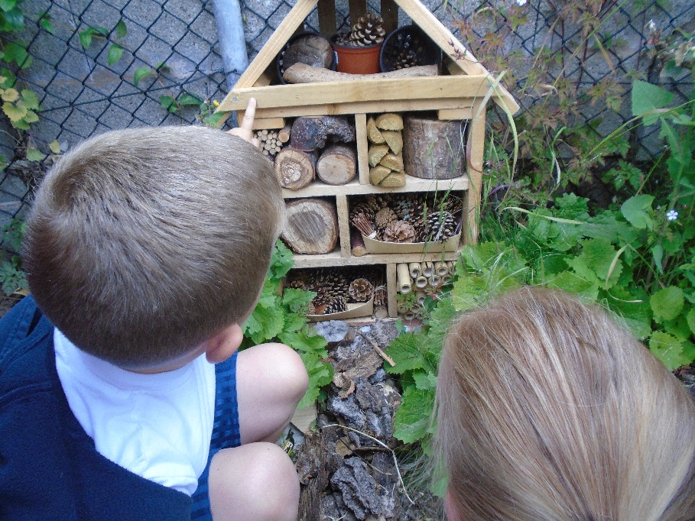
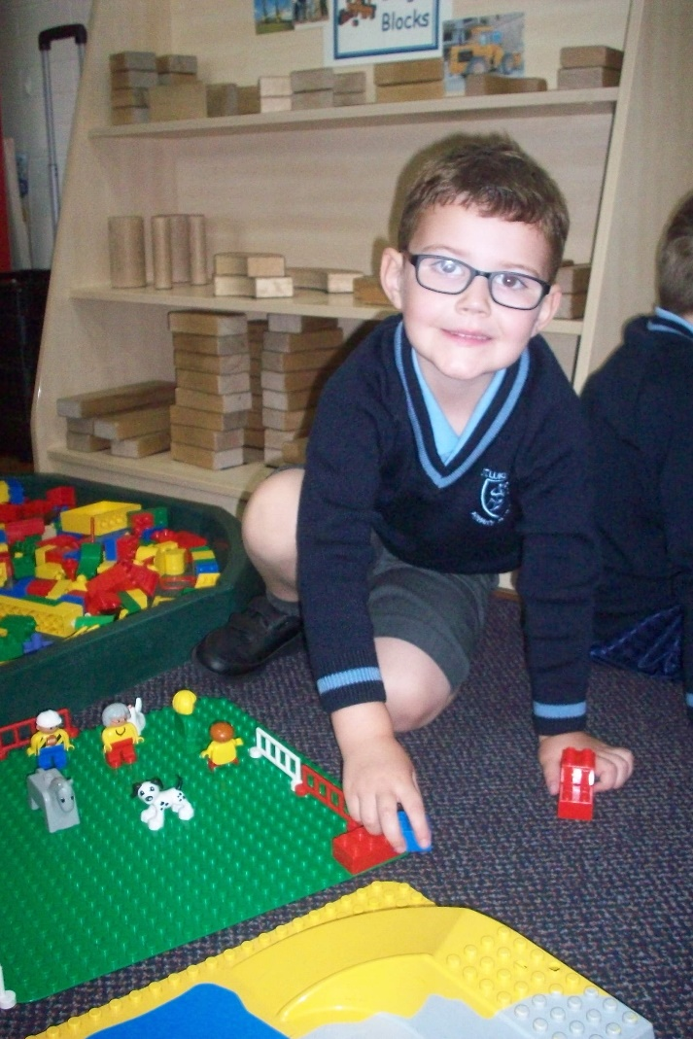
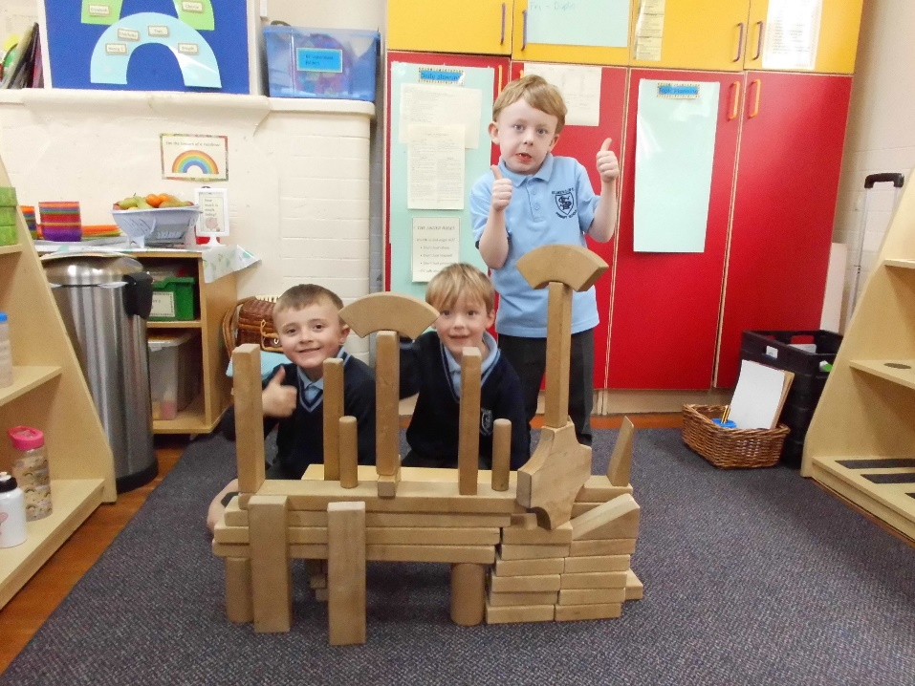
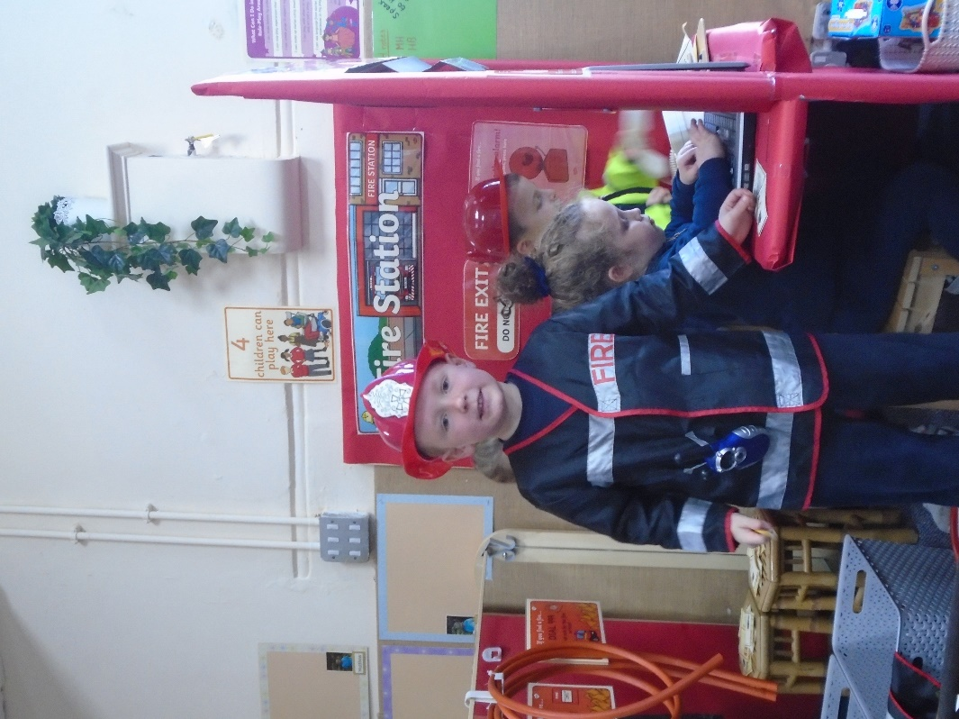
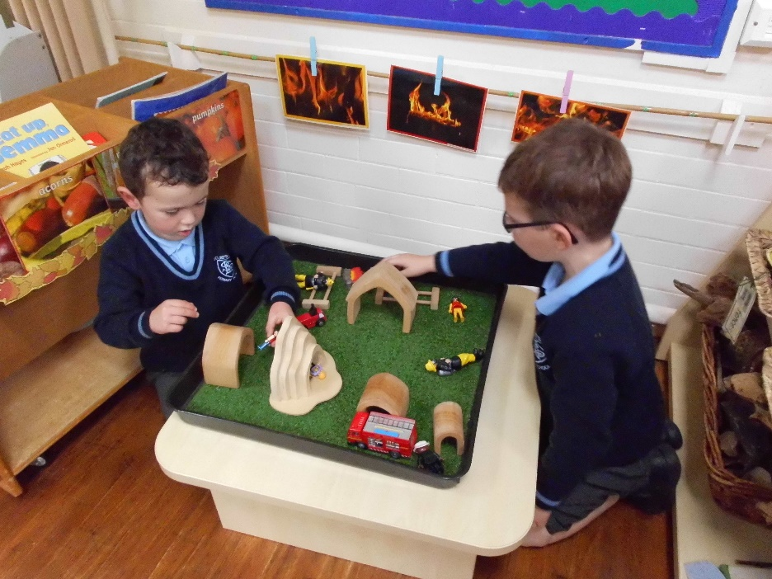
Indoor Environment

Slide 7
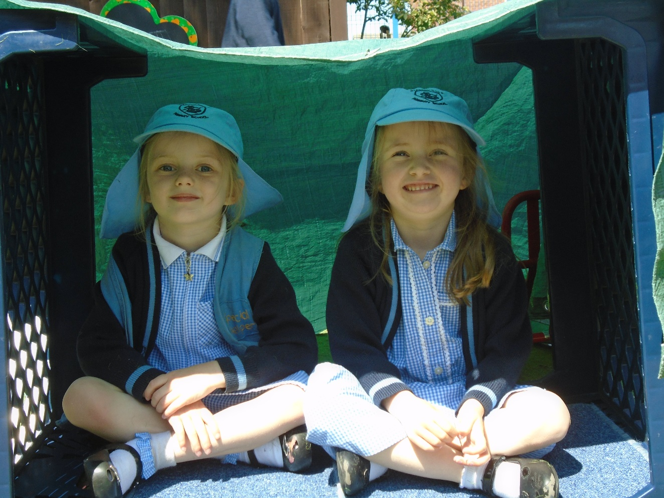
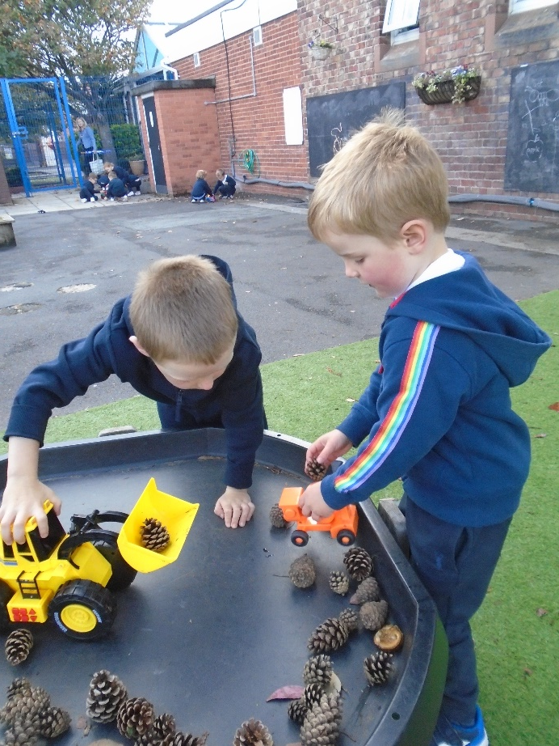
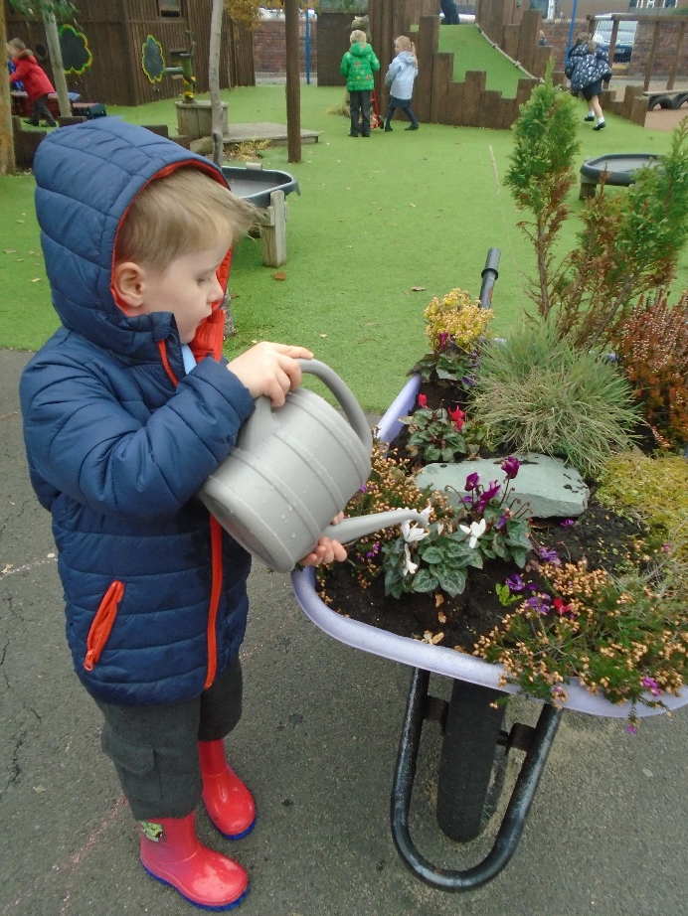
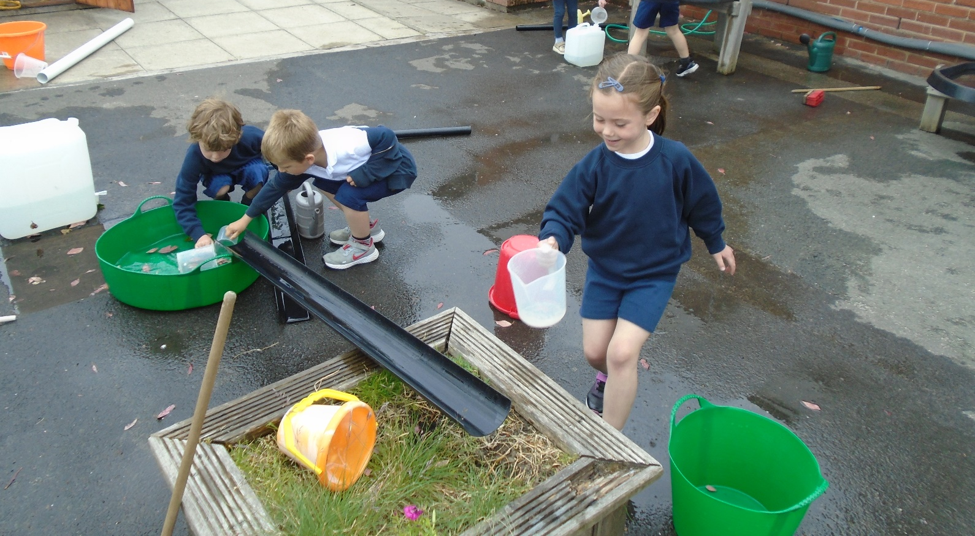

Outdoor Environment

Slide 8
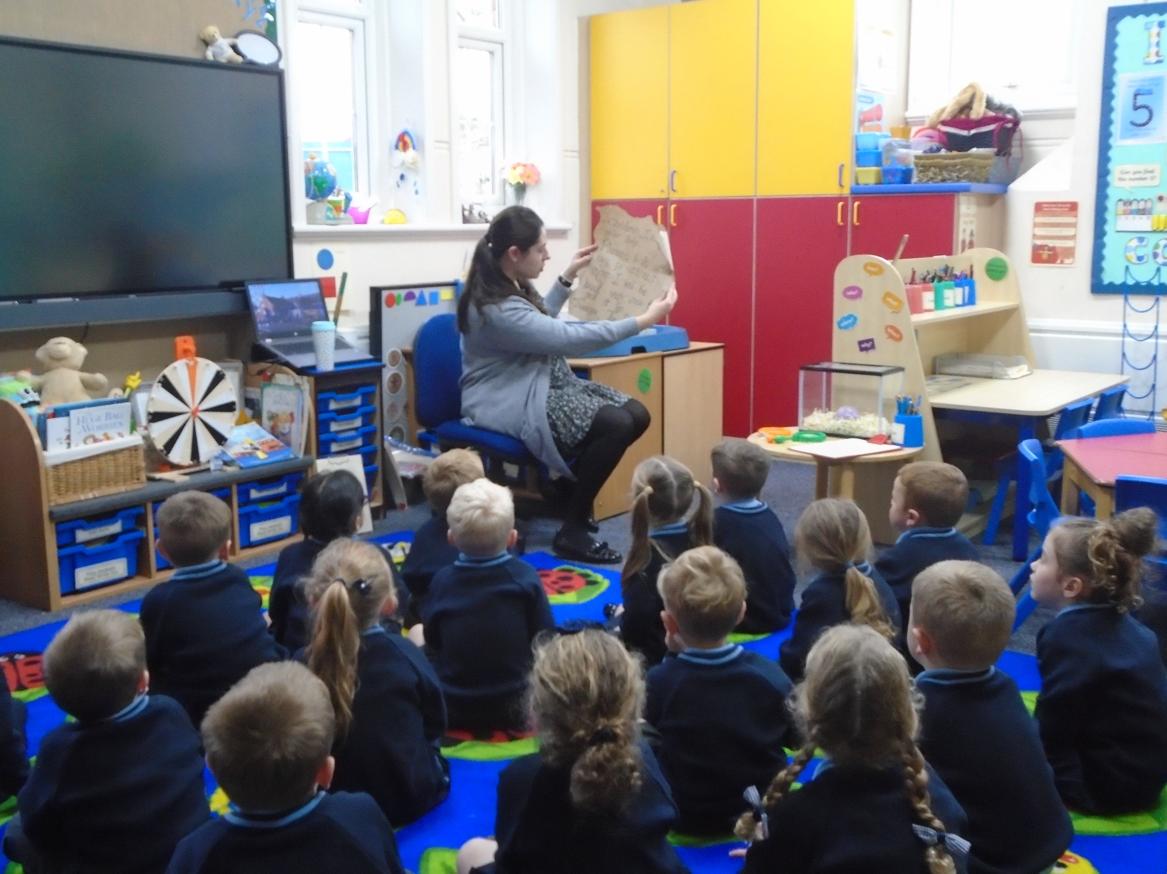
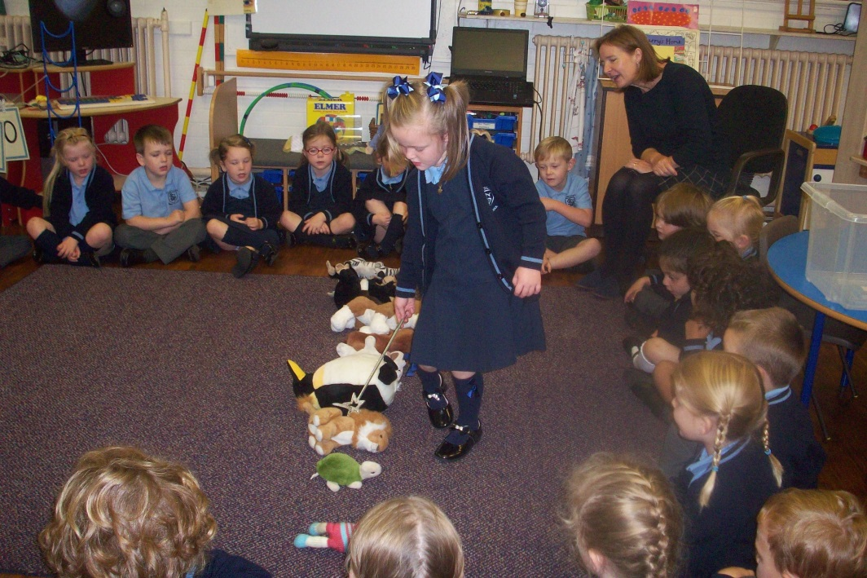
Whole class teaching

Slide 9

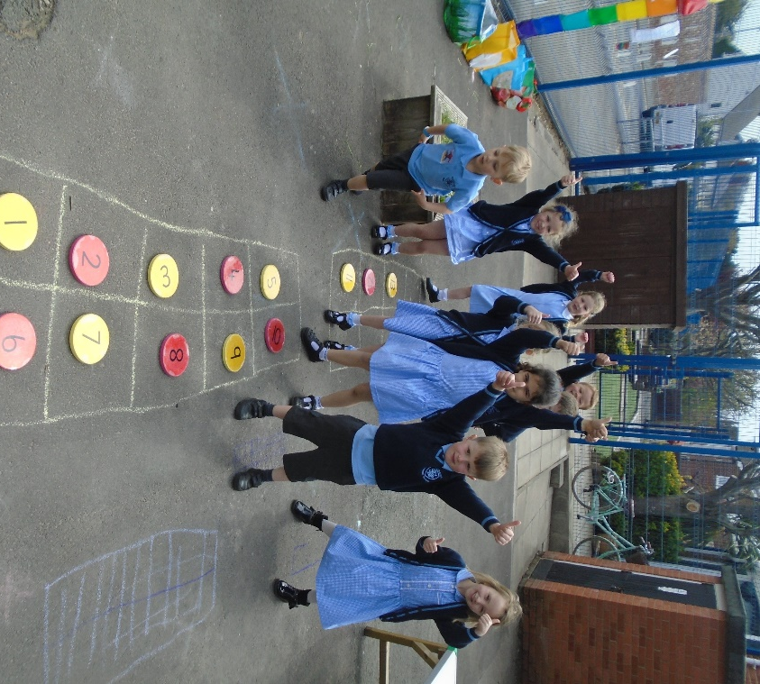
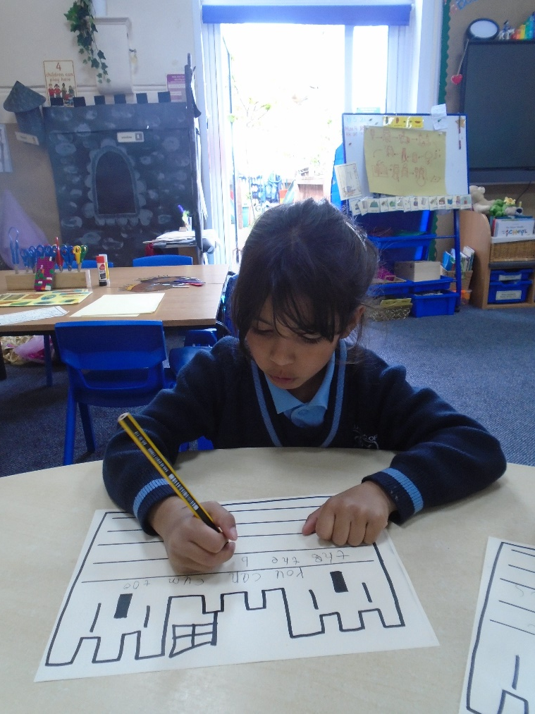
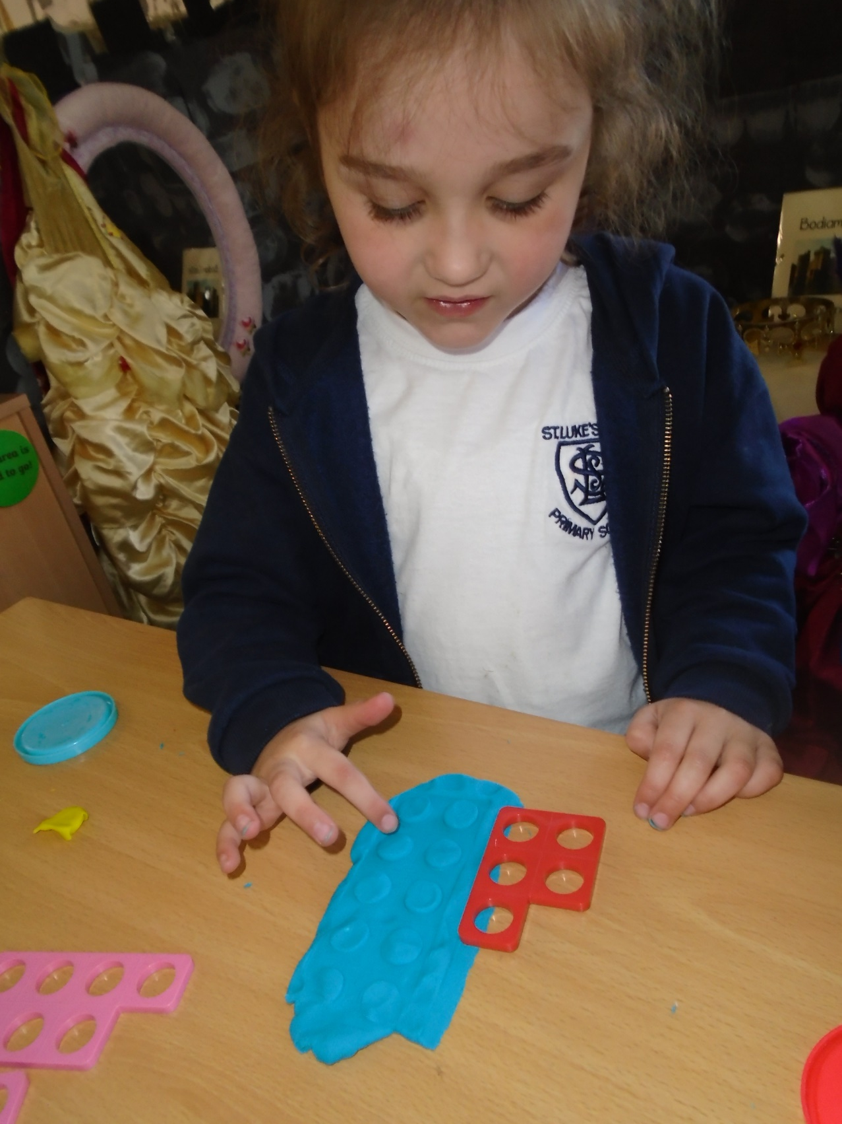
Adult guided teaching

Slide 10
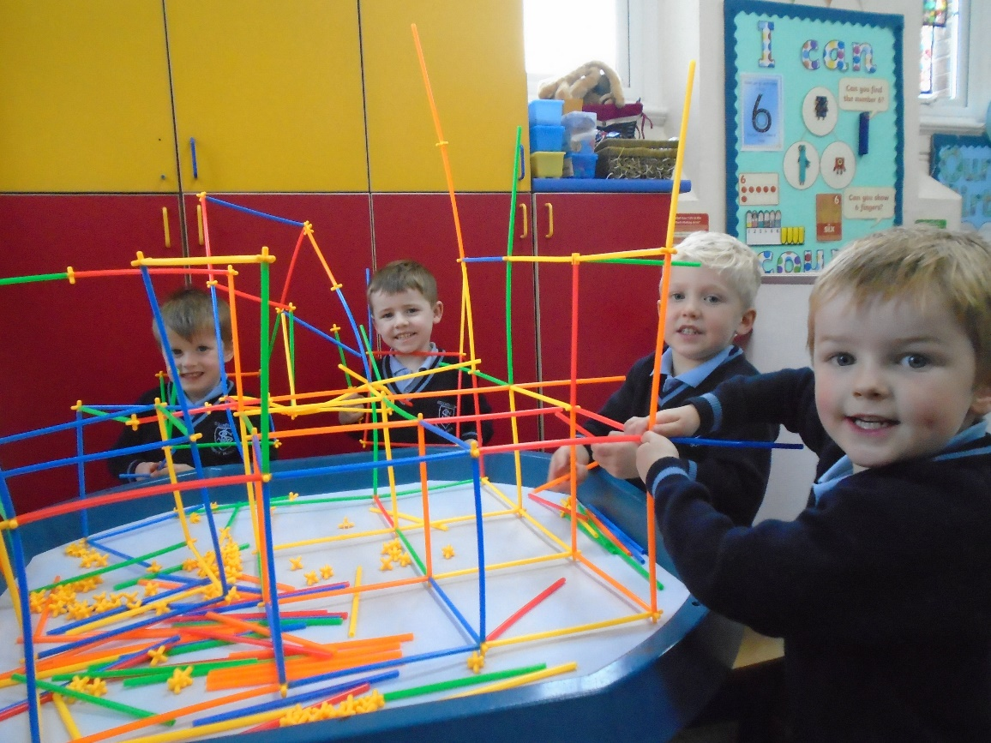
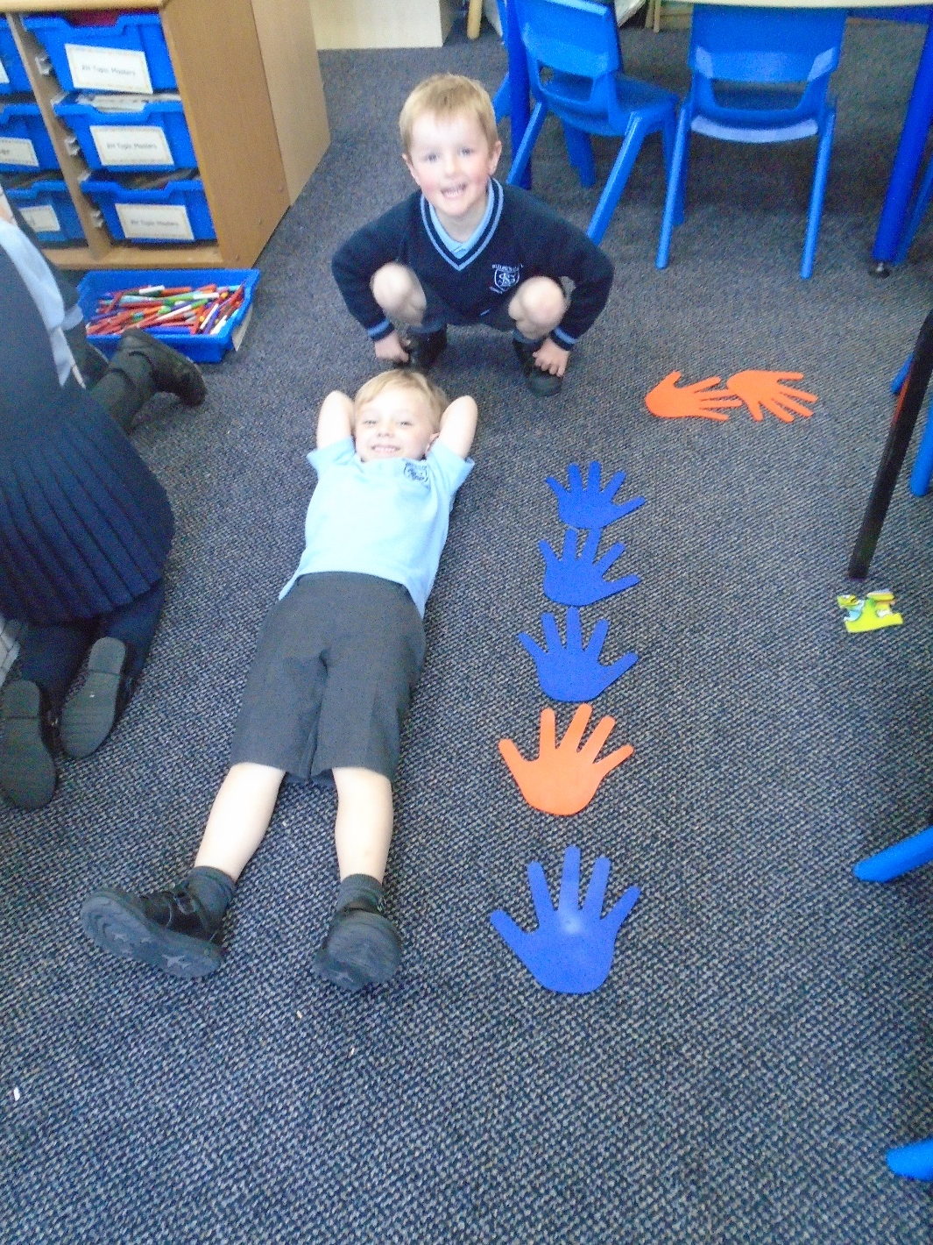
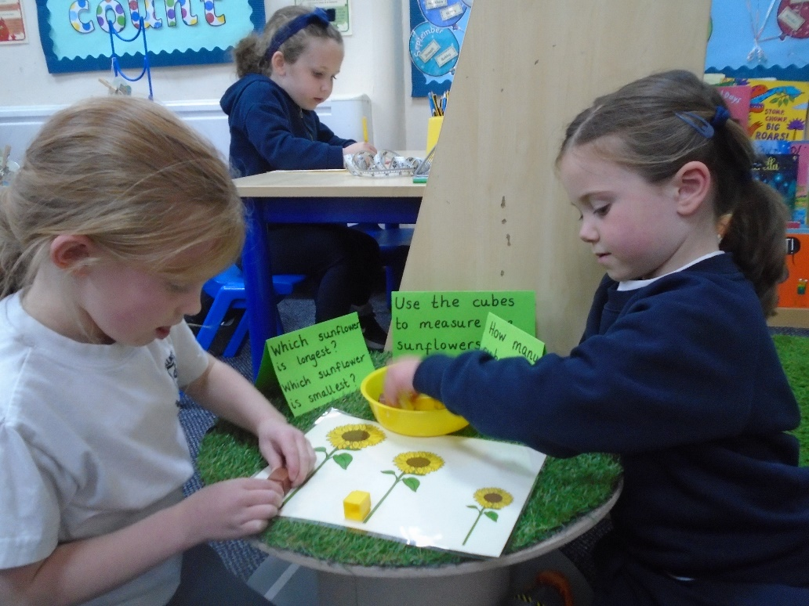

Child-initiated Learning
through Continuous Provision

Slide 11
Reception – here we come!
Our ‘getting to know you’ visit will be on
Friday 9th July 2021 at 12:45PM – 2:15PM.
Please bring your child into the ROLA (reception playground) and take them to their class teacher who will be standing in the classroom door. You are more than welcome to see them into the classroom, we do however ask as soon as they are happy and settled for you to say goodbye, telling them that you will be back soon, as this sets a good precedent for September.

Slide 12
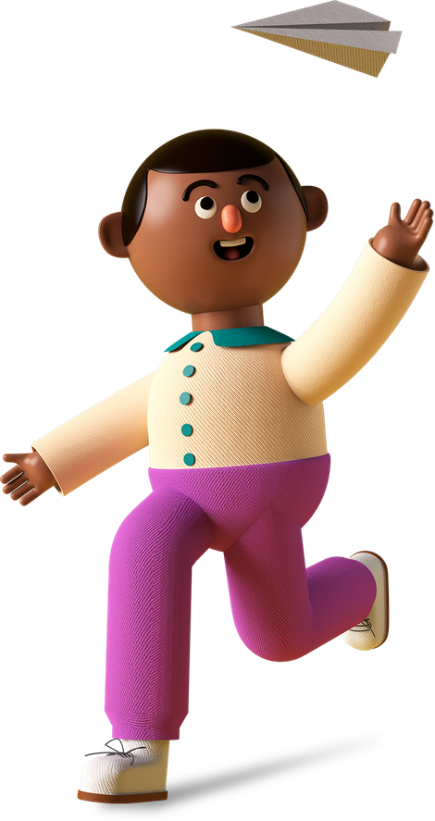

We know how big of a milestone it is, when your child starts school
We will be here every step of the way to make it as enjoyable and successful as we possibly can.

Slide 13

It’s time to start school
All children will start full days on Wednesday 8th September 2021
On the next slides we will share some of the things we can all work towards over the Summer to ensure our children are ready to start school confidently and independently.

Slide 14
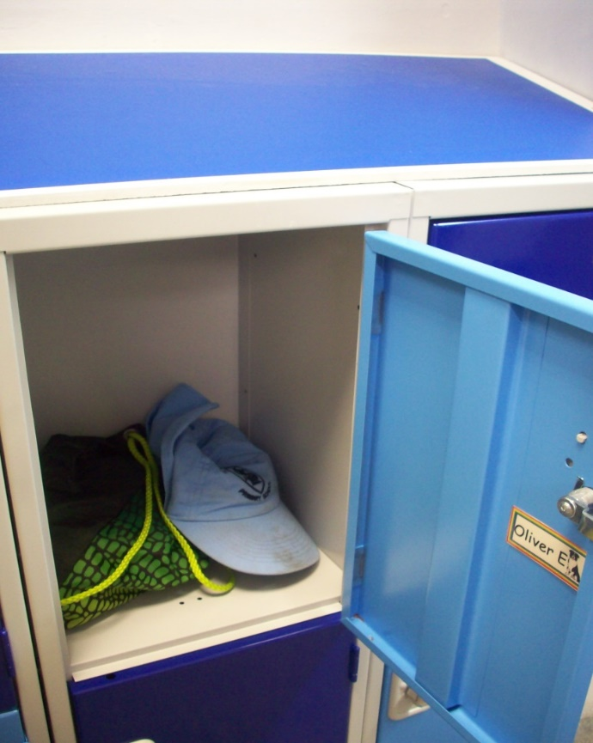
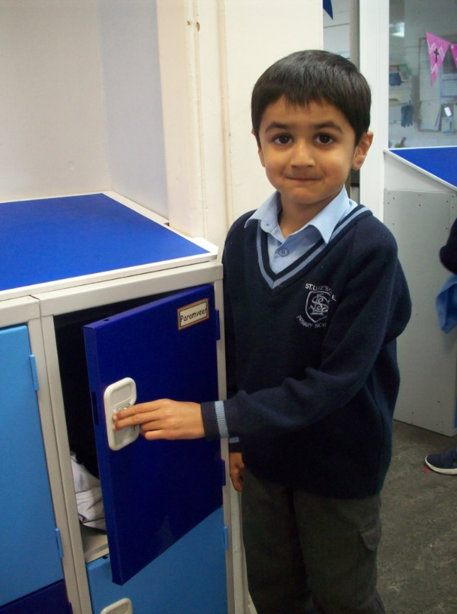
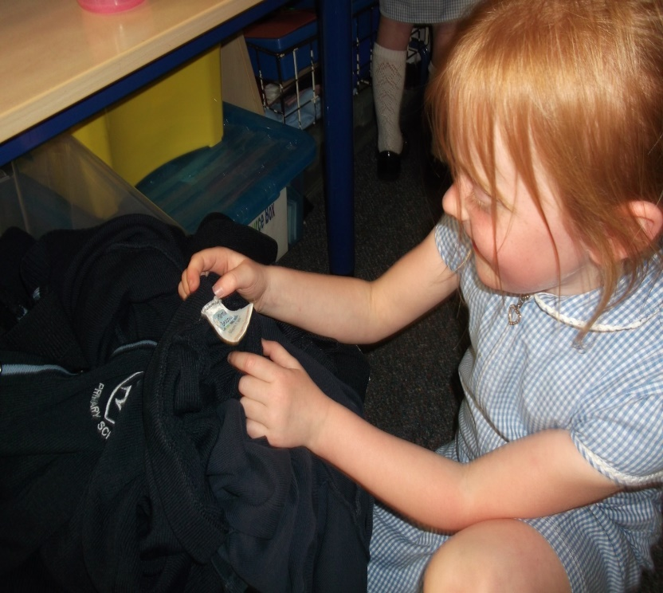
Recognising
their name
It is important if you don't do so already, to ensure your child has plenty of opportunities to recognise their name and what it looks like.
It is incredibly helpful when children can spot their own name on labels, lockers, clothing and water bottles.

Slide 15
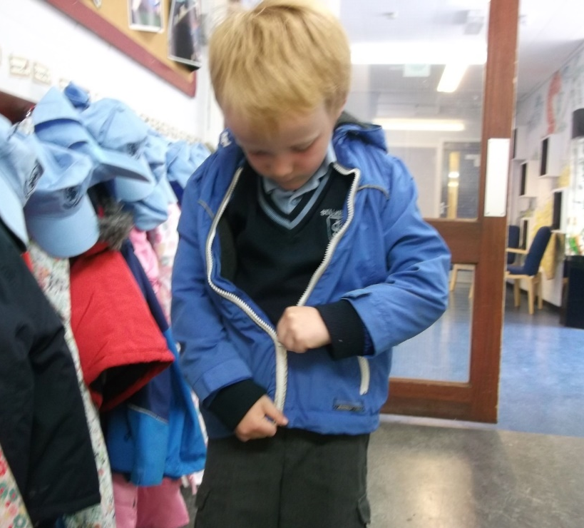
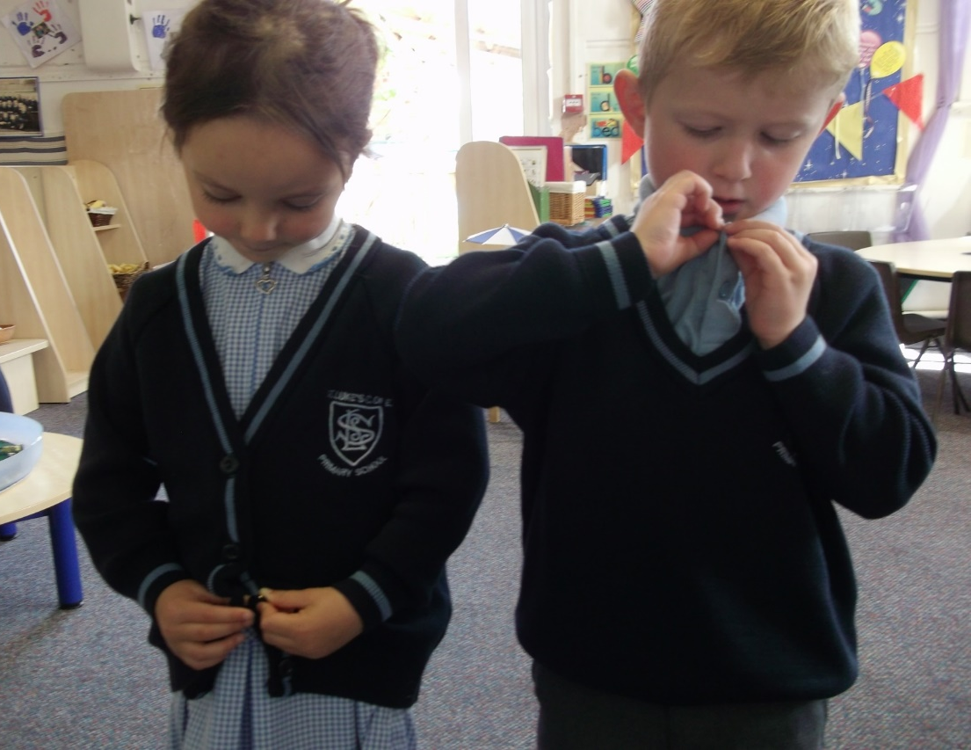
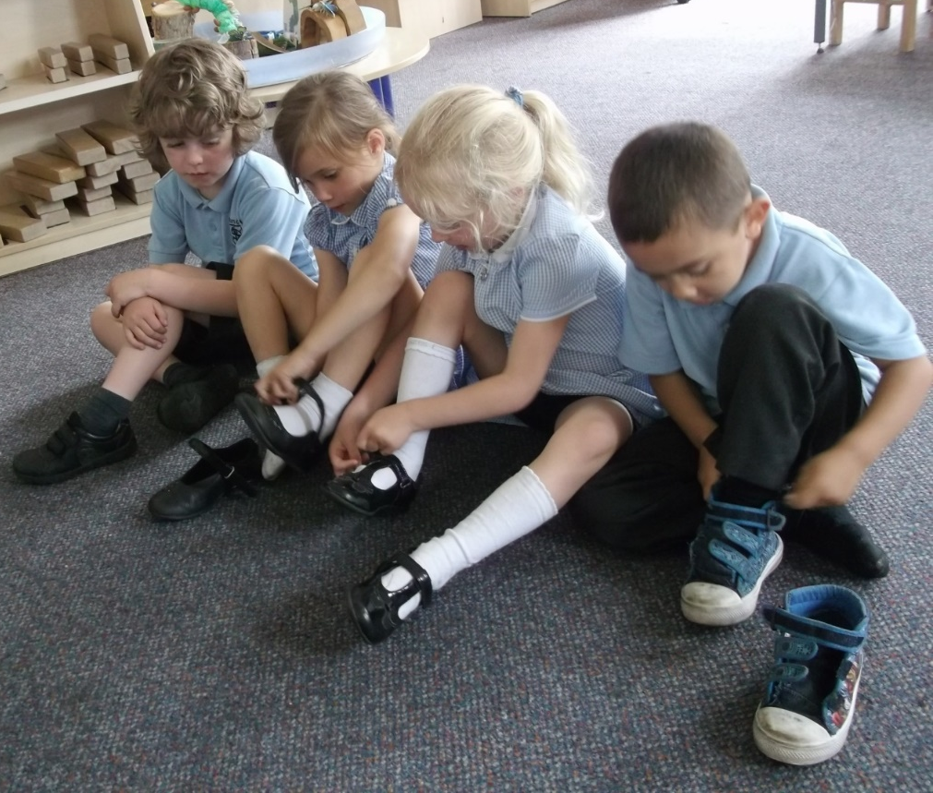
Dressing/undressing independently
To promote your child's learning and development let them practice putting on their school clothes, taking them off and practice zips and buttons on shirts and cardigans.
It’s handy to have uniform with elastic waistbands and shoes with Velcro for your child to independently dress themselves at school.

Slide 16
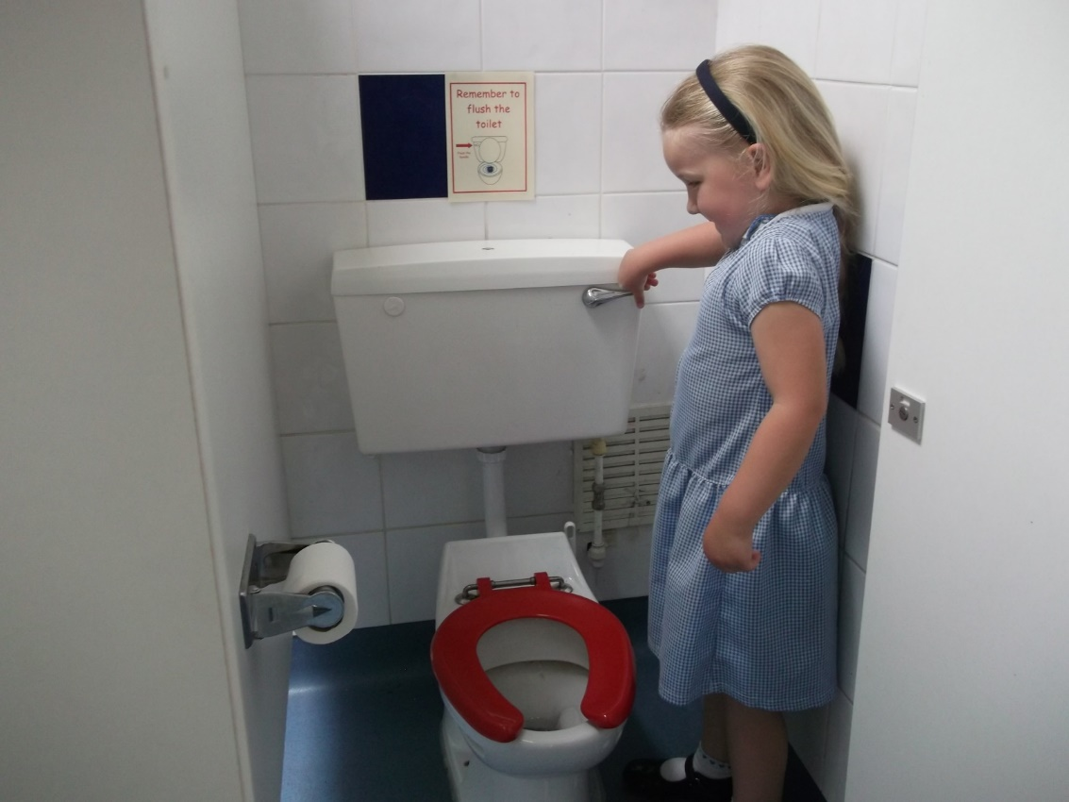
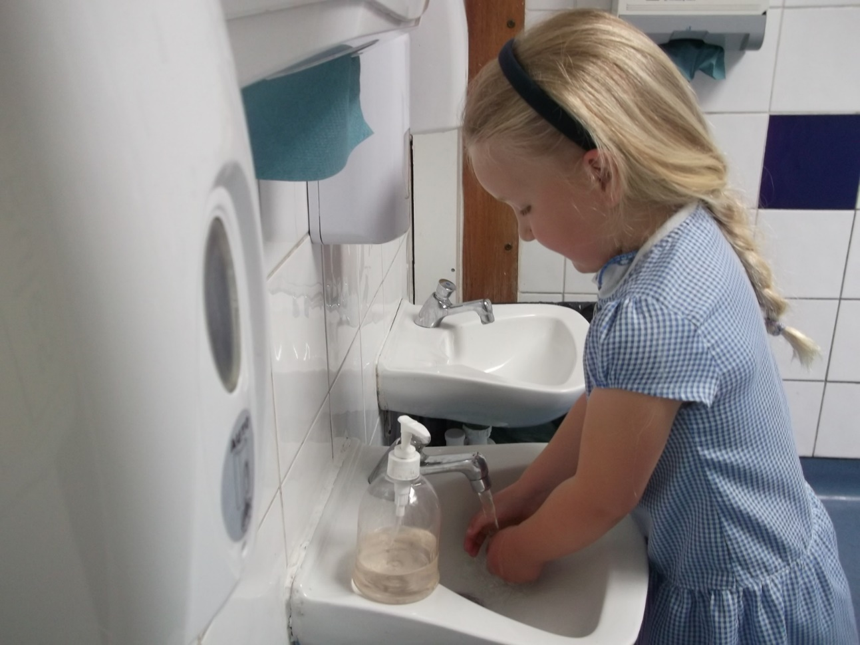
Self-care
Before your child joins us in September, we ask you to encourage your child as much as possible to become confident about getting to the toilet and using the toilet independently.
We are unable to wipe bottoms, if needed we can talk to your child through the door and pass things to them that they need. Please do contact us if you have any issues regarding this or any other aspects of personal care.

Slide 17
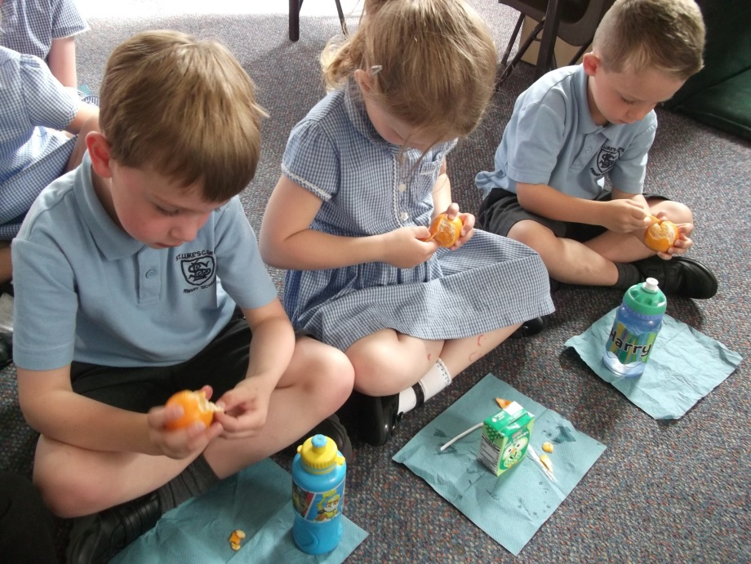
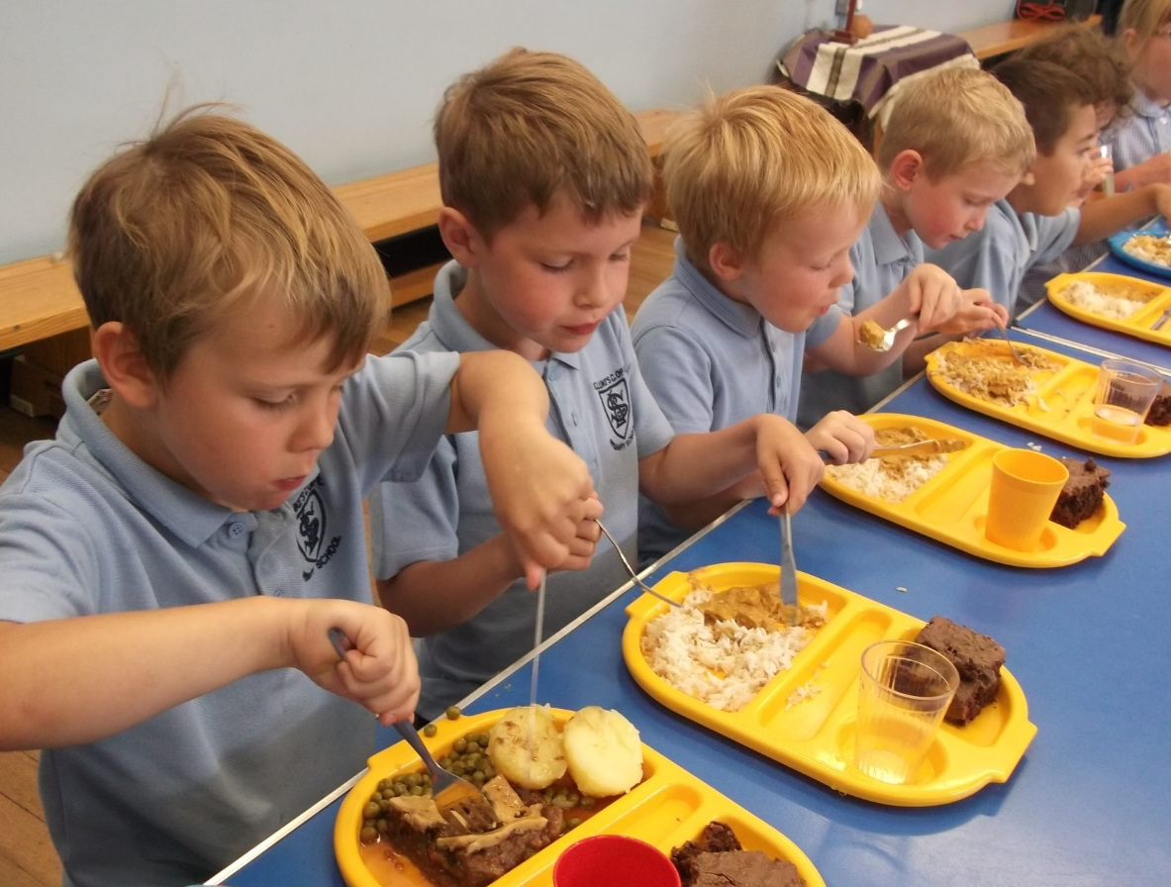
Promoting mealtime independence
With all the fun and learning going on in Reception, children need to keep their energy levels up.
We offer healthy snacks and lunchtime options each day, where your child can independently feed themselves.
Our lunchtime menu: Primary Menu 2020

Slide 18
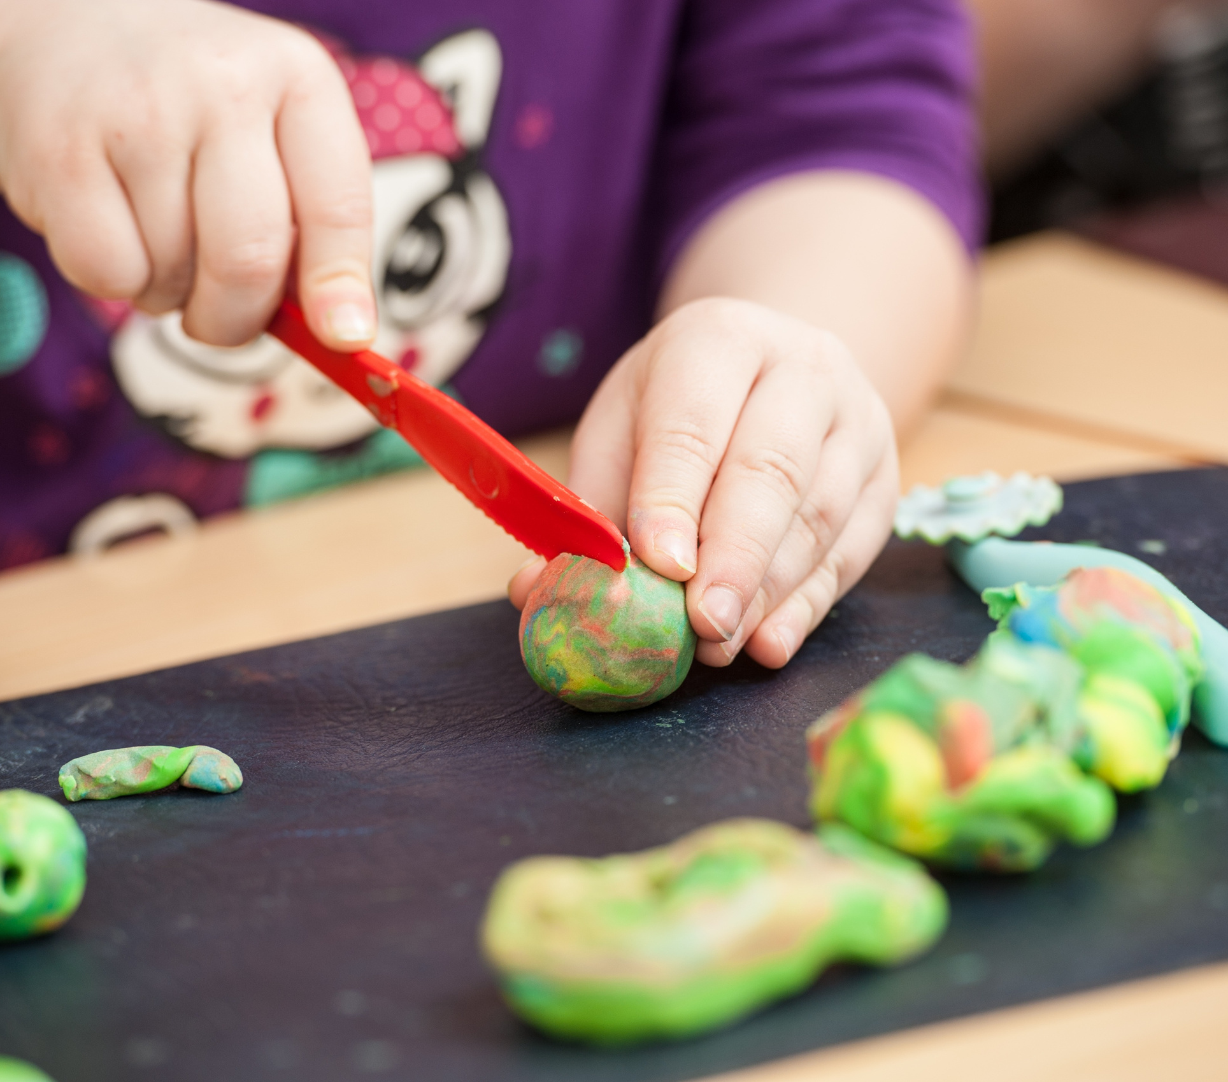


Practice, practice,
practice
Allow your child plenty of opportunity to peel fruit such as bananas and oranges.
If your child is bringing a packed lunch, practise opening any of the containers or packaging inside. Encourage your child to have a go at inserting straws into cartons.
For children who are having school dinners it is beneficial for them to be able to use a knife and fork. Play Doh is a great way for children to develop cutlery skills at home.

Slide 19
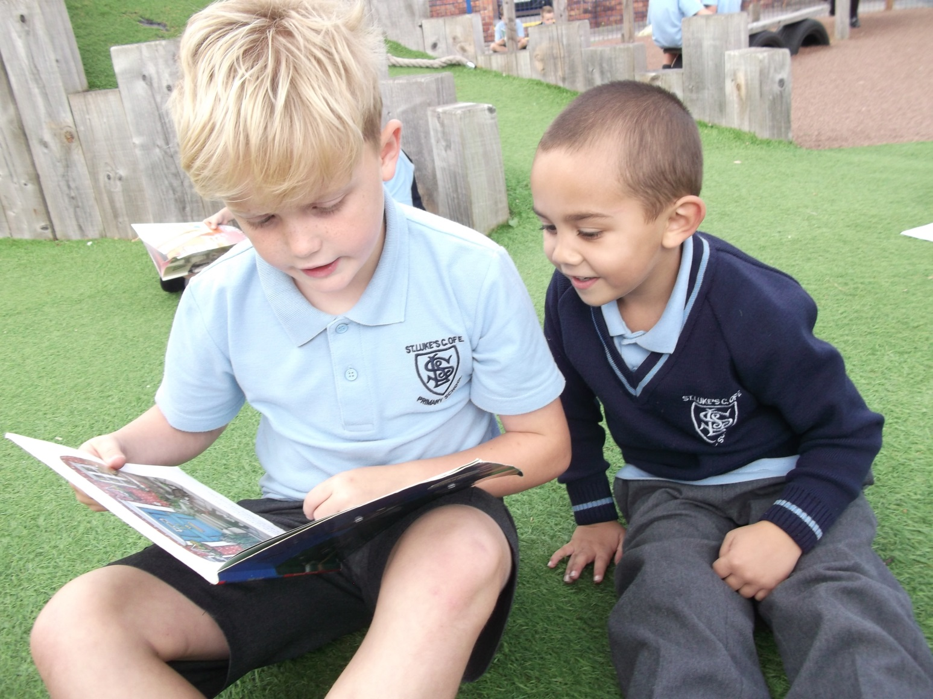
Year 4 Buddies
Our reception children are lucky enough to be buddied up with our Year 4 pupils. This process starts during the summer holidays where your child’s buddy will send a letter to your home.
We use the buddy system as we walk to church, assisting staff in showing the children how we walk sensibly, and how we behave in church. We share stories with one another in one of the first few weeks in school and we get together during many other events throughout the year.

Slide 20

What will my child need?
  Uniform - Contact Whittakers (Southport)
01704 533394
  Velcro shoes - unless your child can tie laces independently
  PE Drawstring bag - small enough to fit inside a locker please
  Waterproof coat with a hood
  Water bottle with sports cap
  We will provide a St Luke's emblem book bag and sun hat once your child starts school. The cost is £6 each (this will be collected at school visit or paid via school spider app in September).

Slide 21
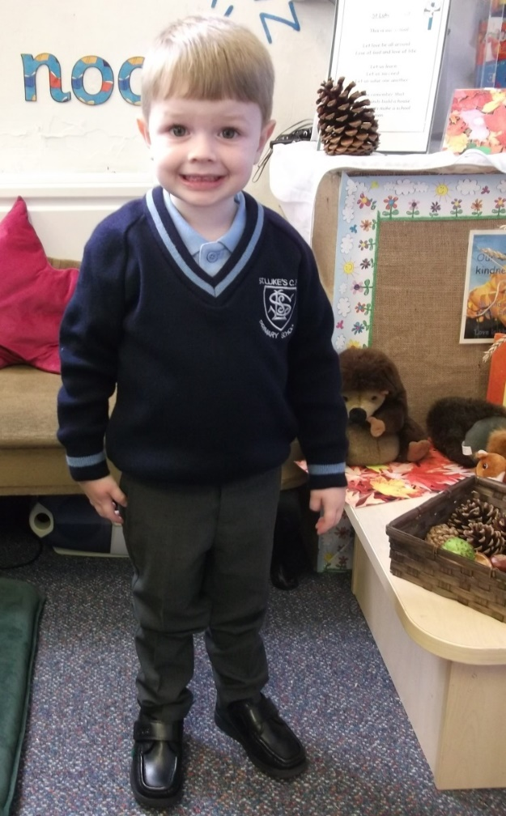
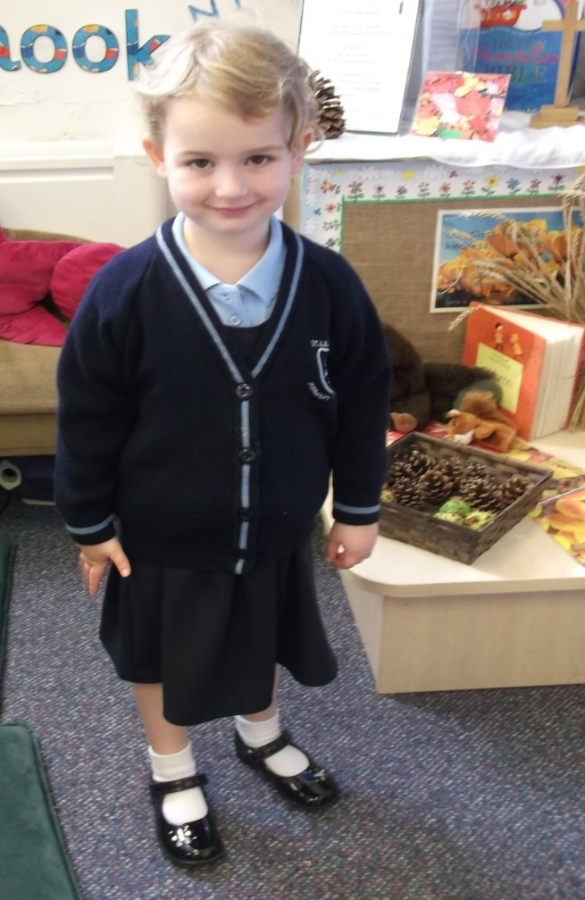
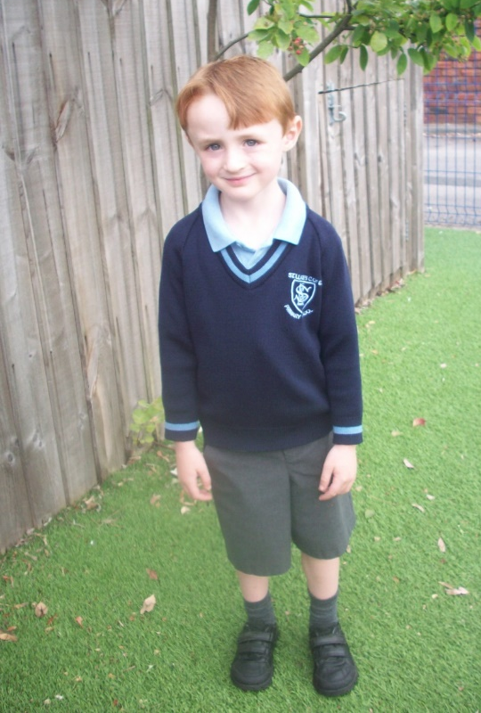
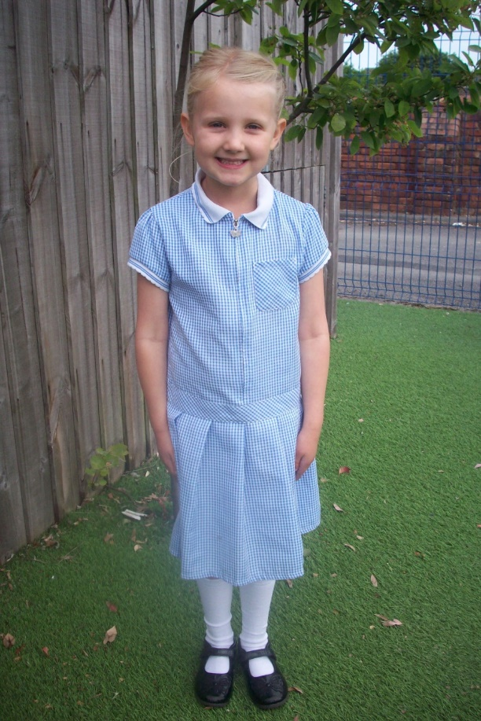
Winter uniform
Summer uniform
Grey trousers with grey socks or navy skirt, pinafore, trousers or culottes with white or blue socks/tights and pale blue polo shirt with badged jumper or cardigan
Grey shorts or pale blue and white checked summer dress/playsuit

Slide 22
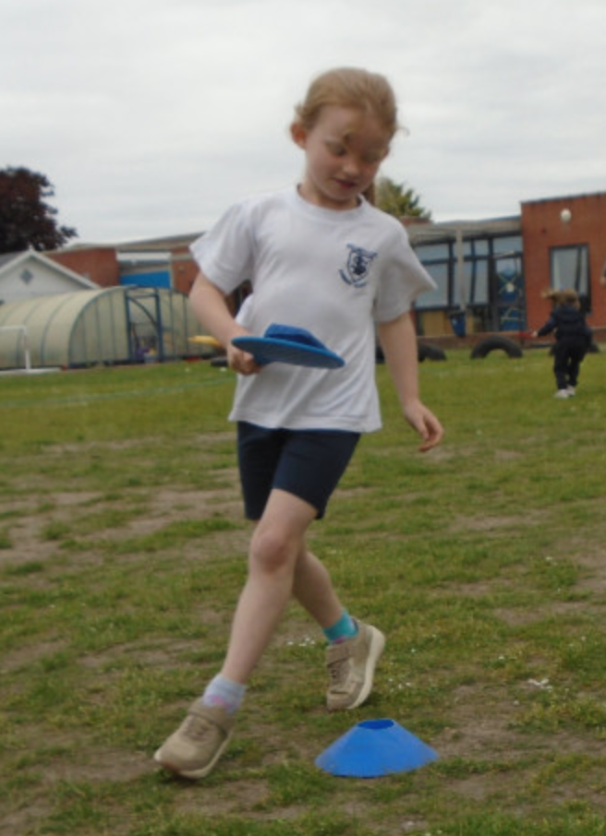
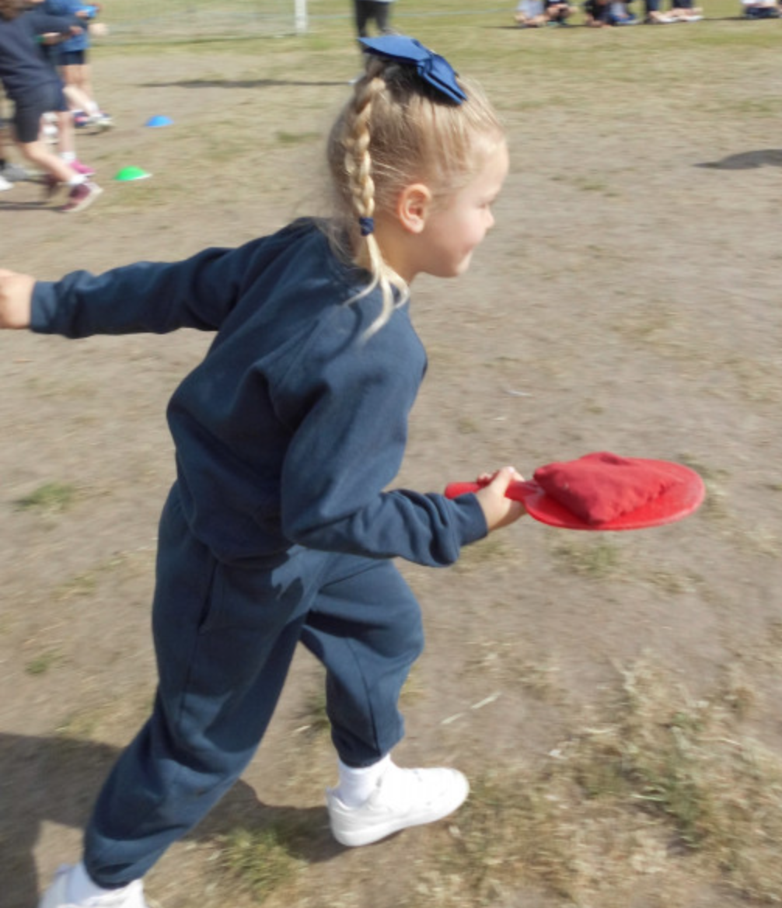
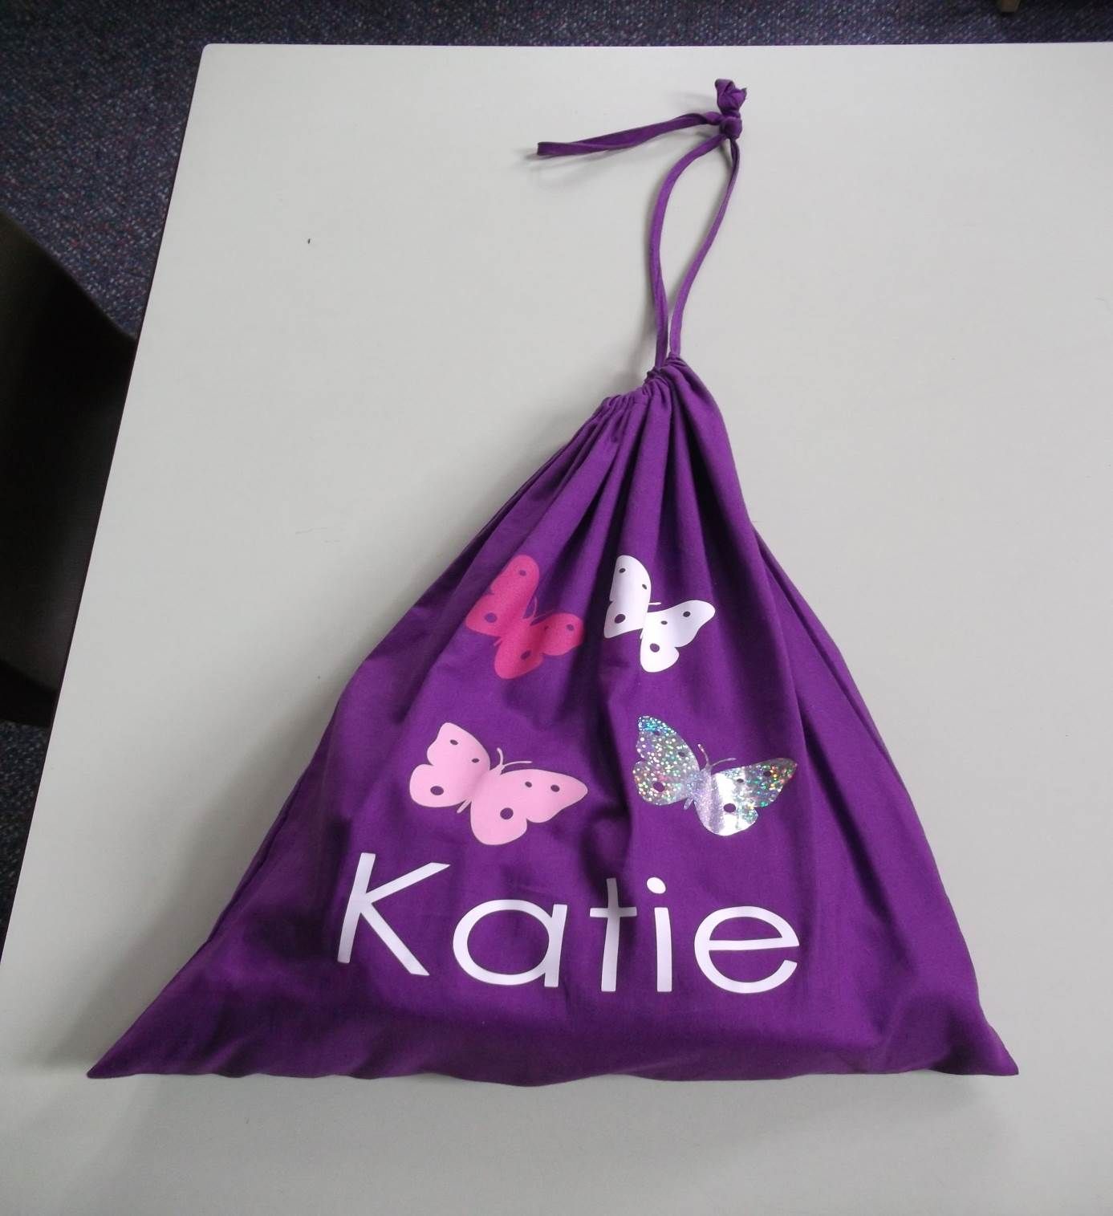
PE kit
White t-shirt, plain navy tracksuit bottoms, plain navy
sweatshirt, and velcro trainers

Slide 23

Opportunities to get together...
  School visit in September
  Two Parent/Teacher liaison meetings
  Read Write Inc Phonics workshop
  Maths workshop
  Check the school website for upcoming events

Slide 24
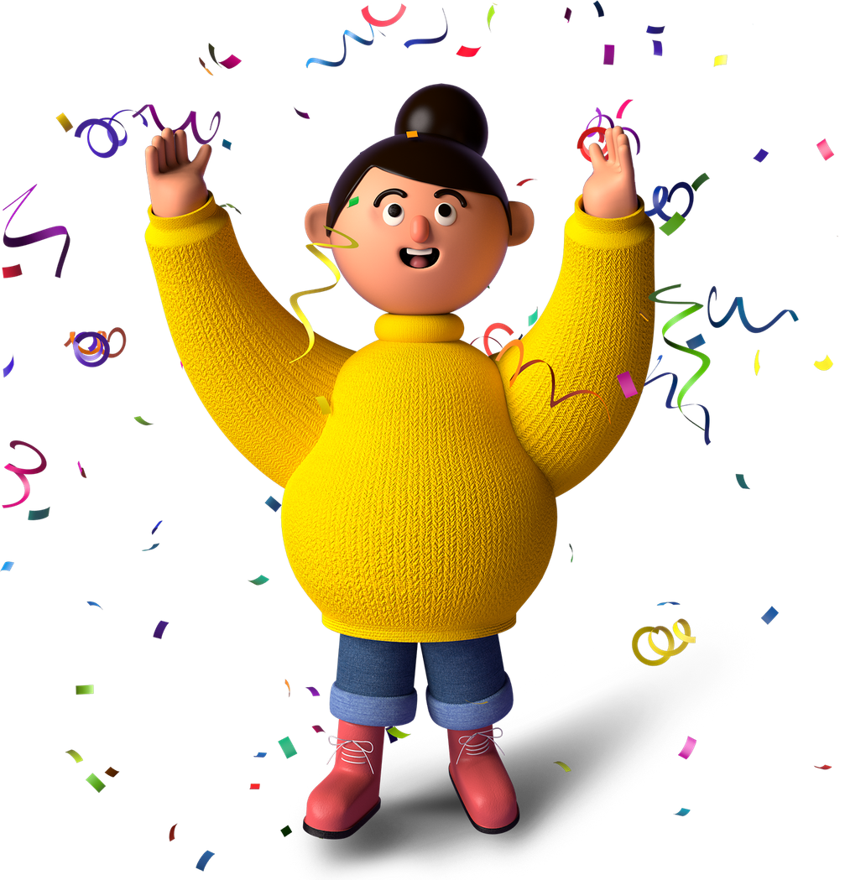
Communication is key to happy and successful children
If you have any questions at all
please do get in touch with us:
reception@slf.sefton.school
admin@slf.sefton.school
We look forward to seeing you soon!

