Slide 2
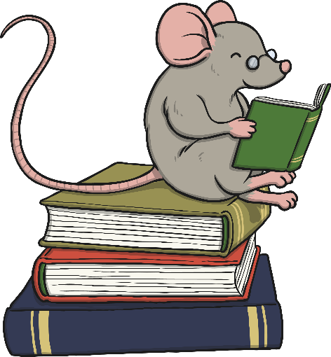
About World Book Day
The first World Book Day was in 1995.
World Book Day is a celebration of:
  authors – people who write books;
  illustrators – artists who draw pictures for books;
  books – funny, scary and true stories, poetry, jokes and
  much more.
Most importantly, it’s a celebration of readers – that’s you!

Slide 3
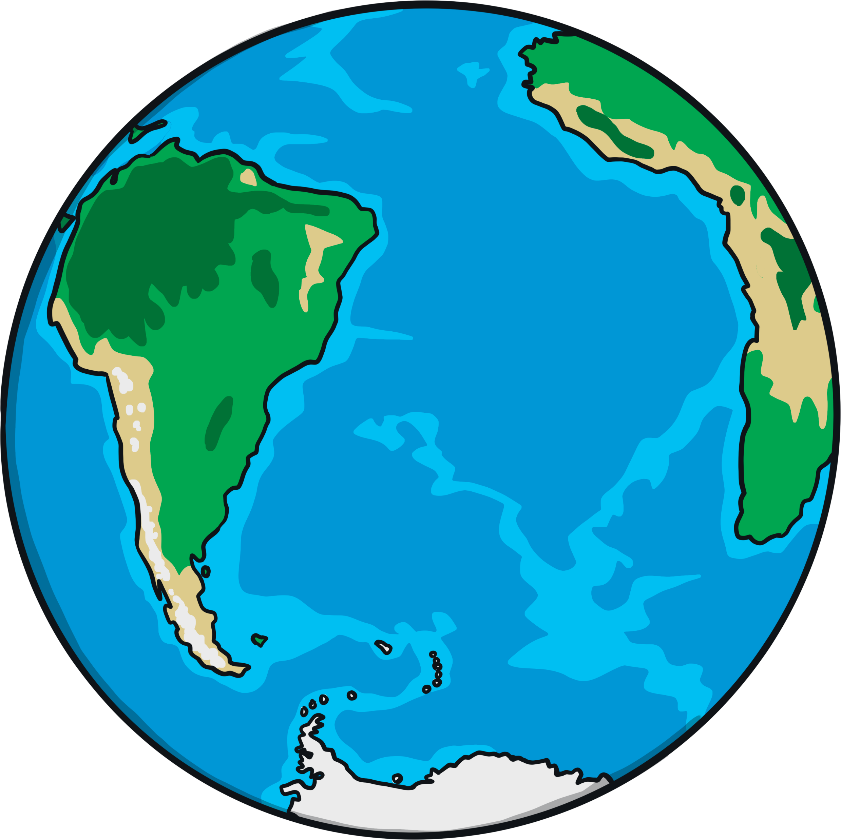
Do Other Countries Celebrate
World Book Day?
It’s not just celebrated in Britain - over 100 different countries also celebrate World Book Day.
They include:
Ireland
Spain
Sweden
United States of America

Slide 4

When Is World Book Day?
The date for World Book Day changes every year but it is always on the first Thursday in March.
People do lots of different things to celebrate World Book Day.
What kinds of things could you do at school?
What kinds of things could you do at home?

Slide 5
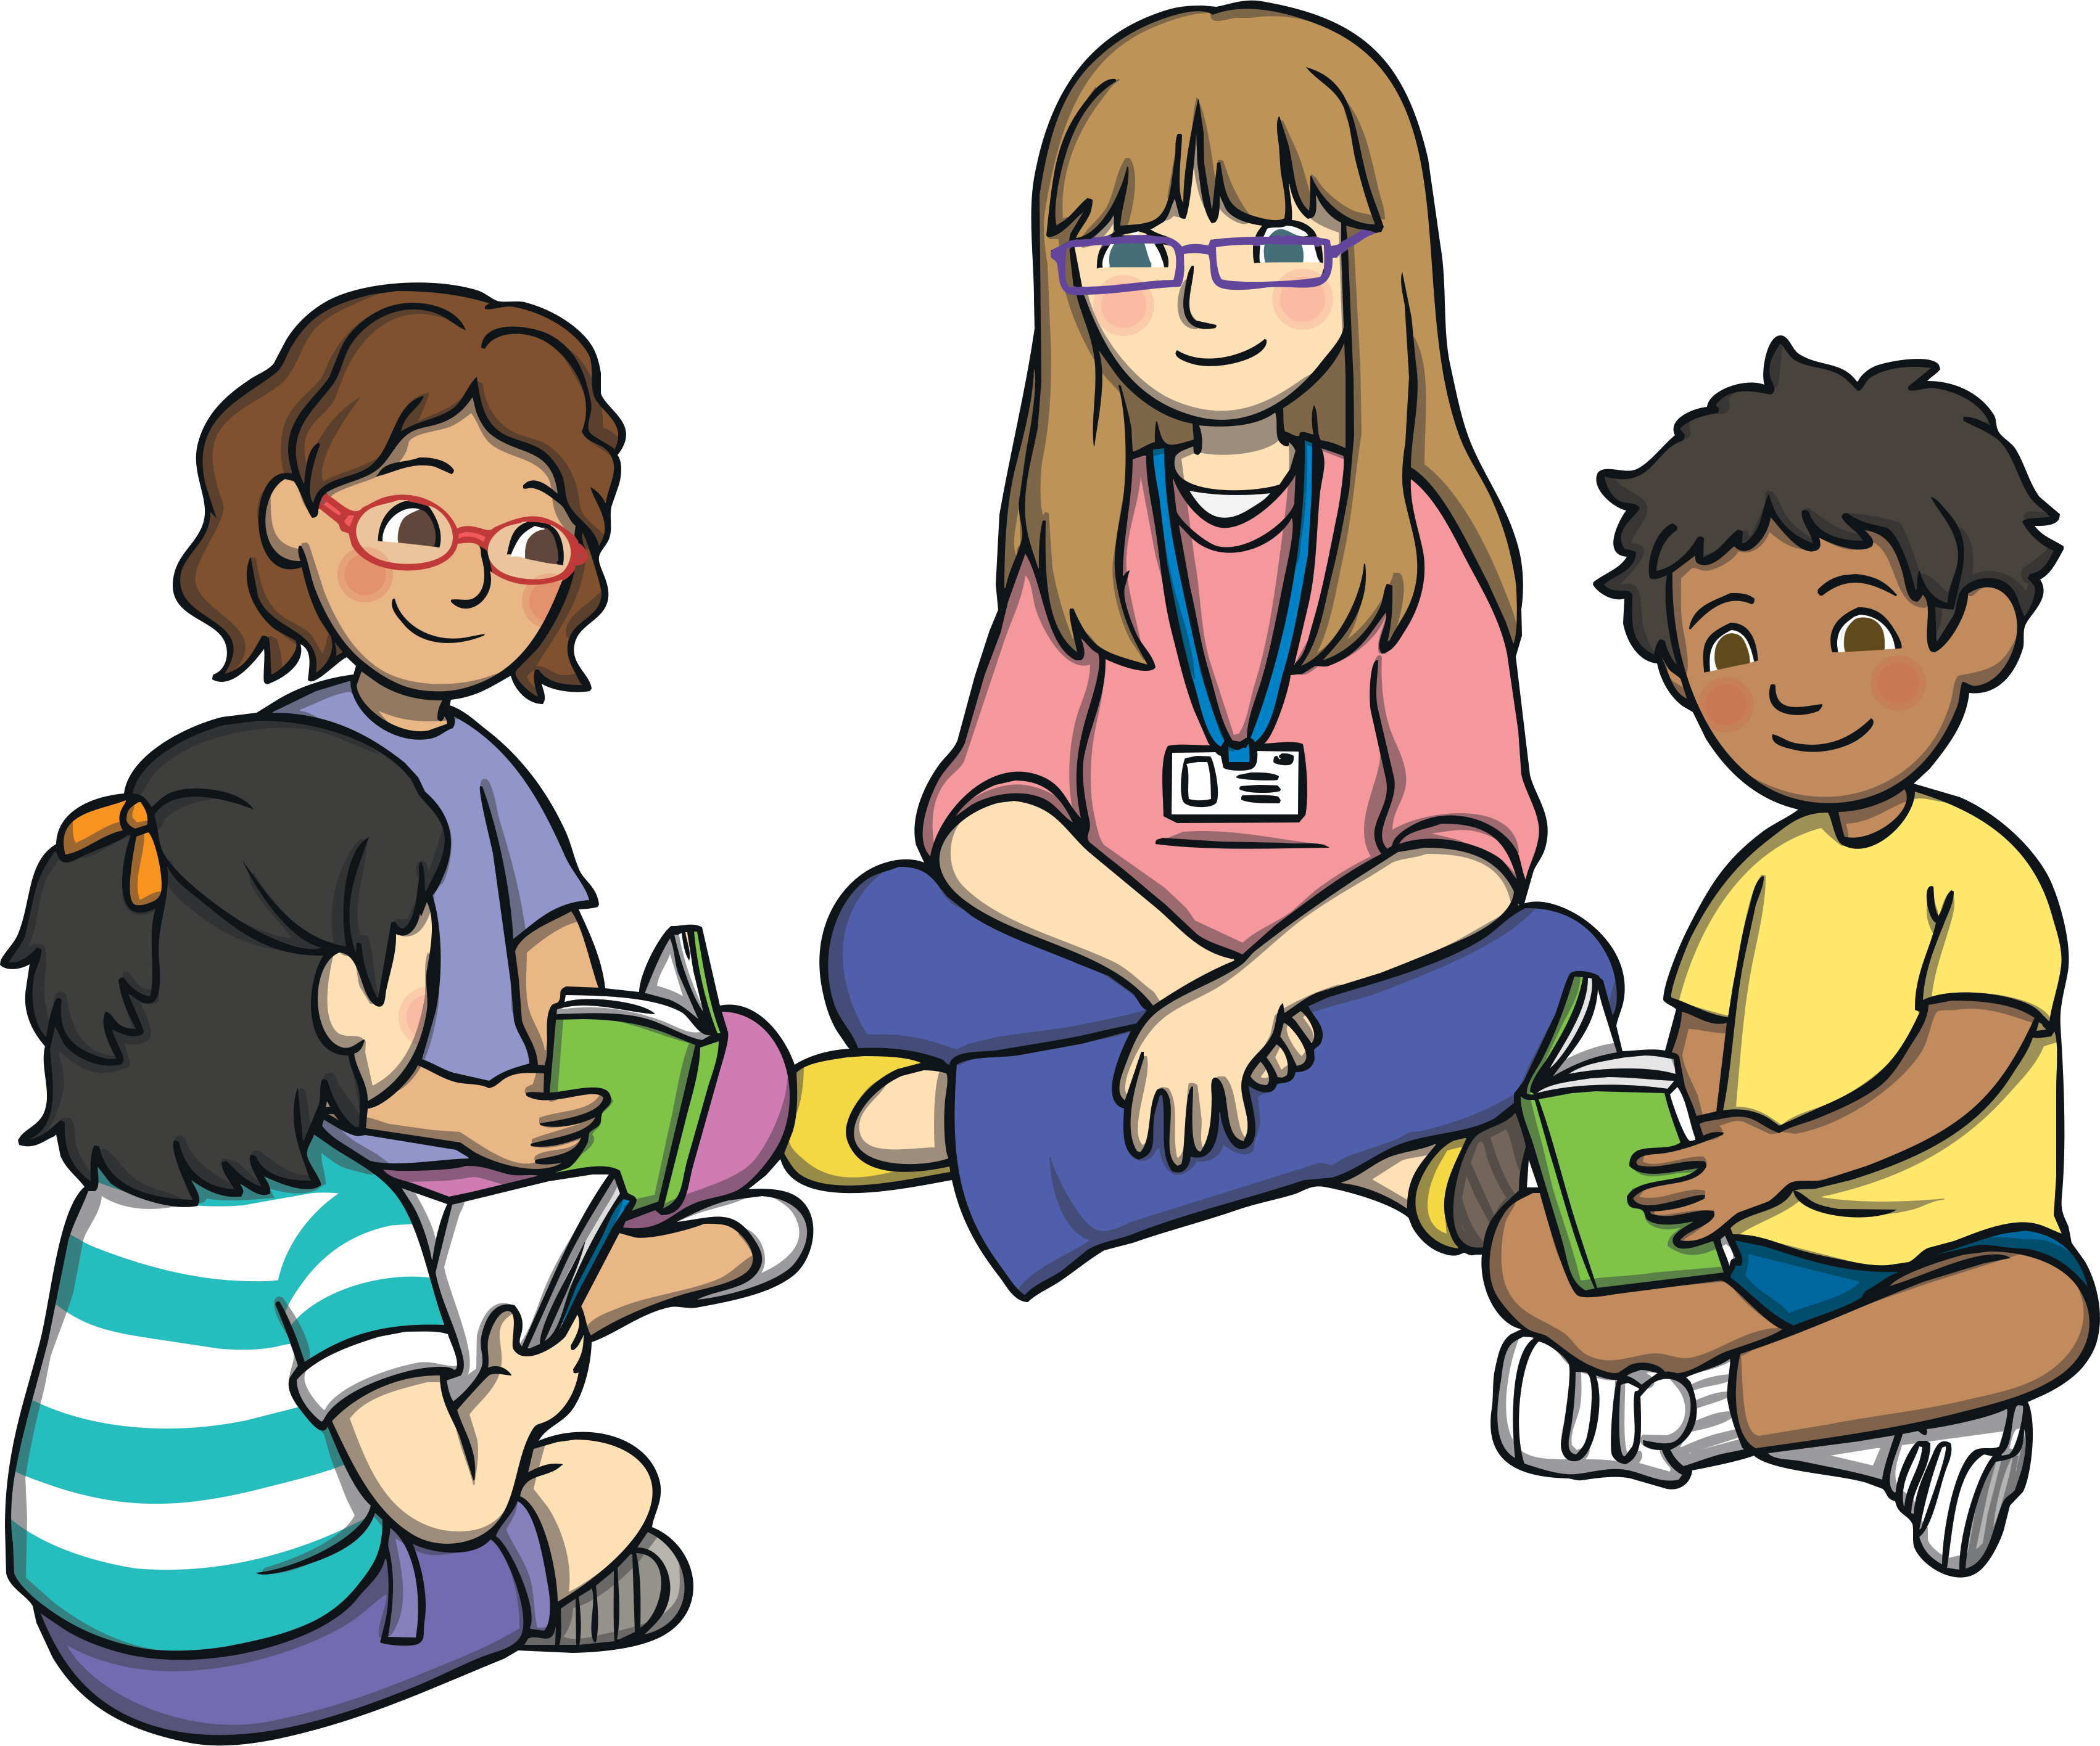
How Could You Celebrate
World Book Day?
You could hold a sponsored read and raise money for charity.

Slide 6
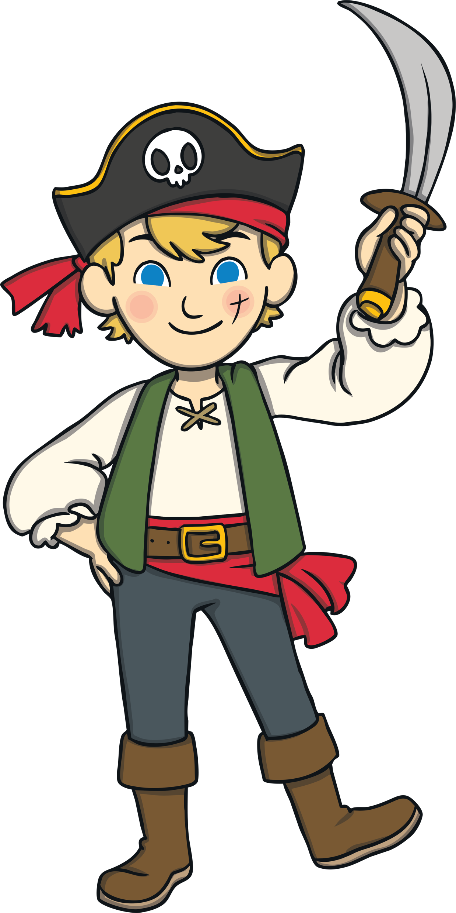
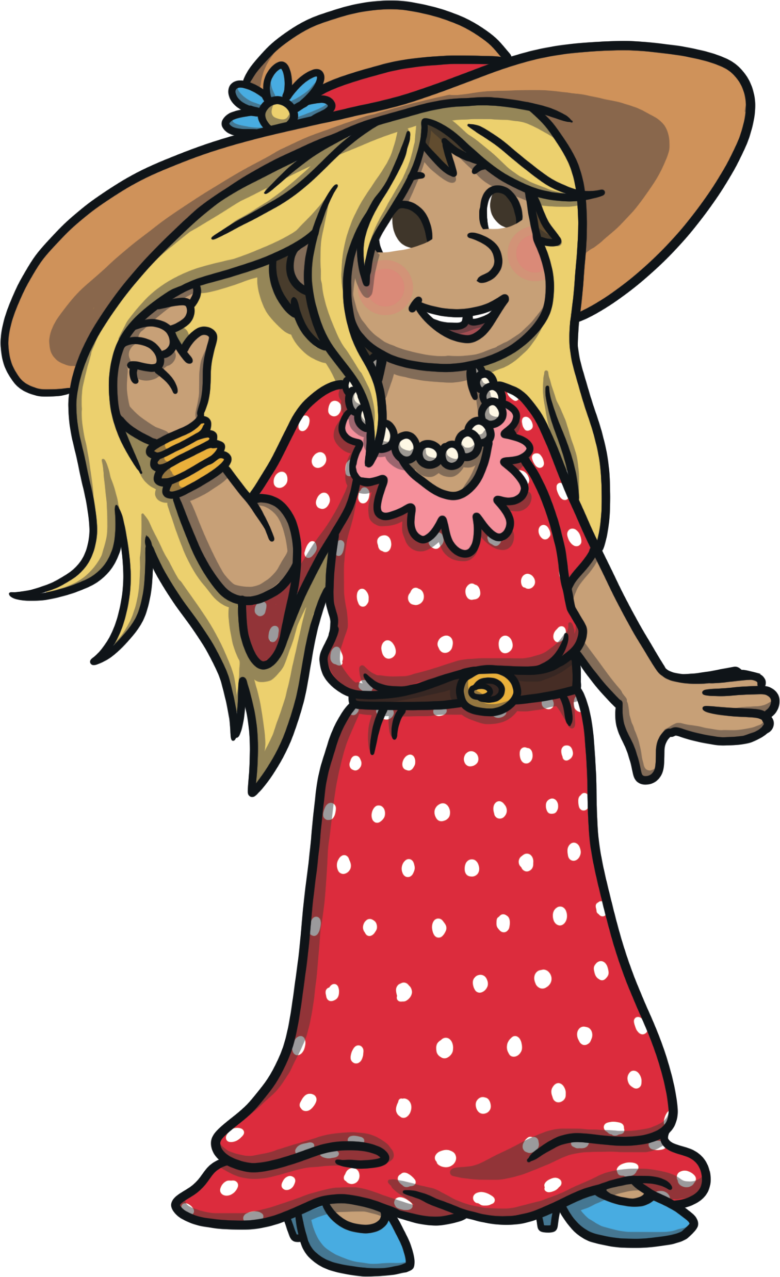
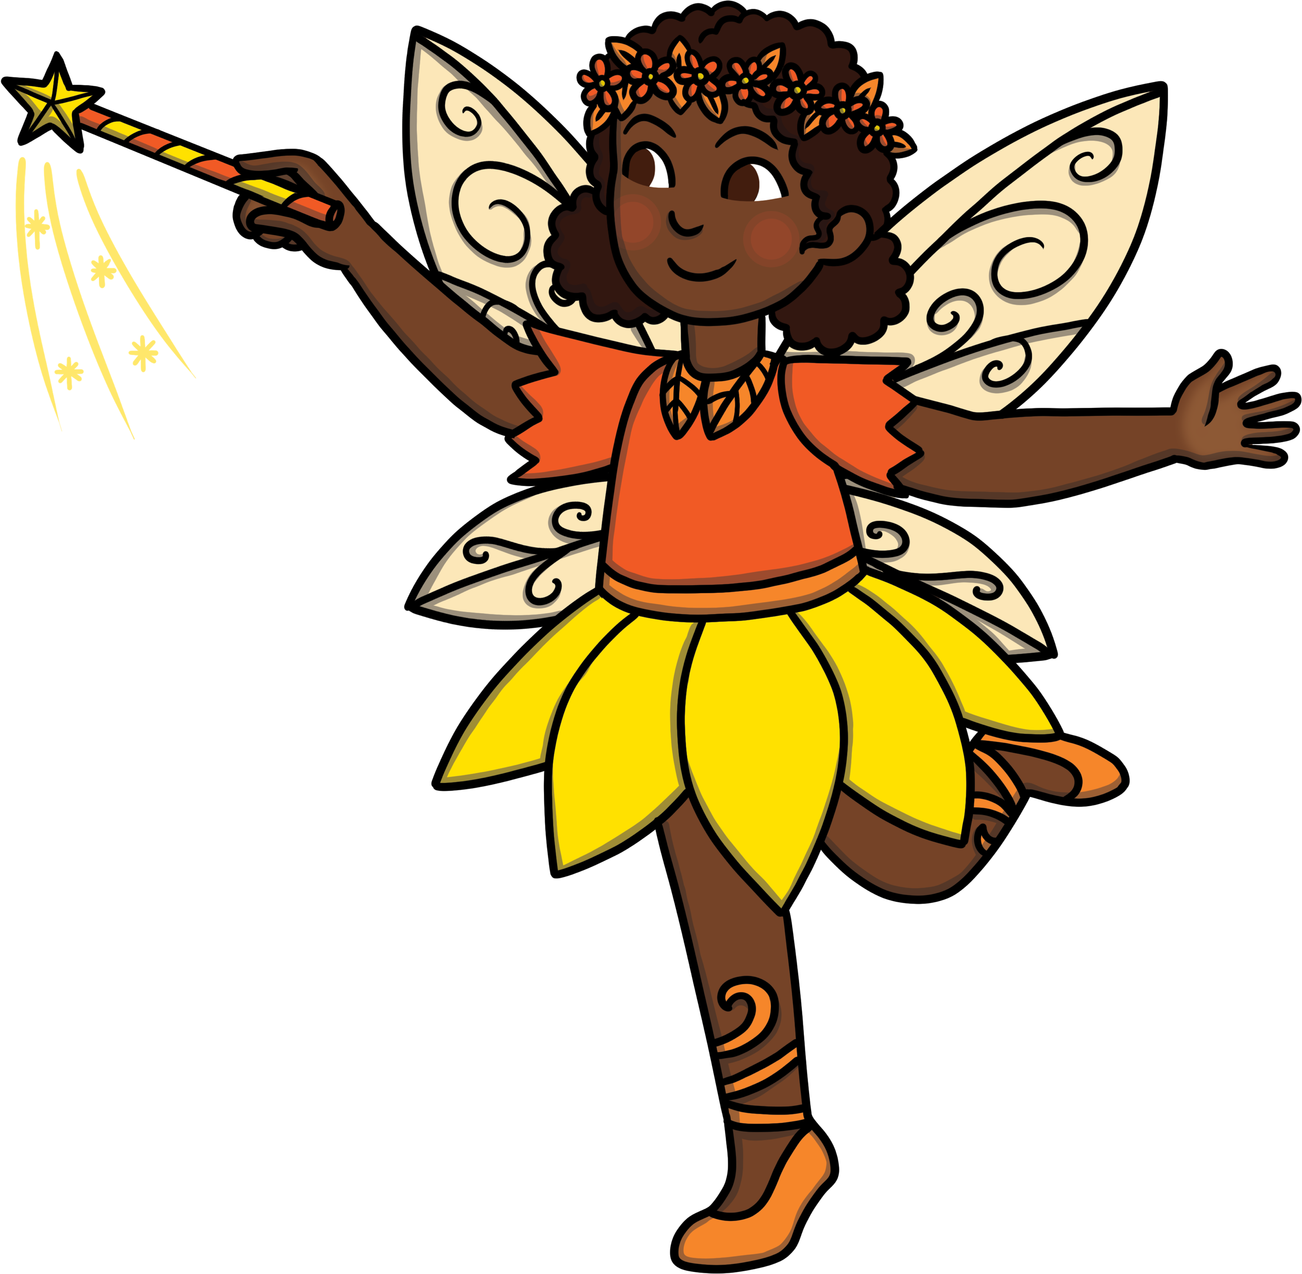
How Could You Celebrate
World Book Day?
Costume Parade - you could dress up as characters from your favourite books and have a costume parade.

Slide 7

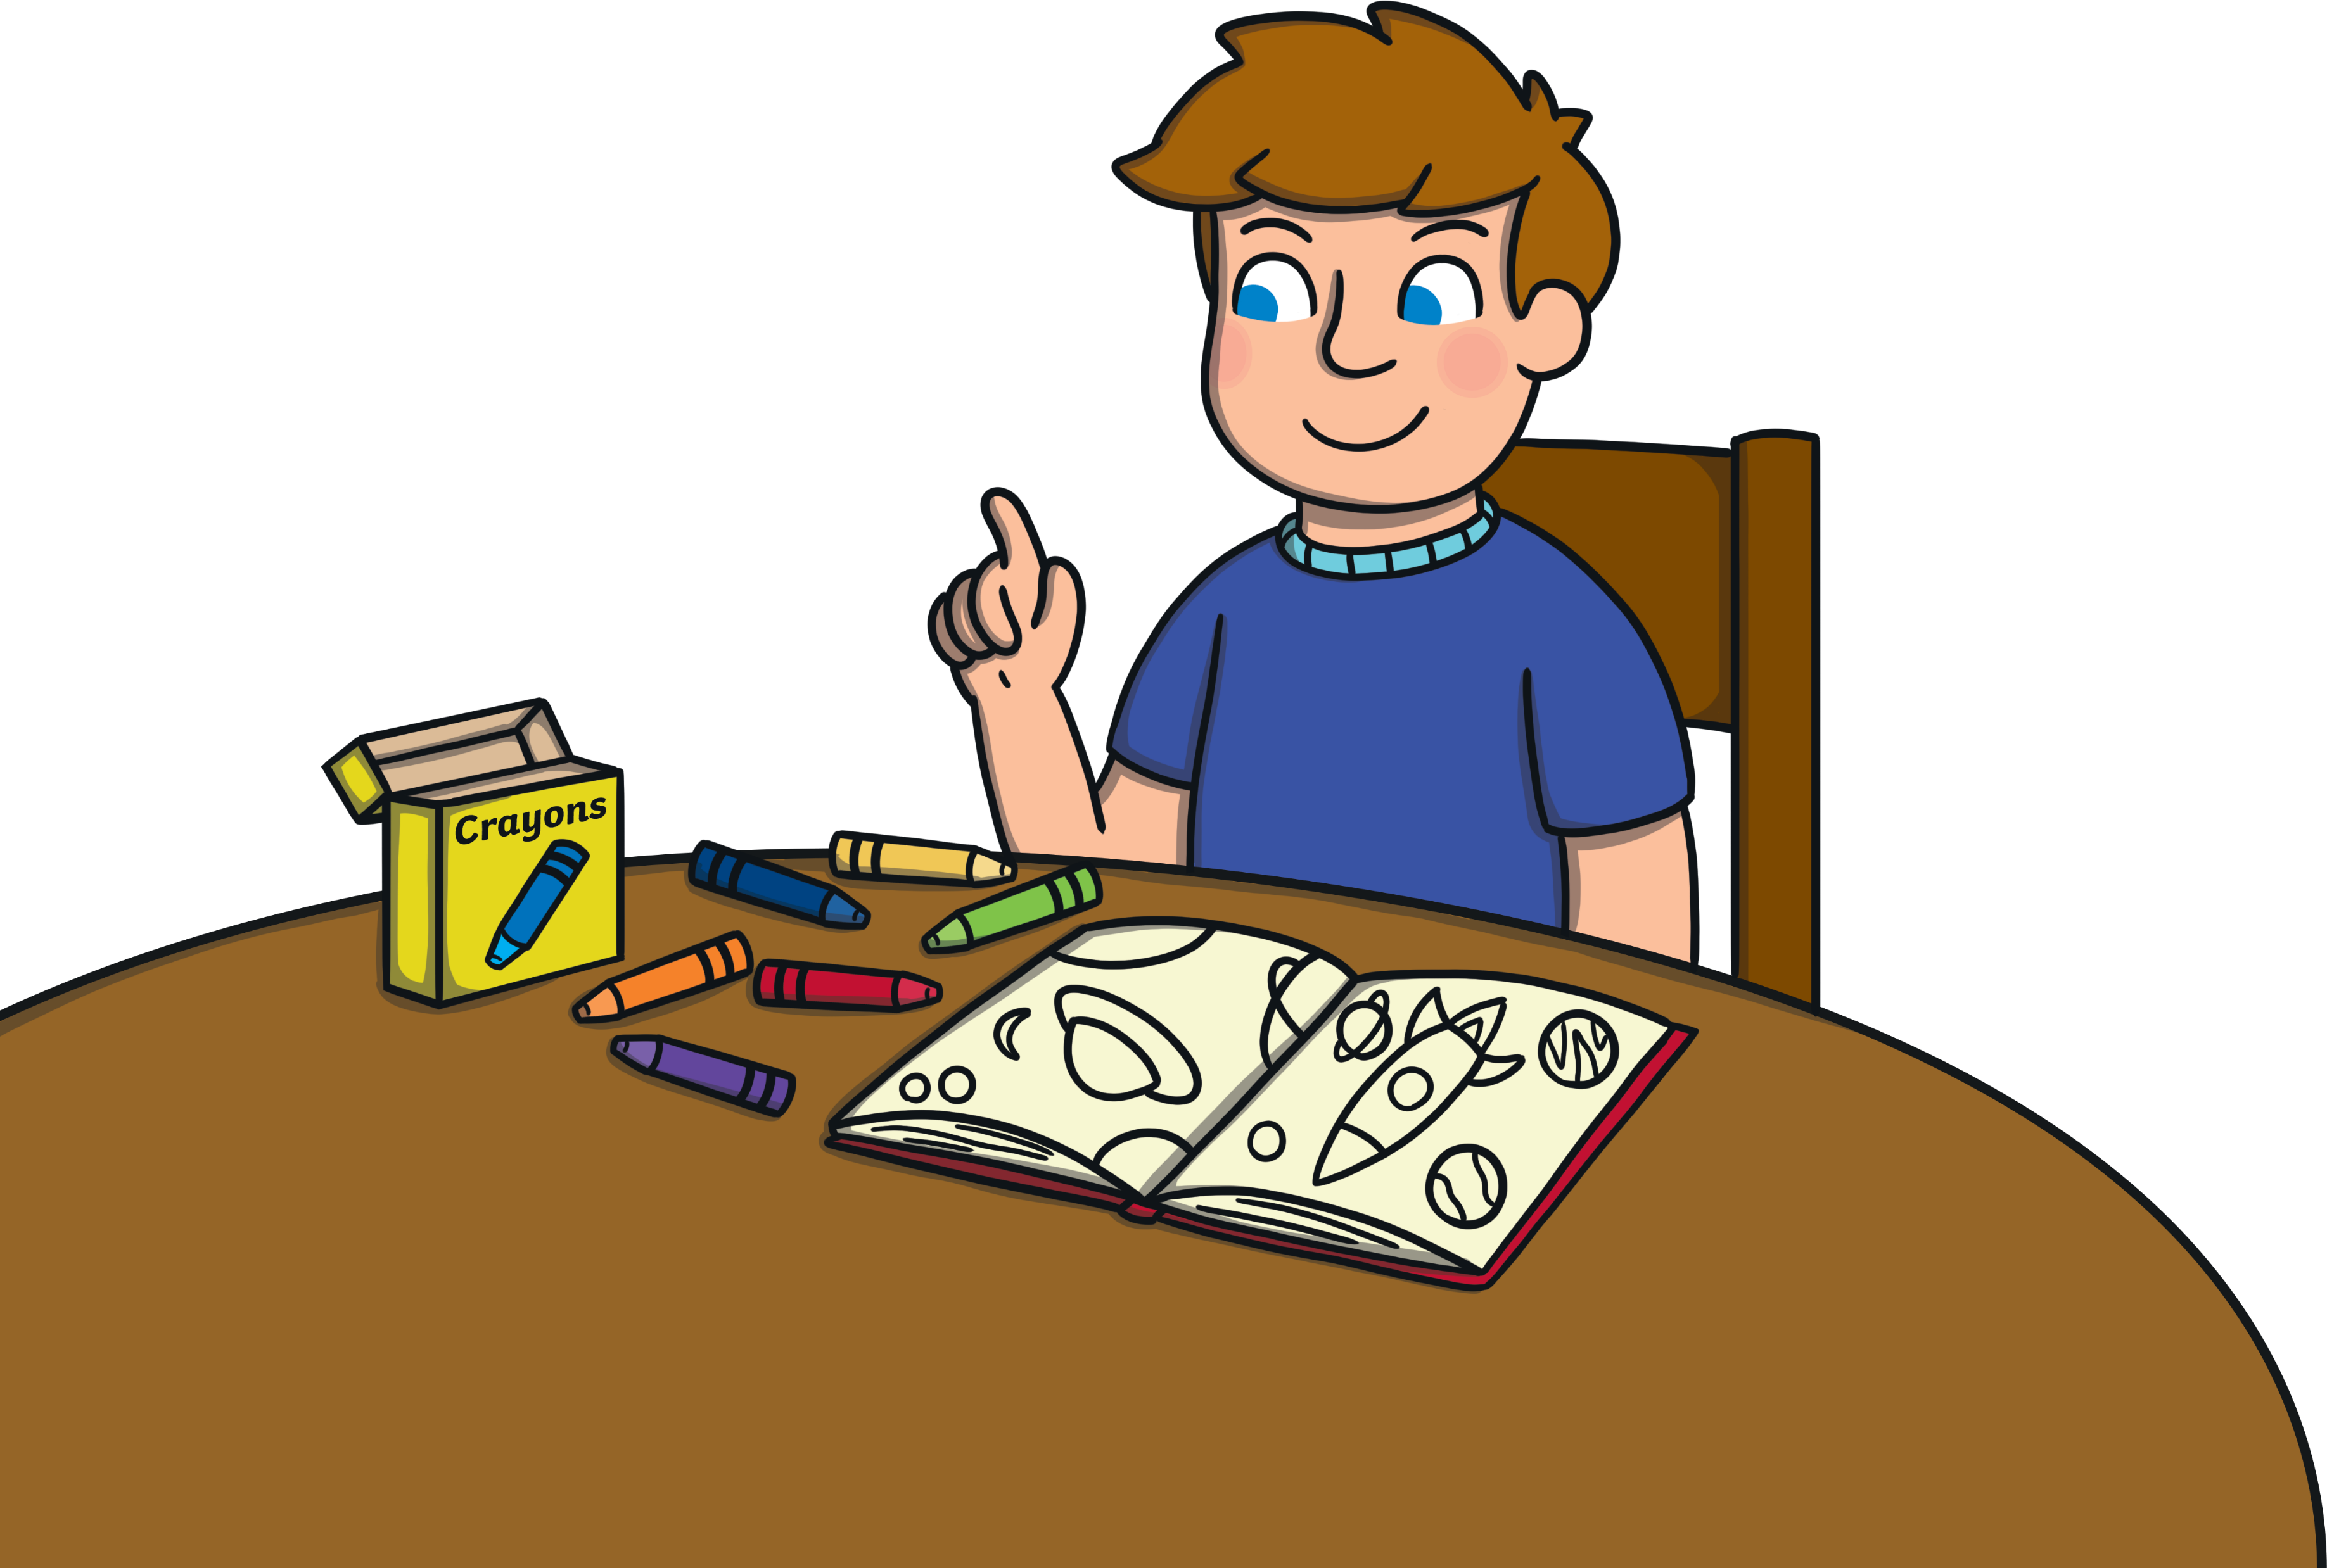



How Could You Celebrate
World Book Day?
Design a book cover, poster, bookmark or bunting to decorate your house.

Slide 8
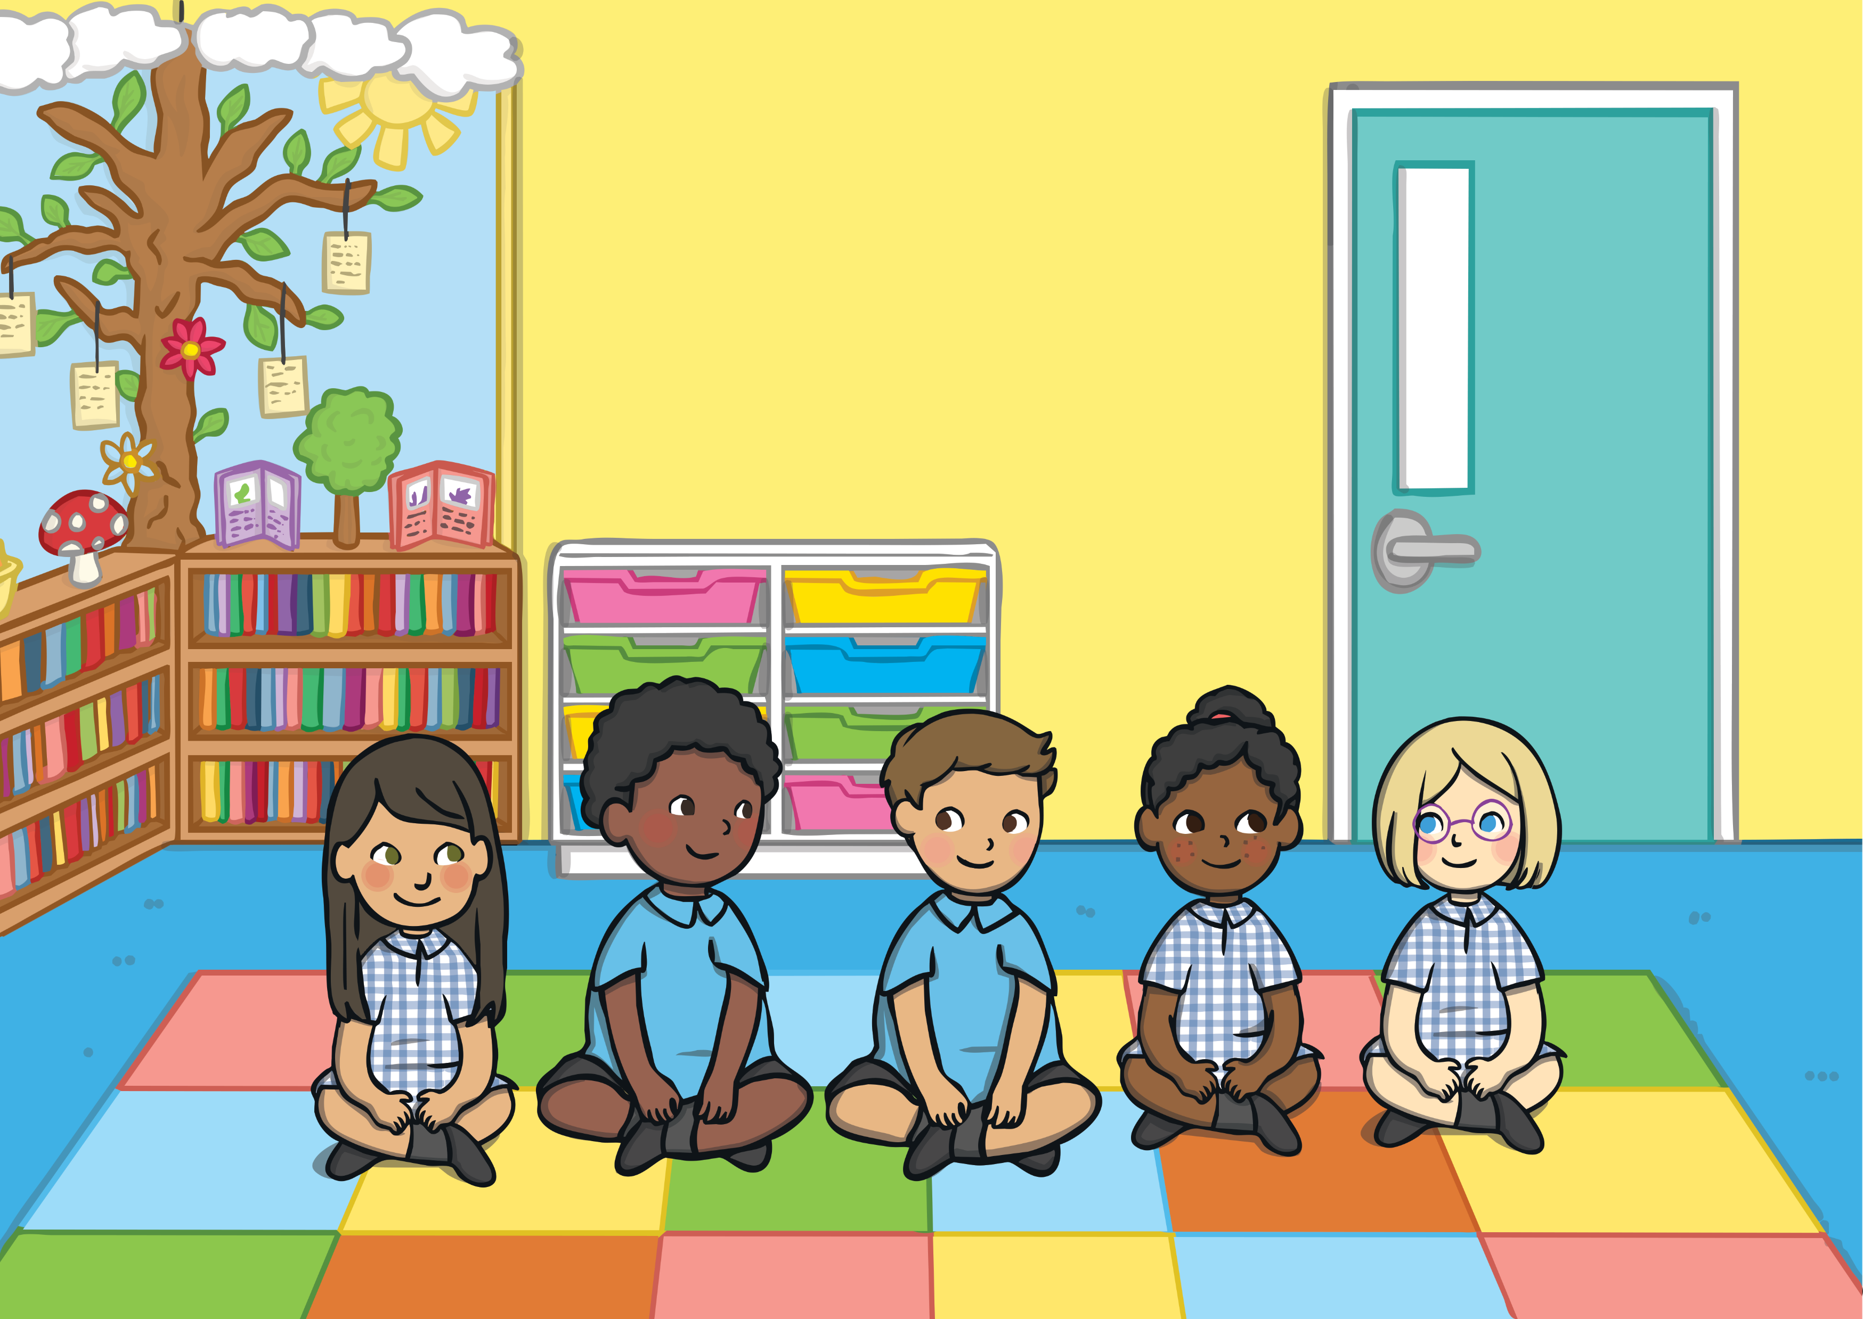
How Could You Celebrate
World Book Day?
Share a Story - share a story for 10 minutes a day. Perhaps you could try to keep it up for a whole month… or longer!

Slide 9
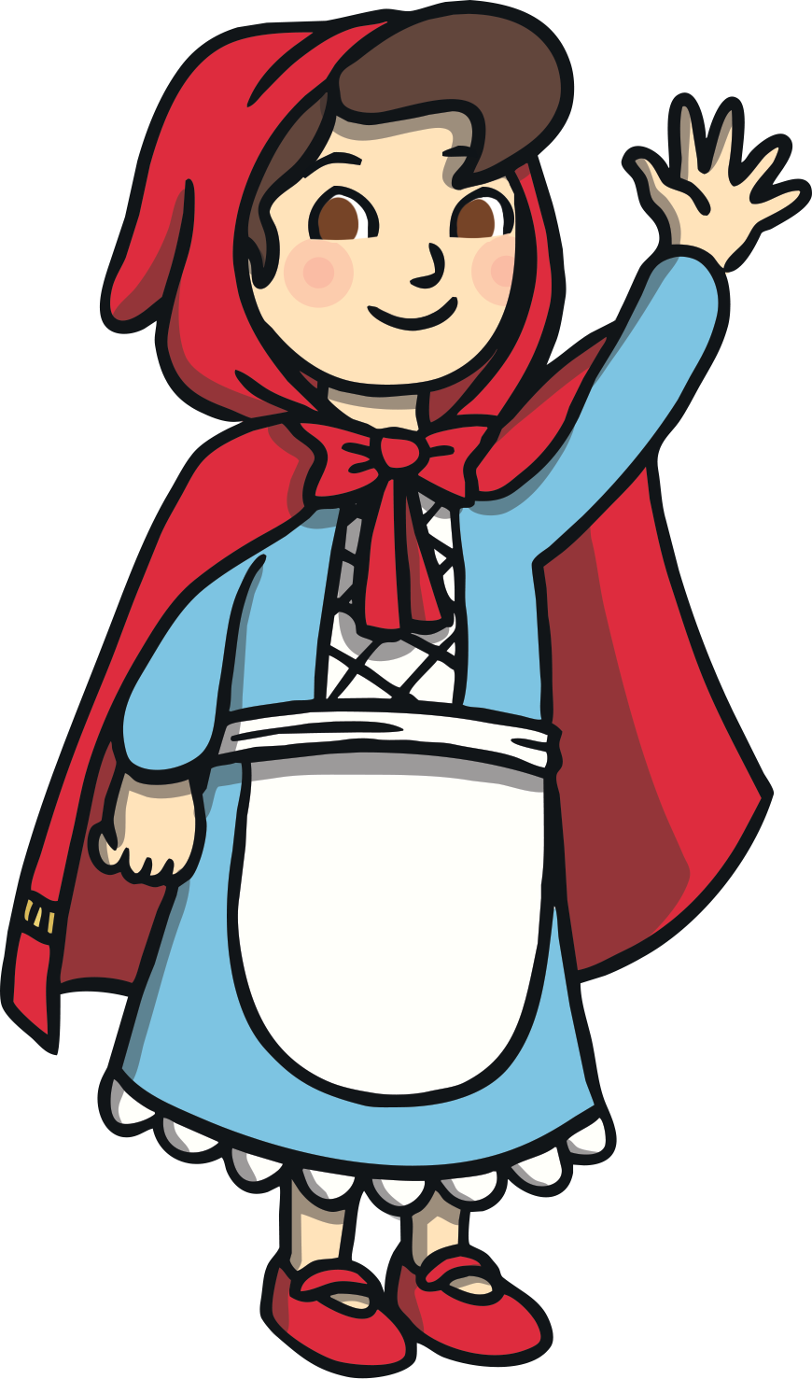
Can You Guess the Character and Book?
?
Use the clues below to identify the character and say which book they are from:
Clue 1
I carry a basket.
I’m not keen on wolves.
Clue 2
?
My favourite colour is red.
Clue 3
I’ve got a poorly grandma.
Clue 4
?
Answer
Little Red Riding Hood from Little Red Riding Hood

Slide 10
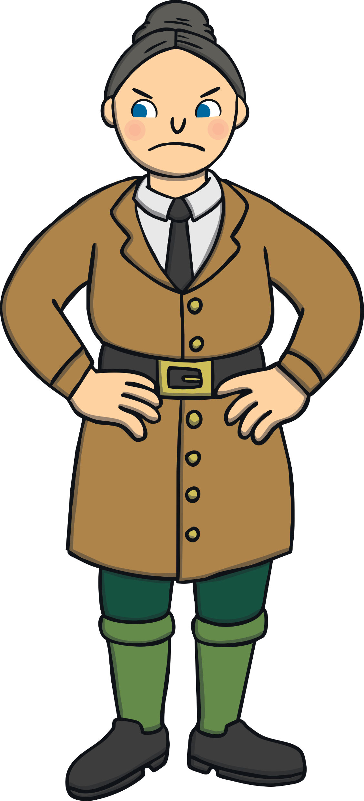
Can You Guess the Character and Book?
?
Use the clues below to identify the character and say which book they are from:
I am very strict.
I’m good at the hammer throw.
Clue 1
Clue 2
?
I hate pigtails.
I might put you in the ‘chokey’.
Clue 3
Clue 4
?
Miss Trunchbull from Matilda by Roald Dahl
Answer

Slide 11
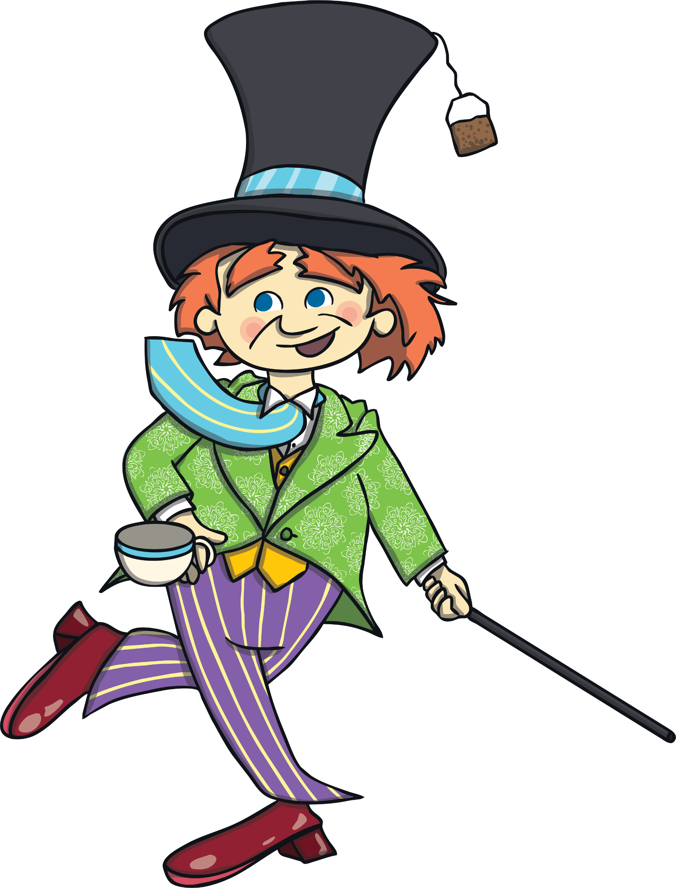
Can You Guess the Character and Book?
?
Use the clues below to identify the character and say which book they are from:
Some might say I’m crazy.
Where I live is
‘wonder’ ful.
Clue 1
Clue 2
?
I like to host parties.
Clue 4
Clue 3
I’m friends with a dormouse and a hare.
?
Answer
The Mad Hatter from Alice’s Adventures in Wonderland

Slide 12
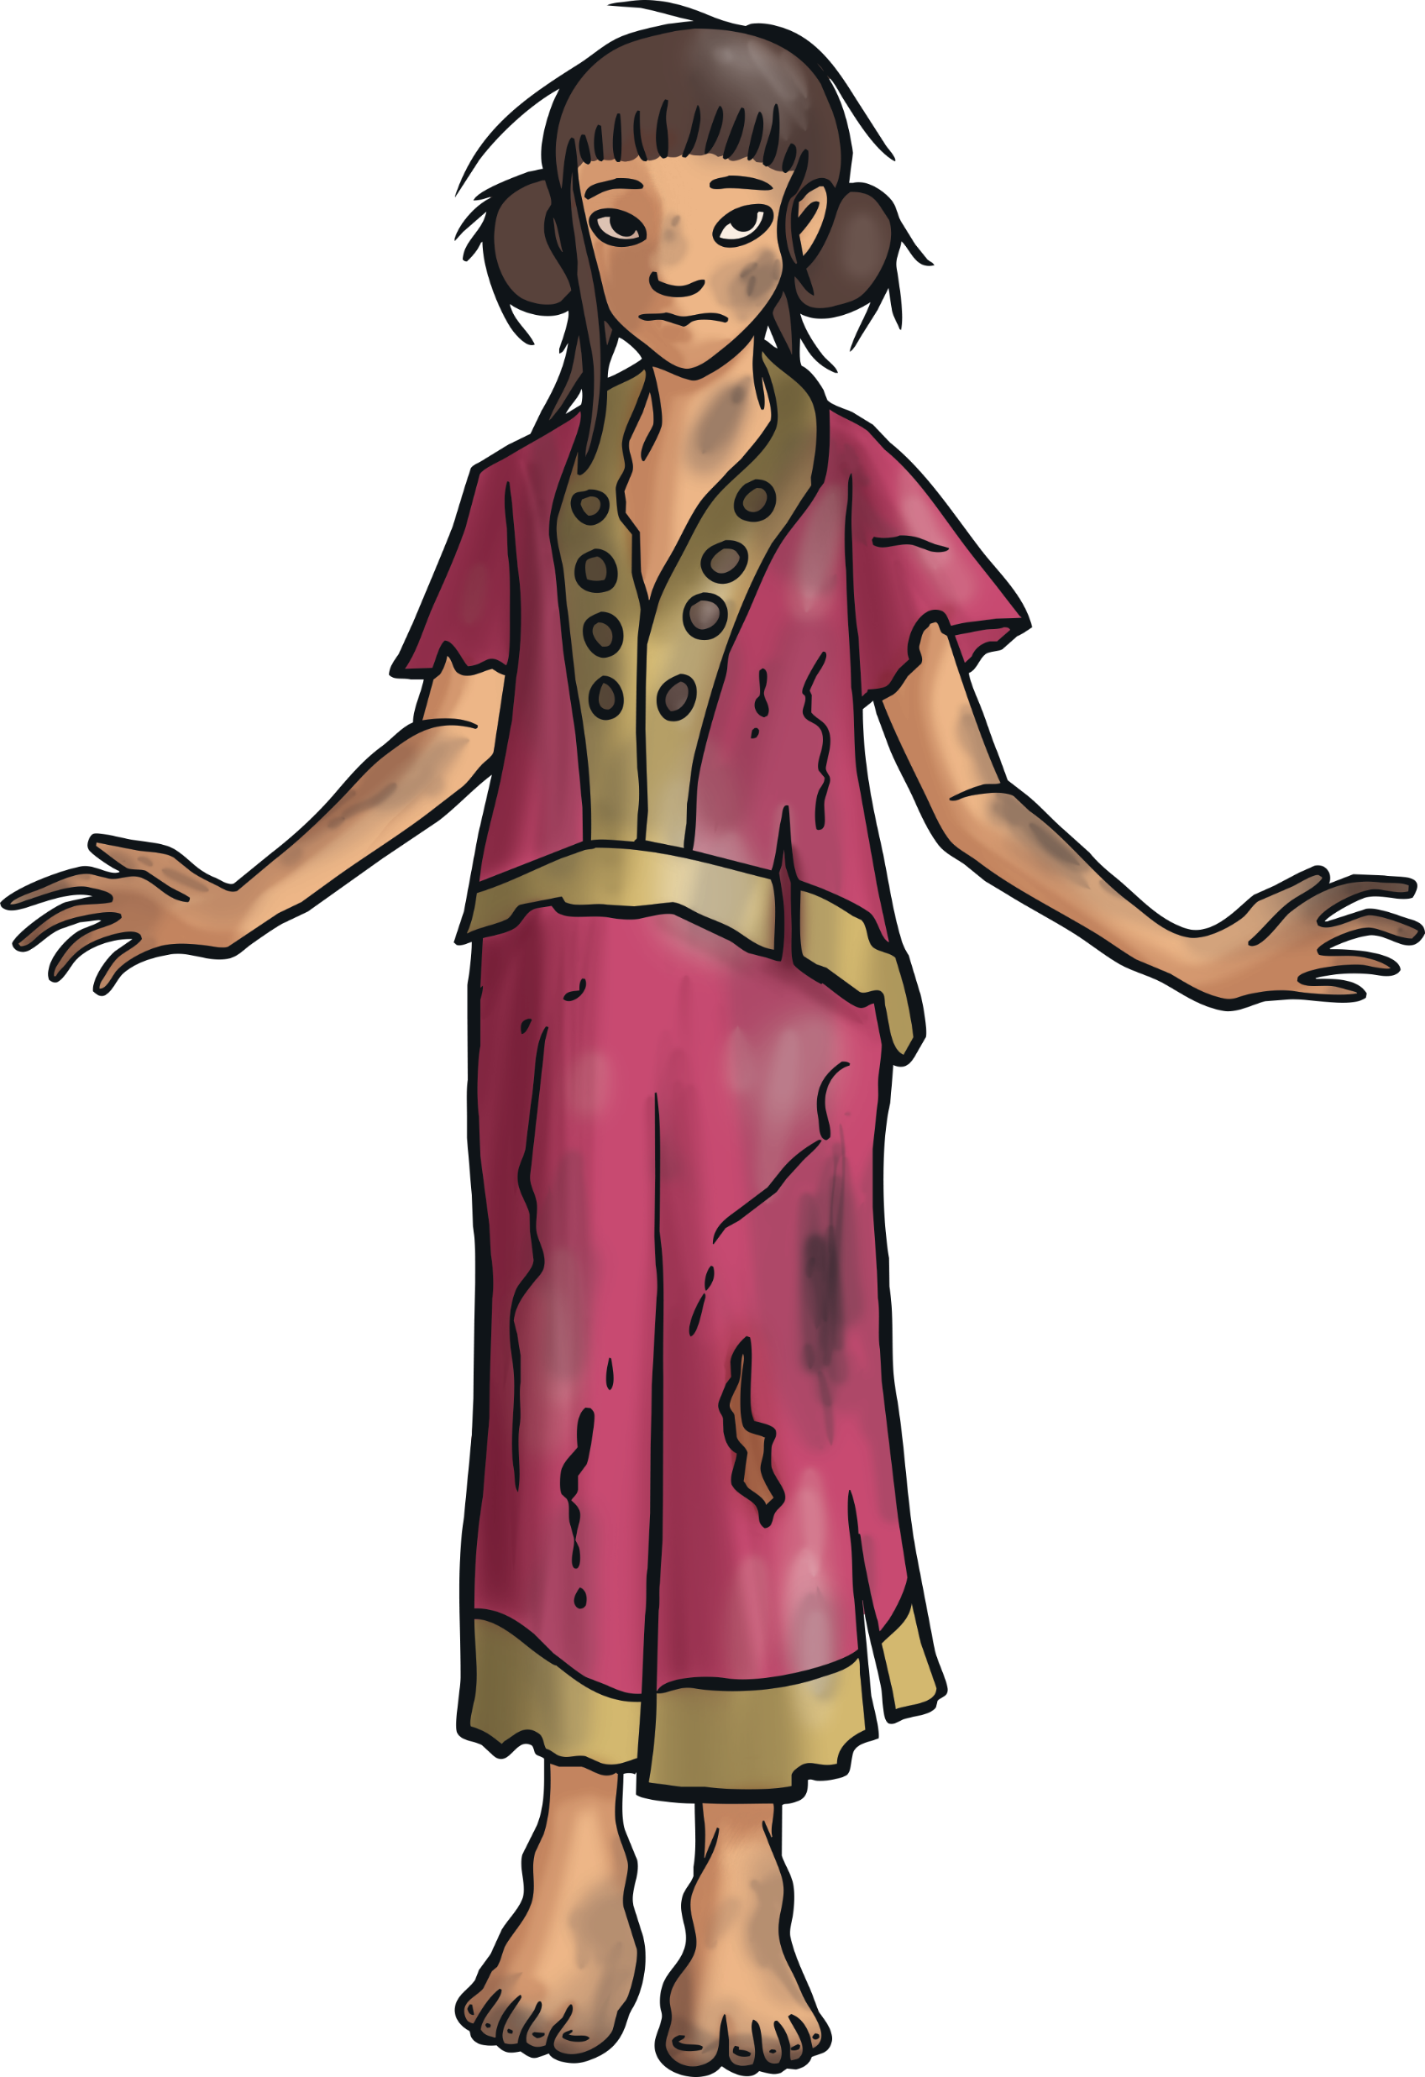
Can You Guess the Character and Book?
?
Use the clues below to identify the character and say which book they are from:
I have talent, perseverance and luck.
I know a talking white elephant.
Clue 1
Clue 2
?
My father is called Lalchand.
I want to make fireworks.
Clue 3
Clue 4
?
Answer
Lila from The Firework Maker’s Daughter

Slide 13
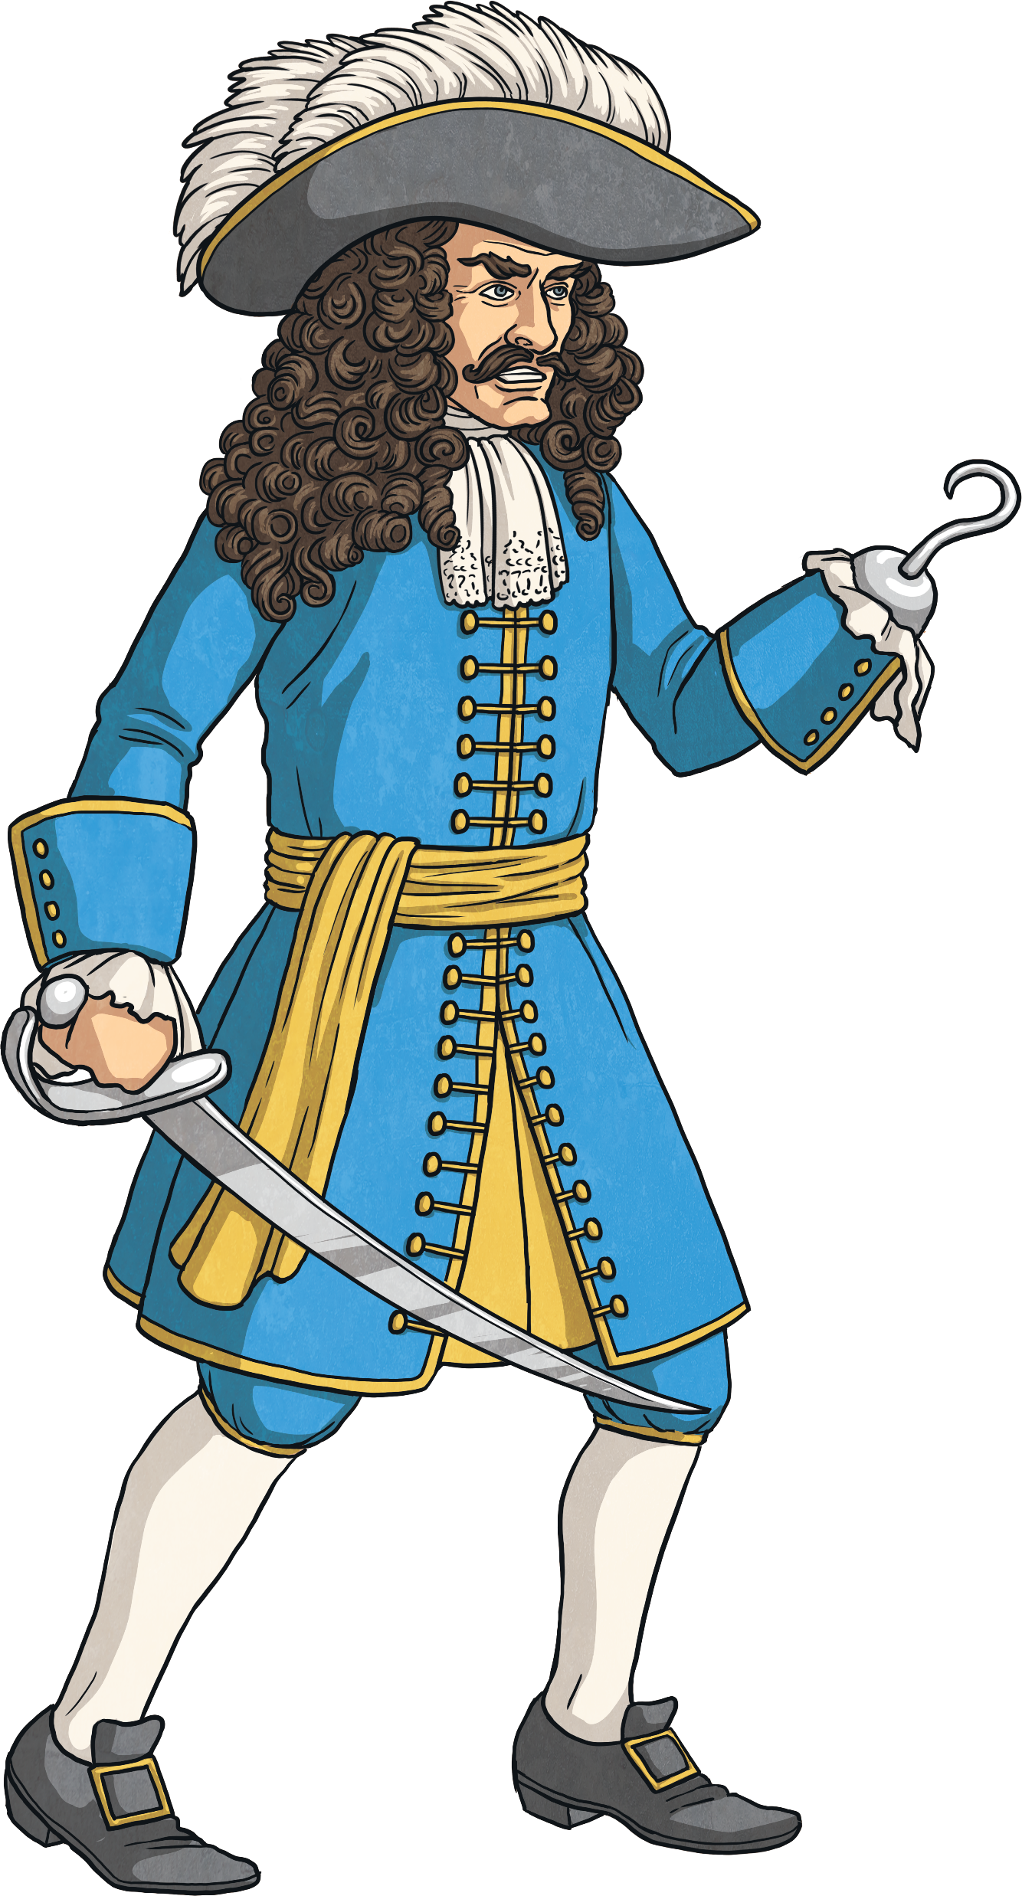
Can You Guess the Character and Book?
?
Use the clues below to identify the character and say which book they are from:
I don’t like crocodiles.
I only have one hand.
Clue 1
Clue 2
?
I live in Neverland.
I might tell you that you have ‘bad form’.
Clue 3
Clue 4
?
Answer
Captain Hook from Peter Pan

Slide 14
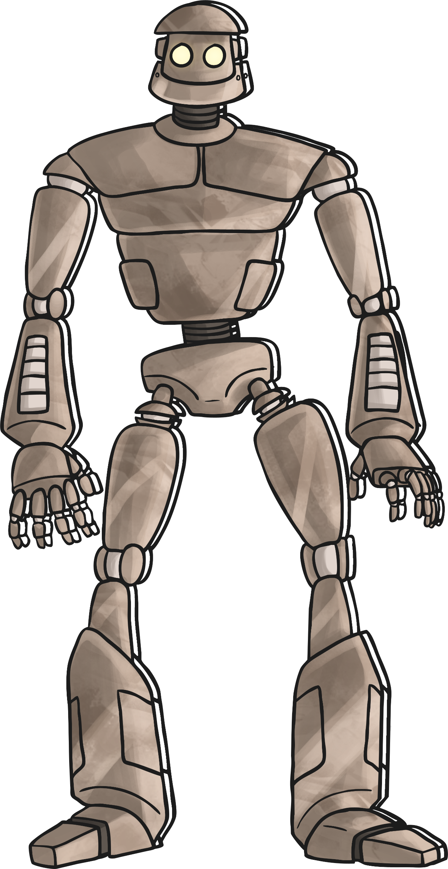
Can You Guess the Character and Book?
?
Use the clues below to identify the character and say which book they are from:
I like to eat tractors and diggers.
I am very large.
Clue 1
Clue 2
?
I have a friend called Hogarth.
I took on the ‘Space-Bat-Angel-Dragon’.
Clue 3
Clue 4
?
Answer
Iron Man from The Iron Man

Slide 15
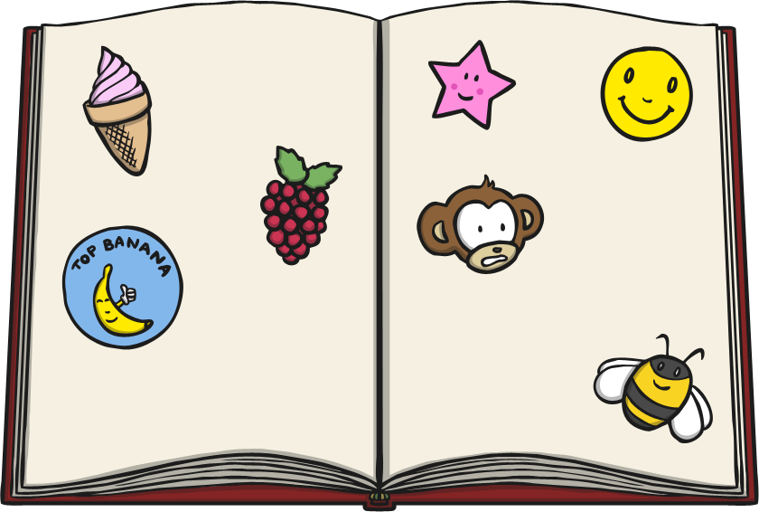
Get a Free Book with a
£1 Book Token!
£1 Book Tokens are sent to schools all over the country for World Book Day every year.
That’s 15 million £1 World Book Day book tokens!
When you get your £1 Book Token from school, you can take it to a bookshop and swap it for one of the 15 World Book Day books!
That’s right – you can choose a
book for free with your token!

Slide 16
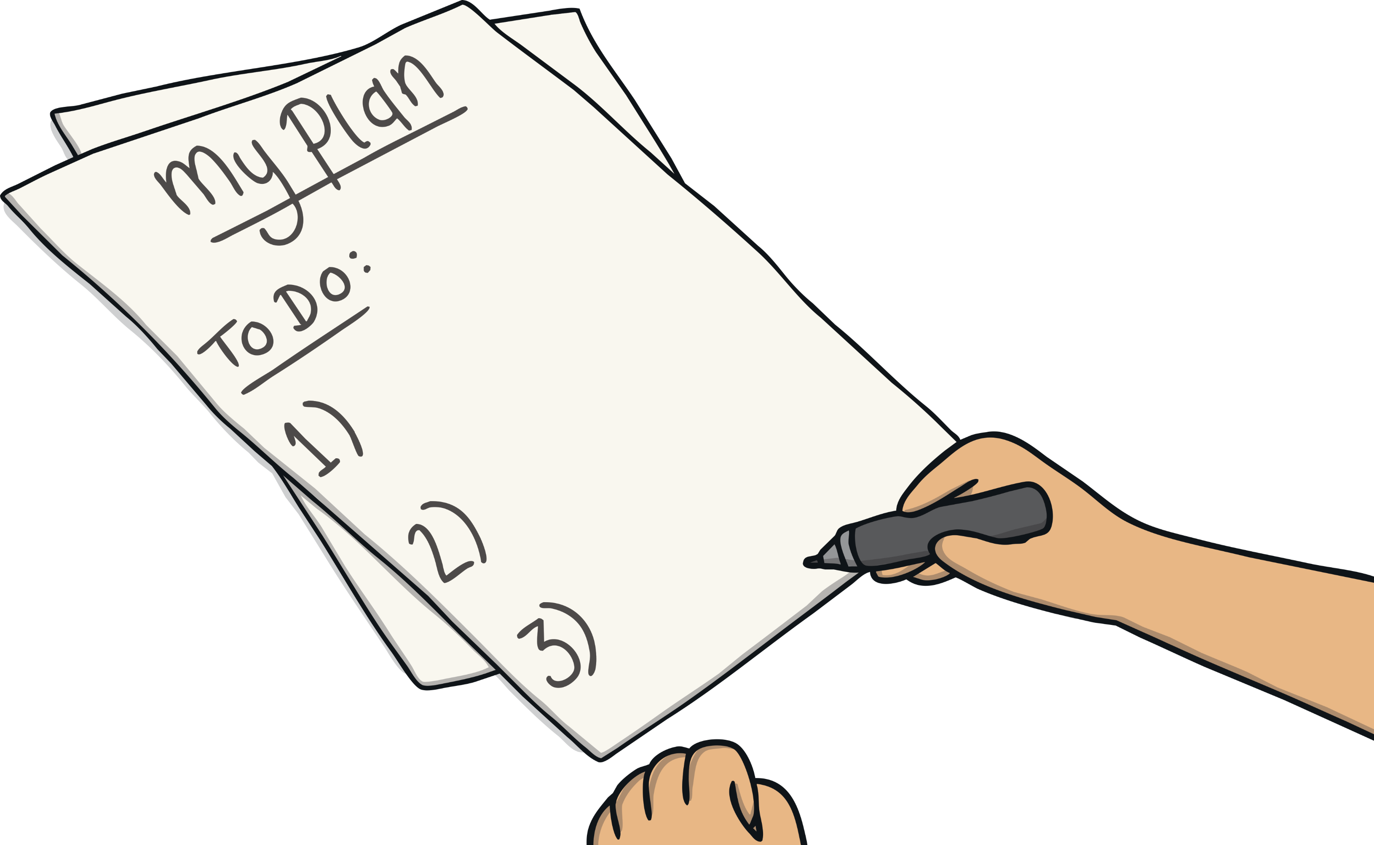
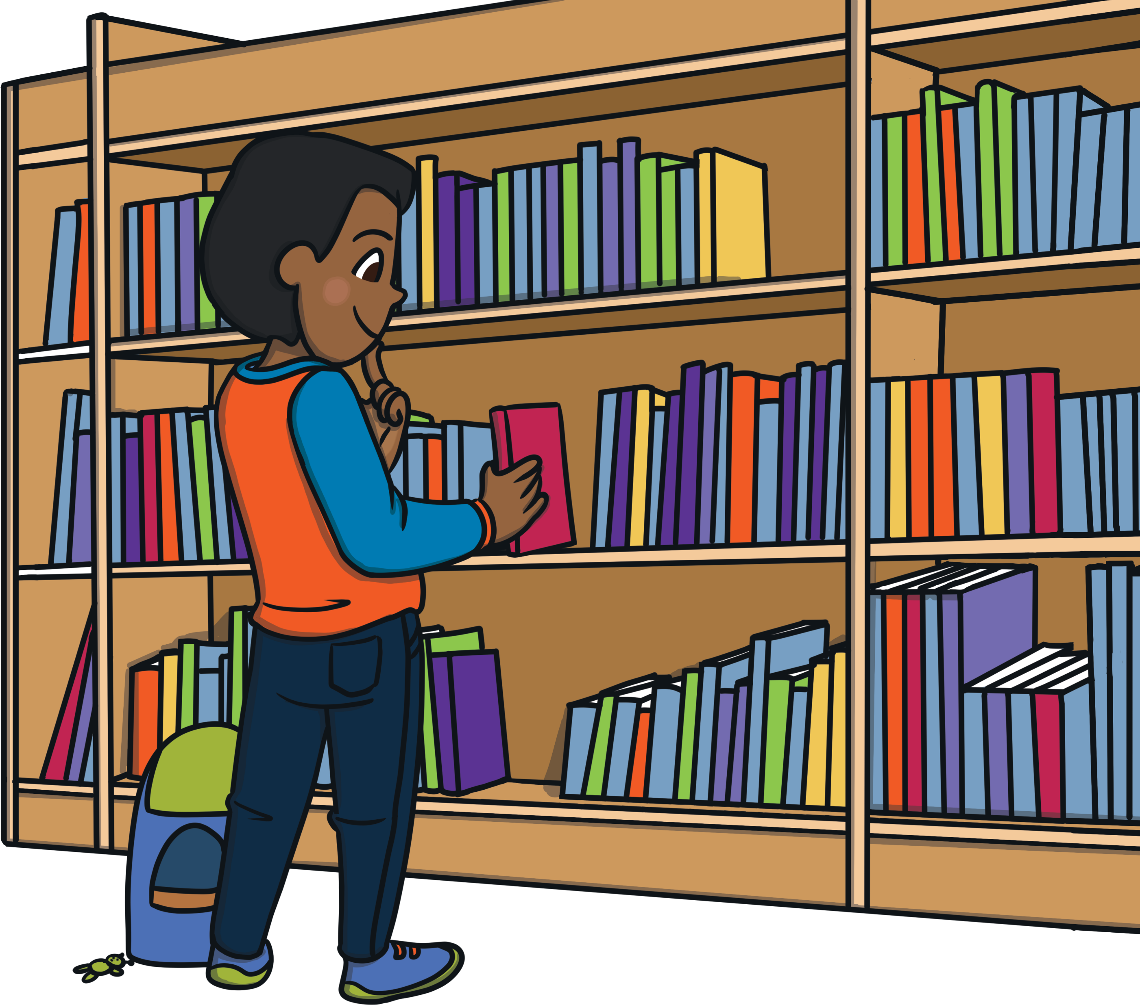
Your World Book Day
Challenges:
Design a new cover for your favourite book.
Hold a competition to guess how many books you have at home.
Write a review of your favourite book.
Design a poster to celebrate World
Book Day at home.
Make a list of different activities you’d like to do to celebrate World Book Day. Who can
make the longest list?

Slide 17

