Slide 1


Geography
Exploring Eastern Europe
Year One
Geography | Year Five| Exploring Eastern Europe| Continents, Countries and Cities

Slide 2
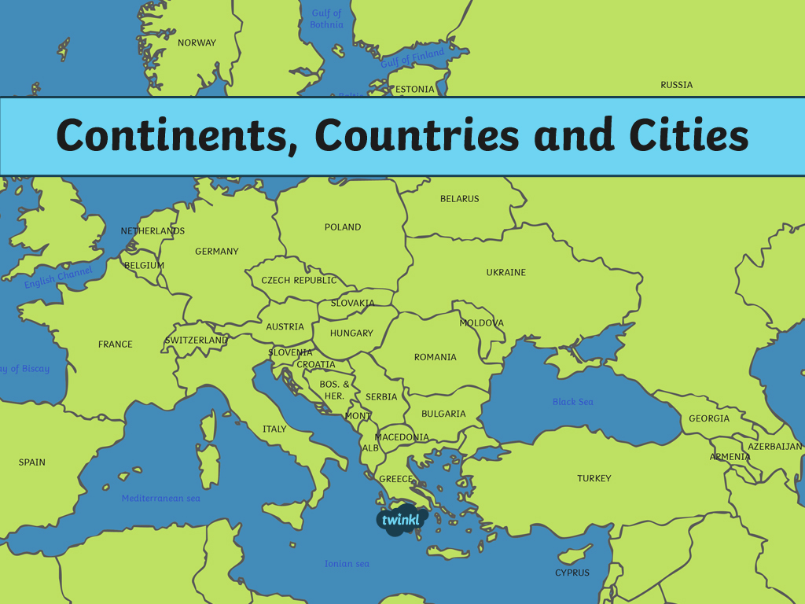

Slide 3
Aim
I can identify the countries of Europe.
I can identify countries and capital cities in Europe.
Success Criteria
I can tell you that a continent is a large landmass.
I can tell you that continents are groups of countries.
I can identify some countries in Europe.
I can use an atlas to find the names of countries.
I can use an atlas to find names of cities.

Slide 4
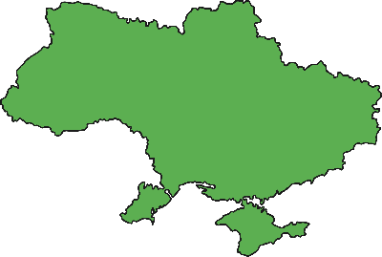
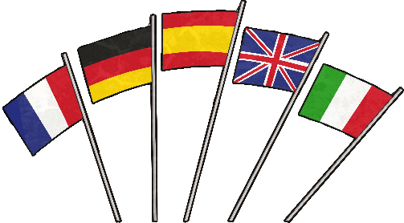
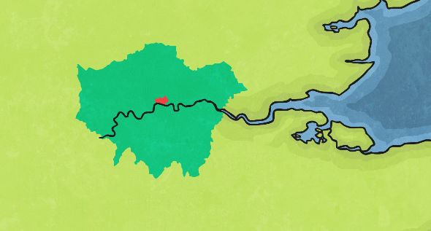
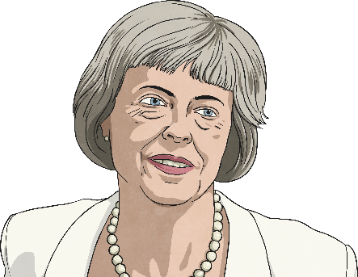
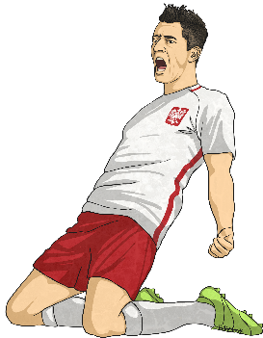


What do you know about Europe?
Tell you partner what you already know about Europe.
Countries
Any flags associated with Europe
Capital cities
Political leaders
Sports teams
Any other information

Slide 5
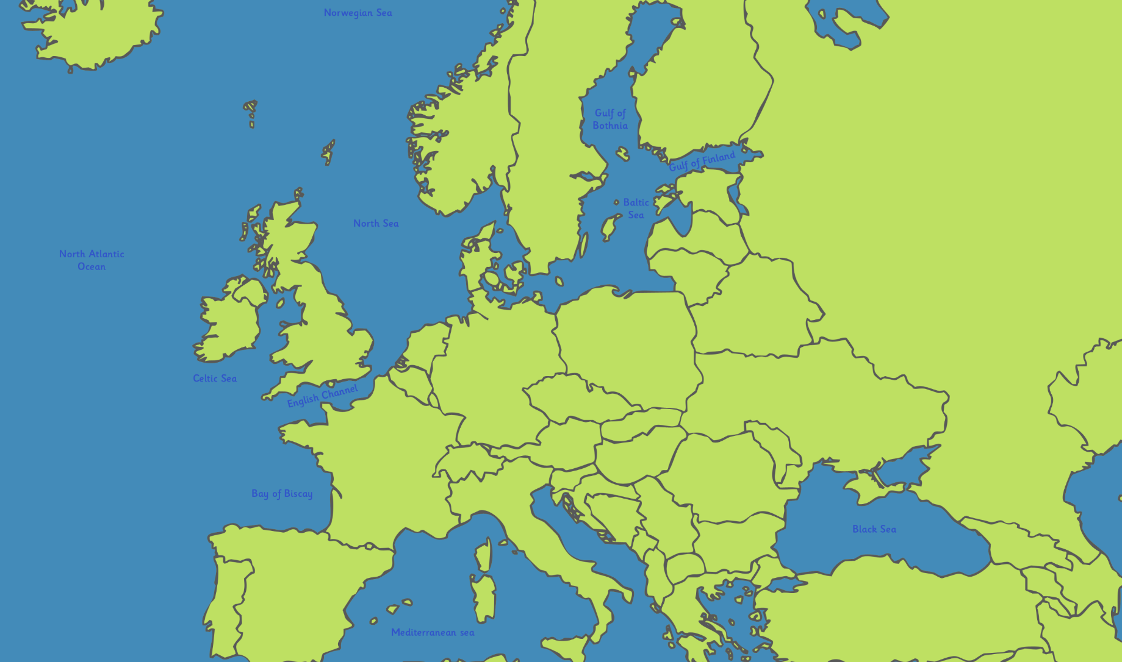
European Countries
Use an atlas to find the names of the places shown on this map.

Slide 6
European Countries
Use an atlas to find the names of the places shown on this map.
What do you notice about Sardinia?
Finland
Poland
France
Sardinia

Slide 7
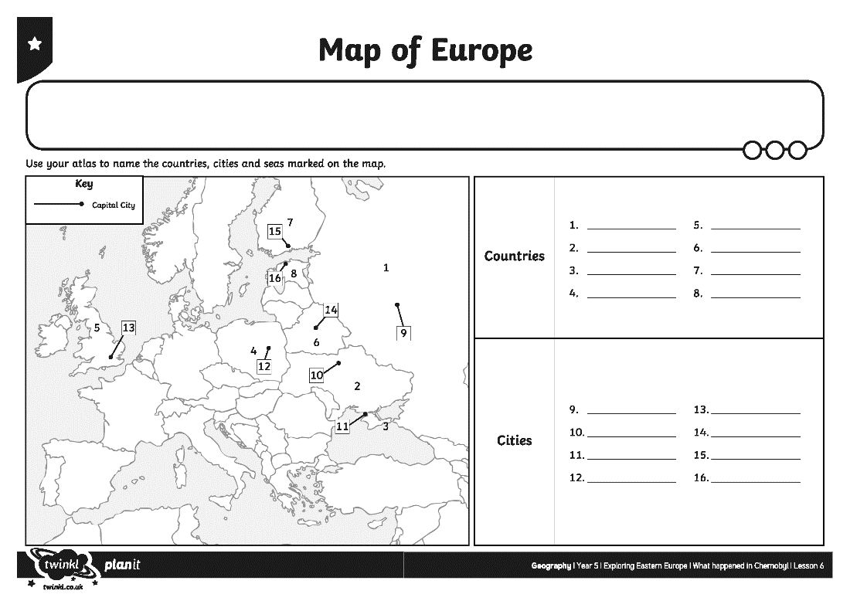
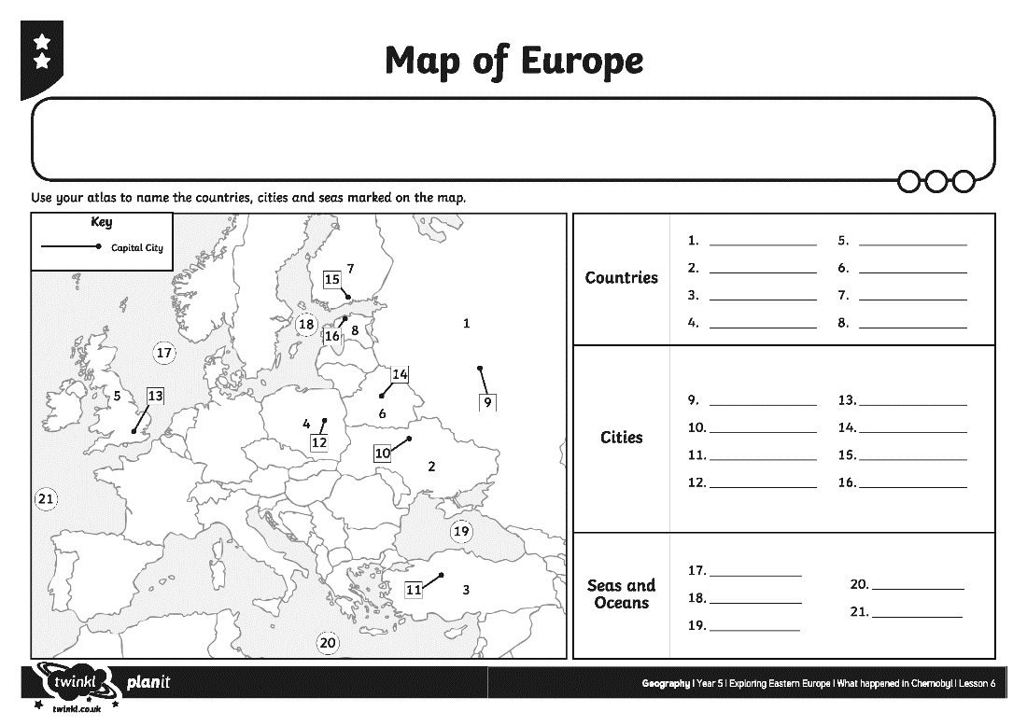
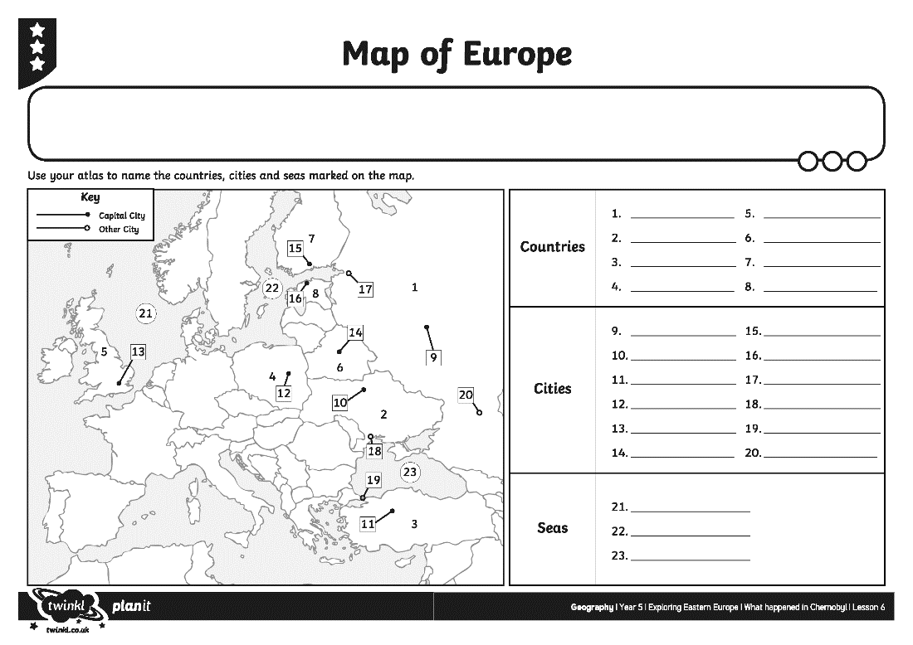
Countries and Cities
Use your atlas to identify and label the countries and cities of Europe.

Slide 8


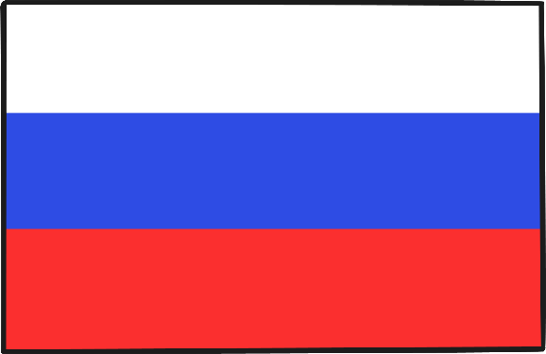
Giving Directions
East
What direction would you travel if you travelled between these countries?
What other countries would you pass through?
Passing through Belarus
Russia
Belarus
Poland
to
Poland
Russia
Next Slide

Slide 9
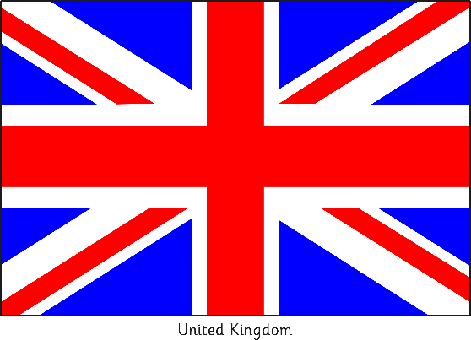
Giving Directions
West
What direction would you travel if you travelled between these countries?
What other countries would you pass through?
Passing through Germany and the Netherlands
UK
Netherlands
Poland
to
Germany
Poland
UK
Next Slide

Slide 10



Giving Directions
North
What direction would you travel if you travelled between these countries?
What other countries would you pass through?
Passing through Romania and Ukraine
Belarus
Ukraine
to
Romania
Bulgaria
Bulgaria
Belarus
Next Slide

Slide 11


Giving Directions
South-West
What direction would you travel if you travelled between these countries?
What other countries would you pass through?
Passing through Poland
Belarus
Poland
to
Czech Republic
Belarus
Czech Republic
Next Slide

Slide 12

Aim
I can identify the countries of Europe.
I can identify countries and capital cities in Europe.
Success Criteria
I can tell you that a continent is a large landmass.
I can tell you that continents are groups of countries.
I can identify some countries in Europe.
I can use an atlas to find the names of countries.
I can use an atlas to find names of cities.

Slide 13
