Slide 1
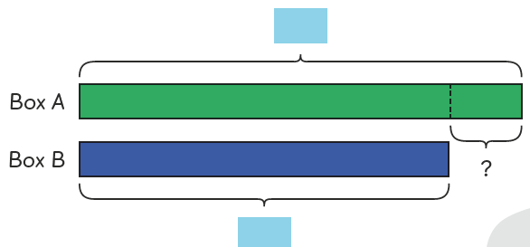
Using Bar Models
F C Down January 2018

Slide 2
Bar Models
What are ‘bar models’?
How are bar models used?
What do bar models look like across key stages?

Slide 3
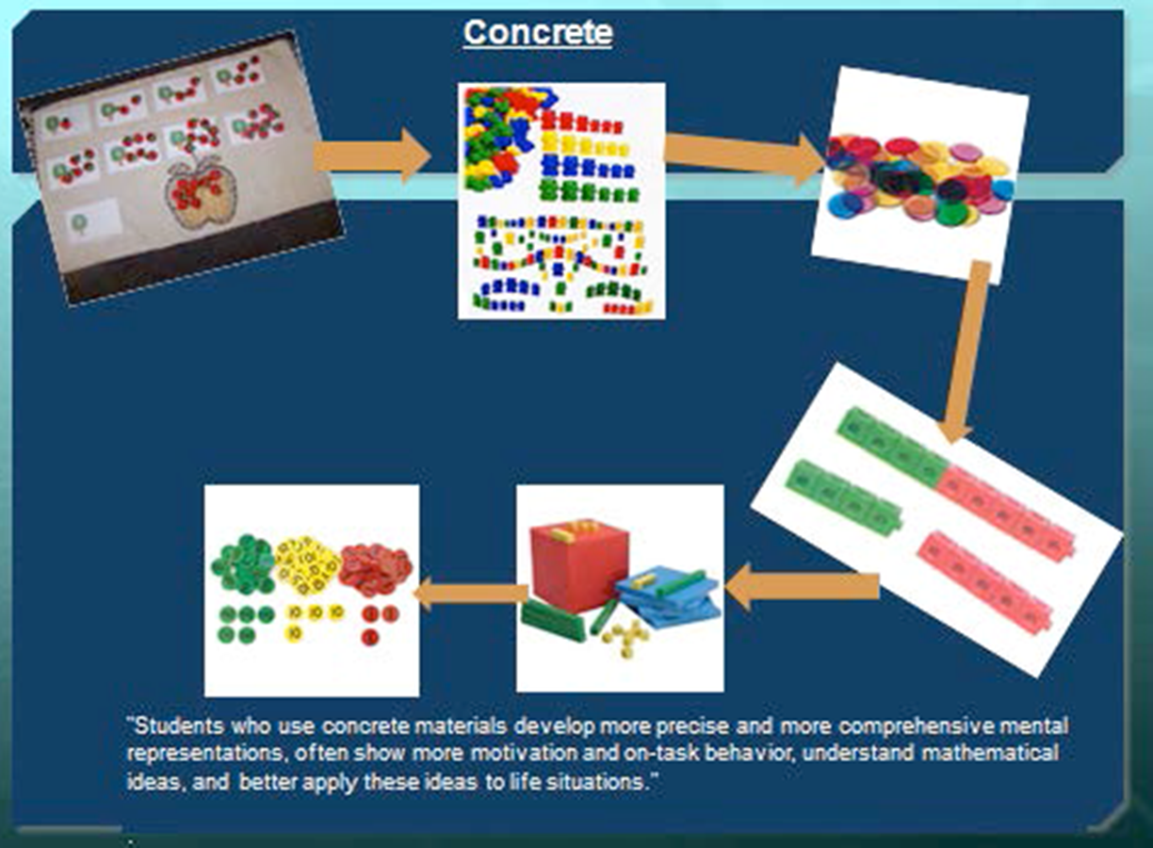

Slide 4
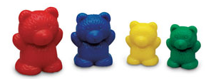
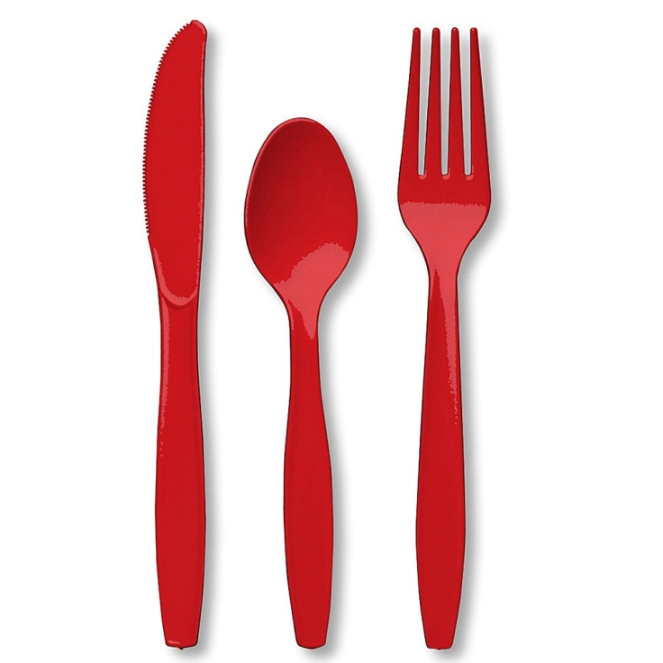
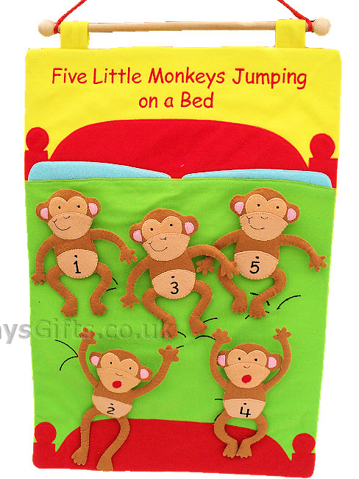
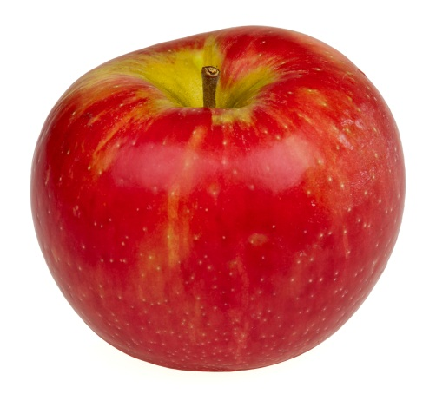
Start with the “real thing” …
Notes:
At first children need the real thing (or close to it!) to see and touch ~ to manipulate. They need a real story to hang the abstract maths story on. So if 3 bears are at the teddy bears picnin and 3 more come along How many are there are now comes before 3 + 3 = 2

Slide 5
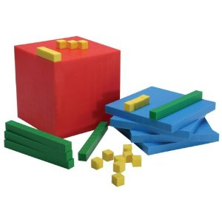
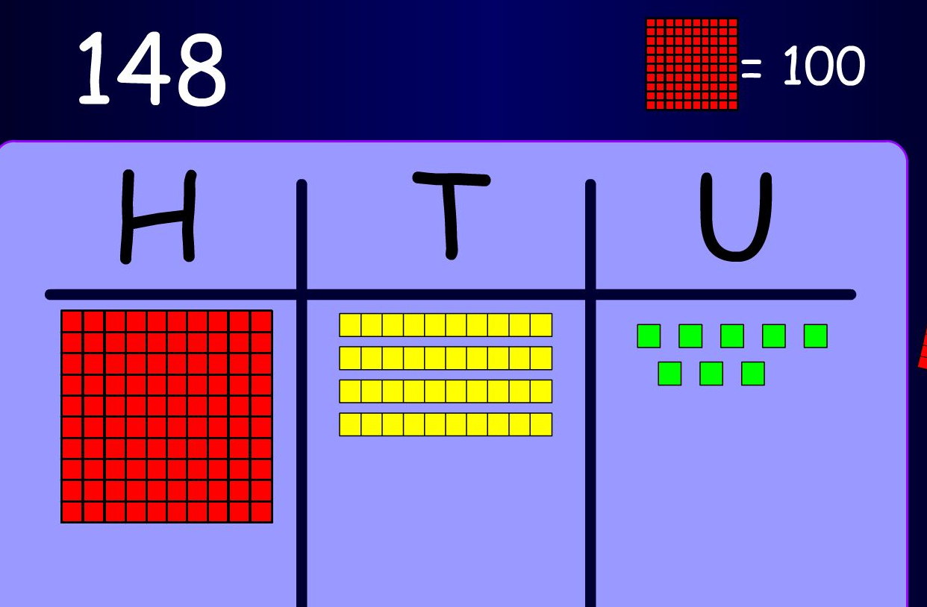
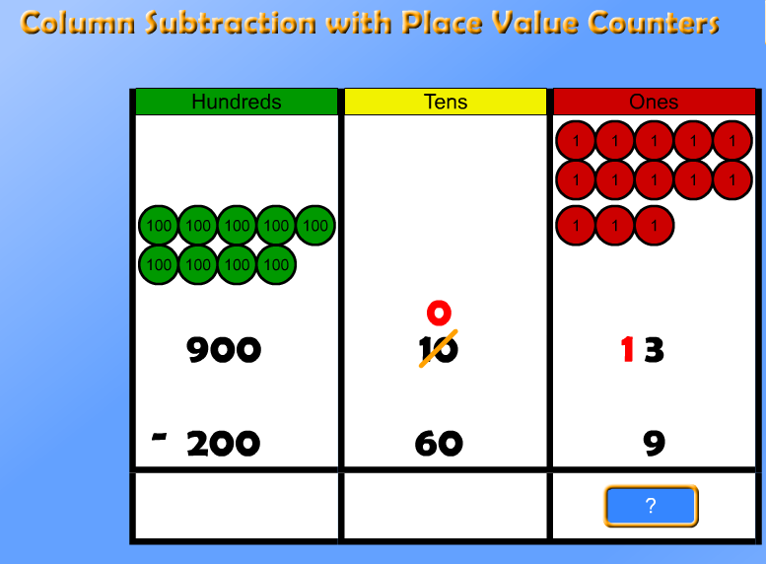
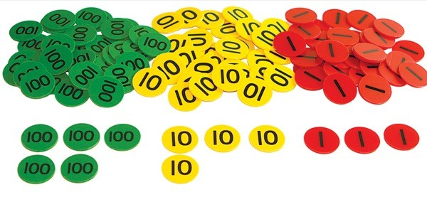
And finally… place value rods and counters
Notes:
These resources have specific values i.e block =100 and is bigger than a 10 rod. The place value counters are the same size but have a different value
They are perfect for helping children understand what is going on when we use a formal method of calculation and children can draw their own reps too to help them calculate. If you visit y6 today, you will see place value counters being used to learn short division.

Slide 6
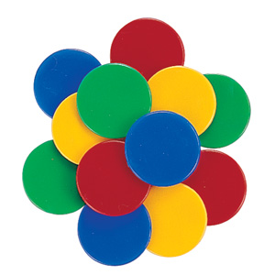
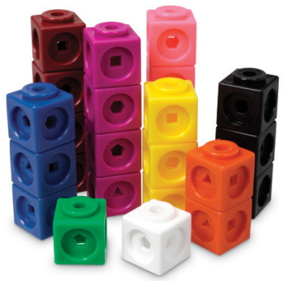
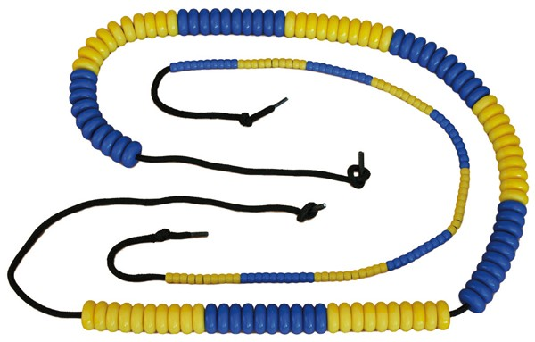
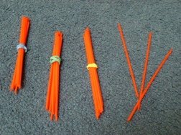
Then representations of the ‘real’ thing…
Notes:
Later children can use maths equipment to represent the real thing. Cubes can be joined into groups to learn how to multiply, beads can be moved along a string to add, subtract and count on. Straws can be grouped into bundles of tens and ones to learn place value. (3 tens and 3 ones = 33)

Slide 7
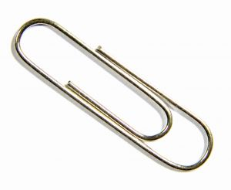
Take a Strip and a paperclip

Slide 8
Your Strip Represents 10p
Show me 5p
Show me 2p
Show me 8p
Show me 7p

Slide 9
Your Strip Represents 1 metre
Show me 50cm
Show me half a metre
Show me 20cm
Show me 80cm
Show me 70cm

Slide 10
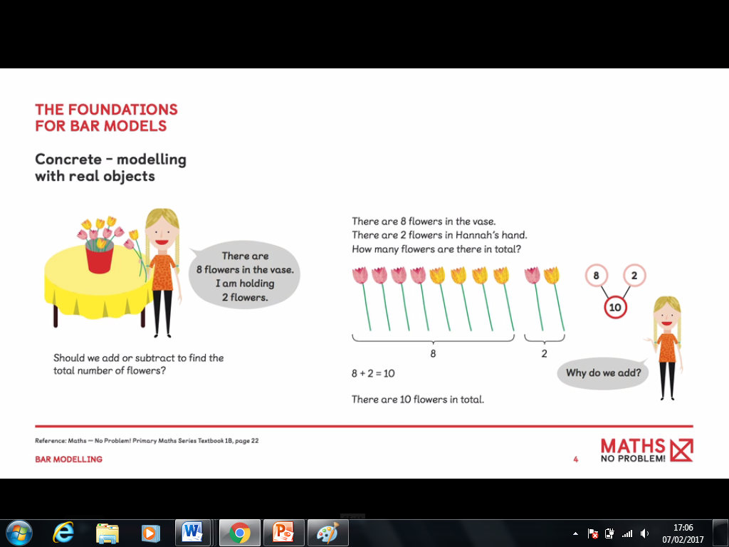

Slide 11
Foundation for bar models
Concrete – flowers cubes or counters
Pictorial – drawing cubes or counters
Abstract- part whole diagram

Slide 12
What Are Bar Models?
16
9
7
9
16
7
0
1
2
3
4
5
6
7
8

Slide 13


A Consistent Picture
2 of 20 = ?
Share 20 in the ratio 2:3
5
4 + 11 = ?
5 x 4 = ?
11
20
0
4
?
:
4
4
4
4
4

Slide 14
A Consistent Picture
4 + 11 = ?
15 - 4 = ?
?
15
4
11
4
?
5 x 4 = ?
20 ÷ 5 = ?
?
20
4
4
4
4
4
?
?
?
?
?
2 of 20 = ?
Share 20 in the ratio 2:3
5
20
20
?
?
?

Slide 15
When solving word problems, it is often not the calculation that children can’t do – rather they are not sure which calculation they need to do.
(NCETM, 2013)

Slide 16
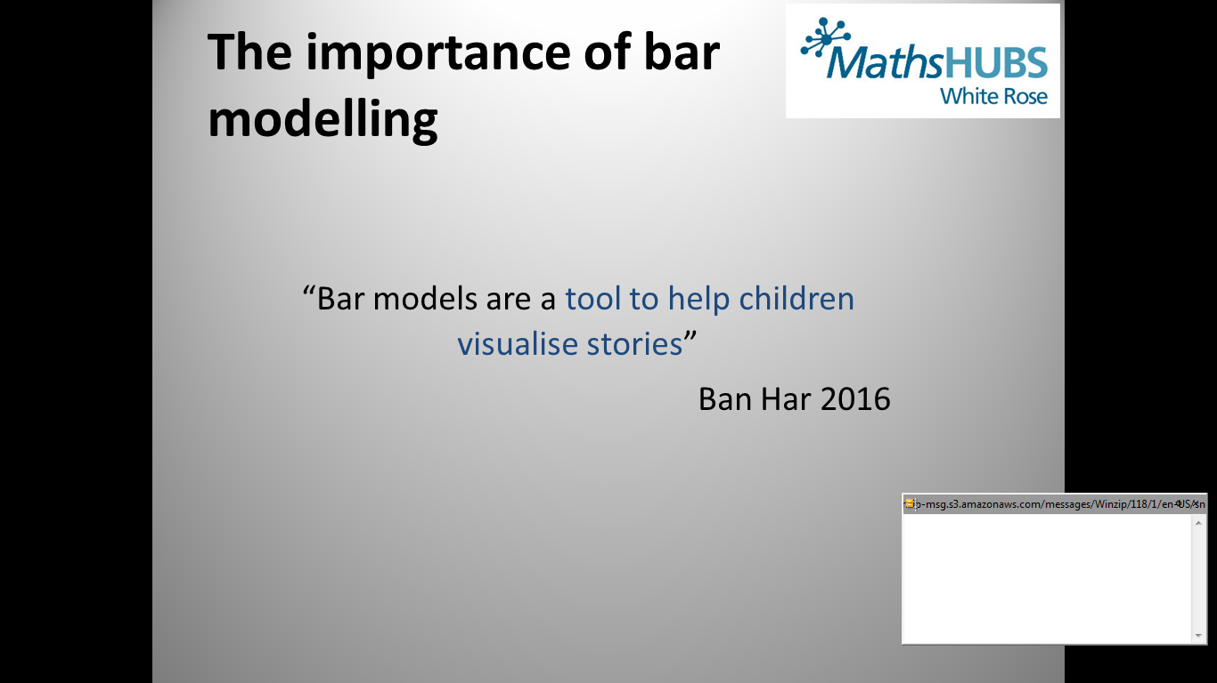
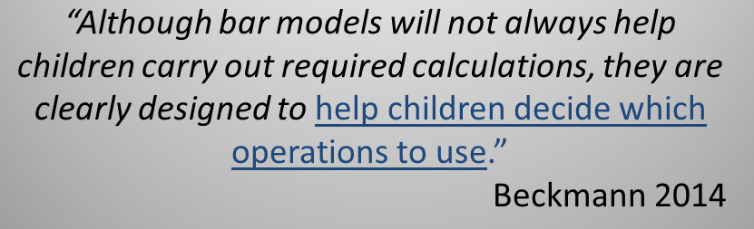
The Importance of Bar Modelling

Slide 17
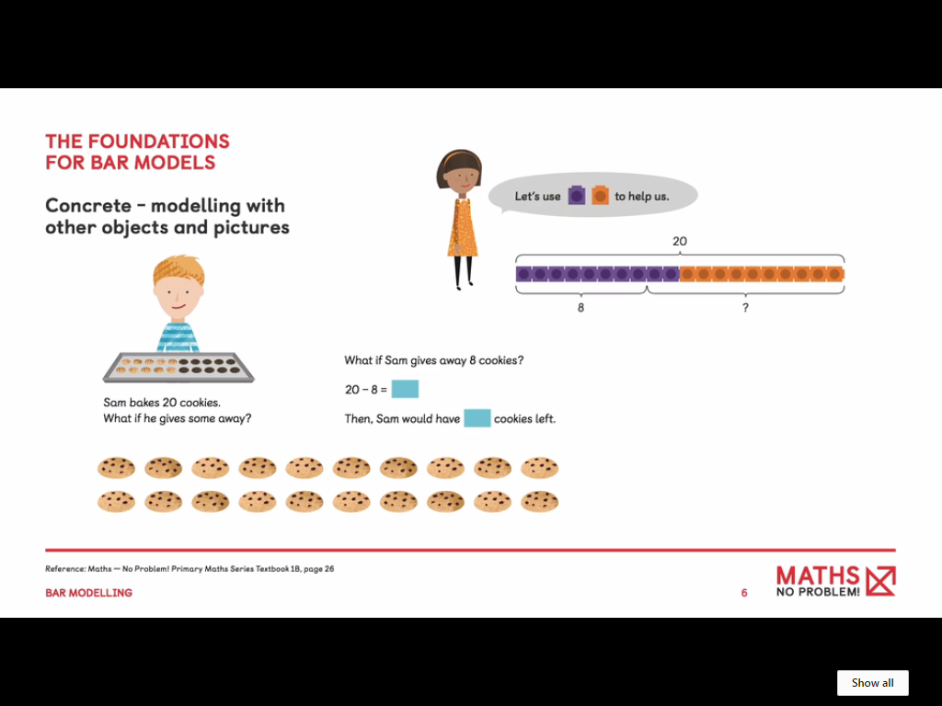

Slide 18
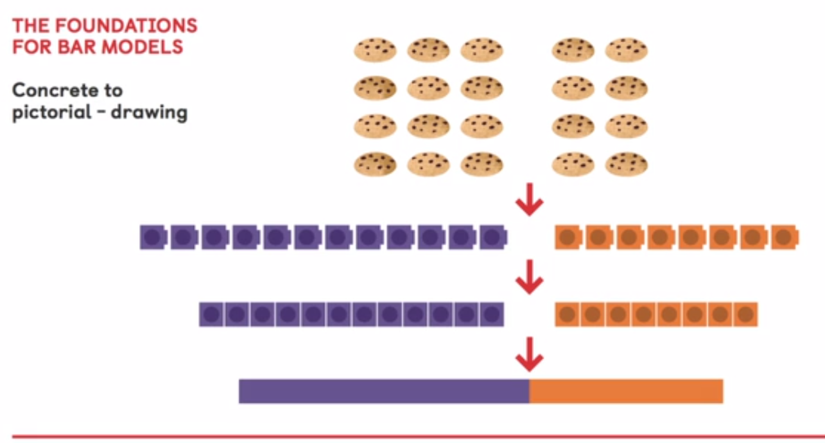

Slide 19
Bar Models
Year 1 – foundations for bar models
Year 2- bar models drawn
Year 3 – Children draw own bar models

Slide 20
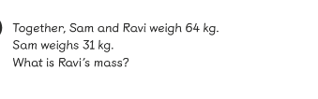
Year 2 Textbook 2A C6L6

Slide 21
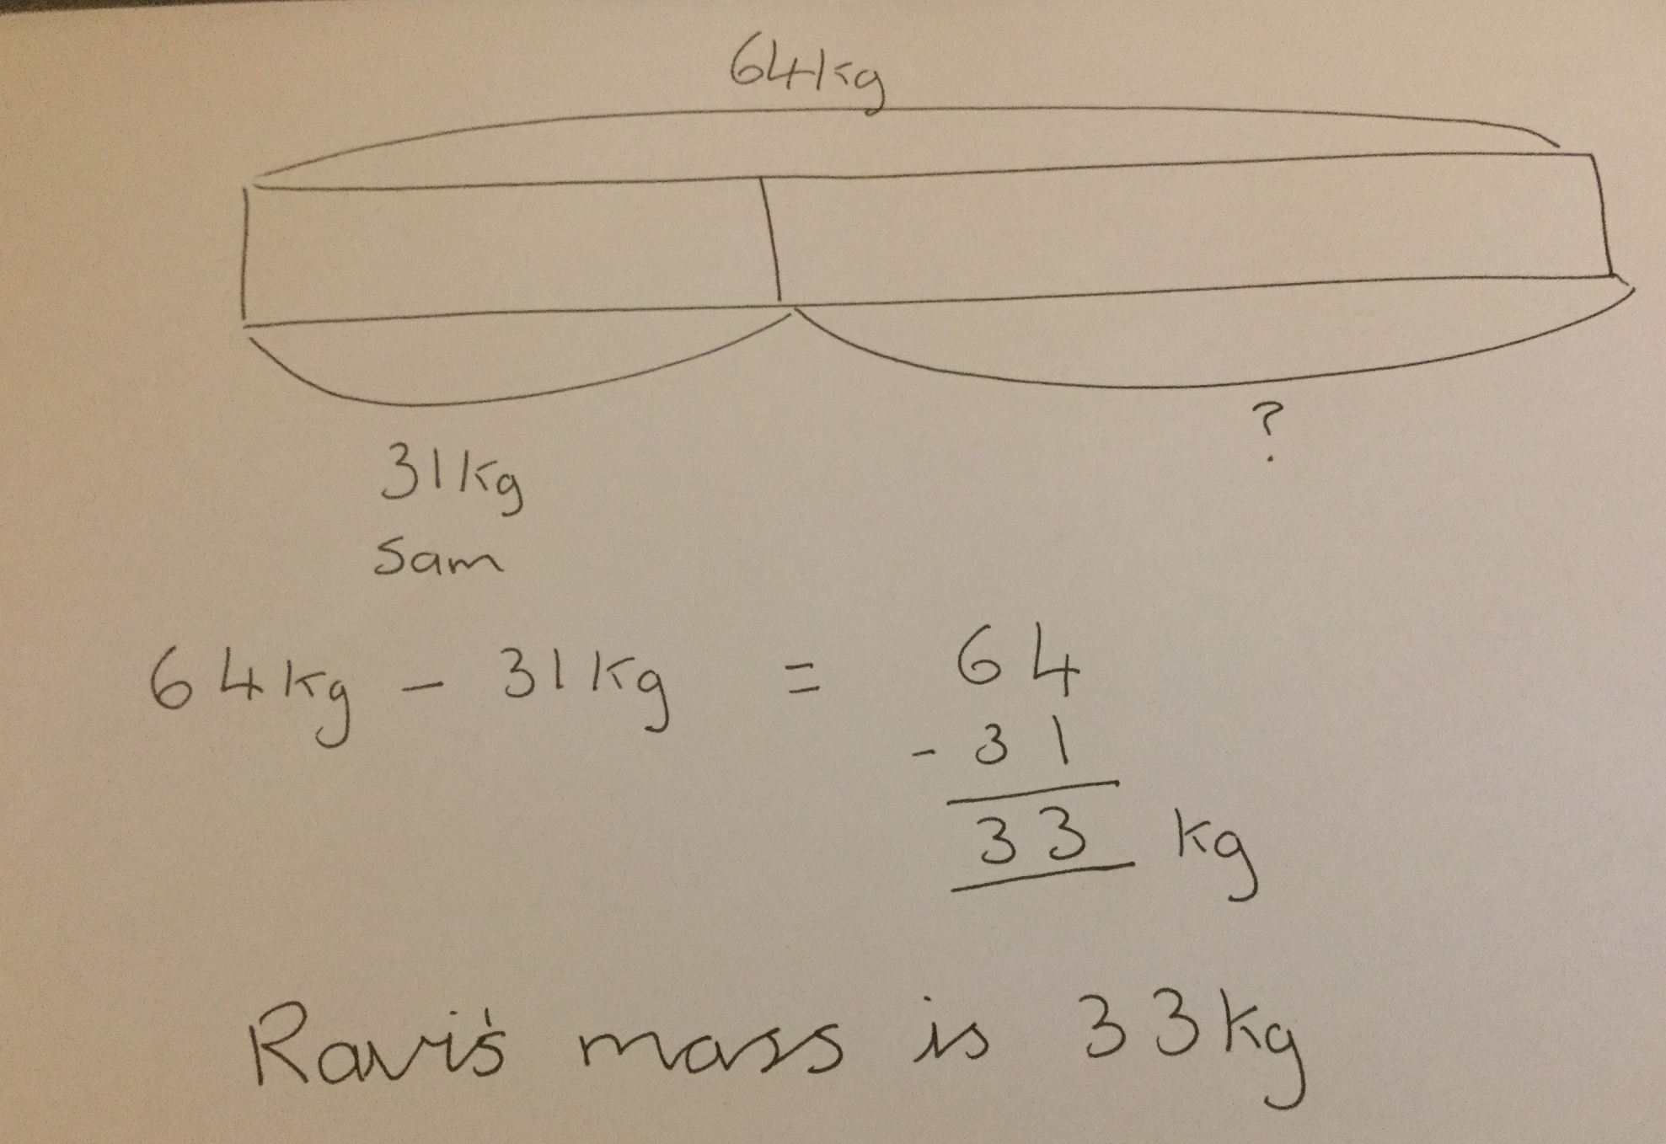

Slide 22
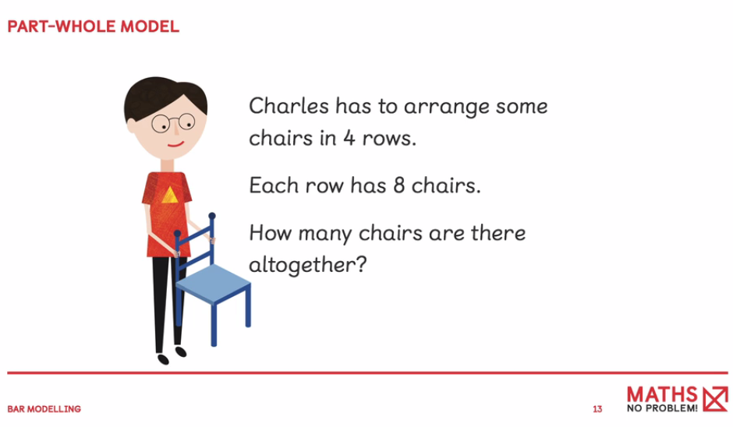

Slide 23
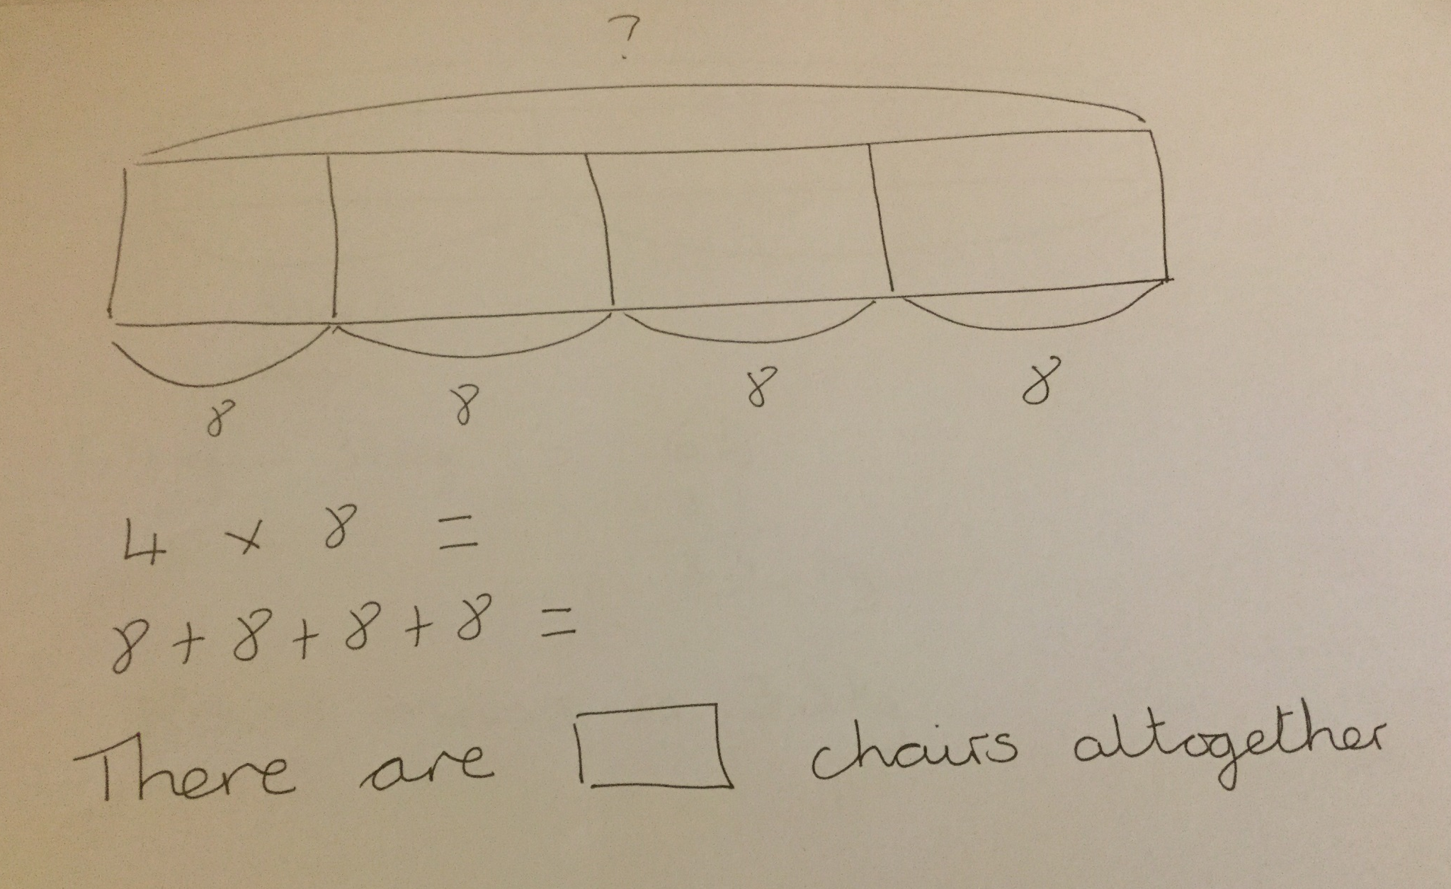

Slide 24
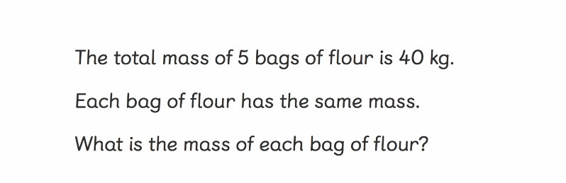

Slide 25
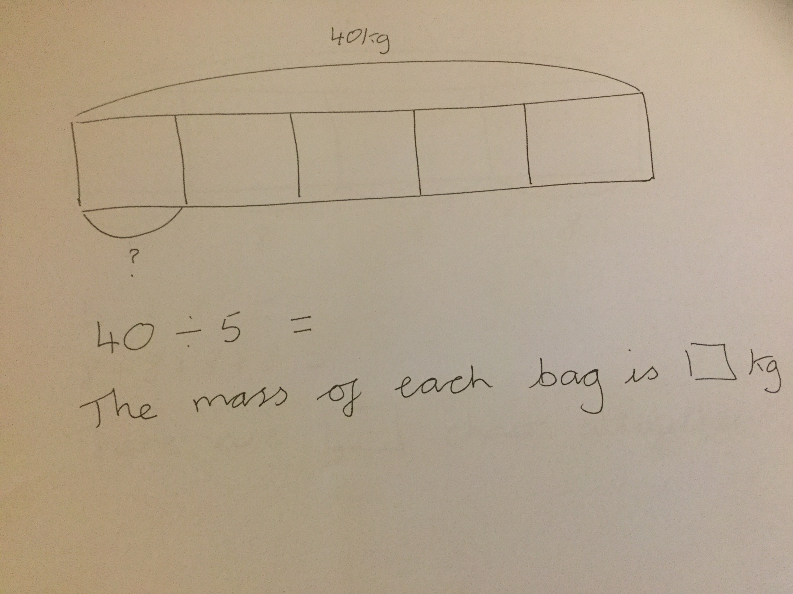

Slide 26
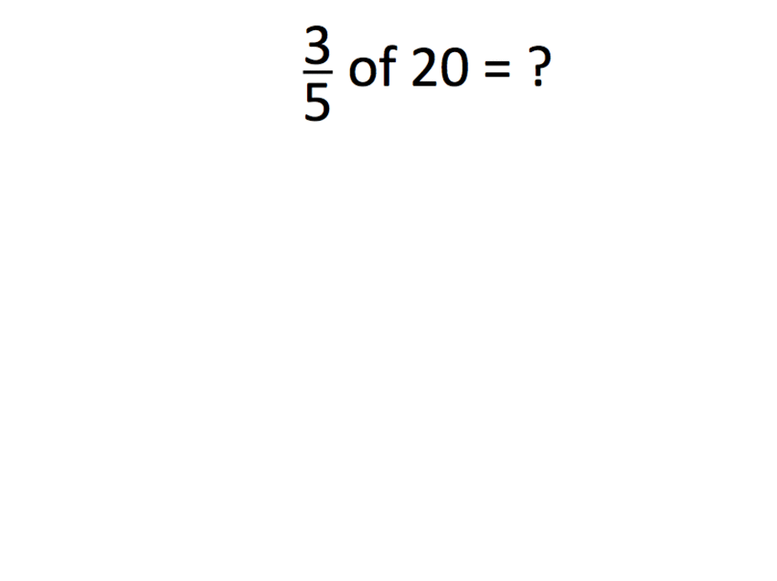
KS2 barmodelling

Slide 27


Fractions, Decimals and Percentages
Bar Modelling can support children to understand the part whole relationships when solving problems involving fractions, decimals and percentages
½
25%
50%
100%
Children will be familiar with bar model image when downloading apps
Notes:
Moving from concrete representation to pictorial image
When modelling problems involving proportion, it is useful to divide the bar into equal parts so that the proportional relationship and multiplicative structure are exposed.
Once the value of one part is labelled, the other parts can be identified as they are the same

Slide 28
Ratio Problems
There are 32 children in a class.
There are 3 times as many boys as girls.
How many girls?
Ratio 3:1
B | B | B | G
32
Notes:
Encourage children to ask, what do I know? What do I need to find out?
When modelling problems involving proportion, it is useful to divide the bar into equal parts so that the proportional relationship and multiplicative structure are exposed.
Once the value of one part is labelled, the other parts can be identified as they are the same

Slide 29
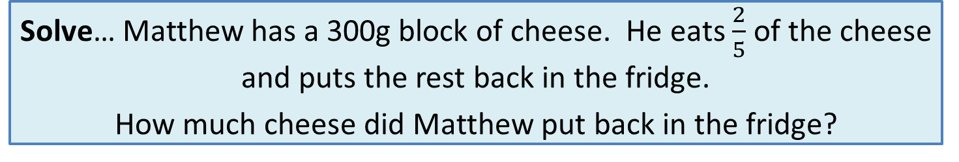
KS2 Bar Modelling
Solve… Matthew has a 300g block of cheese. He eats $\frac{2}{5}$ of the cheese and puts the rest back in the fridge.
How much cheese did Matthew put back in the fridge?
Model
Calculations
300g
300 ÷ 5 =
60
60
60
60
60
60
3 x 60 = 180
Eats
Put back
?
180

Slide 30
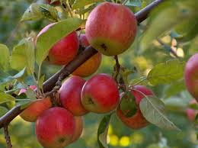
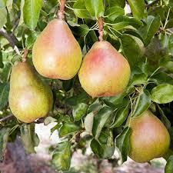
Simon likes apples and pears. A cox apple tree costs £40. It costs £25 less than a conference pear tree . How much would he need to spend in total?
Apple tree
Pear tree

Slide 31
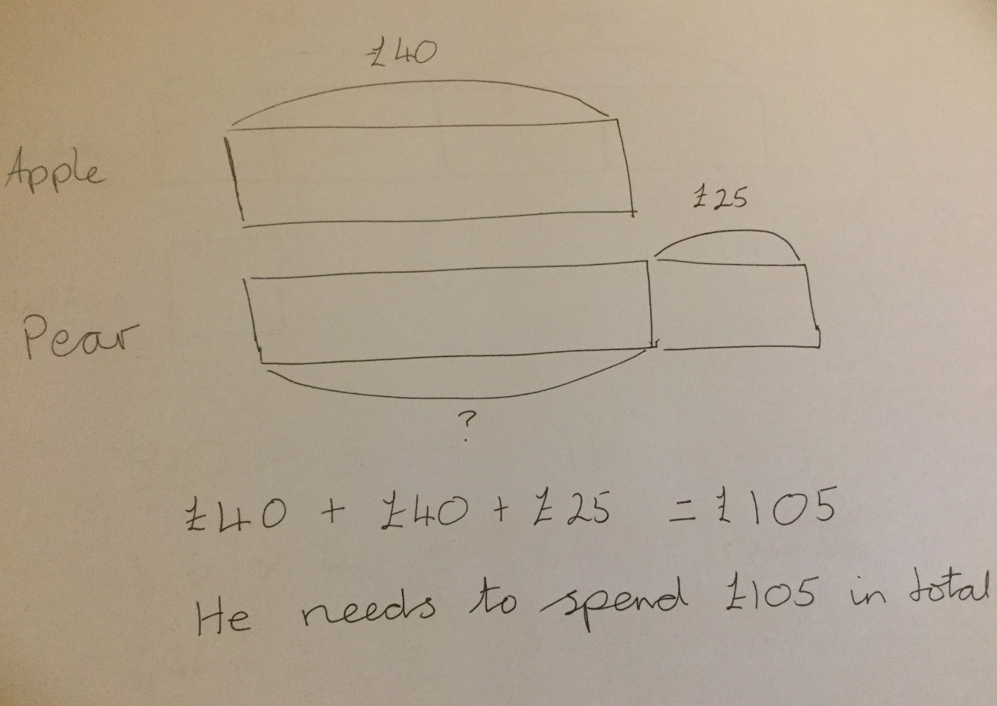

Slide 32
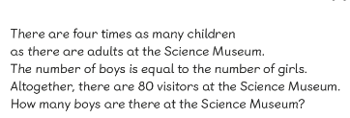
Year 3 Textbook 3A Chapter 4 Lesson 10

Slide 33
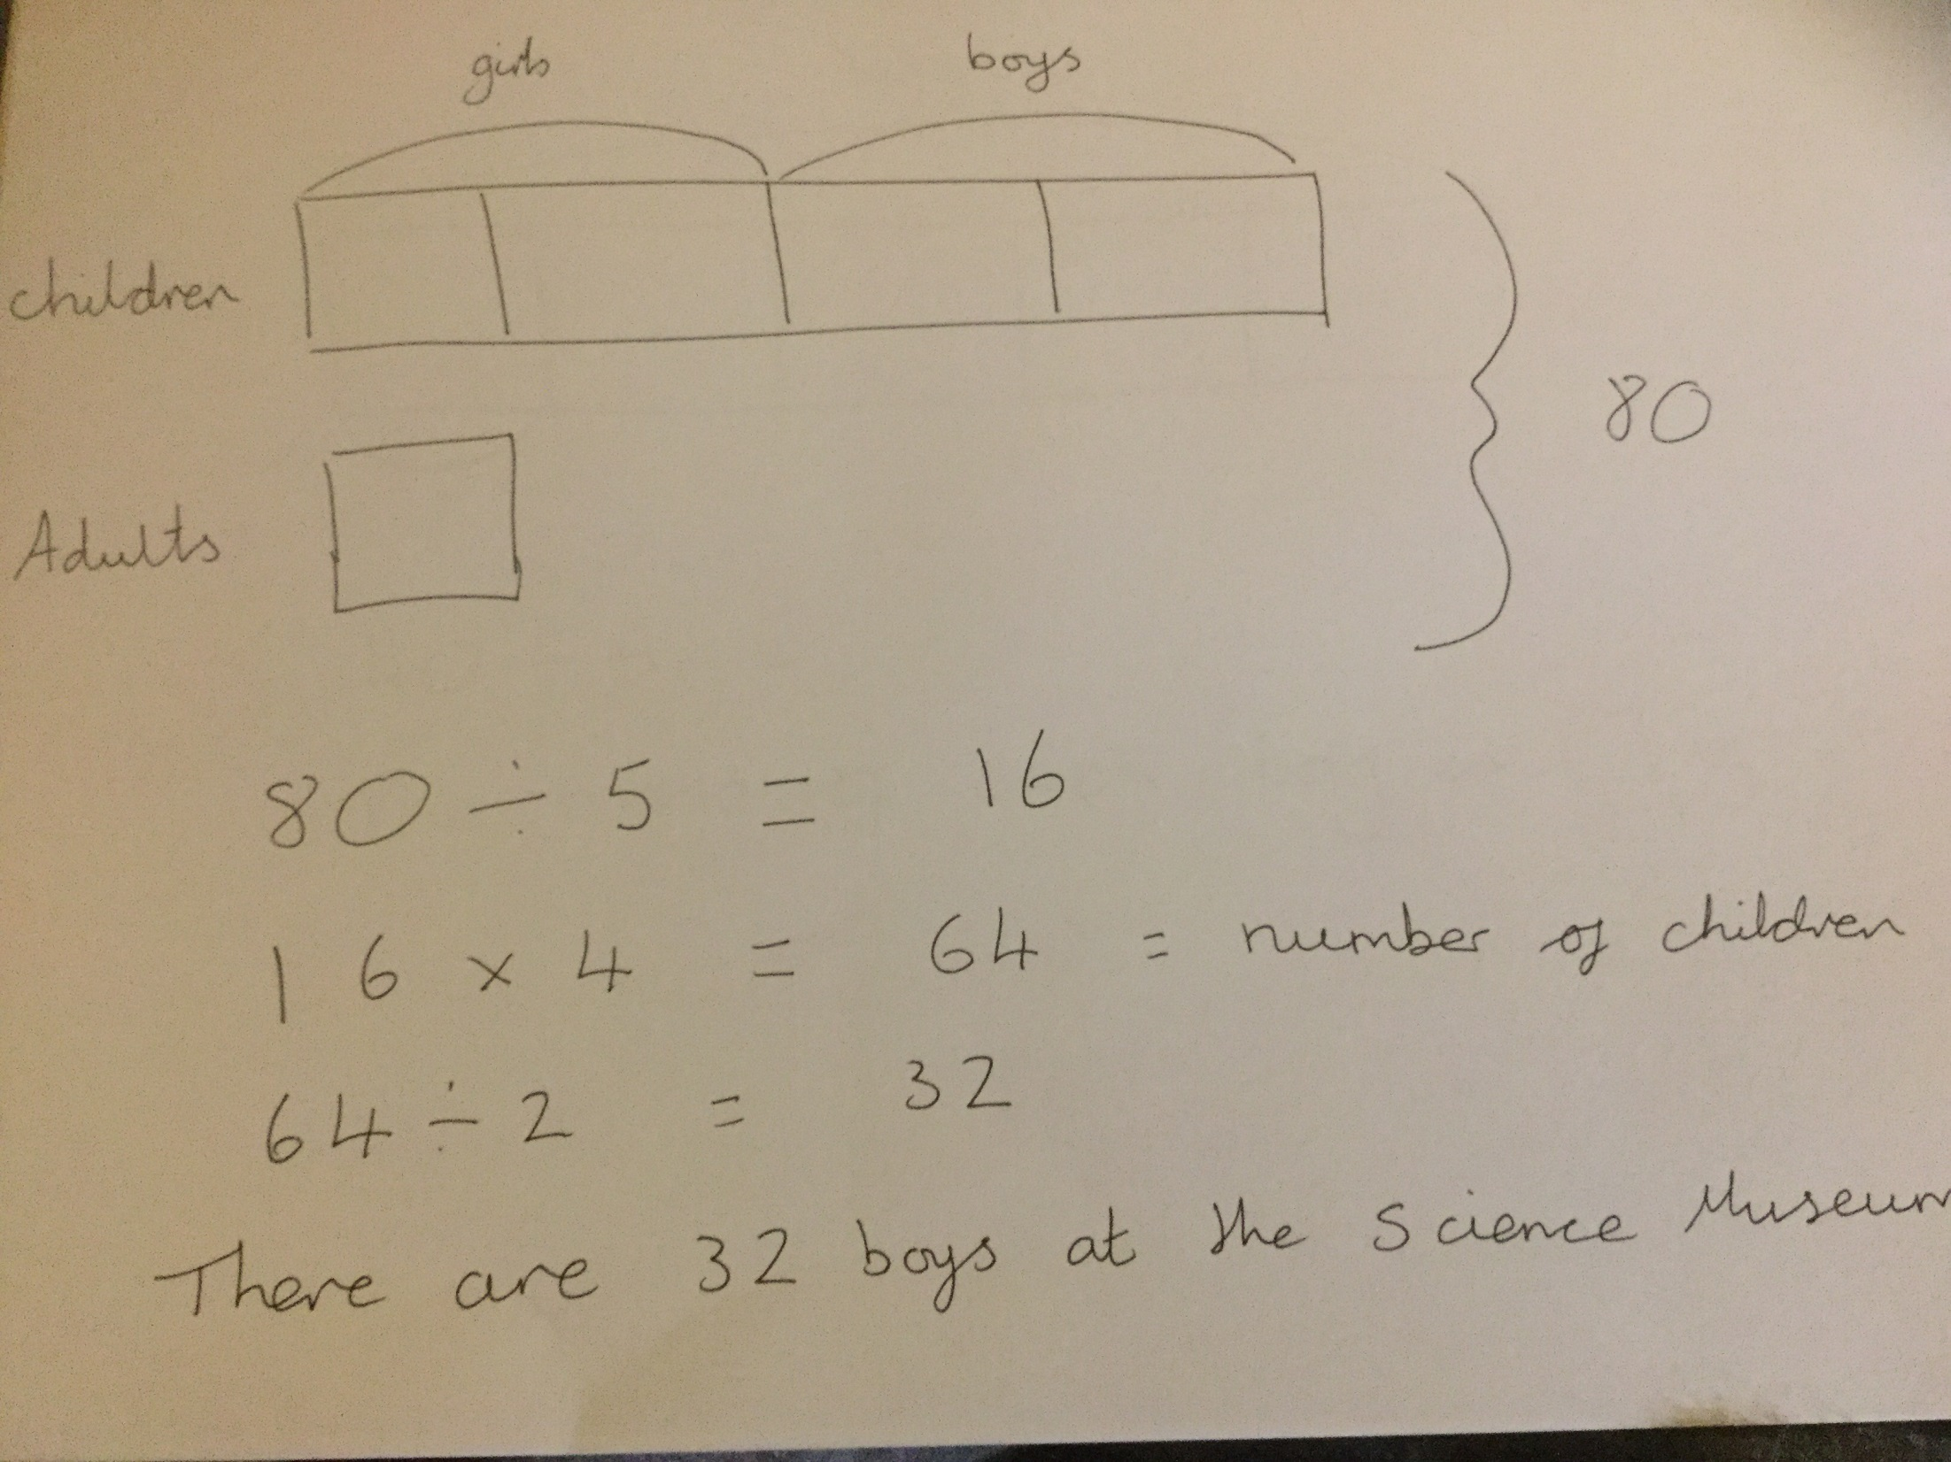

Slide 34
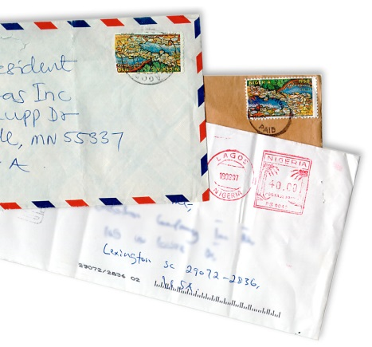
Problem Solving
Ralph posts 40 letters, some of which are first
class, and some are second.
He posts four times as many second class letters as first.
How many of each class of letter does he post?
GCSE higher paper 2012!

Slide 35
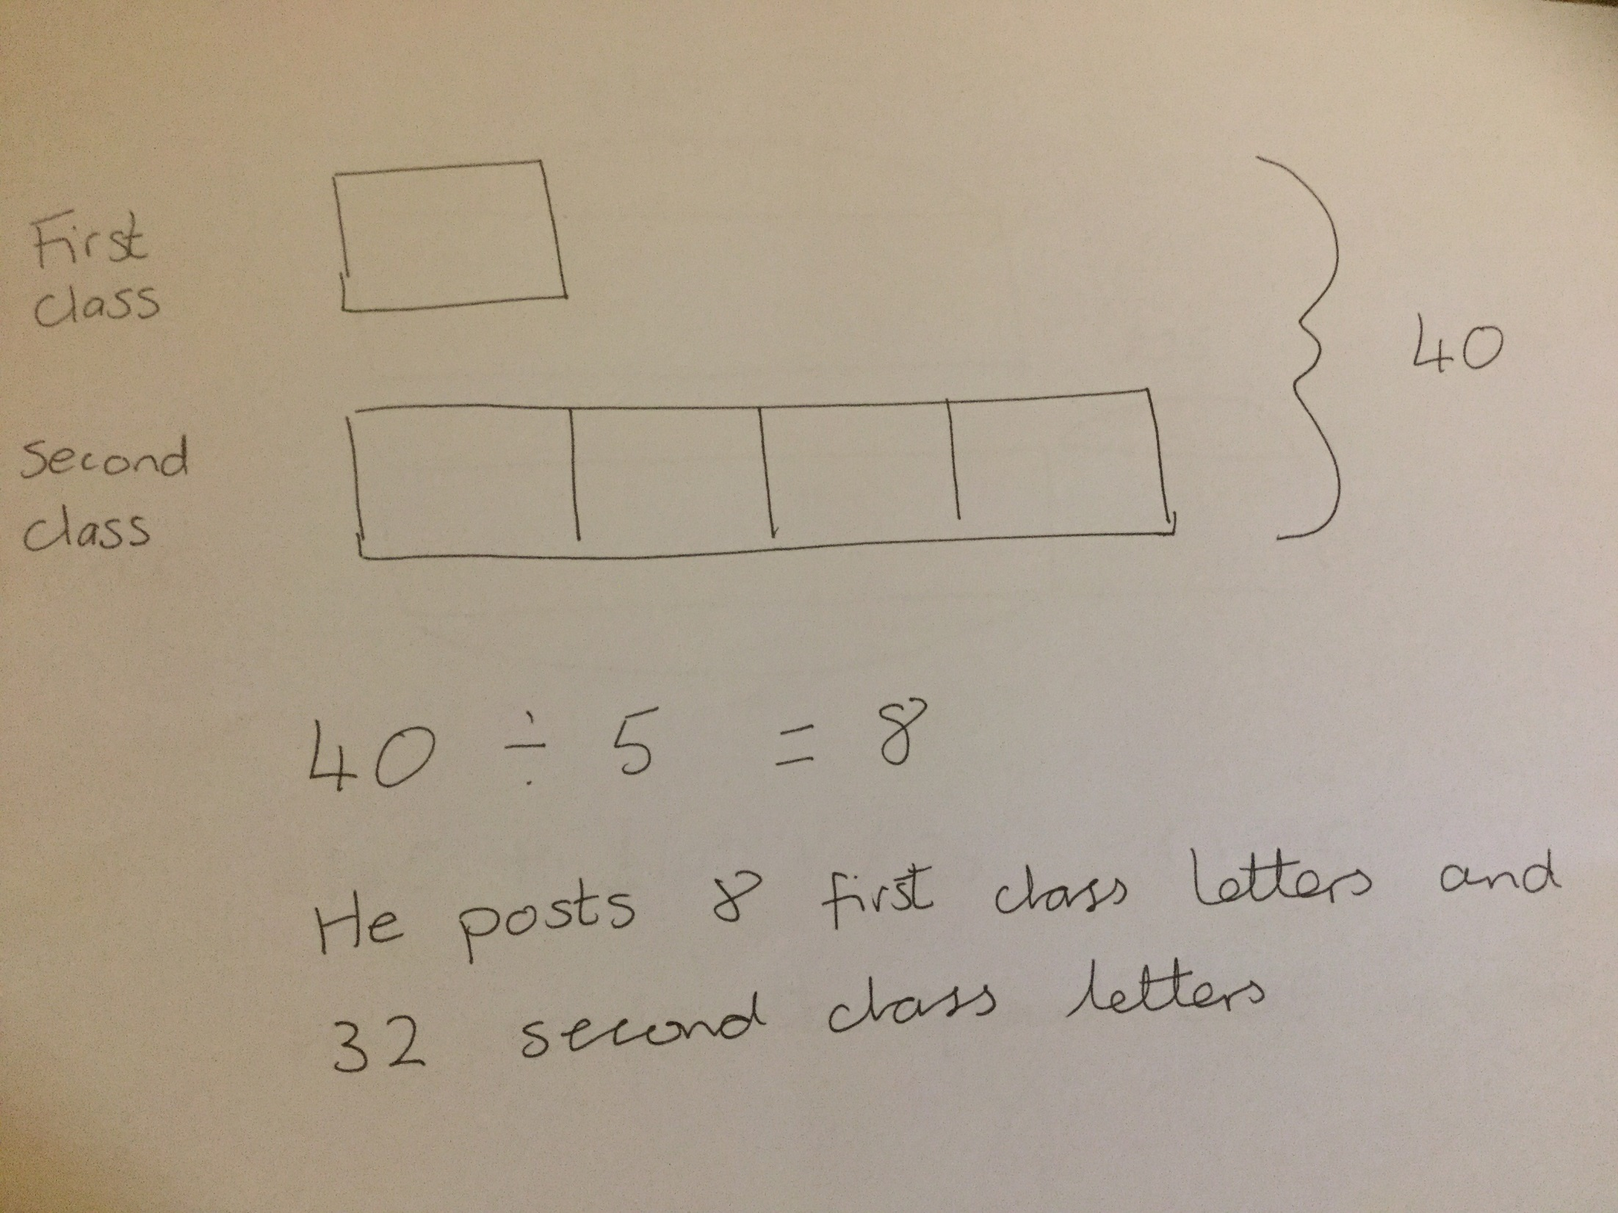

Slide 36
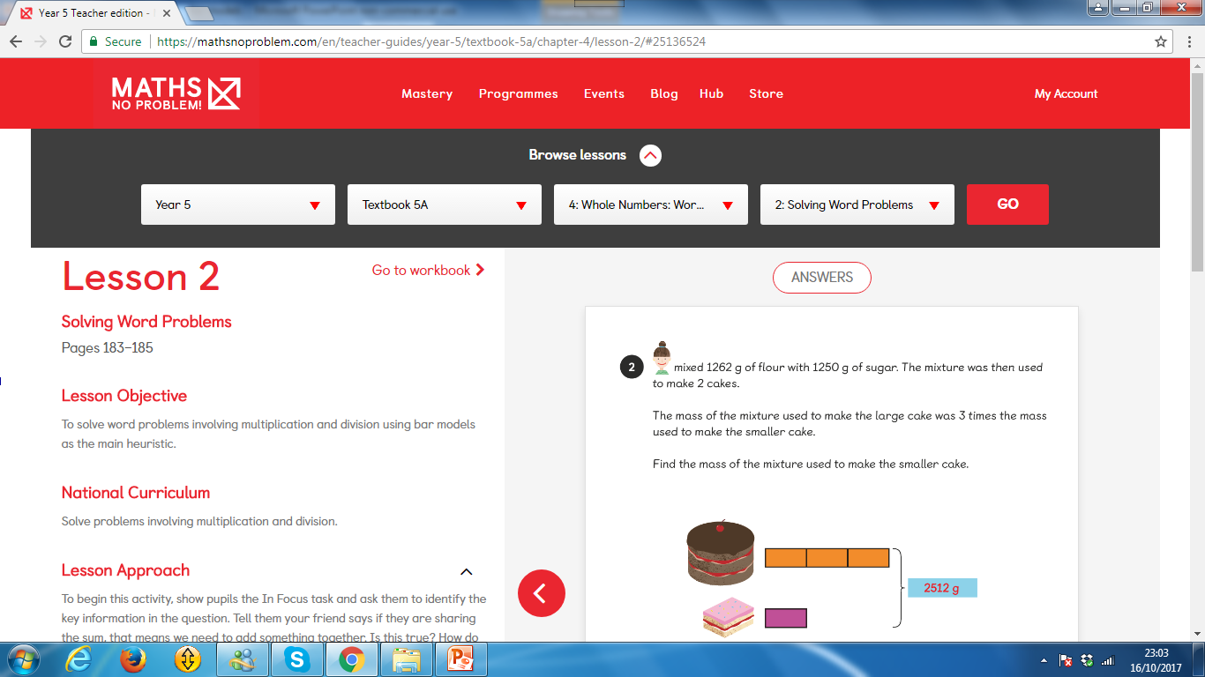
Year 5 Textbook 5A- C4 L2

Slide 37
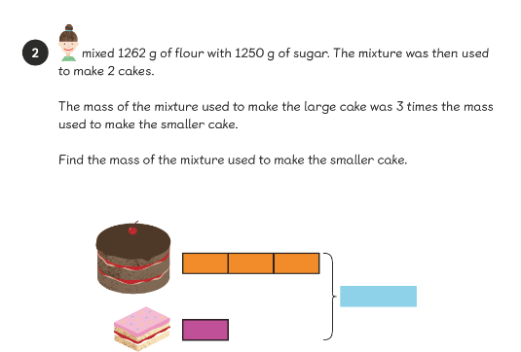

Slide 38
