Slide 1
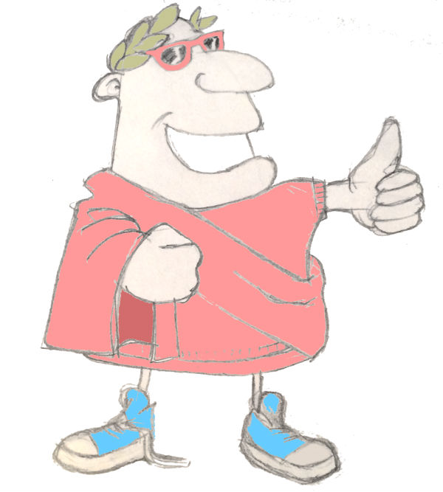
How to use this audio-visual dictionary
© Charlie Andrew 2022 maximumclassics.com
Firstly, make sure you’re in slideshow mode.
Then, either go straight to the page where the word you’re looking for is by clicking on one of these boxes below …
ad-
to de-
di- to ins-
inv- to nar-
nav- to quan-
quat- to sp-
st- to v-
… or use the forward and back buttons to explore.
To hear a Latin word read out loud, click on the picture.
click to start exploring the dictionary

Slide 2



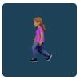



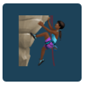






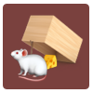

















ad- to de-
A
ad
to
aequus
fair, equal
amare
to love
ambulare
to walk
amicus, amica
friend
animus
mind, spirit
aqua
water
ascendere
to climb
B
C
audire
to hear
bene
well
bonus
good
campus
field
canis
dog
cantare
to sing
capere
to seize
cautus
careful
celare
to hide
celeriter
quickly
centum
hundred
circum
around
clamare
to shout
clarus
famous
construere
to build
consumere
to consume, eat, drink
D
© Charlie Andrew 2022 maximumclassics.com
curare
to take care of
currere
to run
dare
to give
dea
goddess
decem
ten
delere
to destroy
descendere
to go down
deus
god

Slide 3




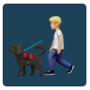

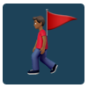

























di- to ins-
dicere
to say, speak
digitus
finger
doctus
clever
dormire
to sleep
ducere
to lead
duo
two
dux
leader
e, ex
out, out of
F
equus
horse
esse
to be
et
and
fabula
story
facere
to make, do
facile
easily
familia
family
feles
cat
G
femina
woman
finire
to finish
flos
flower
fortiter
brav ely
fortuna
luck
frater
brother
frigidus
cold
gladius
sword
H
I
© Charlie Andrew 2022 maximumclassics.com
gratus
thankful
habere
to have
habitare
to live
hortus
garden
ignis
fire
in
in, into
infans
baby, young child
insula
island

Slide 4




















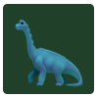

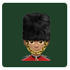









inv- to nar-
L
invenire
to find,
irate
angrily
iratus
angry
ita vero
yes
itaque
therefore
iuvenis
young man
laborare
to work
lacrimare
to cry
M
laete
happily
legere
to read
lingua
tongue
locus
place
luna
moon
maga
witch
magnus
big
magus
wizard
male
badly
malus
bad
manere
to stay
mater
mother
maximus
very big, biggest
medicus
doctor
miles
soldier
mille
thousand
N
© Charlie Andrew 2022 maximumclassics.com
minime
no
mirus
amazing
mons
mountain
monstrare
to show
mortuus
dead
multus
much, many
mutare
to change
narrare
to tell

Slide 5
















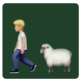




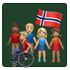










nav- to quan-
navigare
to sail
navis
boat
nemo
noone
nescire
to not know
nihil
nothing
non
not
novem
nine
novus
new
O
P
nox
night
numerare
to count
numquam
never
octo
eight
optime
very well
optimus
excellent, best
panis
bread
paratus
ready
pastor
shepherd
pater
father
pax
peace
per
through
ponere
to put, place
populus
people
porcus
pig
portare
to carry
Q
© Charlie Andrew 2022 maximumclassics.com
posse
to be able
post
after
primus
first
probus
honest
pugnare
to fight
quae
who
quaerere
to look for
quando
when

Slide 6



















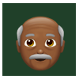










quat- to sp-
quattuor
four
qui
who
quid
what
quietus
quiet
quinque
five
quis
who
quod
because
quomodo
how
R
S
regere
to rule
regina
queen
respondere
to reply
rex
king
ridere
to laugh
rogare
to ask
rota
wheel
salutare
to greet
salvus
safe
scire
to know
scribere
to write
secundus
second
sed
but
senex
old man
sentire
to feel
septem
seven
© Charlie Andrew 2022 maximumclassics.com
sex
six
silva
forest, woods
sol
sun
solus
alone
sonus
sound
sordidus
dirty
soror
sister
spectare
to watch

Slide 7































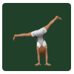
spe- to v-
T
sperare
to hope
stare
to stand
stella
star
sub
under
super
above
surgere
to get up, rise
taberna
shop
tacere
to be quiet
U
terra
land, ground
tertius
third
totus
whole
trans
across
tres
three
ubi
where
umbra
ghost, shadow
unda
wave
V
unus
one
urbs
town, city
vacca
cow
validus
strong
velle
to want
ventus
wind
verus
true
vetare
to forbid
© Charlie Andrew 2022 maximumclassics.com
vexare
to annoy
via
street, road
victoria
victory
victus
defeated
videre
to see
visitare
to visit
vita
life
vivus
alive

