Slide 1

EYFS and Year 1 Maths meeting for Parents and Carers
Monday 25th September 2023

Slide 2
End of year expectations…
By the end of Reception Children at the expected level of development will:
Have a deep understanding of number to 10
Subitise (recognise quantities without counting) up to 5;
Automatically recall (without reference to rhymes, counting or other aids) number bonds up to 5 (including subtraction facts) and some number bonds to 10, including double facts
Count beyond 20, recognising the pattern of the counting system;
Compare quantities up to 10, recognising when one is greater than, less than or the same as the other;
Explore evens and odds, double facts and how quantities (up to 10) can be shared equally.

Slide 3
Developing Number Fluency…
For children in the Early Years Foundation Stage (EYFS) to achieve ‘mastery’ they need to have an in-depth and deep understanding.
Play is essential in teaching and consolidating maths. Play enables children to be independent and remain curious. “I wonder…”
Lots of maths language for example more, less, big, small, wide, thin and positional language needs to be modelled by adults for children to learn.
Children should then be able to recall and apply this knowledge over and over again to different situations quickly and accurately.
Notes:
Children become number fluent when they can apply their previously acquired knowledge and solve problems. Not only this, they will be able to give the reasoning behind it and explain the steps they have taken to get there. It becomes second nature to them, it’s as if they can bring what they have previously learned to the forefront and apply it to the new problem.

Slide 4
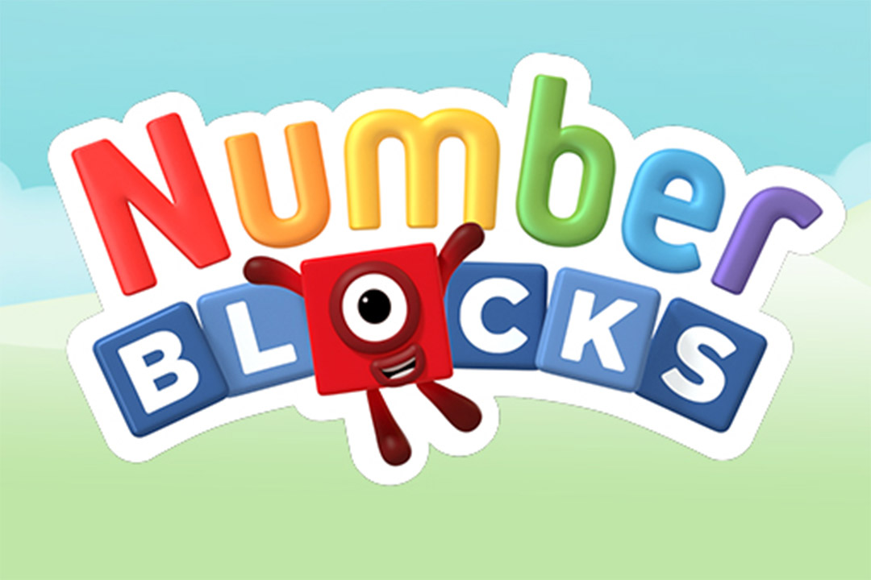
Teaching for Mastery…
Children are taught through daily whole-class interactive teaching using high quality resources from the National Centre for Excellence in the Teaching of Mathematics (NCETM).
NCETM have collaborated with Numberblocks - a BBC television series aimed at introducing children to early number.
Notes:
Snappy animation and loveable characters combine with engaging storylines to gently introduce concepts of number to support early mathematical understanding.

Slide 5
Exploring mathematical concepts
We also provide the children with a ‘number a week’ method which will work throughout the year.
Term 1 | Term 2 | Term 3
September – December | January - April | April - July
Numbers from 0-10 will be covered during this term. | The numbers from 0-10 will be explored in further detail. In terms of consolidation and putting a greater emphasis on number operations. Numbers to 20 will also be covered. | Numbers from 0 – 20 will continue to be explored here. With a greater emphasis here on number bonds.
Notes:
You may have heard your child talking about one of something the last week or so, they have been encouraged to find and explore the number 1.

Slide 6
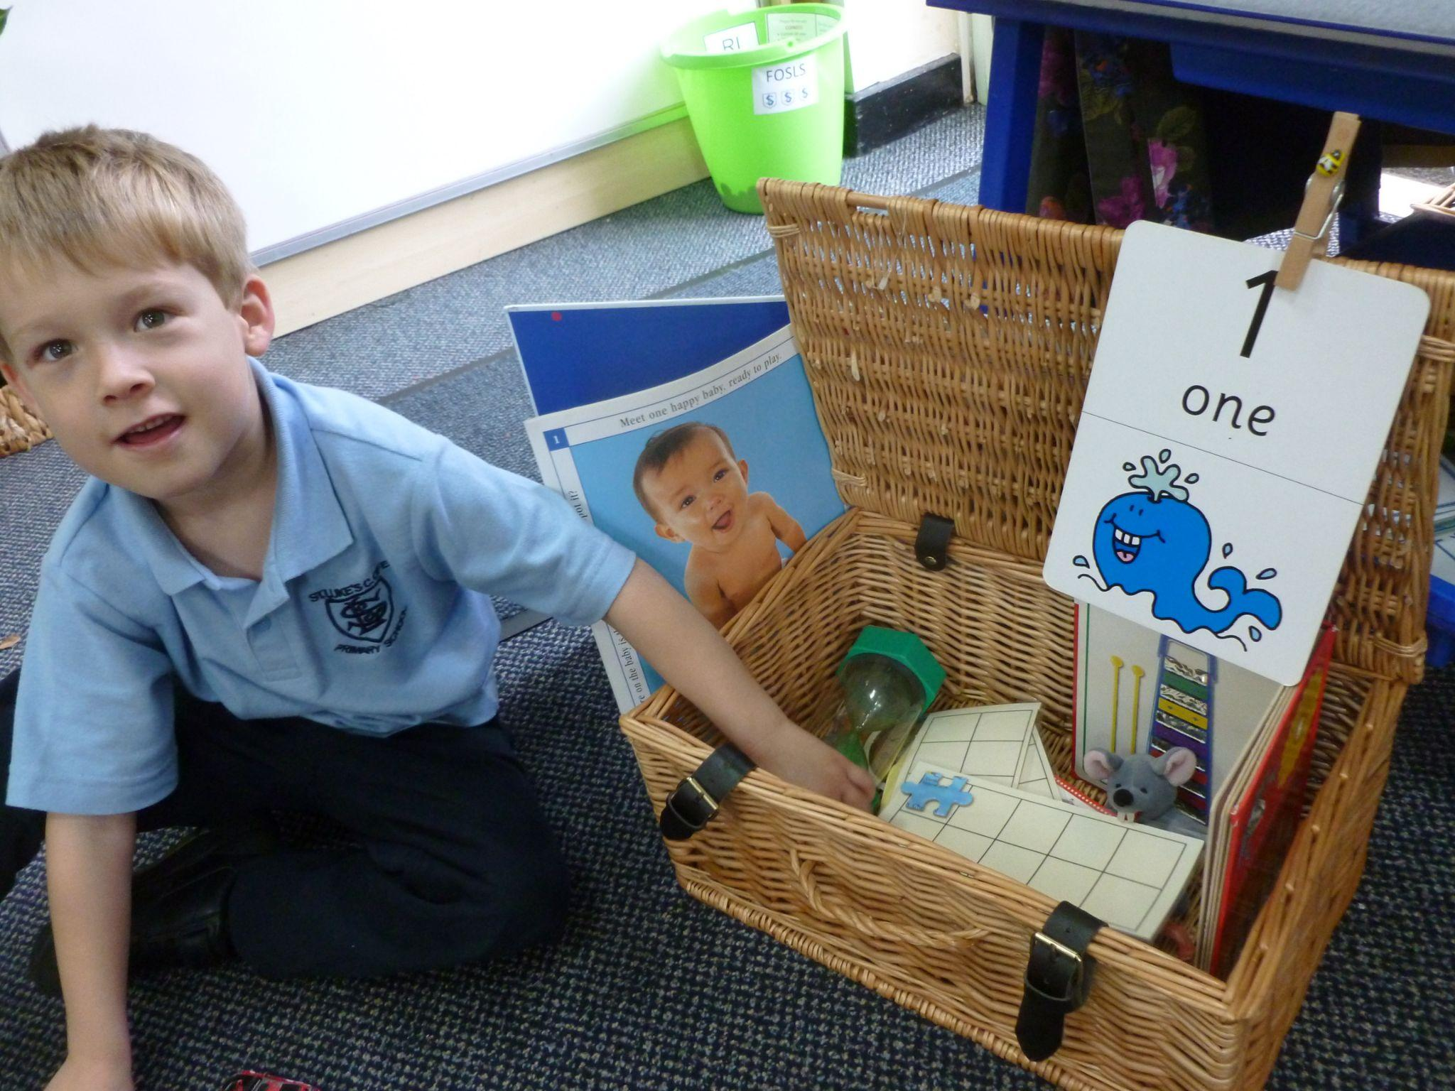
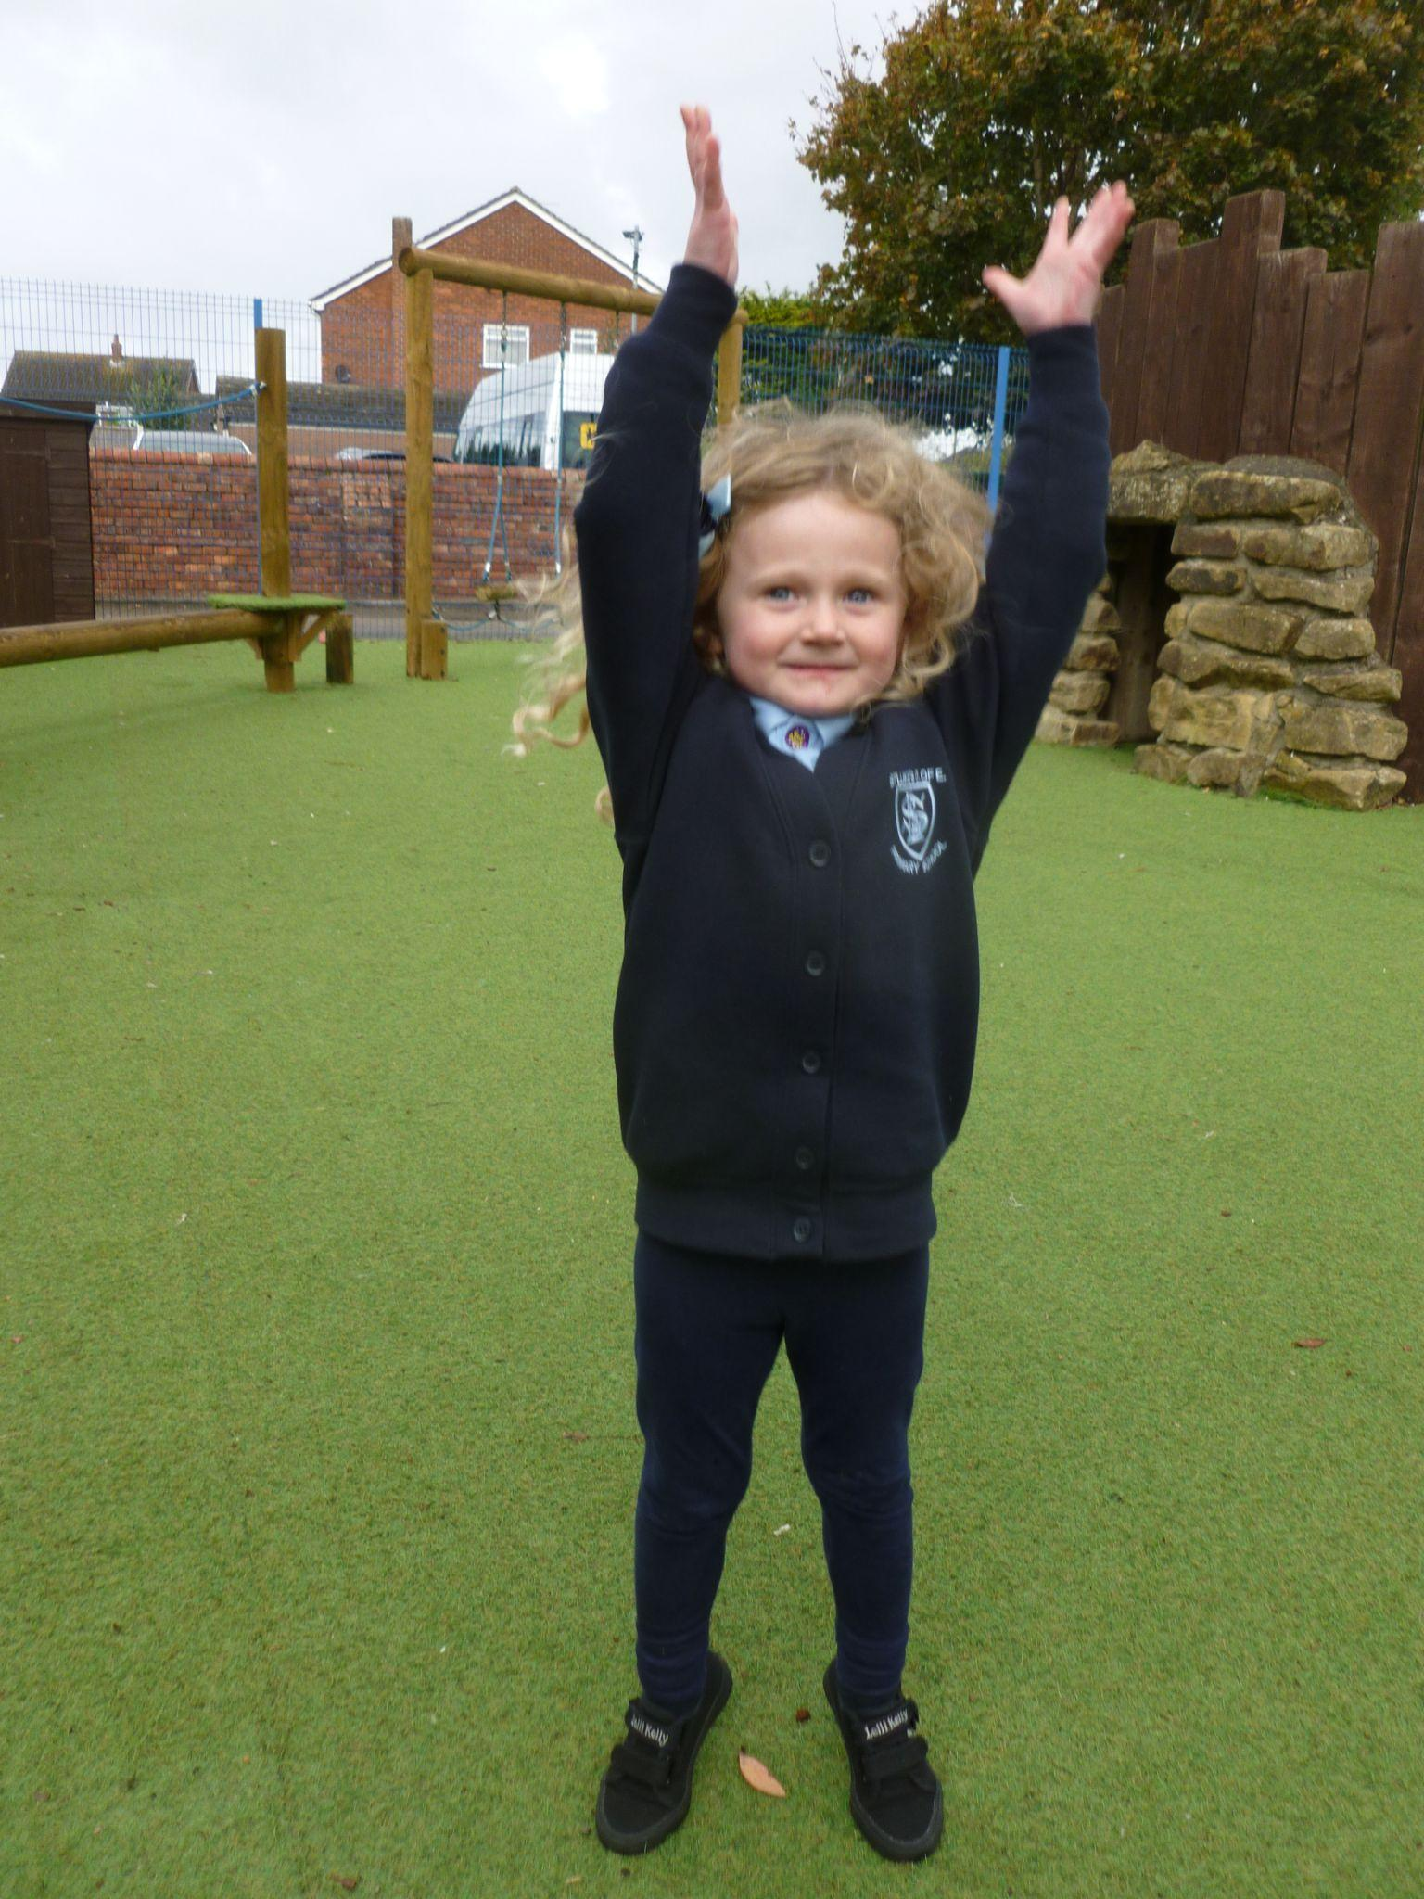
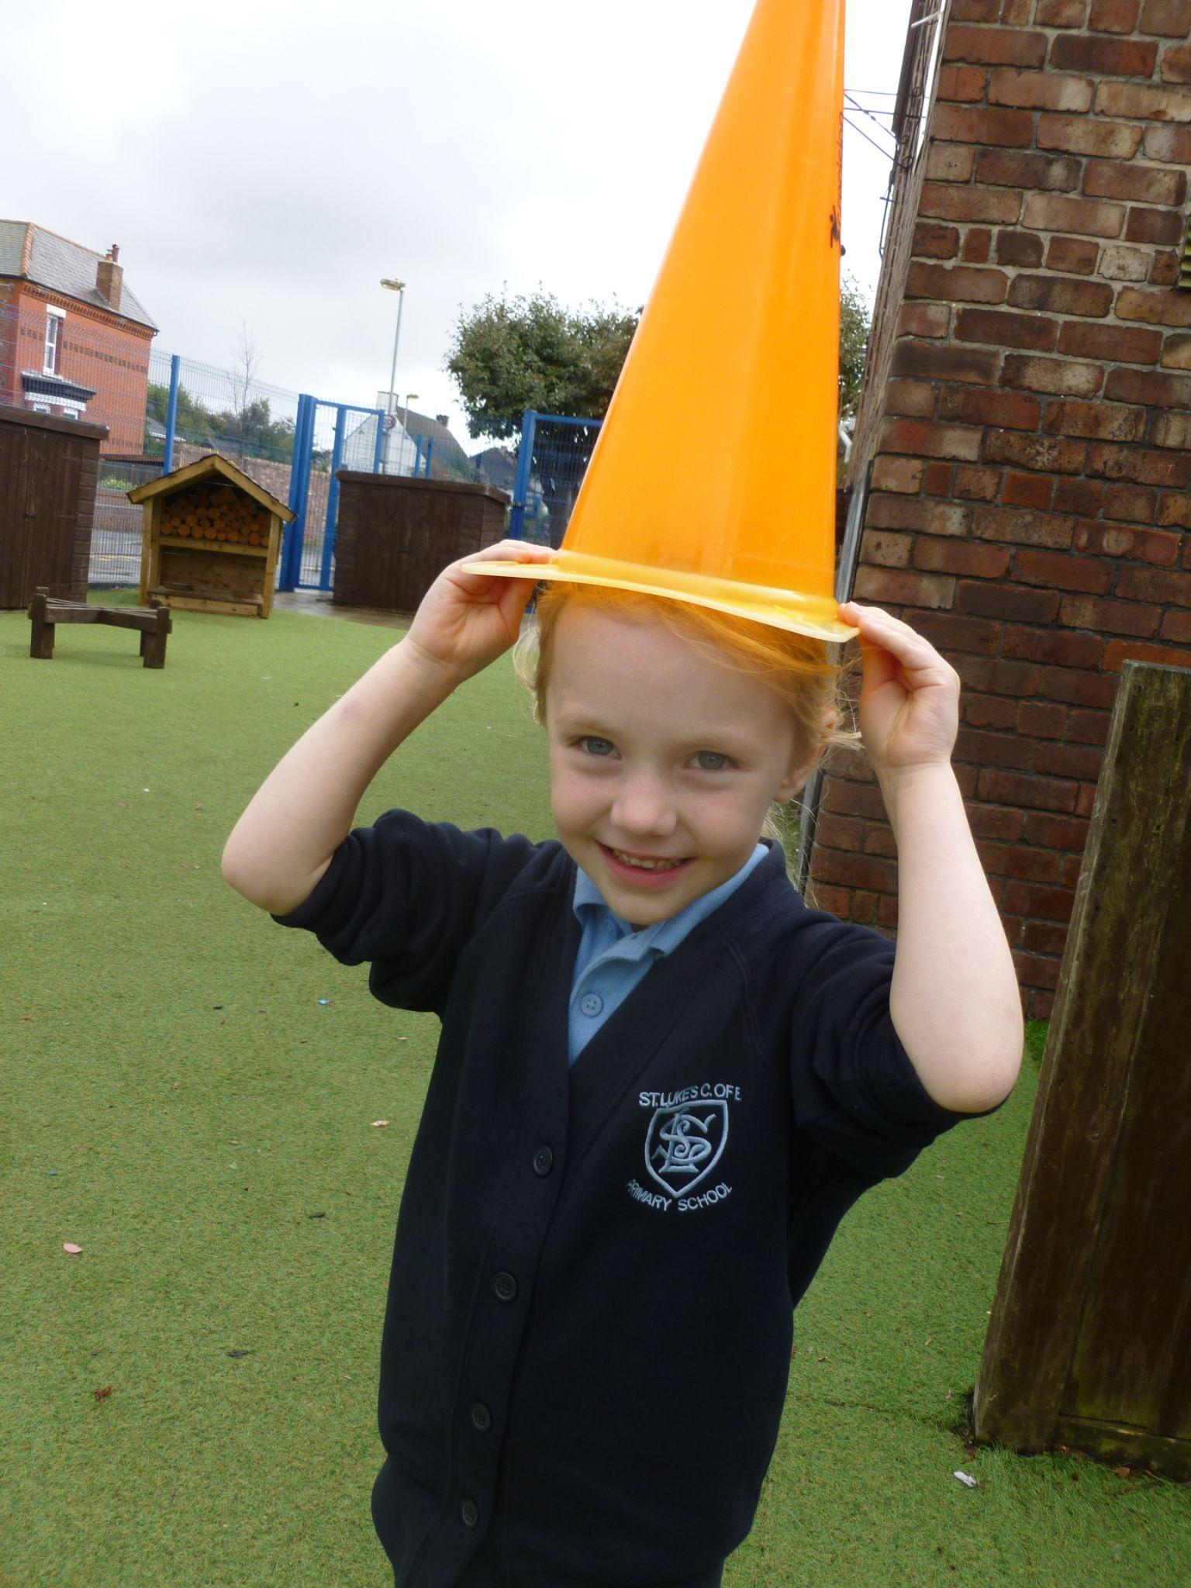
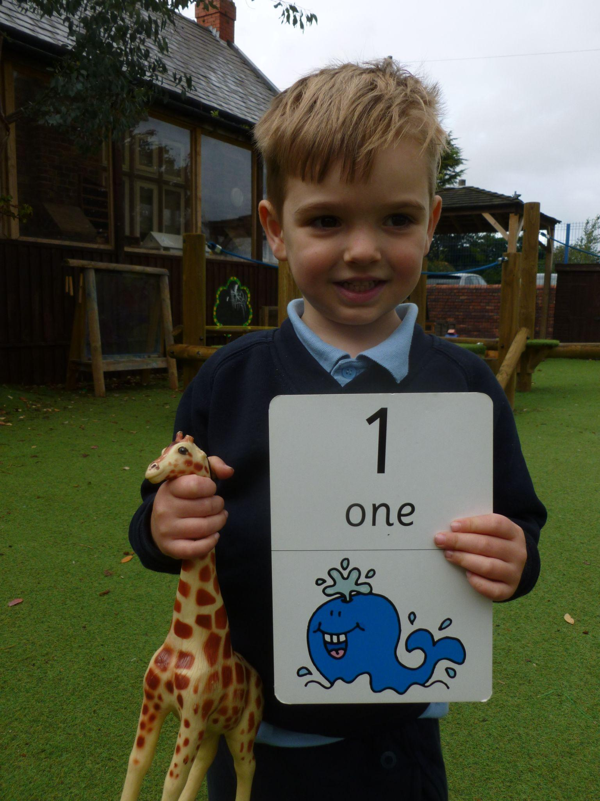
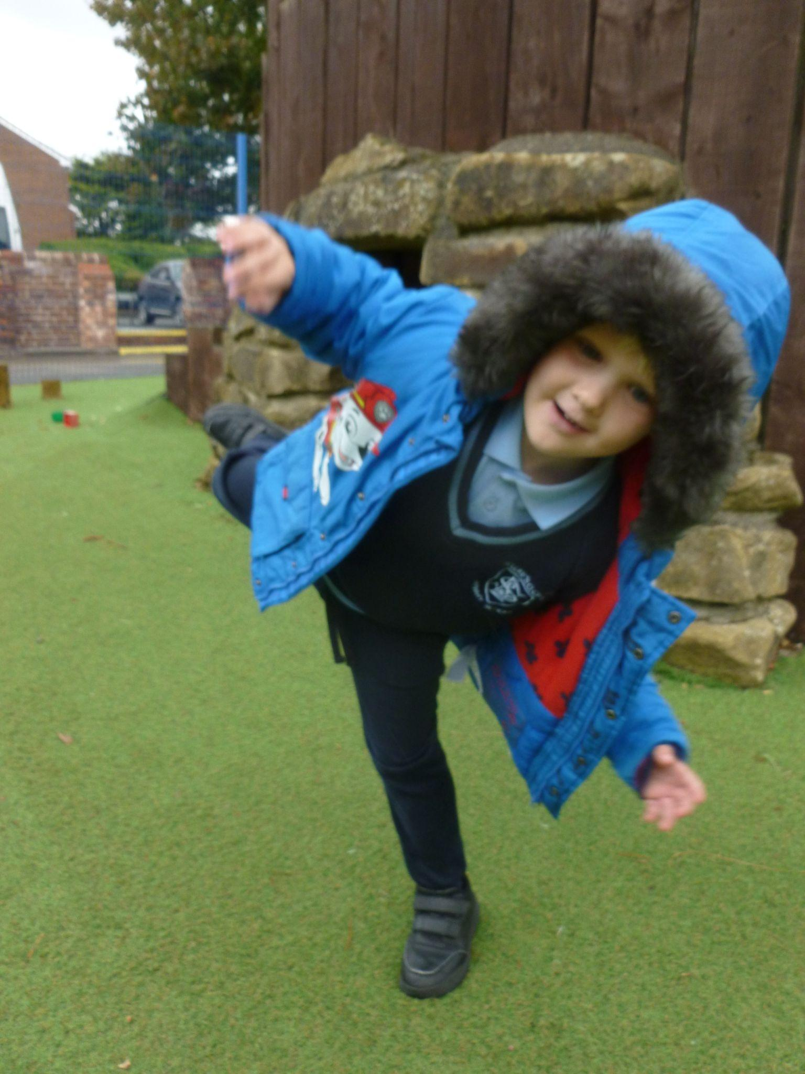
What does ‘one’ look like?

Slide 7
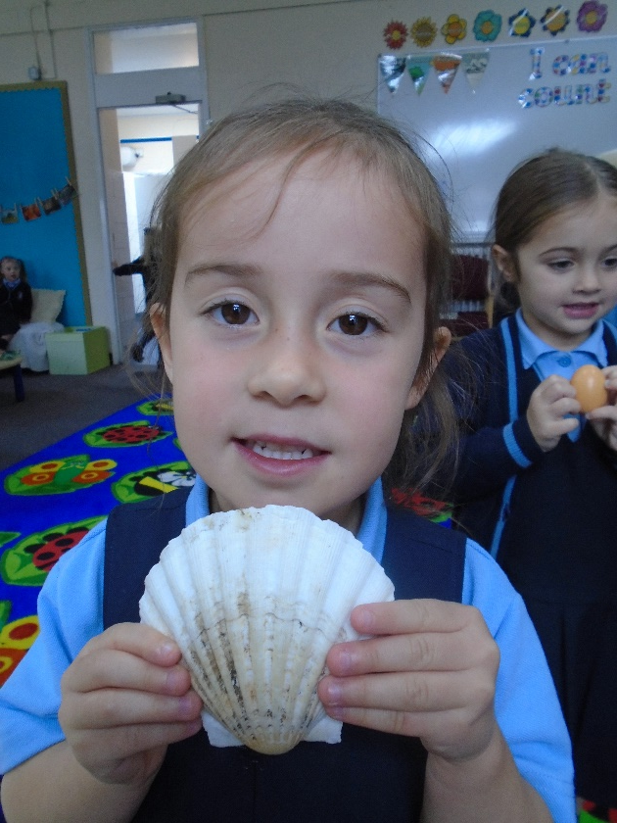
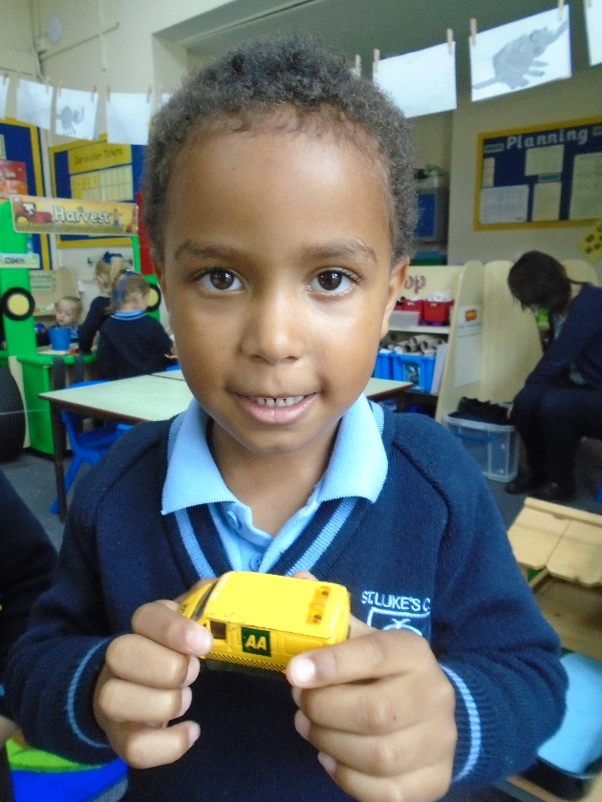
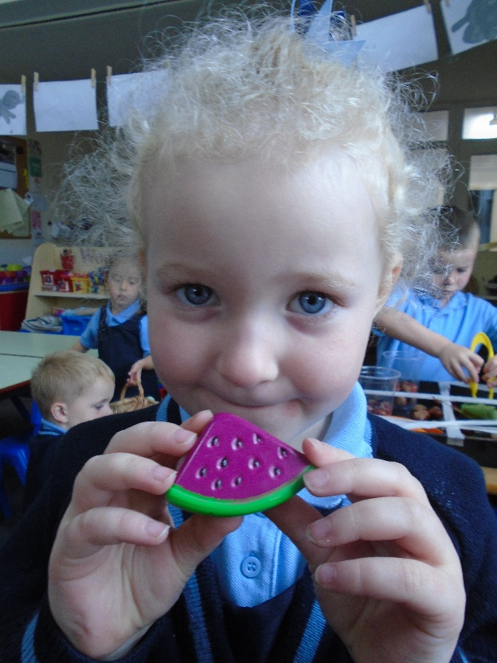
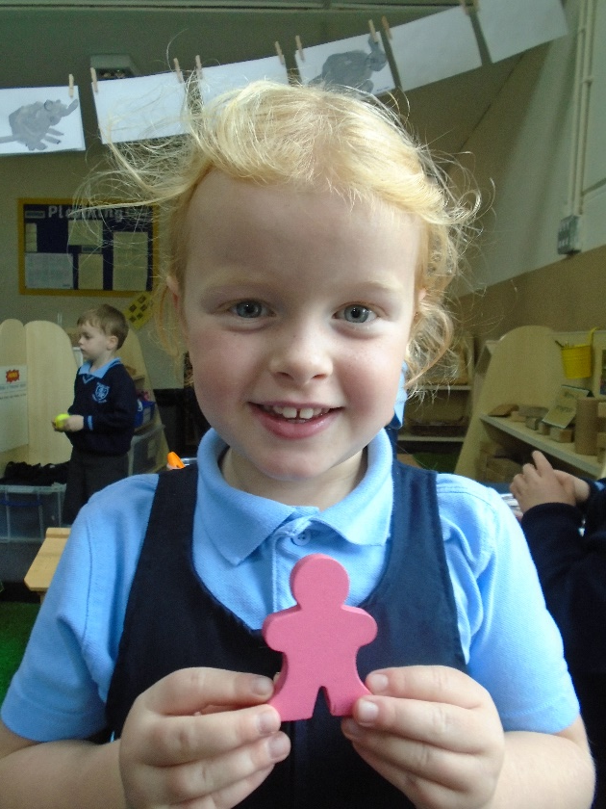
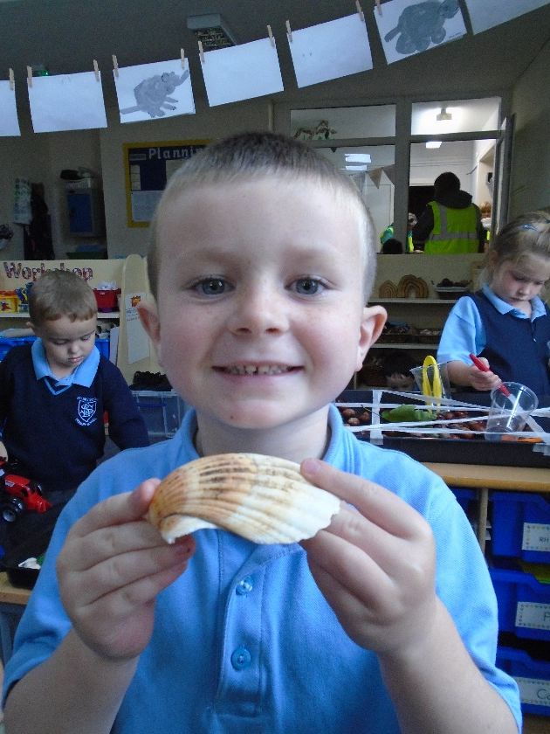

Slide 8
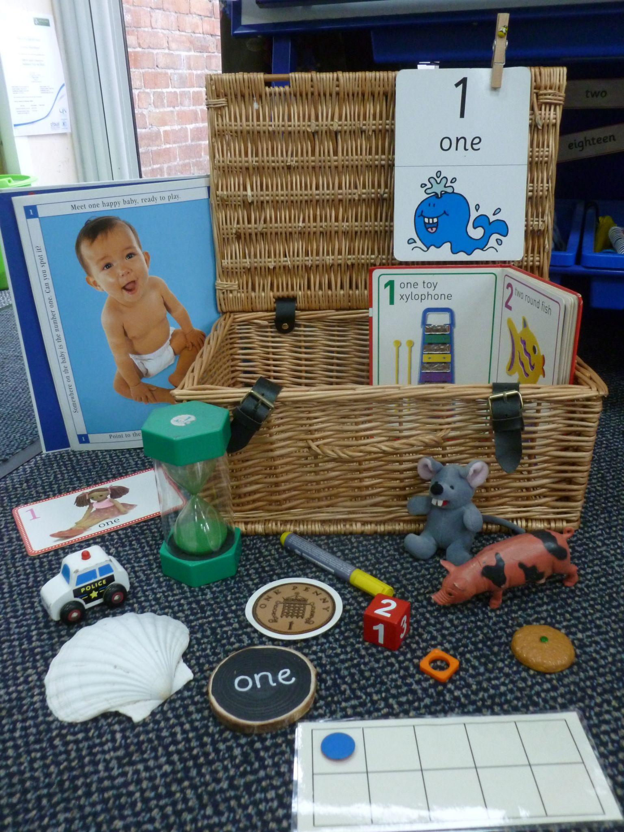

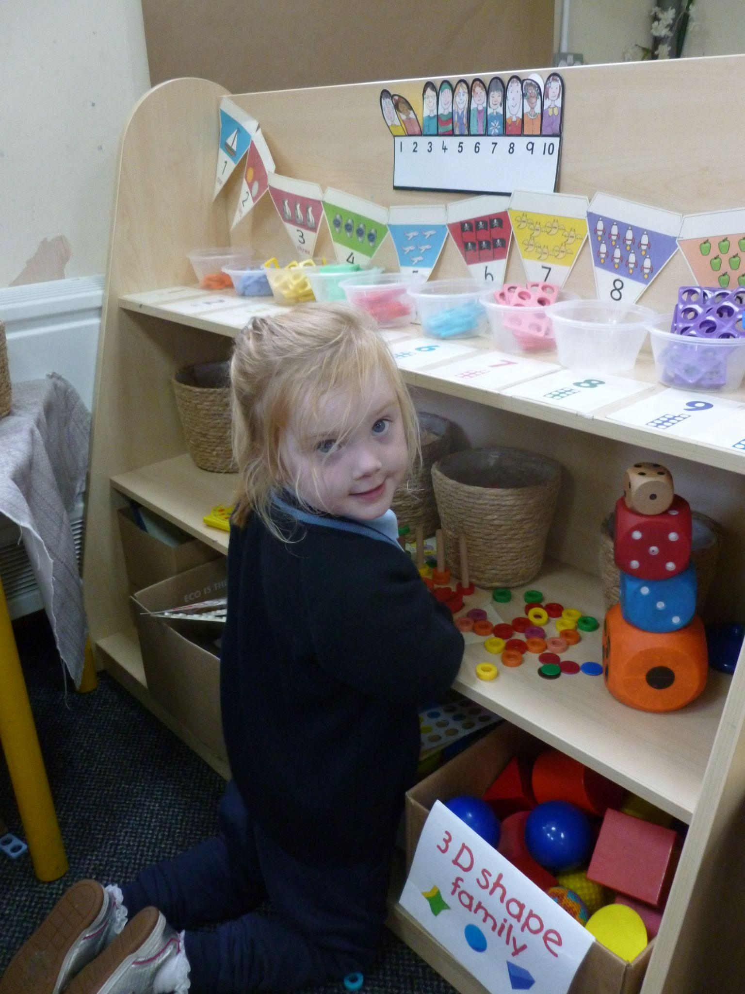
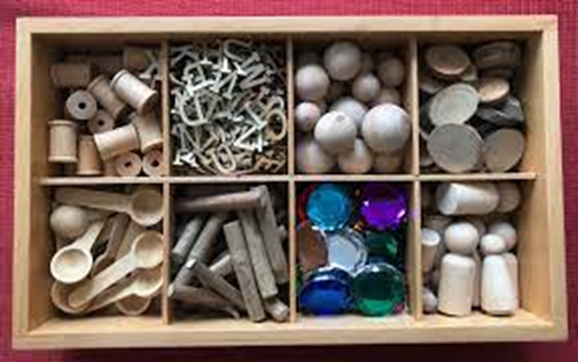
Maths in the classroom environment
Notes:
We have the number 1 throughout our continuous provision and in the majority of areas within our classroom so children are constantly seeing and hearing the number. E.g. when we start lining up we talk about who is first in the line, who will be first to tidy up and how many things we can do in 1 minute using a 1 minute timer

Slide 9
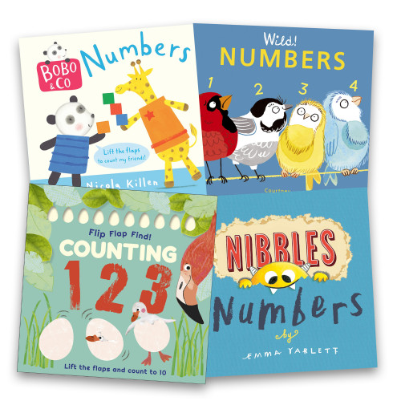
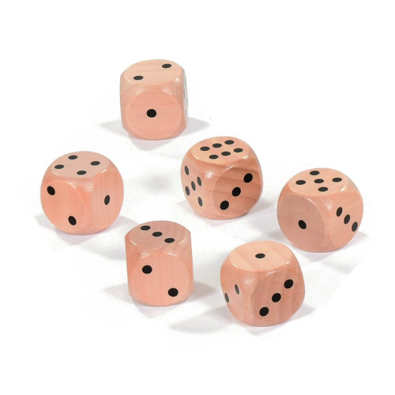
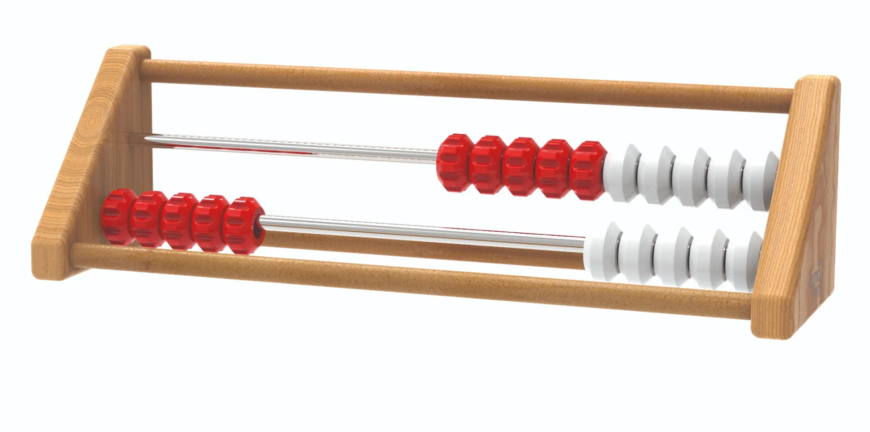

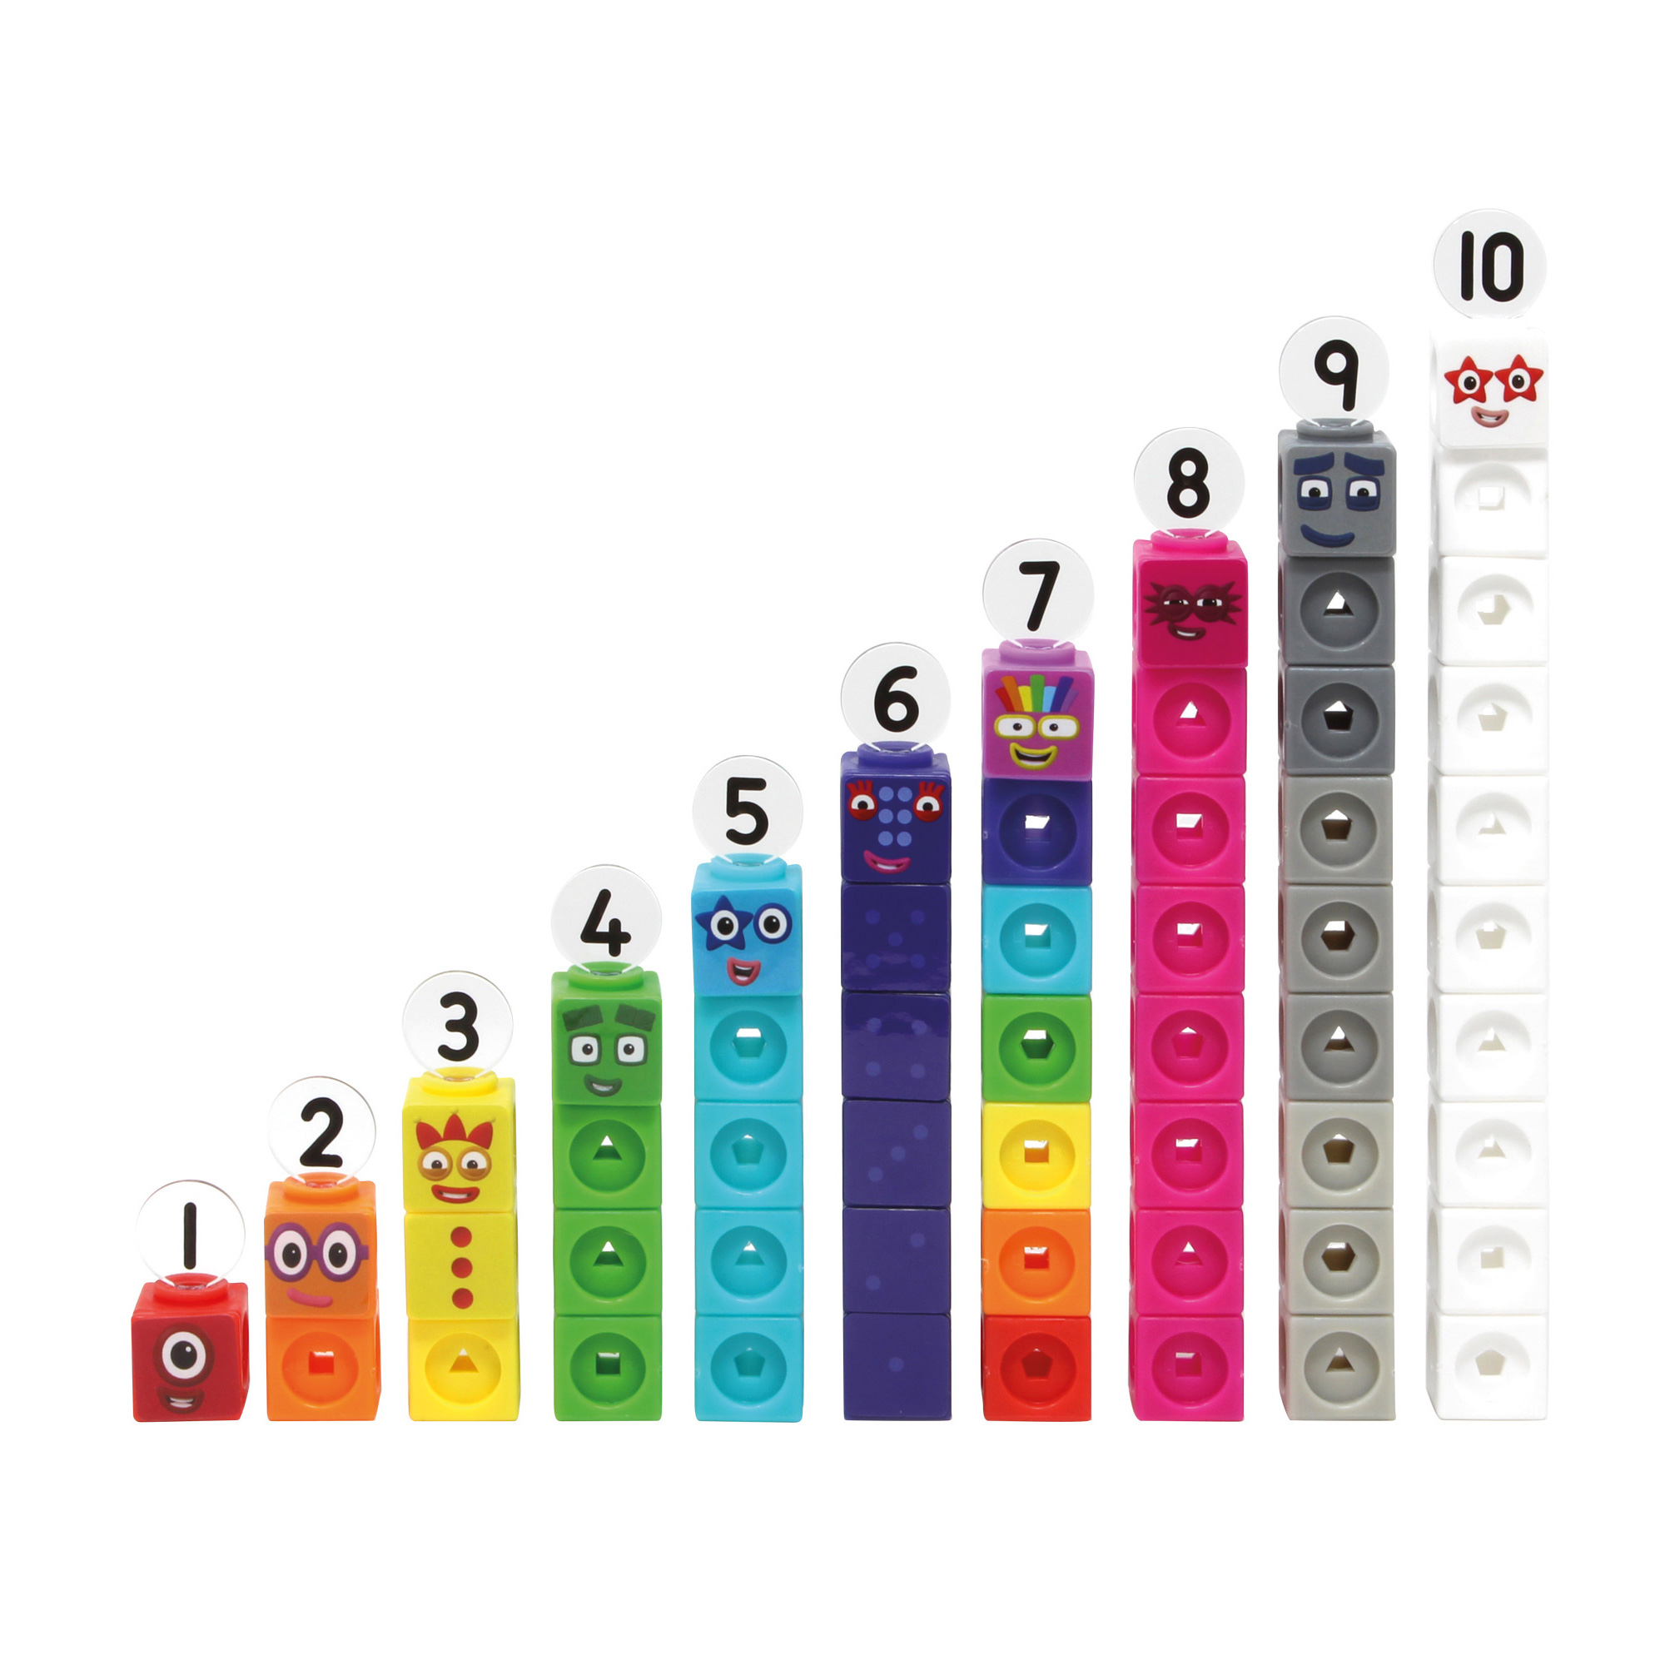
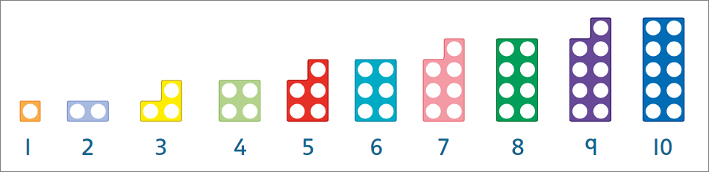
Resources
we use…
Notes:
Books!
Dice - subitising
Rekenrek - 20 bead resource to learn subitising, addition, subtraction, number bonds
Numberblocks - Interlocking cubes which children can build to deepen number sense of addition and subtraction
Numicon - plastic shapes with holes in to represent a number. Can be used to combine when teaching and practising number bonds.
Ten Frame - two-by-five rectangular frame using counters to represent numbers to 10

Slide 10


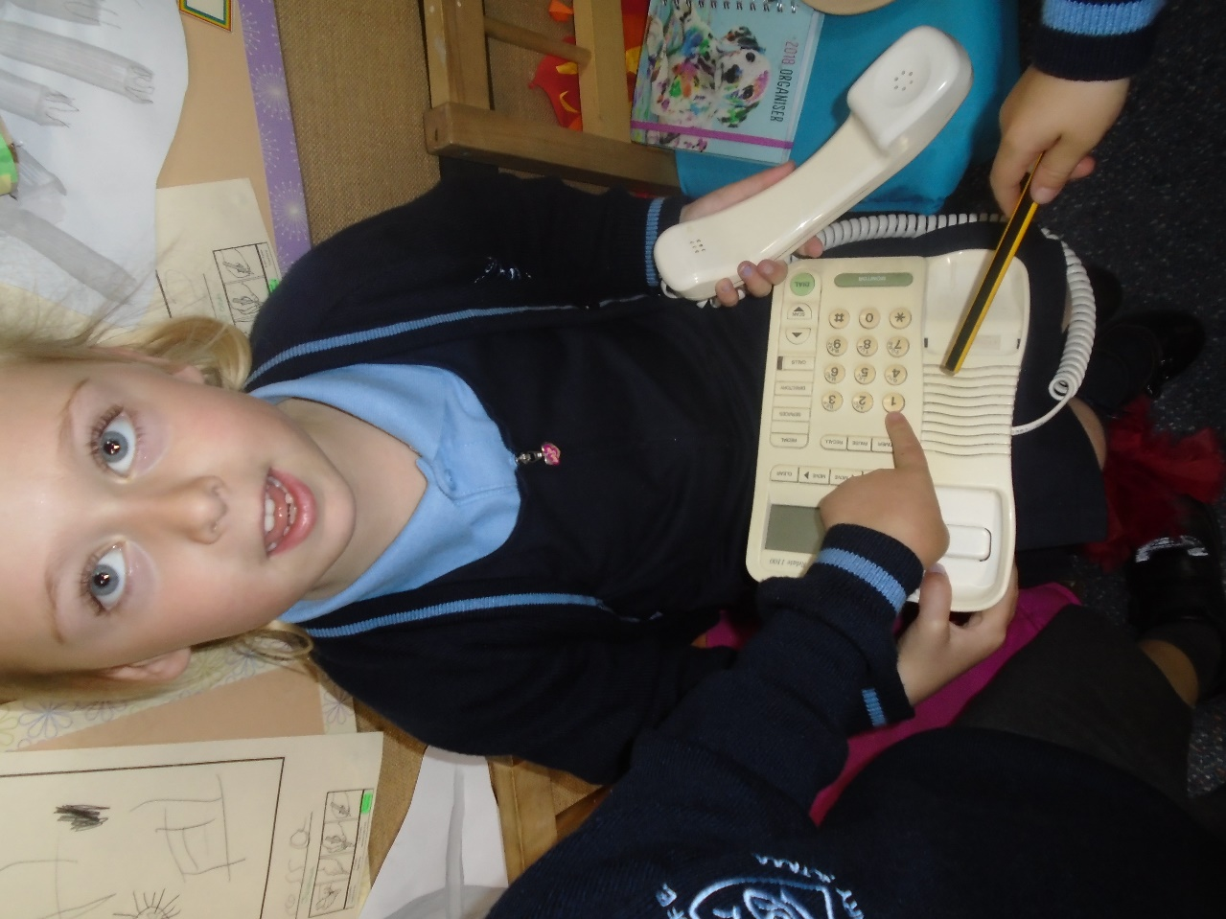

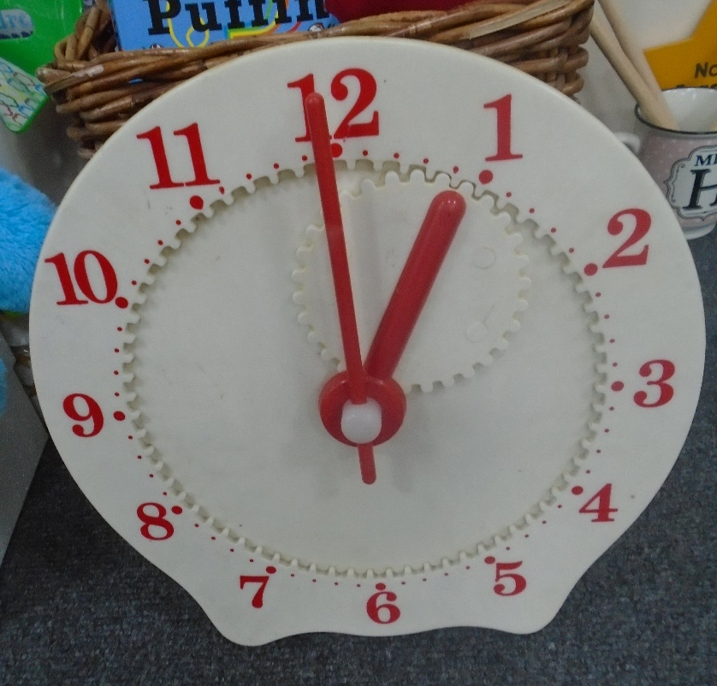
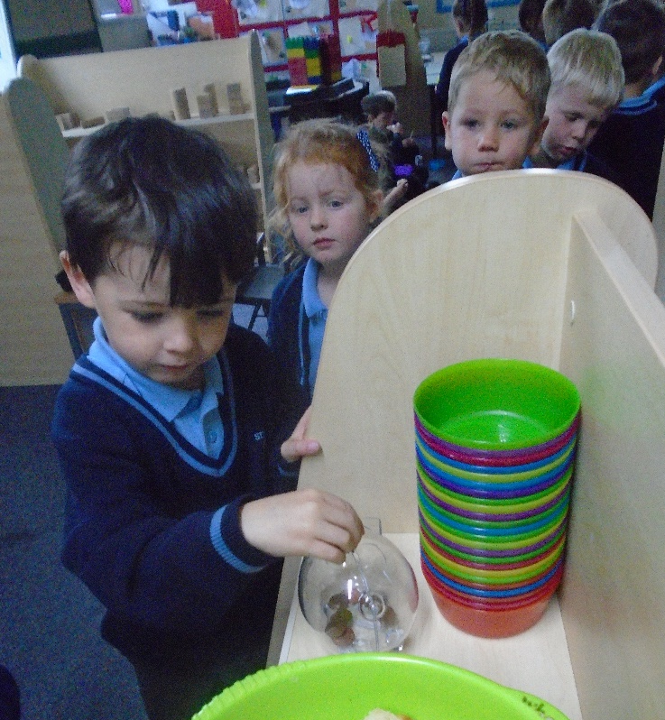
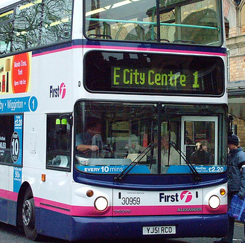
And beyond…
Notes:
These are just a few pictures to help us see and recognise that we are surrounded by number and we can all encourage number recognition with our children. Children learn best when they can experience the real thing, when numbers are brought to life and have meaning or they’re relevant to the child. A few examples here are door numbers, baby brother/sister birthday cards. Balloons and cards in the shops, 1 O’Clock, paying for things in the shop with £1 or 1p.

Slide 11
Moving to Year 1 and the National Curriculum.

Slide 12
Mathematics Year 1 expectations
Count to and across 100, forwards and backwards from any number.
Read and write numbers to 20 in numerals and words.
Count, read and write numbers to 100 in numerals.
Say 1 more/1 less to 100.
Count in multiples of 2, 5 and 10.
Use bonds and subtraction facts to 20.
Add and subtract 1 digit and 2 digit numbers to 20, including zero.
Identify and represent numbers using objects and pictorial representations including the number line, and use language of: equal to, more than, less than (fewer), most, least.
Solve one-step problems that involve addition and subtraction, using objects, pictorial representations and missing number problems.
Solve one-step problems involving multiplication and division using objects, pictorial representation and arrays.
Recognise half and a quarter of objects, shape or quantity.
Sequence events in chronological order.
Use language of day, week, month and year.
Tell time to hour and half past.
Compare, describe and solve practical problems for lengths and heights, mass or weight, capacity or volume, and measure and begin to record them.
Recognise and know the different denominations of coins and notes.
Recognise and name common 2D and 3D shapes.
Describe position, directions and movements, including whole, half, quarter and three-quarter turns.

Slide 13
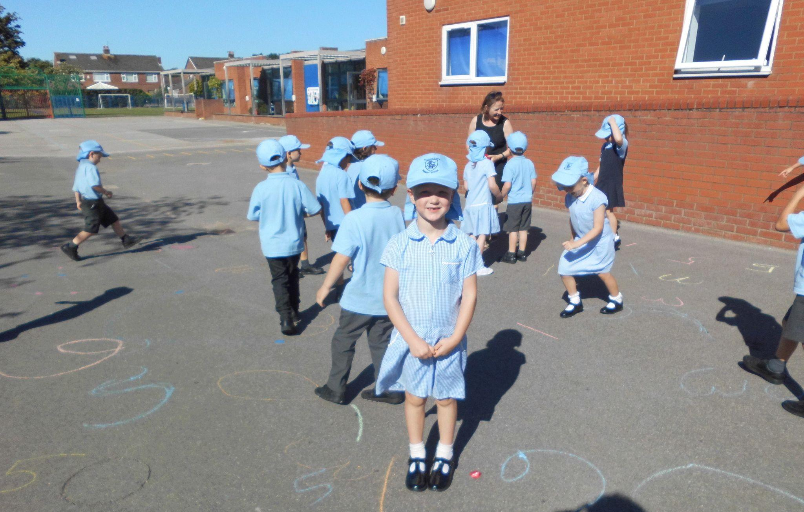
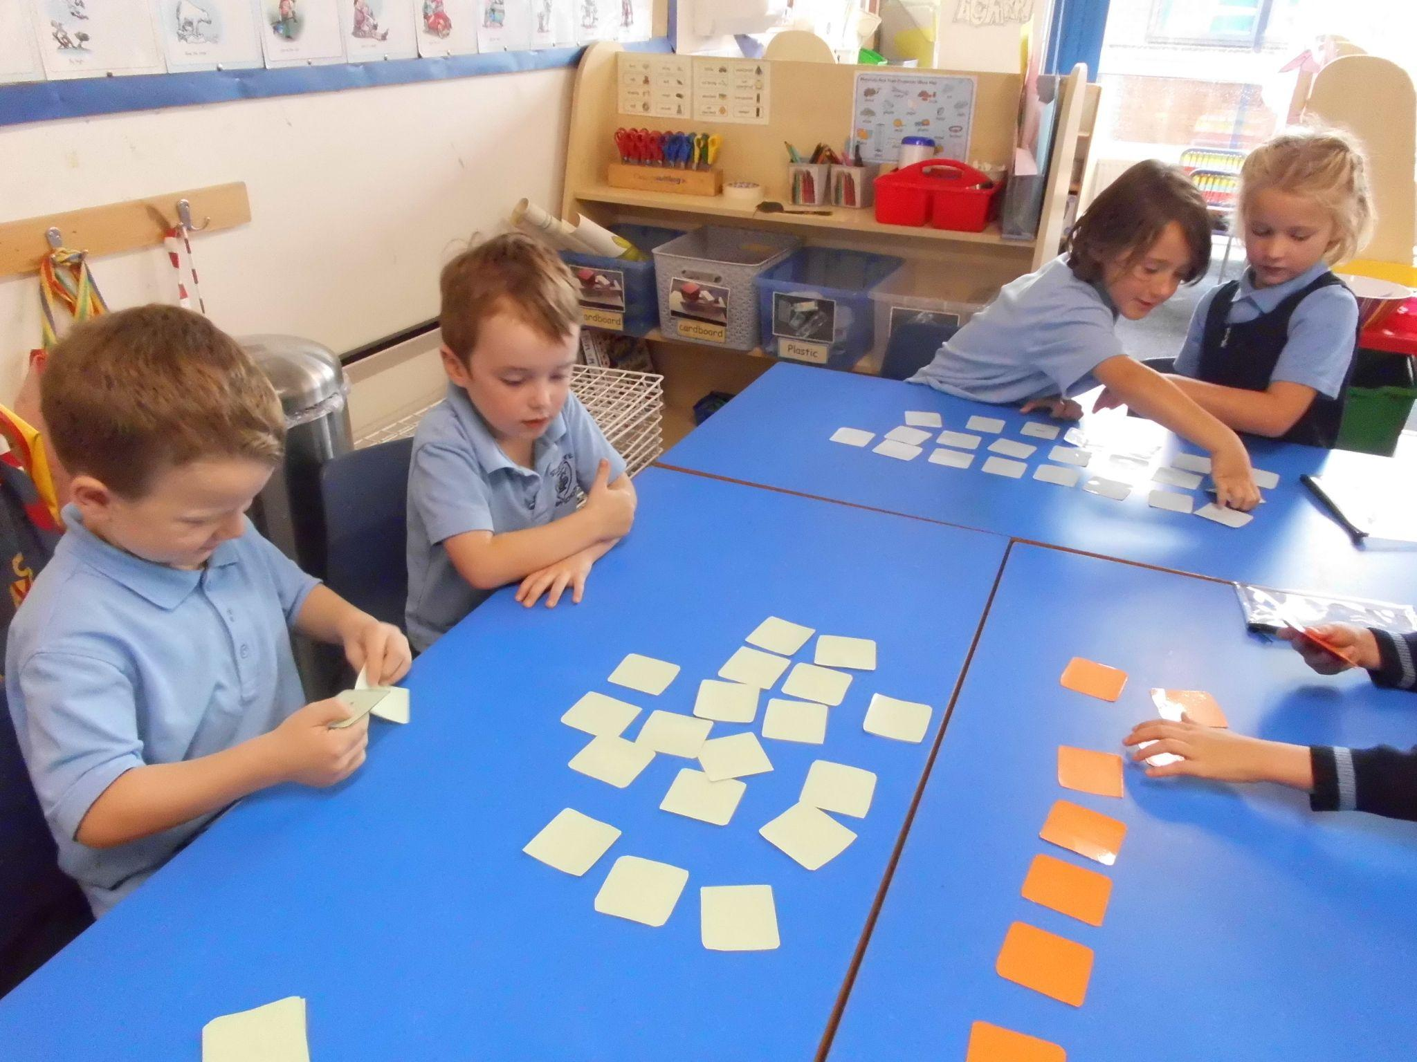
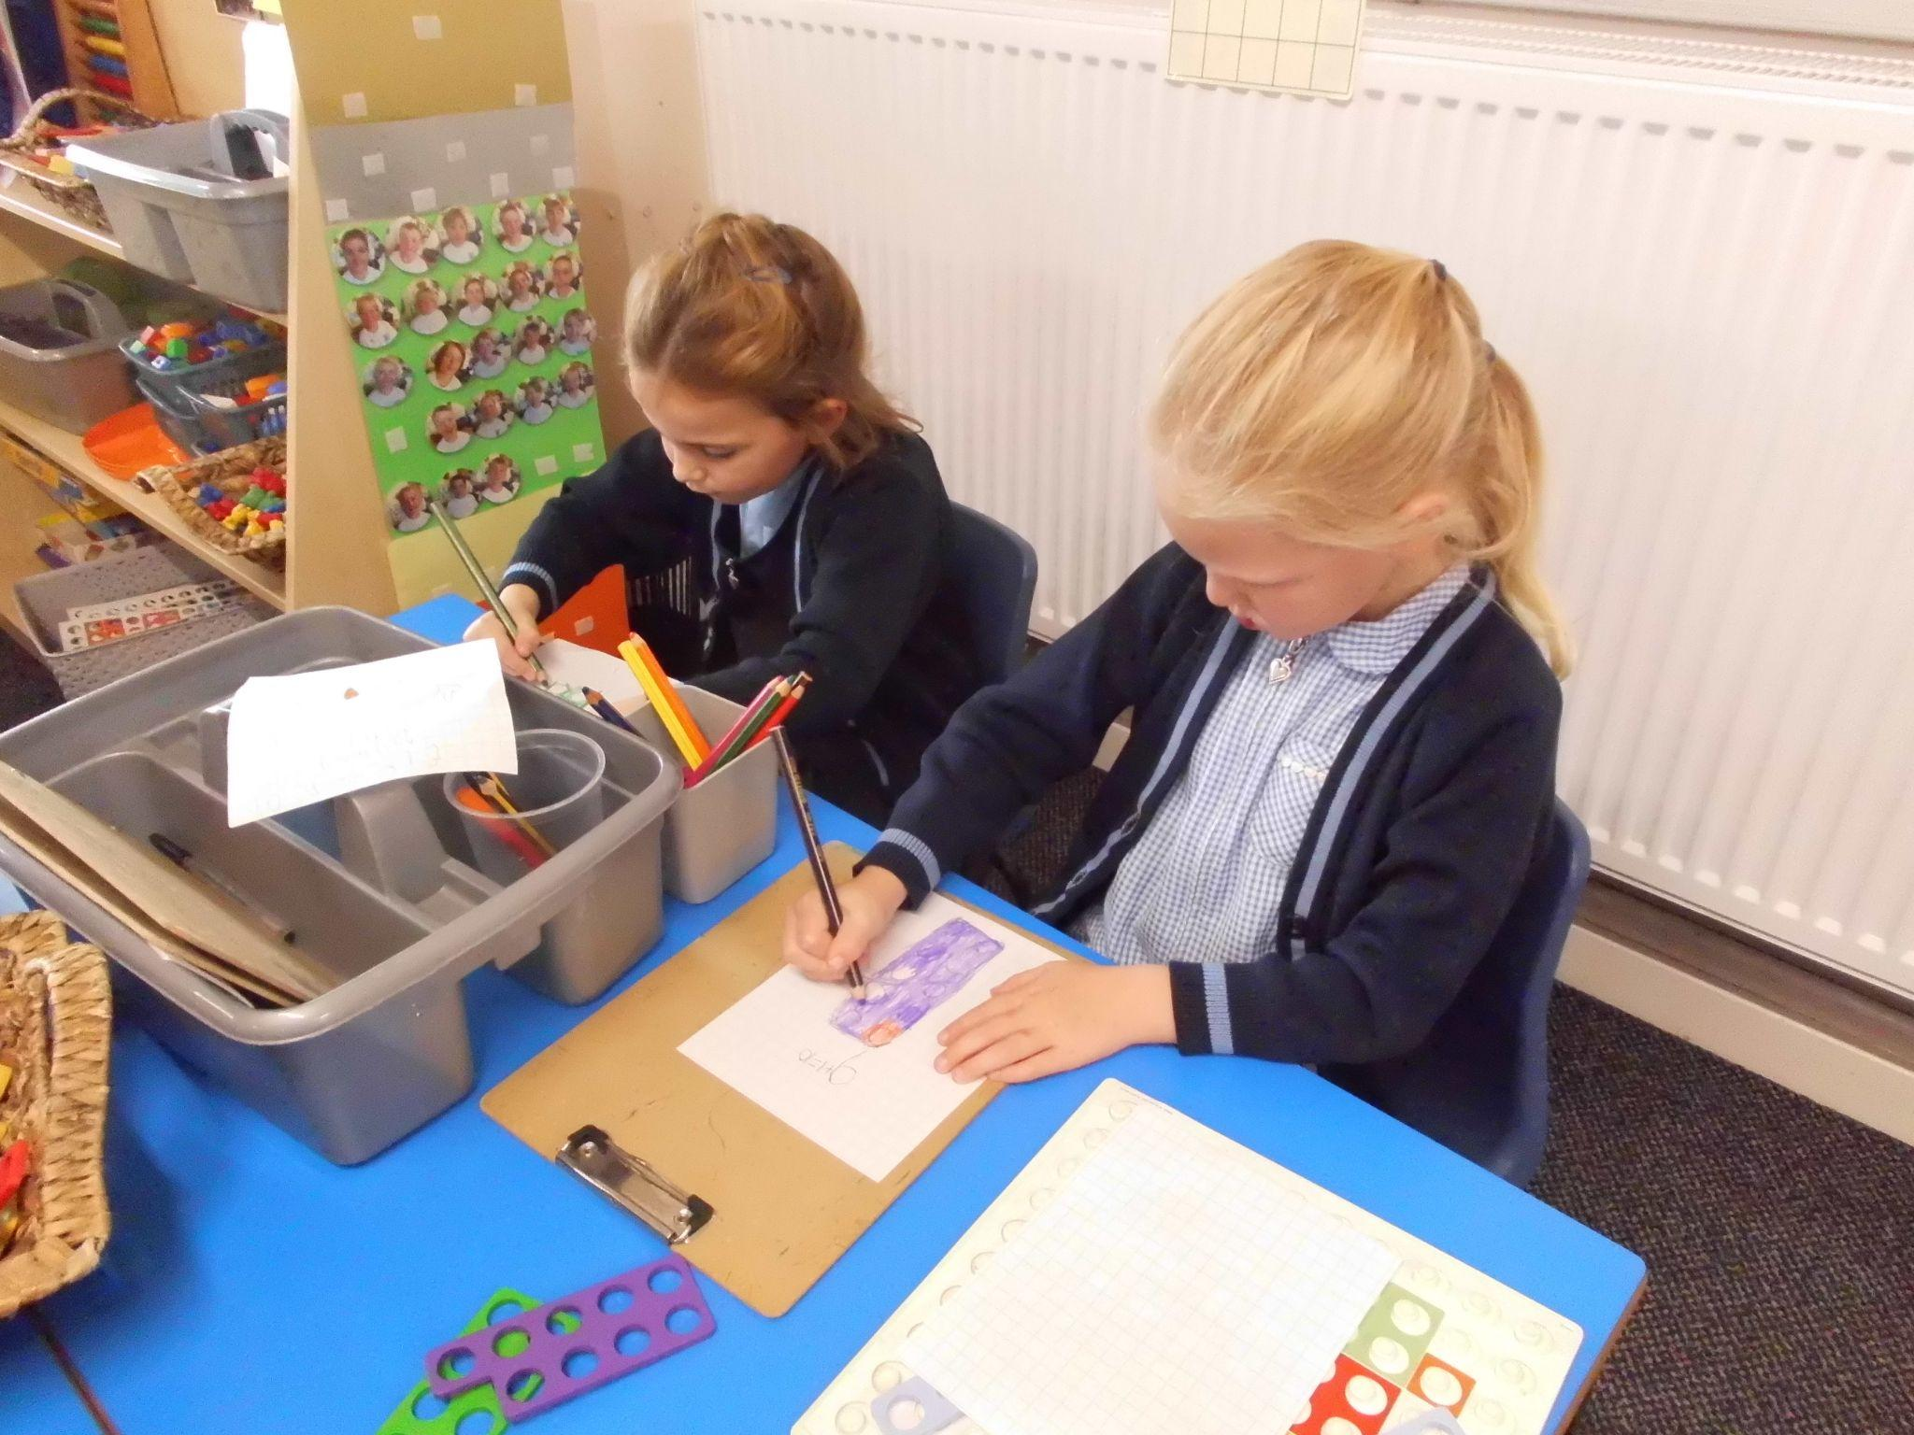
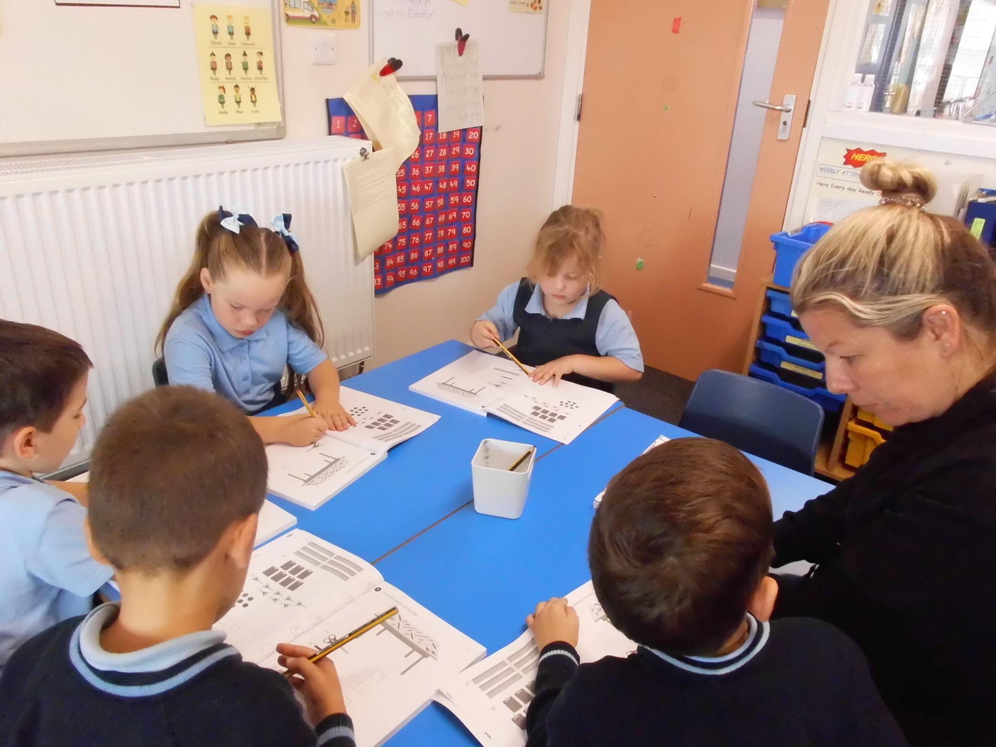
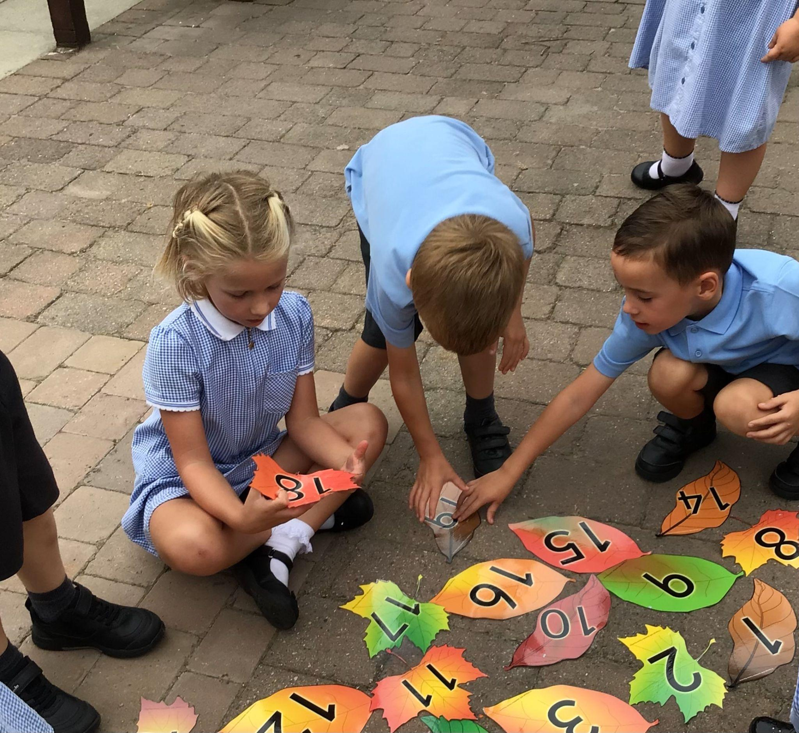
Playing maths games independently, after adult guidance.
Taking maths outside.
Choosing my own learning!
Maths in Year 1
Morning motivator
Daily ‘Maths No Problem’ lesson- Exploring, Journaling and guided session.
Rekenrek session.
Maths within the daily Continuous Provision.
Seeing maths opportunities everywhere!
Maths No Problem, guided sessions.
Linking maths to topics.

Slide 14
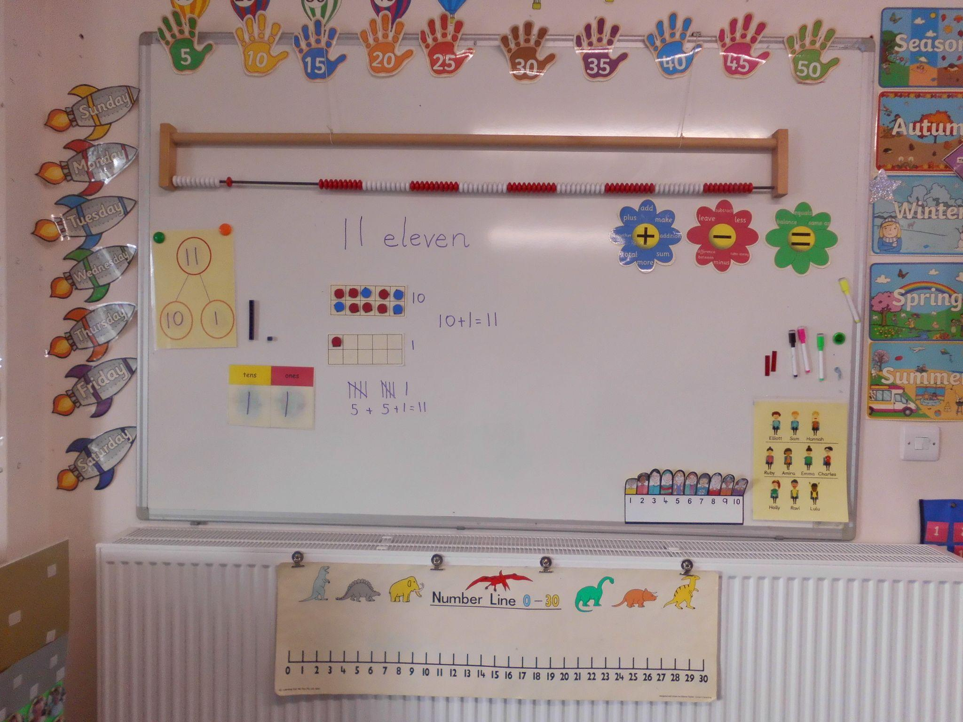
Maths working wall.
Referred to daily by adults, and reflects ongoing skills and concepts as well as new teaching.
Children are encouraged to use the working wall to support their learning and growing independence.

Slide 15
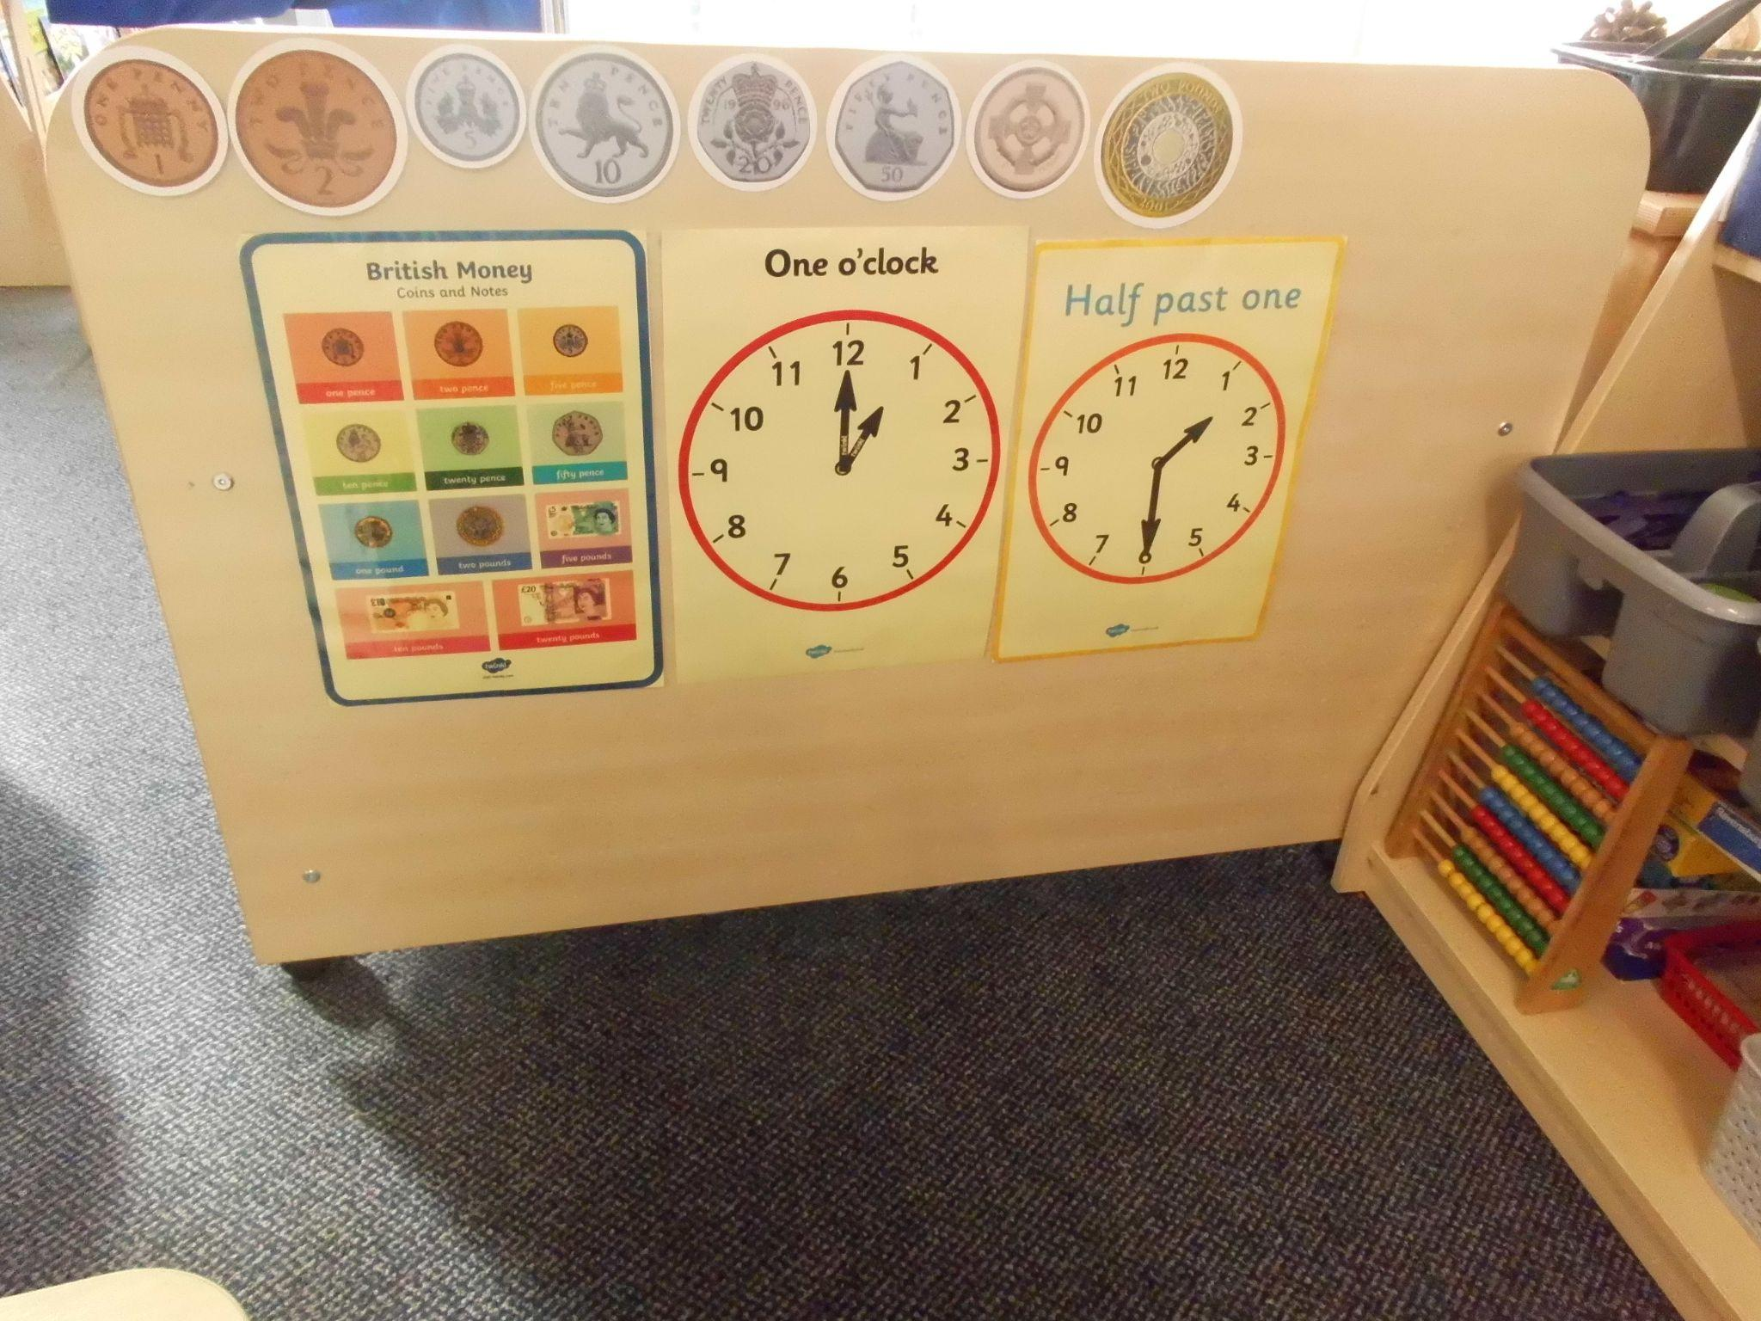
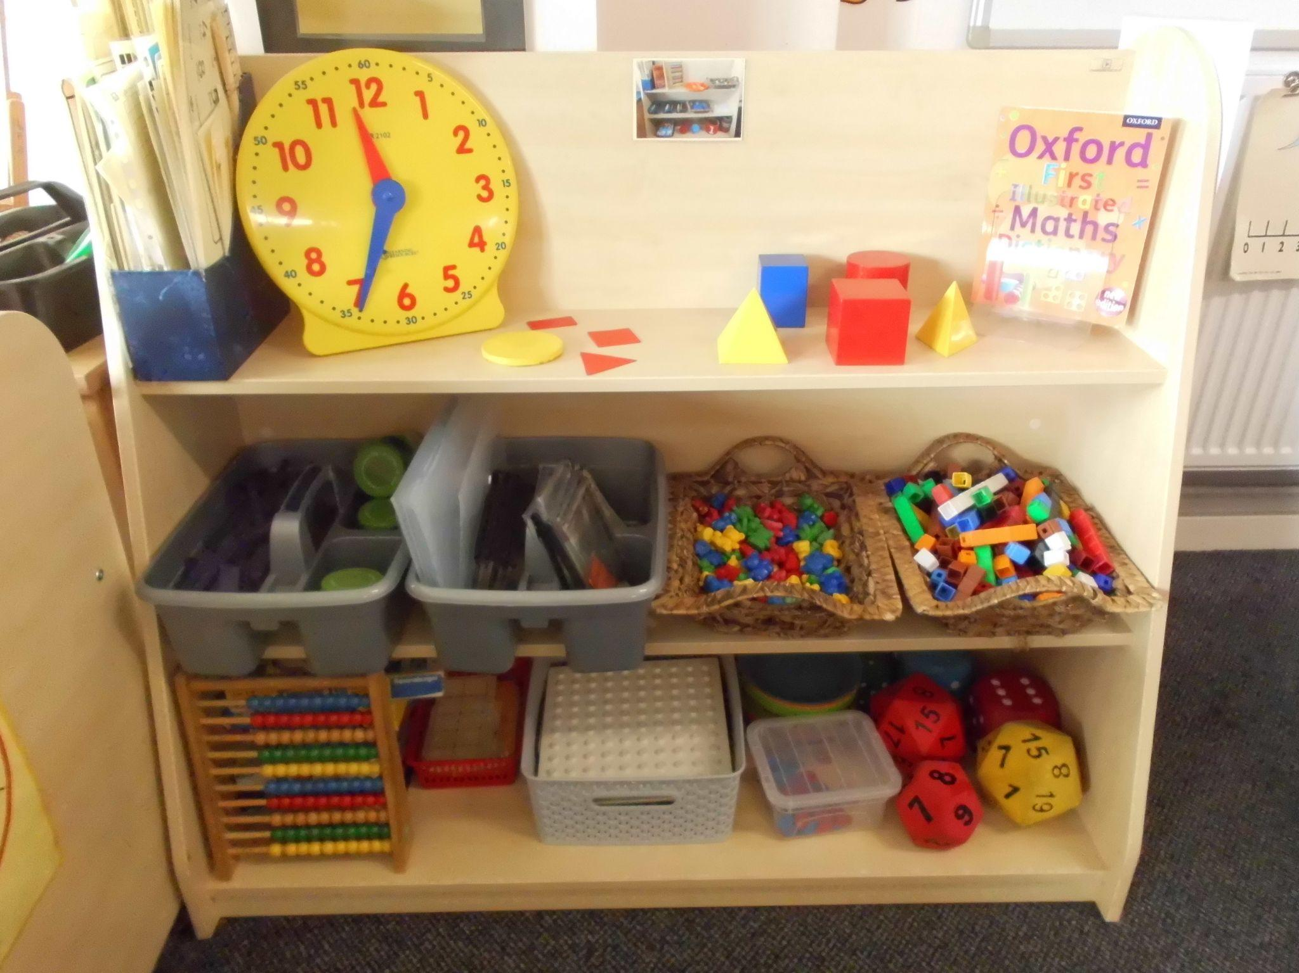
Children learn to access resources to encourage independent learning.
Weekly Shape, Space and Measure is taught weekly, during morning motivator time. As well as discrete teaching through the year.

Slide 16
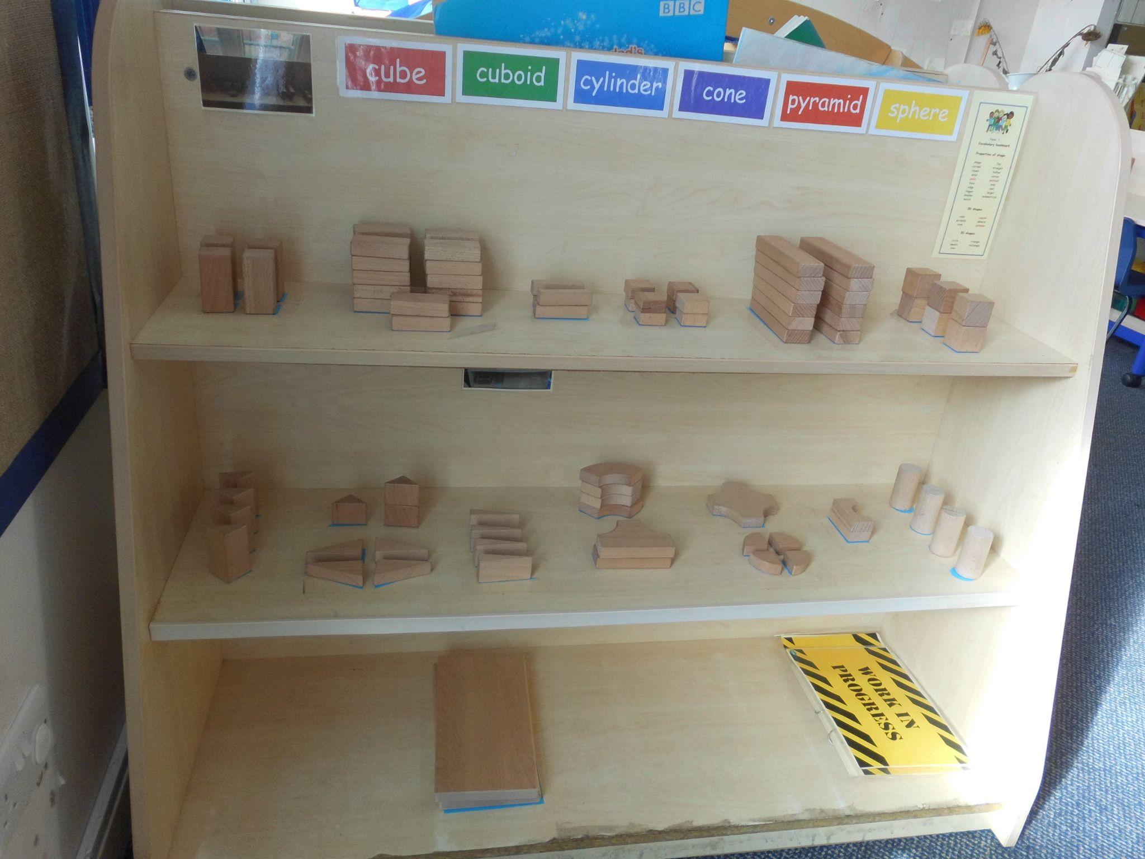
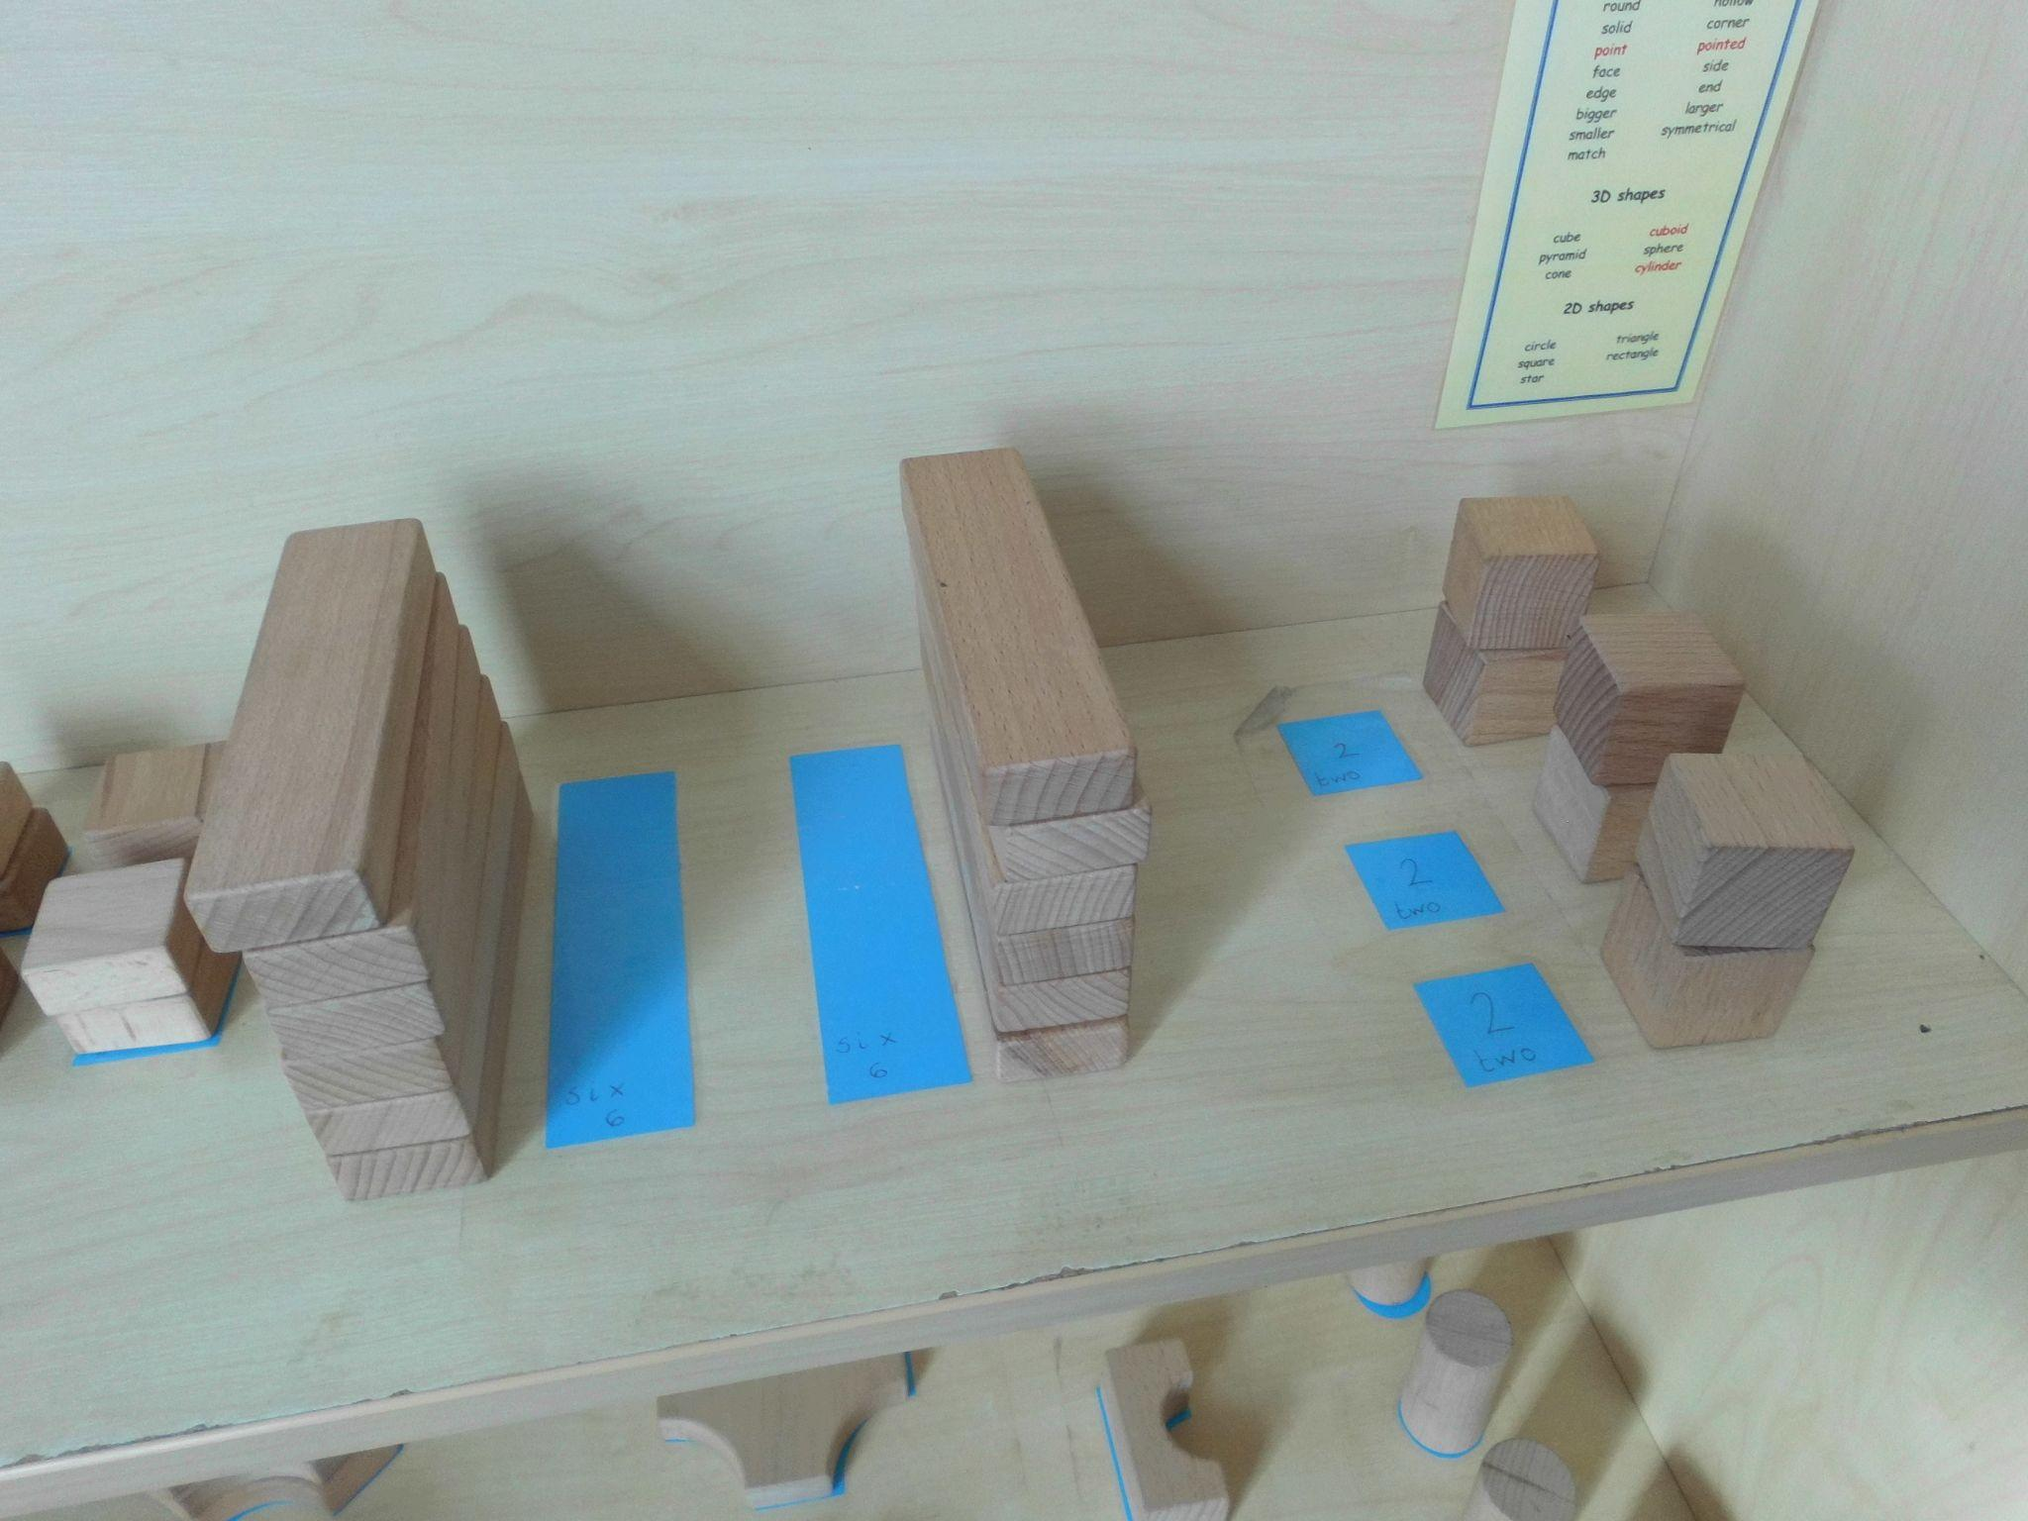
Learning is woven through independent learning opportunities in the continuous provision. Wherever possible, adults engage with children to help develop their knowledge, skills and understanding, and apply their learning to everyday situations.

Slide 17
How to help your child to achieve the Year 1 objectives in maths.
Engage with the weekly home learning tasks on the ‘Home Learning’ page of the school website. This will inform you of what your child has been taught, how you can support at home, as well as what will be covered the following week.
Engage with the maths ideas on the Year 1 Home Learning grid (on the inside cover of your child’s home learning book).
Numbots online resource. Your child’s password will be placed in their Home Learning Book.
Help your child to see maths everywhere, and engage your child in everyday situations that involve maths e.g. shopping, measuring, time, counting etc.
Be a role model and demonstrate a positive attitude towards maths, and encourage your child to do the same. Say it is ok to get things wrong. Encourage your child to rise to the challenge to get it right, thus developing resilience and perseverance.

Slide 18
Further on in School
The fundamentals of Early Years and Year 1 are used in daily life throughout the rest of your child’s time here.
We encourage children to explore mathematically as much as possible, both inside and outside of lessons to gain a deeper understanding of maths.
We continue to use manipulatives similar to those on your table right through Ks2.

Slide 19
Manipulatives
Help Children to understand mathematical concepts better.
Run right through to Year 6.
Always made available for children to use.

Slide 20
Subitisation

Slide 21
Useful Resources
Numbots - Subatisation, Early Addition and Number-bonds (Online or App). https://play.numbots.com/?#/game/game-mode
Number Blocks (BBC iplayer) - Website to help for numbers.
Top Marks - Website with resources and games.
NRICH - Activities for all ages.

Slide 22
Thank you for your support.
Please remember, staff are always here to help and guide. Please just ask if there is anything you need clarification with, and we will be happy to help.

