Slide 1

Sefton’s
Mental Health Support Team
(MHST)
Understanding & Managing
Anxiety in Children.
A Workshop for Parents and Carers.

Slide 2
Introduction
Housekeeping
  Fire alarms
  Toilets
  Phones
  Expected length of session
Confidentiality Contract
Respect each other
Participate

Slide 3
Useful Information and Terms
What is an Education Mental Health Practitioner (EMHP)?
Early intervention for mild to moderate Mental Health difficulties
What is a Mental Health Support Team (MHST)?
MHST - early intervention Mental Health support in school following green paper (2018) recommendations ‘transforming CYP’s MH provision’
How do I refer?
Speak to your child’s Teacher/SENCO/Mental Health Lead

Slide 4




What do you want to get out of today?

Slide 5
Aims and Outcomes
An understanding of anxiety
Understand how anxiety presents in children
Gather ideas around how to talk about anxiety and how you can help them
Know how to get further support for your child’s mental health if needed

Slide 6
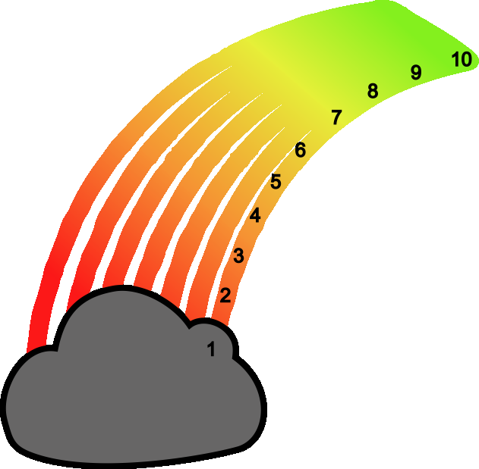
How are you feeling?
The ROAR rainbow
Merseyside Youth Association (MYA)
ROAR Training available for school staff
Check emotions and feelings
Raise awareness
What is your ROAR rainbow number today?
/
https://www.roarresponse.com/

Slide 7
What is anxiety?
What comes to mind when you hear the word “anxiety”?
Words? Images?
Please share with others/the group!
Food for thought – does this activity make you feel anxious?

Slide 8
NHS.uk describes anxiety as a feeling of unease, such as worry or fear, that can be mild or severe.
Everyone has feelings of anxiety at some point in their life. For example, you may feel worried and anxious about sitting an exam, or having a medical test or job interview.
During times like these, feeling anxious can be perfectly normal.
But some people find it hard to control their worries. Their feelings of anxiety are more constant and can often affect their daily lives.

Slide 9

What types of things can children worry about?
Friendships
Family
School/education
How they look
Getting ill or being sick
Getting in to trouble
Things that have happened
Things that could happen
Death
Loss/Grief
New family circumstances
Separation

Slide 10

Everyone has worries!
Some young people are good and stopping their worries from affecting them.
Some young people already have a good understanding of their worries and what worry is.
But sometimes young people get stuck with their worries and can’t stop thinking about them which make them grow bigger.

Slide 11
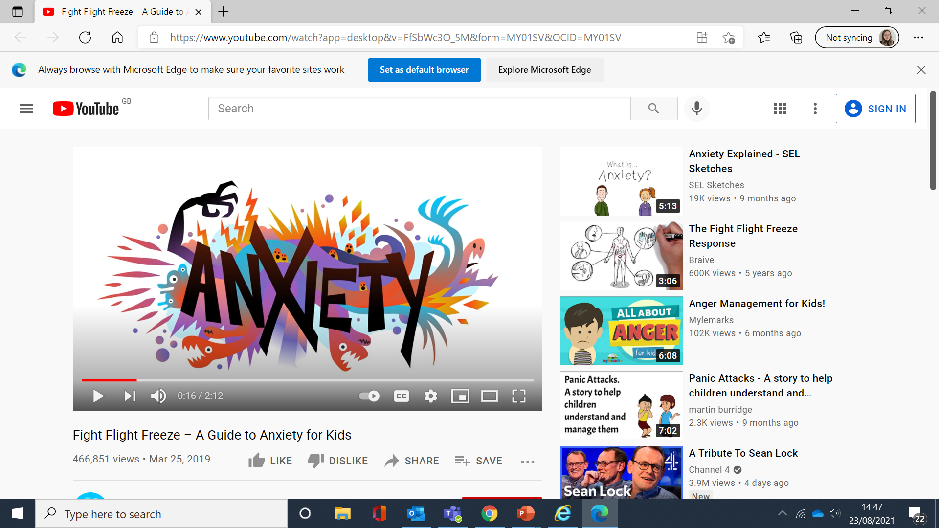
Why do we get anxious?
Fight Flight Freeze – A Guide to Anxiety for Kids - YouTube

Slide 12
Main points to takeaway…
Anxiety effects our mind and body
It’s automatic, we have no control over it and we cant chose how to react
  Fight
  Flight
  Freeze
It does this to keep us safe – it is not dangerous
Our brain does not always know the difference between actual and imagined danger – it reacts the same to both
Knowing about why our body reacts the way it does takes away some of the worry about worry!

Slide 13
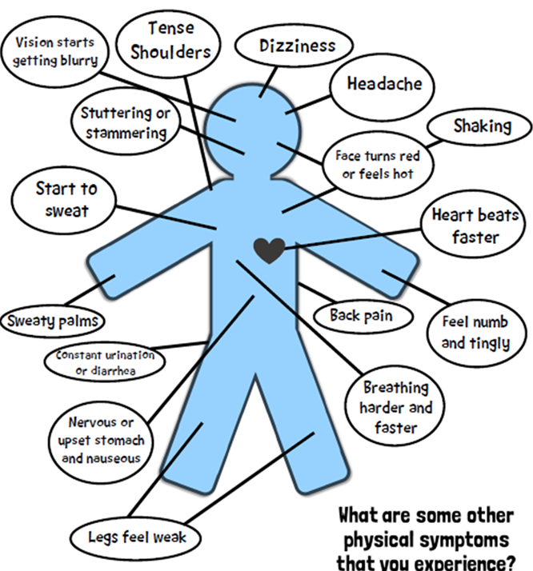
What does anxiety sound like in children?
“I have a tummy ache”
“I feel sick”
“My head feels funny”
“I have a lump in my throat”
“I feel light/floaty”
“I can’t stop shaking”
“I just feel horrible”
Any of these familiar to anyone?

Slide 14
What it can look like in children
Fight
  Angry
  Irritated
  Frustrated
  Argue
  Shout
  Anything that can push the ‘dangerous’ thing away
Flight
  Avoid
  Refusal to go places
  Cry
  Panic
  Make up excuses – ‘don’t feel well’
  Delay
  Go on phones, Xbox/play stations, play with fidgets etc.
  Anything that takes us away from the ‘danger’
Freeze
  When we feel we can’t fight or escape the danger
  Shut down
  Can’t speak
  ‘dream-like’
  Out of our body

Slide 15
How are you currently supporting your child with anxiety?
You can either share them with the group
Or if you’d prefer, write them down and share them anonymously

Slide 16
Ways to support your child with worry and anxiety
Create a space for conversation
Show that you are available to talk but don’t force the conversation
Be open and available, allowing conversation to flow when the young person is ready
Children often find it easier to talk when they are doing another activity such as during a walk, drawing or baking
Take it seriously
Ask open questions
“How did your day go today?” rather than “Did you have a good day?” – helping to extend the conversation and invite them to give more details
Don’t downplay what they’re saying or tell them they’re “just being silly”. What they feel is real, even if we don’t agree with what caused them.

Slide 17
Calmly stay with the feelings that arise
Children look to those around them to judge how they should react/respond
You may notice your automatic reaction to steer away from difficult emotions. Remember this is an opportunity to model that it’s ok to feel them and good to talk about them
Empathise, normalise, validate rather than finding solutions
It feels natural to offer reassurance and look for solutions when worry comes along. But early reassurance can sound like “everything’s fine” and that the worry reaction itself is a problem to be solved
Show that you accept what they are telling you but don’t try to solve the problem. Often feelings just need to be felt and accepted – feelings are not problems to be solved

Slide 18


Introduce alternative perspectives and ways of thinking
A worry is a thought – not necessarily a fact
What exactly are they worried about? How likely is this to happen? If it did happen, what would it mean?
Exploring these can help put worries into perspective which in turn can lead to less anxiety-provoking conclusions
Reduce environmental stresses
Work out what makes their anxiety worse (e.g. too much social media/reduce daily activities)
Try to keep a routine (balancing things they need to do and want to do)
Try not to add pressure – if this feels overwhelming, emphasis the importance of self care and being kind to themselves

Slide 19
Problem solving and coping
  Focus on emphasising confidence in their ability to cope and engage them in helping to think about different strategies
Future and action orientation | Holding the hope | Keeping up healthy habits
“So what are we going to do about this?” “We can’t do X… but we can do Y” | That somehow this situation may make space for something different and better to happen | Self care, school, domestic routines

Slide 20
TED Talk
https://www.ted.com/talks/anne_marie_albano_how_to_raise_kids_who_can_overcome_anxiety/up-next?language=en

Slide 21
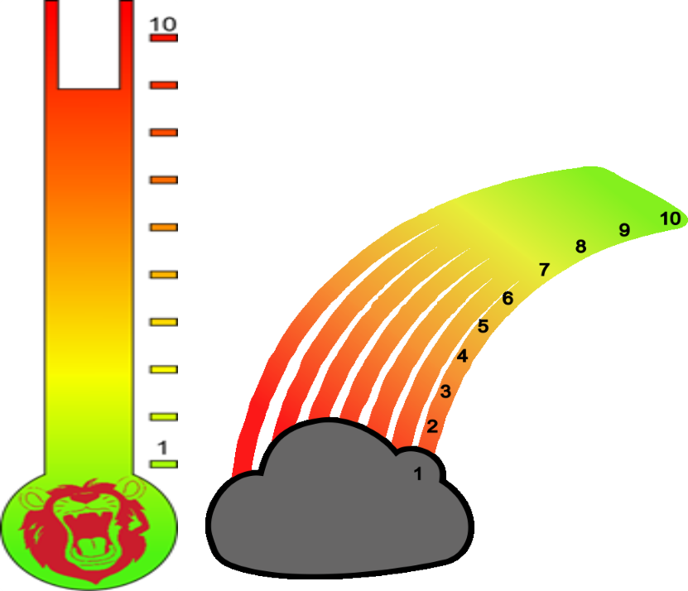
Check-in and monitor progress
ROAR rainbow – daily check in
ROAR thermometer – check in intensity/impact following difficult experiences
Normalise using your own experiences
Give them time and space to digest experiences
Availability

Slide 22
Remember…
No one is perfect!
You may have read through some of those and thought “I do/don’t do that” and start labelling yourself as ‘good’ or ‘bad’
Many of our responses to talking about Mental Health are from what we ourselves have learned from others when we were young
So it may take conscious effort to notice what we are doing and start having healthy discussions about Mental Health

Slide 23
What can I do if I’m worried about my child’s Mental Health?
Talk to class teacher, school mental health lead or GP.
Contact the duty team at Alder Hey for advice and guidance on 0151 293 3577.
Emergency Phone support and crisis management advice is available via: Alder Hey Crisis Care Team - 0151 293 3577 (available 24/7; Under 18s). If/in an emergency contact 999
Access Sefton for Parent Mental Health: 0300 303 2708 Mon- Fri 8am – 5pm
The Samaritans – 116 123 and Childline – 0800 1111 are phone support services, both available 24 hours a day, 7 days a week.
If you feel at risk or unsafe, and in need of urgent support you can go to your local Accident & Emergency (A&E) department (Under 16 = Alder Hey; 16 and over = Adult A&E).

Slide 24
What are you taking away?
Spend some time reflecting on what we have covered today
What stuck out to you/what’s stuck with you?
Is there anything you found particularly useful?
Anything you are going to try moving forward?
Anyone like to share their answers?

Slide 25
Any questions?
Please complete your feedback forms – we value your thoughts and suggestions!

Slide 26
References
https://www.liverpoolcamhs.com/workforce-tools/roar-course/
https://www.roarresponse.com/
https://www.annafreud.org/schools-and-colleges/resources/7-ways-to-support-children-and-young-people-who-are-worried/
https://www.nhs.uk/mental-health/conditions/generalised-anxiety-disorder/overview/
https://www.youtube.com/watch?app=desktop&v=FfSbWc3O_5M&form=MY01SV&OCID=MY01SV

