Slide 1
SATs and Dearne Valley Parents’ Meeting 2026

Slide 2
SATs 2026
Key Dates:
Monday 11th May until Thursday 14th May 2026
Purpose of KS2 SATs
SATs reflect the level a child is working:
Towards the expected standard
At the expected standard
Greater depth
A child needs to achieve a scaled score of 100 or more to be classified as working at the expected standard. If they do not achieve a scaled score of at least 100, this indicates they have not reached the expected standard set out by the government.

Slide 3
Breakdown of SATs
Date | Paper
Monday 11th May | Spelling, Punctuation and Grammar Test Paper 1 - Punctuation and Grammar 45 mins 50 questions worth 1 mark each. Paper 2 – Spelling 20 words to spell worth 1 mark each.
Tuesday 12th May | Reading Test – 1 hour Questions based on 3 texts. Total 50 marks
Wednesday 13th May | Maths Paper 1 – Arithmetic 30 mins Basic skills questions worth 40 marks Paper 2 – Reasoning 1 40 mins Worded questions worth 35 marks
Thursday 14th May | Maths Paper 3 – Reasoning 2 40 mins Worded questions worth 35 marks
Friday 15th May | No Test

Slide 4
What can you do?
Help practise Key Skills with your child (Spellings, Times Tables, Etc.)
Ensure to keep a healthy bedtime routine.
Encourage your child as much as possible to do their best.
Encourage them to eat a healthy and balanced breakfast on the morning of the texts.
Get children into school from 8:35 so that they are not rushing or holding up the cohort.

Slide 5
Dearne Valley 2026

Slide 6
Key Information
Sunday 21st June to Wednesday 24th June 2026 Children will be going to their High Schools for transition (If Formby based) on Thursday 25th June, but will not be in on Friday 26th June.
Dearne Valley is an Outdoor/Adventurous Activity centre run by PGL (The same company which ran Colomendy).
Children will be taking part in team-building, active, adventurous and fun activities throughout the 4 days there.

Slide 7
Accompanying Staff
Mr Hardman
Mr Corbett
Mrs Allen
Mrs Platt
Miss Thomas
Mr Smith
Miss Woodward

Slide 8
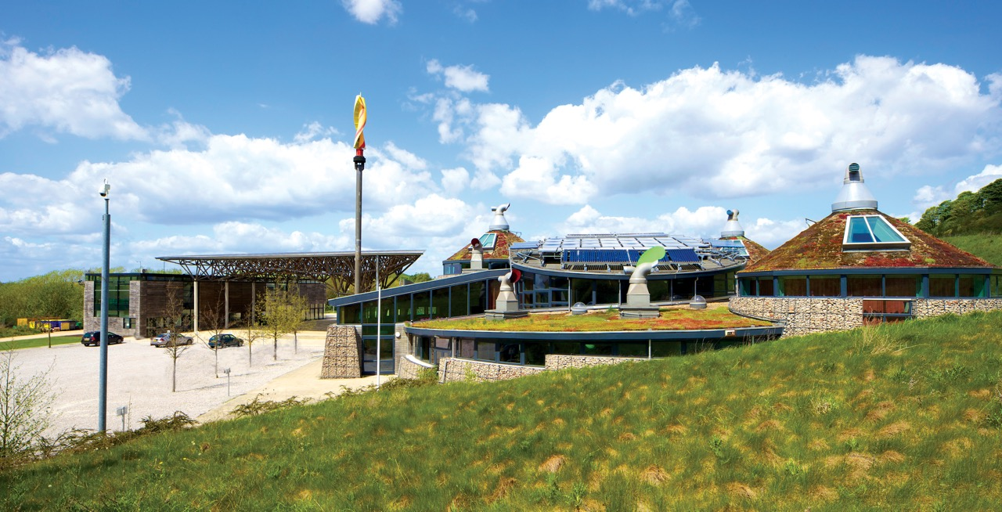
Welcome to
Dearne Valley
Denaby Main, Conisbrough,
South Yorkshire, DN12 4EA

Slide 9
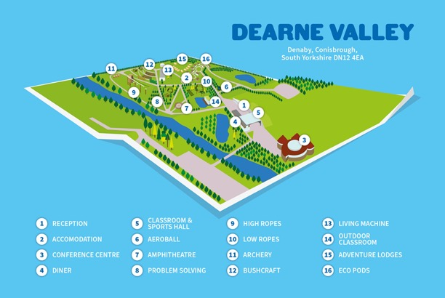
Your centre
A unique blend of nature, adventurous activities, and contemporary purpose built accommodation and high quality learning facilities.
Formerly the Earth Centre, one of the millennium commission projects, Dearne Valley was transformed into a state-of-the-art activity centre in 2012. Dearne Valley is our most environmentally sustainable centre, complete with one of Europe’s largest solar panels and an on-site water treatment plant.
With fantastic indoor and outdoor activity facilities surrounded by the beautiful countryside of South Yorkshire, a purpose built watersports lake and access to the adjacent River Don for watersports, Dearne Valley offers something for everyone.

Slide 10




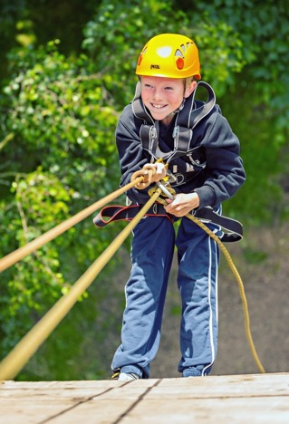
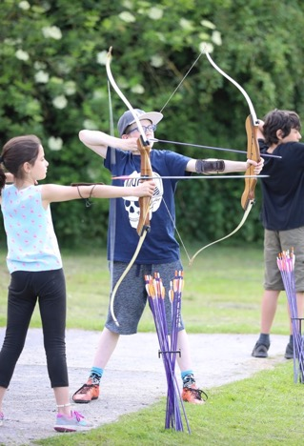
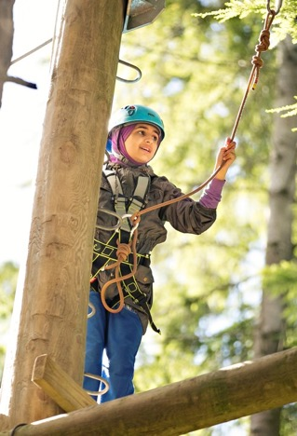
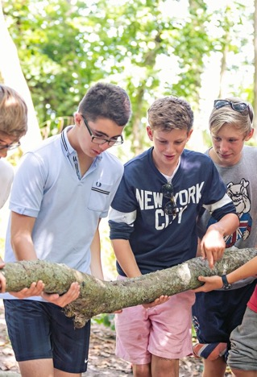
Highlights of
Dearne Valley

Slide 11





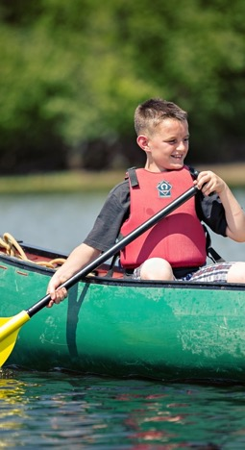
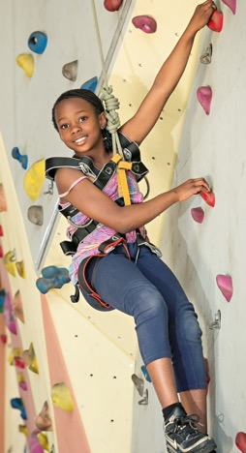
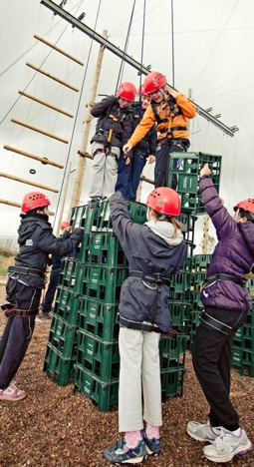
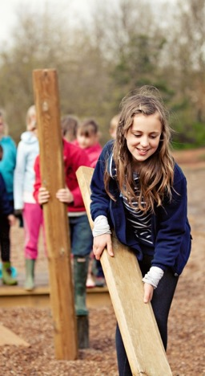
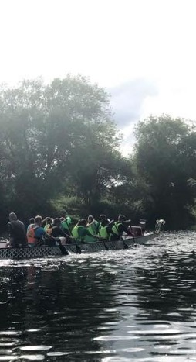
Highlights of
Dearne Valley

Slide 12





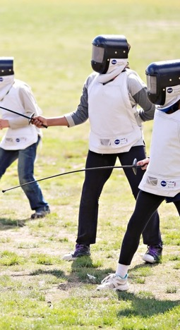
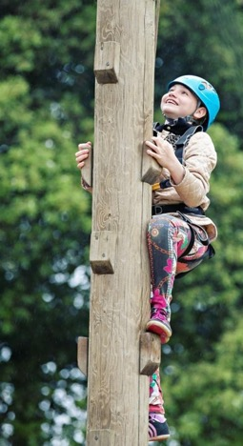
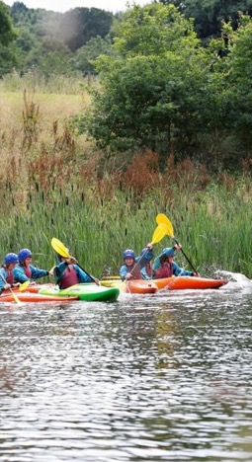
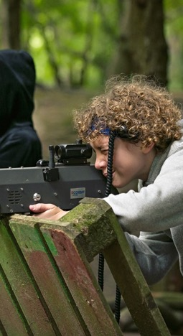
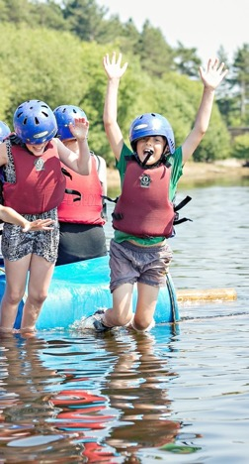
Highlights of
Dearne Valley

Slide 13
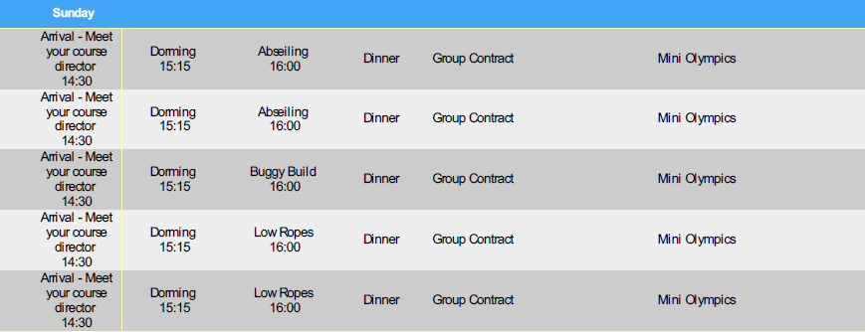

Slide 14
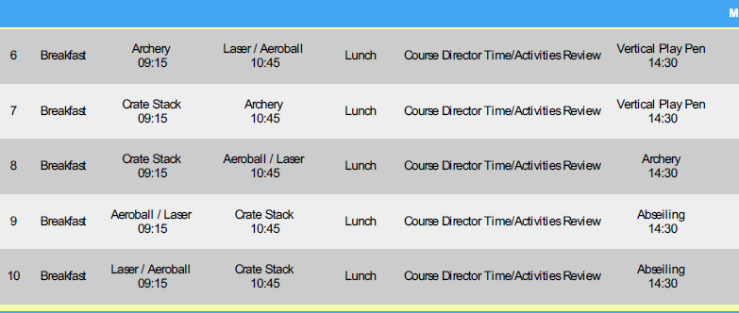

Slide 15
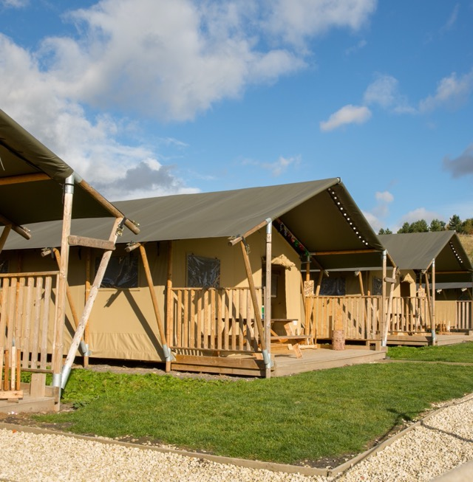
A bit more about your centre…
Sleeping
Dearne Valley has standard dormitory style accommodation. Rooms range from 4 to 16 bed dormitories, some en-suite, with gender-separated bathroom and shower facilities and party leader rooms close by. Adventure Lodges are also available for the ultimate adventure experience, or you could try our brand new Eco Pods! Sheets, duvets and pillows are provided for all guests.
Our Adventure Lodges are the highest quality safari tents, providing a comfortable and secure base for your group throughout your stay. The lodges sites offer a close community feel with campfire areas, perfect for team bonding in the evening.

Slide 16
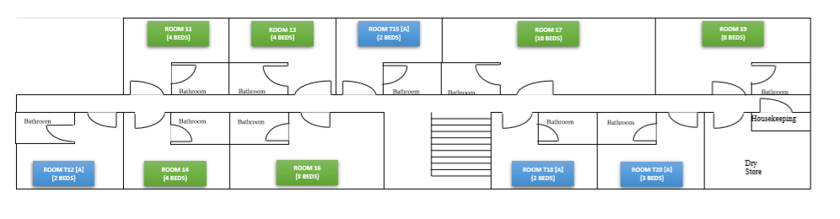
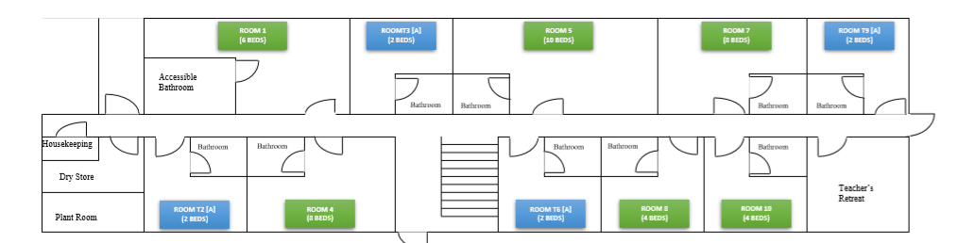

Slide 17
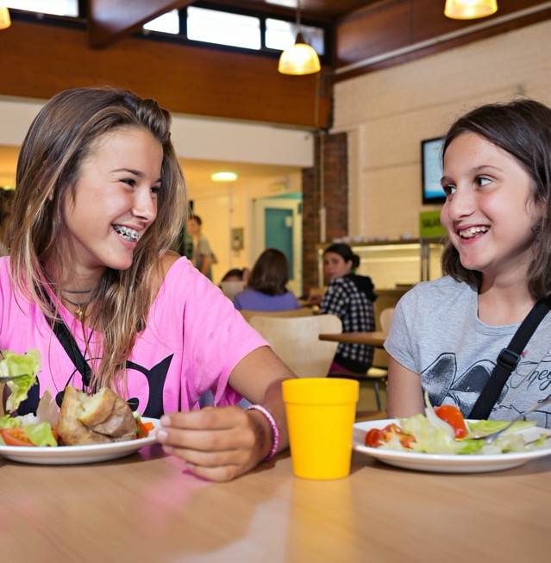
A bit more about your centre…
Eating
To fuel young guests during a long day of thrilling adventure activities, we serve three meals per day, with lots of choice and seasonal variations.
Each day there is a carefully balanced and nutritional meal plan, recently updated to meet and exceed the latest Government standards on young people's. We cater for most dietary requirements – just let us know.

Slide 18
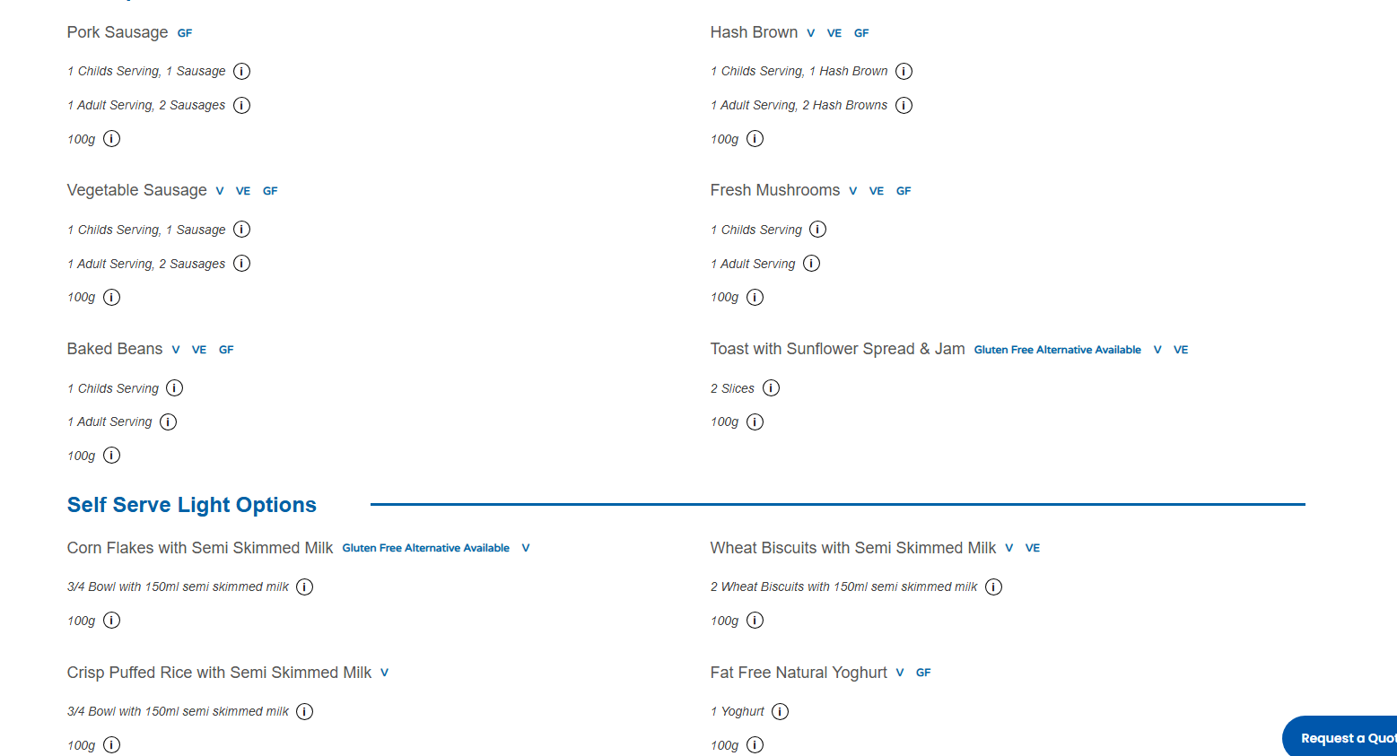

Slide 19
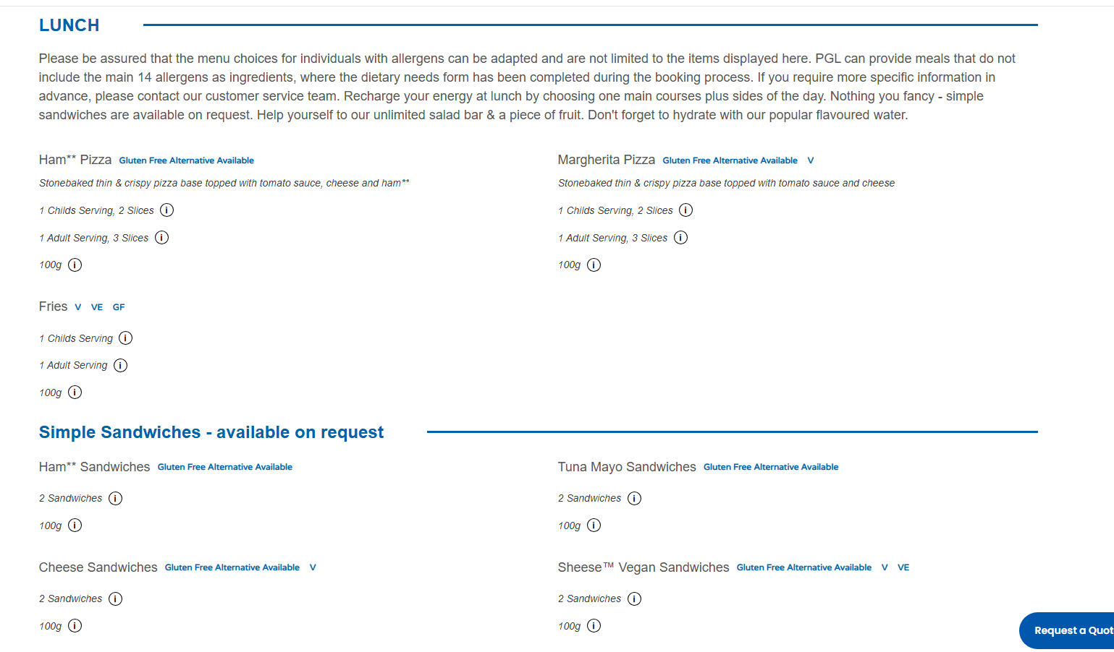

Slide 20
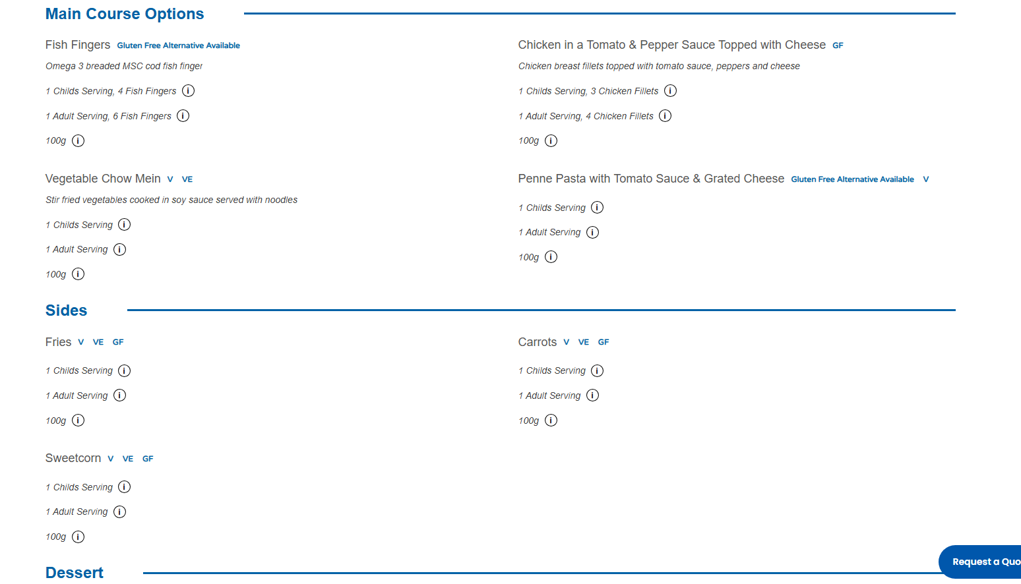

Slide 21
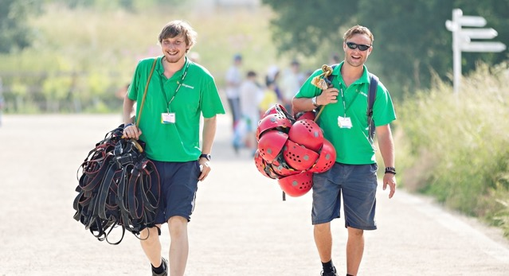
Your centre team
From your first enquiry to getting back to the classroom, we are with you all the way to help you get the most out of your trip.
Experience Experts
They know everything about our programmes and centres, and are your first point of call to tailor-make your perfect school trip.
Guest Services
Our guest services team is here to support you in organising your trip and can answer any questions you have prior to arrival, and before you meet your designated Course Director.
Activity Tutors
Our friendly activity leaders are always on hand to encourage your students. They inspire your students to take on challenges, and fill each day with lots of fun and laughter.
Course Directors
Your dedicated Course Director is your go-to person on any requirements you may have. They will be there when you arrive and throughout your stay, ensuring your trip is a fantastic learning experience that achieves your objectives.

Slide 22
Socks and underwear.
A warm jacket (for evening activities such as when having a campfire).
A waterproof jacket (a cagoule would be ideal).
Waterproof trousers (if you have them).
A large plastic bag for dirty clothing.
Sunglasses (if desired).
Yellow cap and new St. Luke’s hoodie (these will be waiting for you at school on our departure day).
Four thin tops, e.g. t-shirts, shirts, blouses (at least one of these must have long-sleeves).
Two thick tops, e.g. a hoodie and a sweatshirt (one could be your new St. Luke’s hoodie).
Three or four pairs of bottoms, e.g. tracksuit bottoms, leggings, etc. No jeans for the adventure activities please.
Night clothes, e.g. pyjamas, shorts and t-shirt, etc.
One pair of trainers that will be kept clean (please travel in these).
One pair of trainers/outdoor shoes that will be worn for the activities (these will get dirty).
One pair of trainers/outdoor shoes/wet shoes that will be worn for when your child’s group goes canoeing. These could possibly get wet. No wellies or sandals will be allowed to be worn for this activity.
Clothing, e.g. shorts and a t-shirt for when your child’s group goes raft building. These could possibly get wet. After this activity, the children will return to the accommodation to shower and change and a ‘dry room’ is available for their clothing, if required.

Slide 23
A toiletry bag containing: toothbrush, toothpaste, soap, etc. No aerosols please.
A small backpack to be carried onto the coach (for a book, water bottle, etc).
An appropriately sized bag for the coach hold (for clothes, toiletries, etc).
Water bottle.
Sun cream.
Waterproof sandals or flip flops for when visiting the shower (if desired).
Books, playing cards or other quiet activities (if desired).
A familiar item from home such as a small teddy bear (if desired).
A reasonable bag of sweets, e.g. a 160g bag of Maoam (if desired). No nuts please / packed in their coach hold bag.
A disposable camera (if desired).
Towels.
Bedding (e.g. ground sheet, blanket and pillow)
N.B. We will be taking a selection of female sanitary products with us, however, you may wish for your child to bring their own, if required.
A packed lunch
A healthy packed lunch will be required for Sunday 21st June. Please pack this in a plastic bag, which has been clearly labelled with your child’s name. Please put this into the small backpack that they will take onto the coach with them.
Things that you can’t bring
A mobile phone.
Any expensive or cherished items, e.g. a tablet computer, clothing, jewellery, etc.
Money.
Other electronical devices (Fitbit, etc.)

Slide 24
What Happens Next?
Medical Consent Forms should be completed and sent in with NHS number.
Children will find out their Group leader/s on the Friday before we go.
Children should be in school by 10:30 on Sunday so that we can leave by 11:00. Parents are more than welcome to stay to see them off.
Any medication (brown inhaler, travel sickness tablets etc.) should be given to your child’s group leader then.
We will be arriving back around 16:00 on the Wednesday, but you will be updated more via school spider.

Slide 25

Thank you!
Explore more here:
Dearne Valley - PGL Schools & Groups
Any questions?

