Slide 2
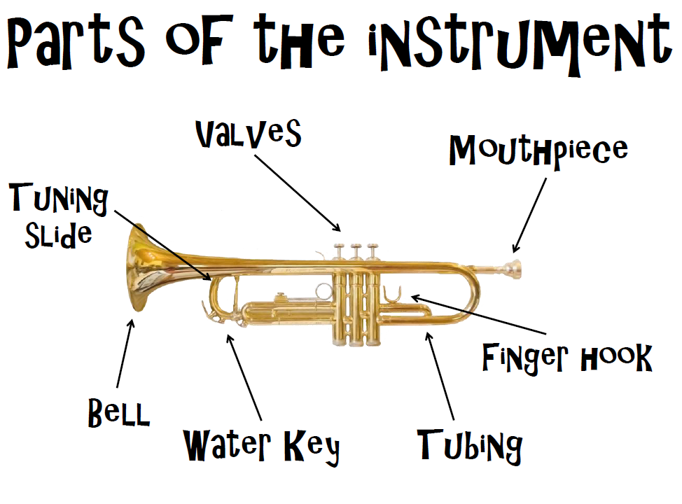

Slide 3
Notes are written on a set of 5 lines with 4 spaces in between.
This is known as a stave.
Each note has its own line or space and it is important to recognise if the note is on a line or in a space.
When we have mastered this then we are reading music.
The stave is only 5 lines and 4 spaces so can only show us 9 notes. If we need more then we need to use small lines outside of the stave. These are called ledger lines(think of them as little ledges for the notes to sit on).
Have a look at the next chart to show the notes and where they live.

Slide 4
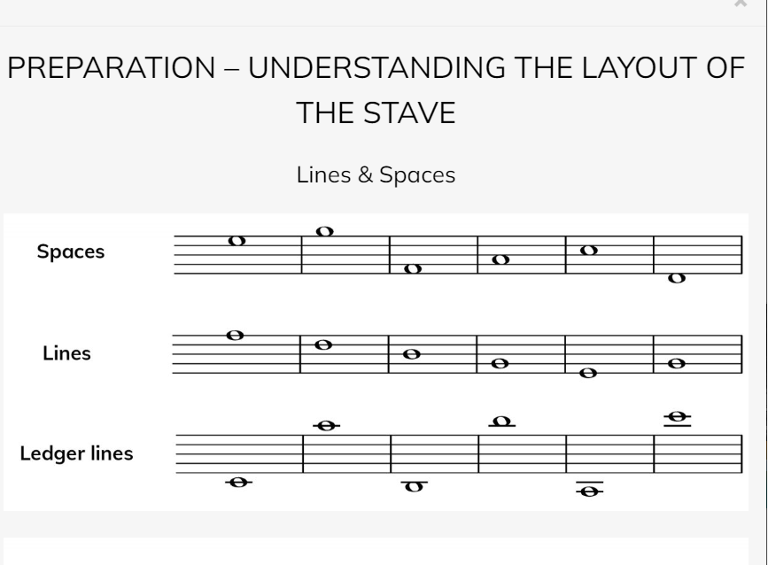

Slide 5
The 1st note we will look at lives on a ledger line underneath the stave.
He has his own little line because he is cool so we can call him cool C to help us remember.

Slide 6
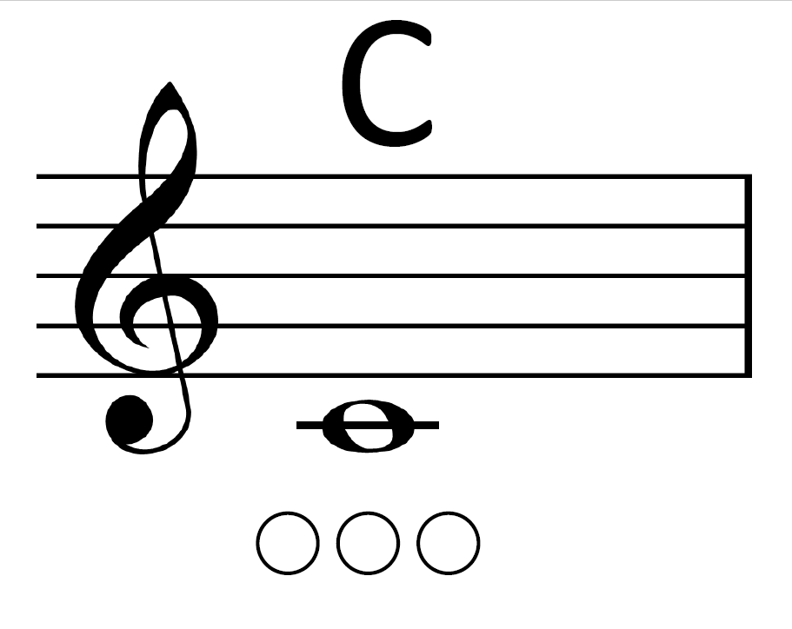

Slide 7
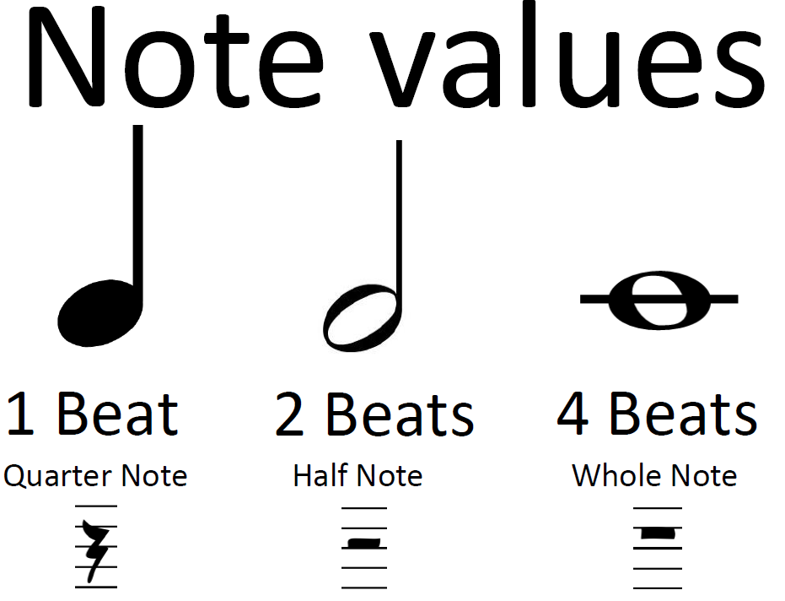

Slide 8
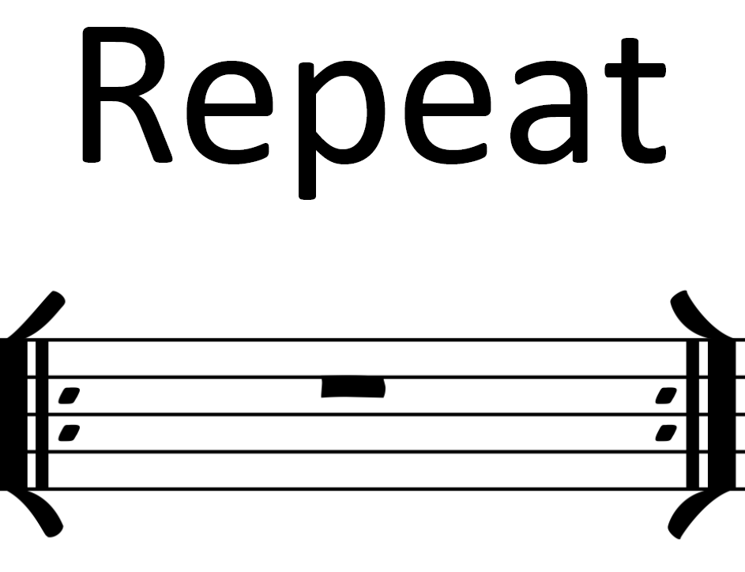

Slide 9
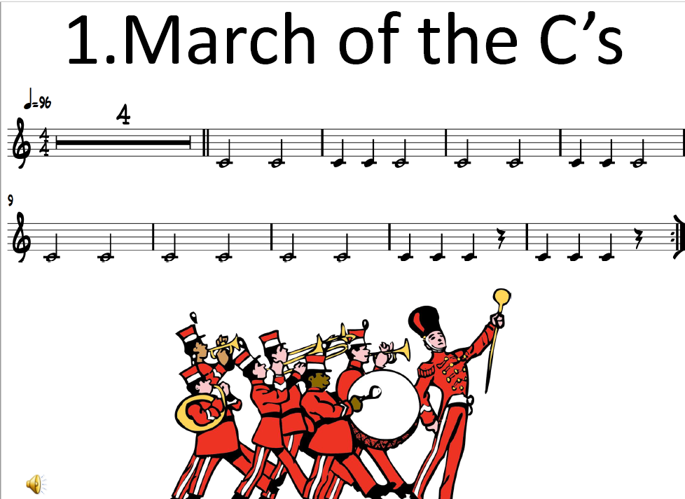


Slide 10
D is played on the trumpet and baritone by pressing the 1st and 3rd fingers down at the same time.
On the trombone we move the slide out to almost as far as you can. This is called 6th position.

Slide 11
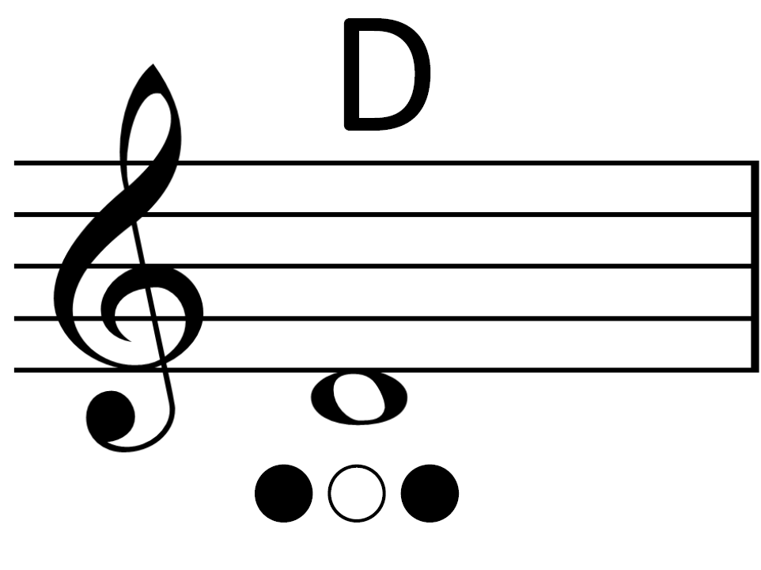

Slide 12
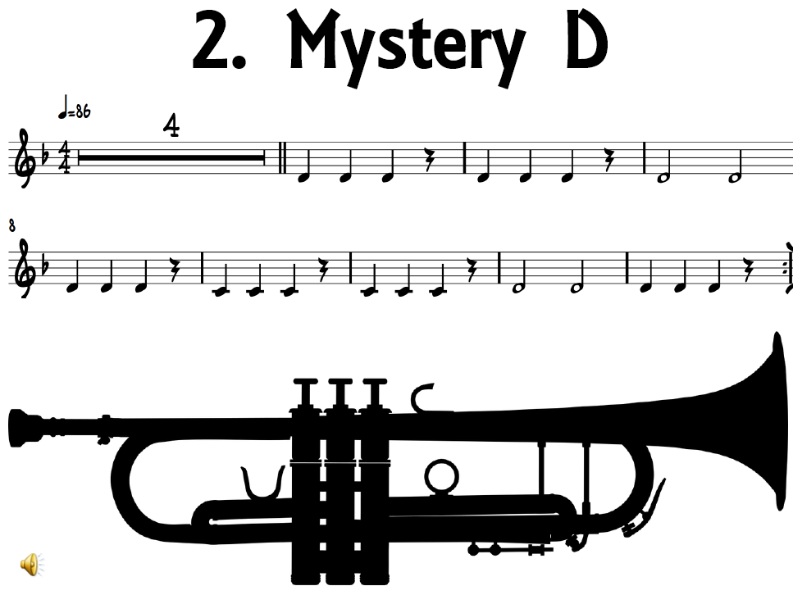

Slide 13
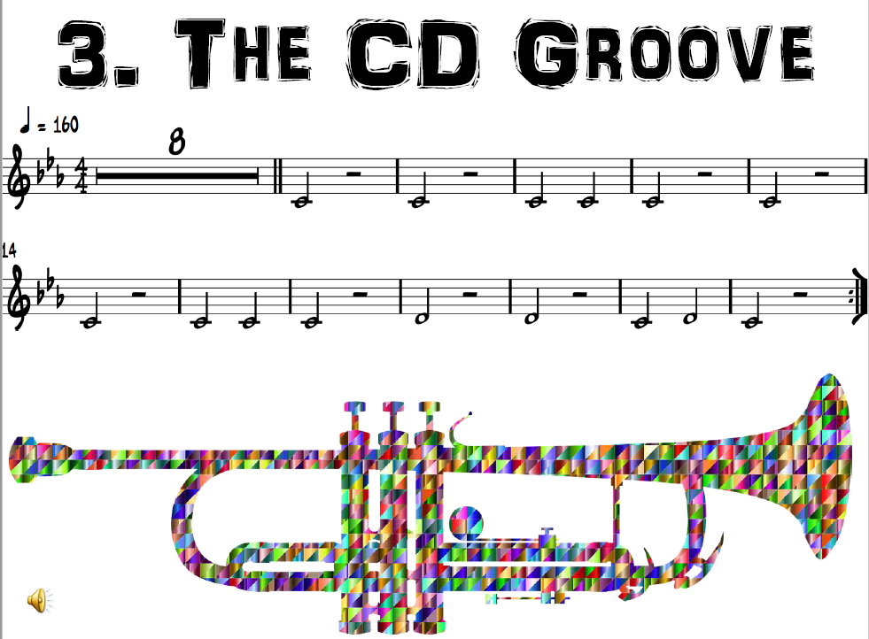
mf

Slide 14
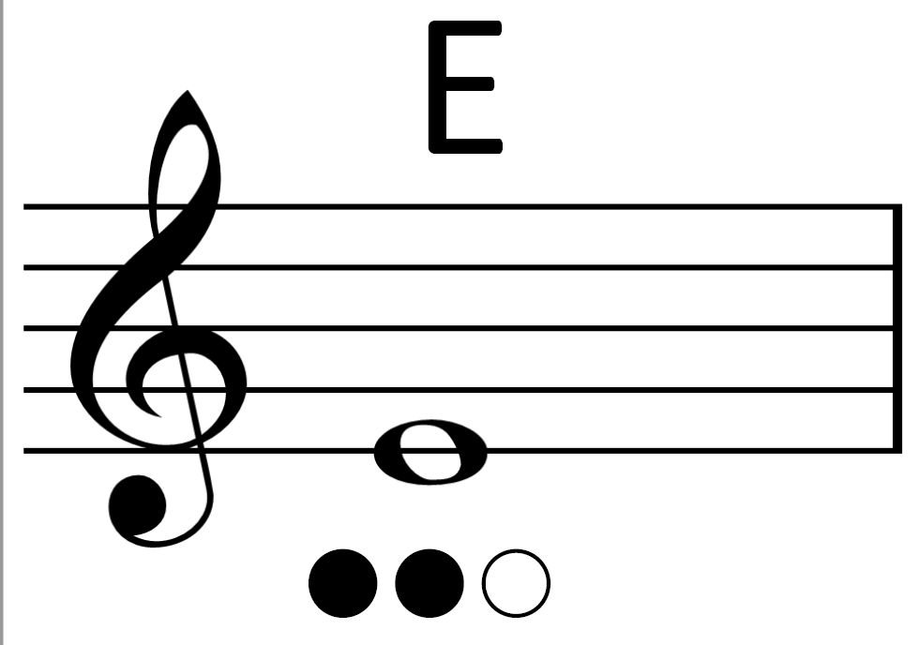

Slide 15
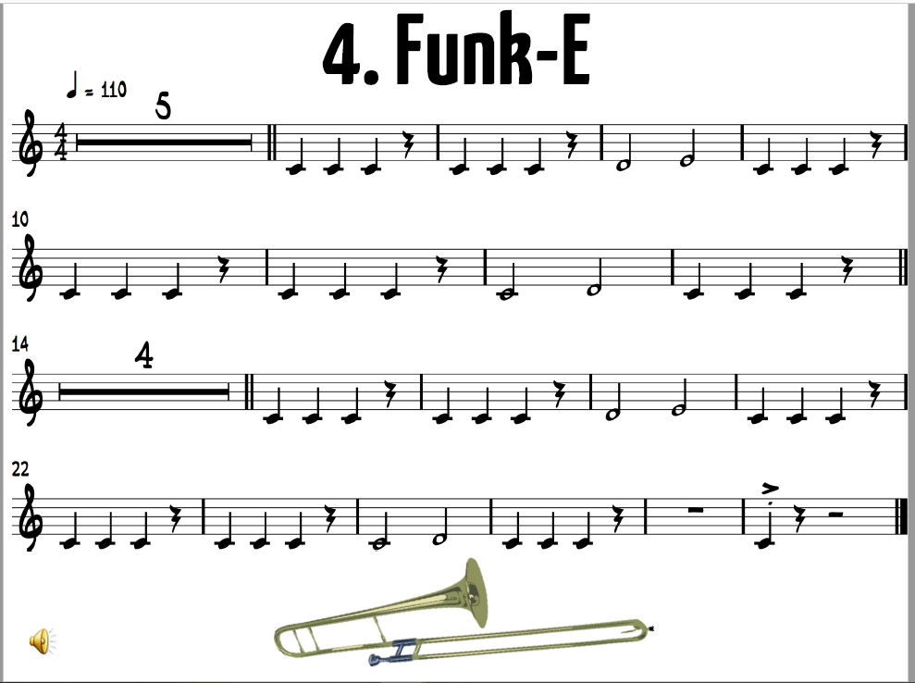

Slide 16
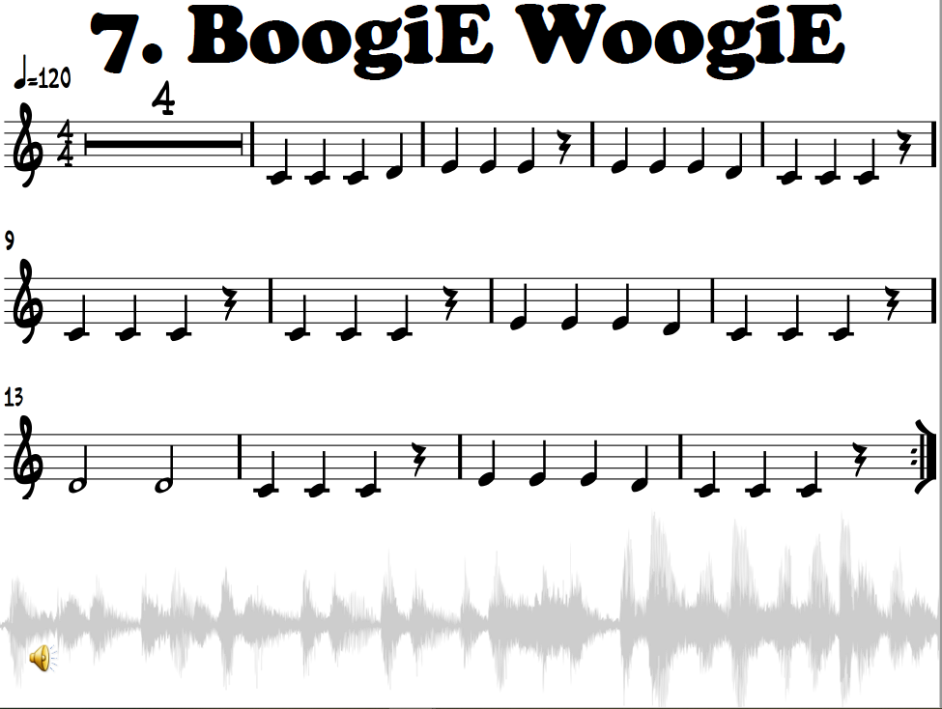

Slide 17
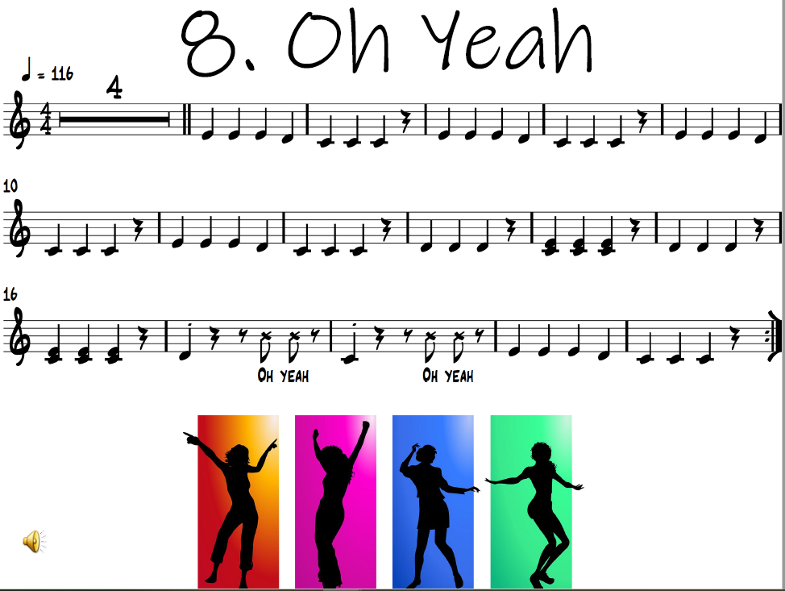

Slide 18
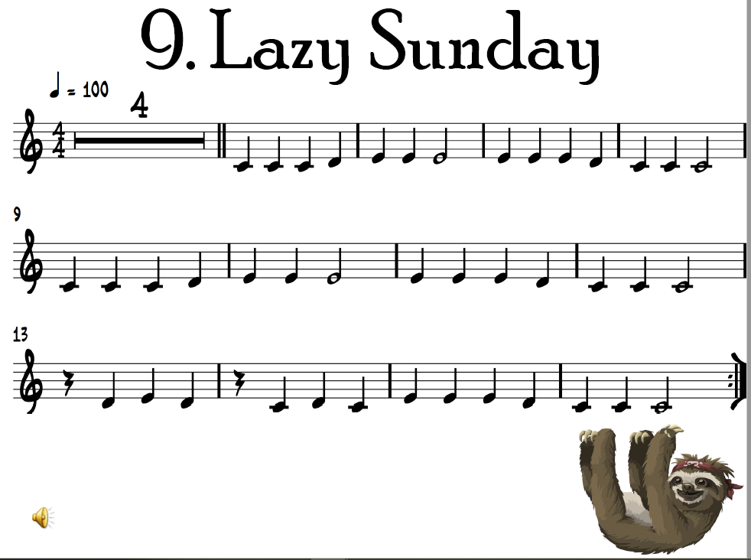

Slide 19
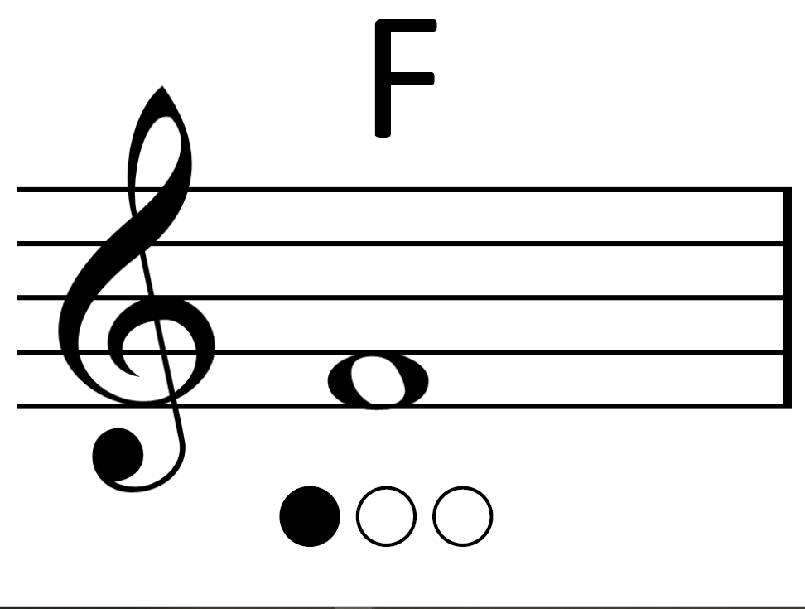

Slide 20
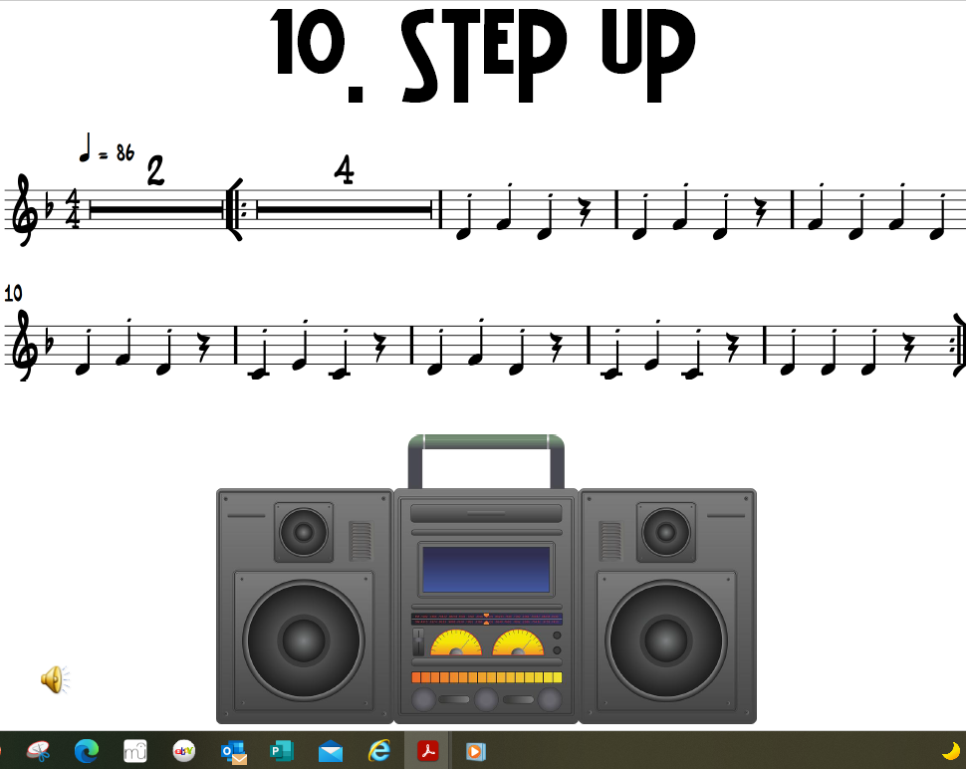

Slide 21
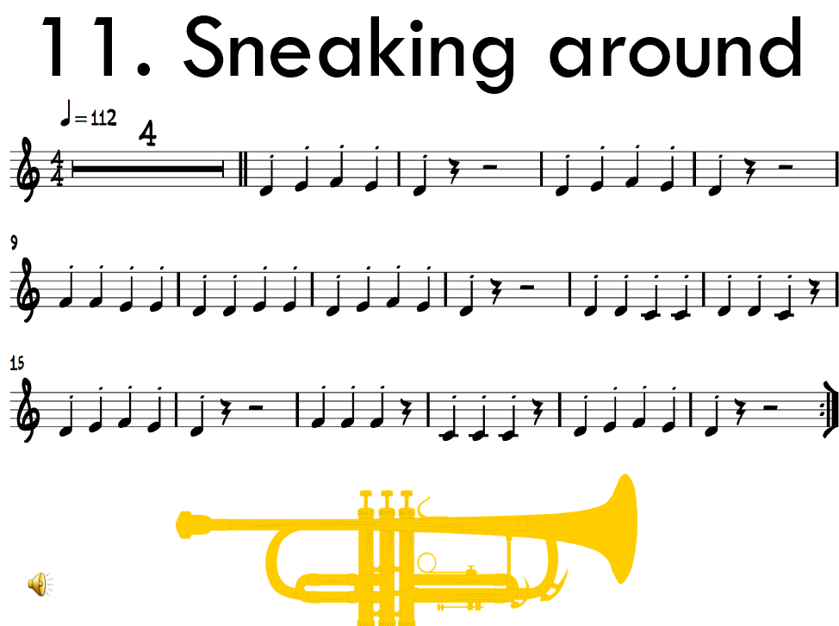

Slide 22
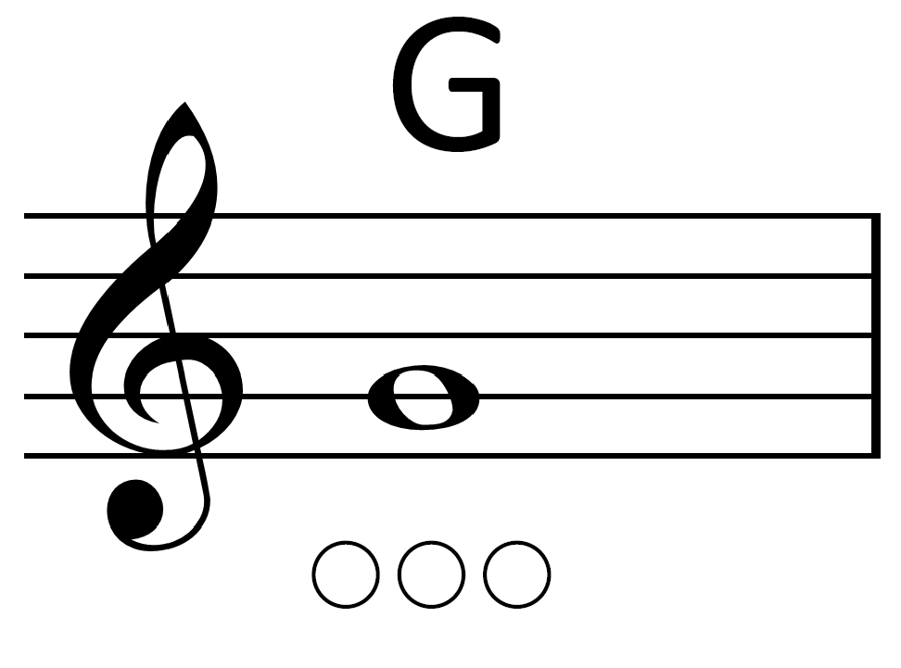

Slide 23
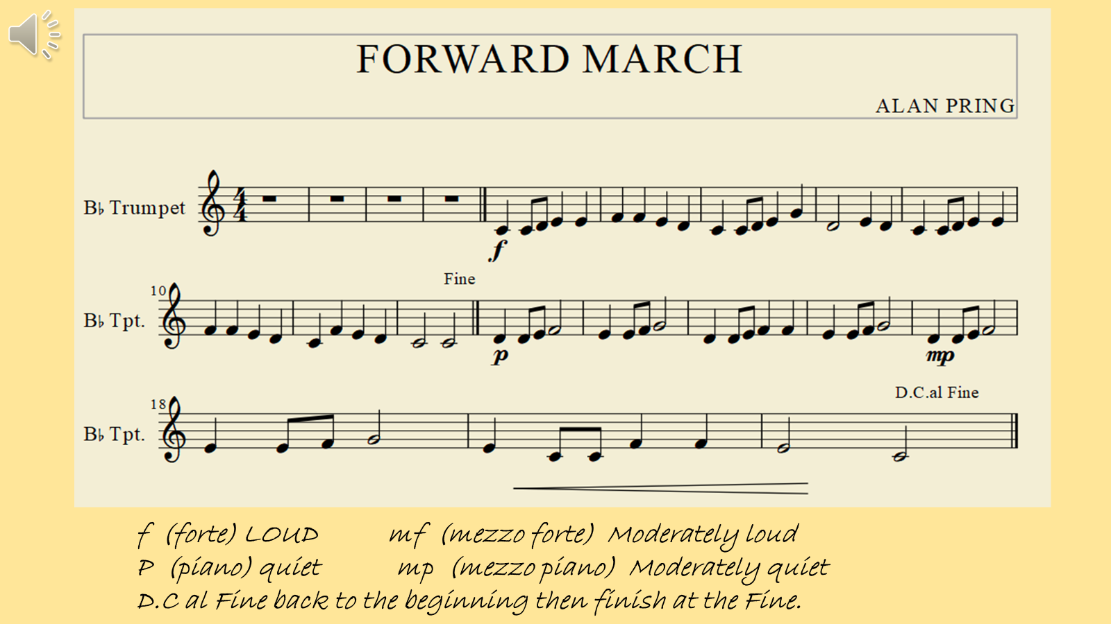

Slide 24
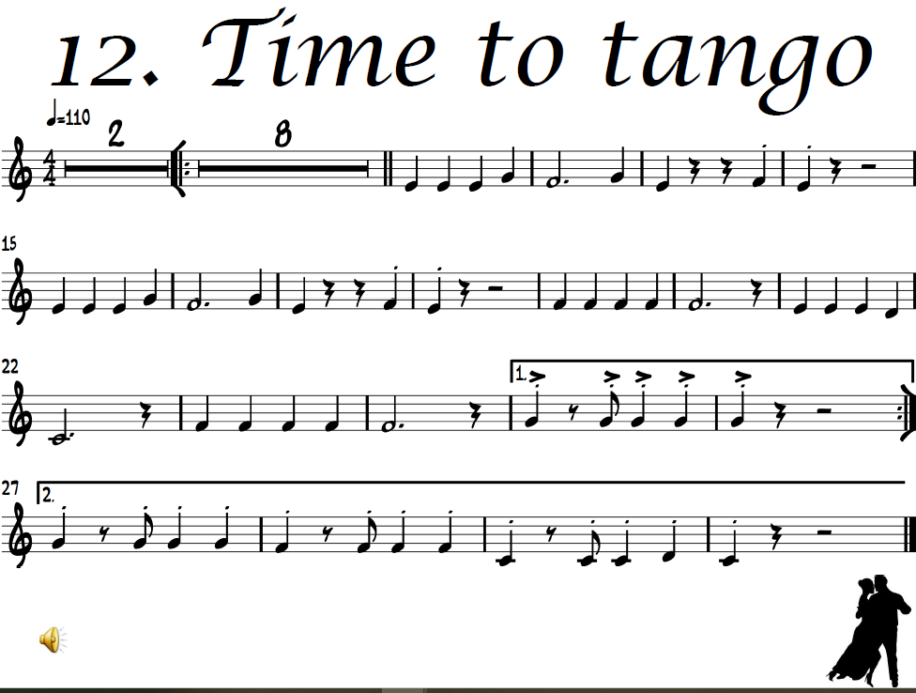
p

Slide 25
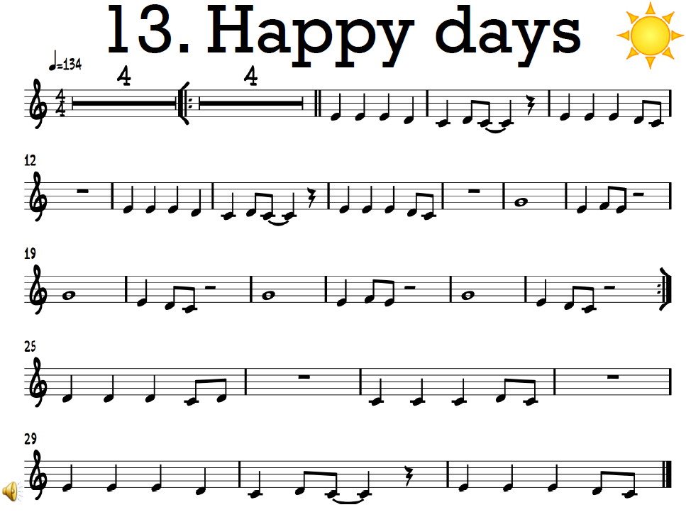
f

Slide 26
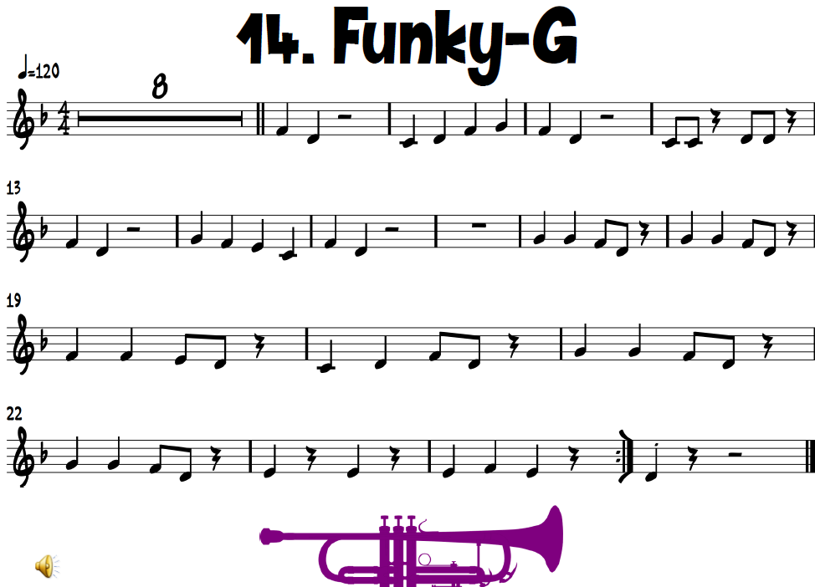

Slide 27
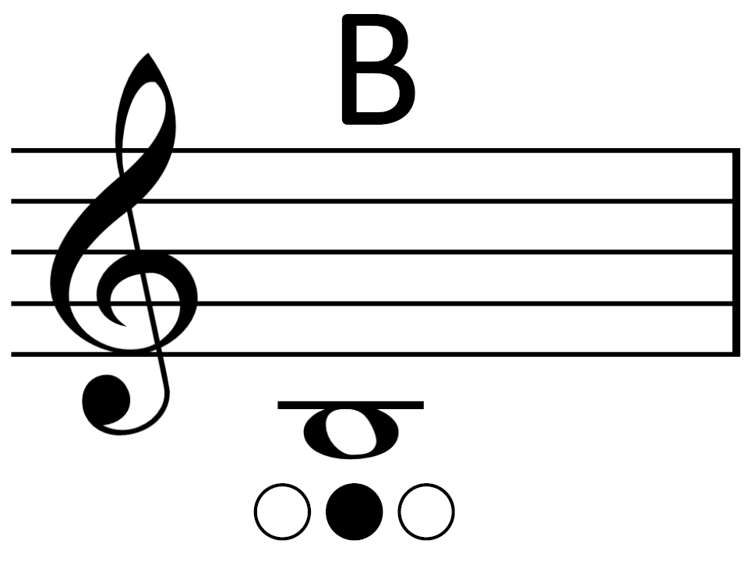

Slide 28
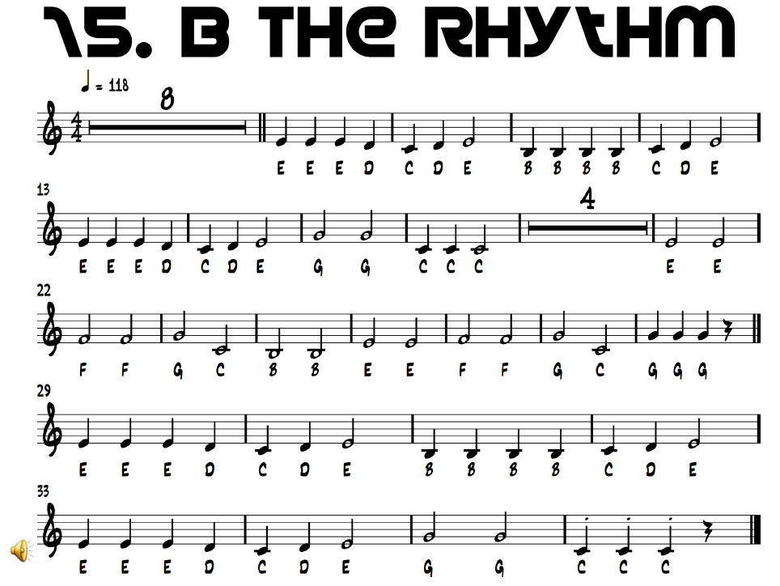

Slide 29
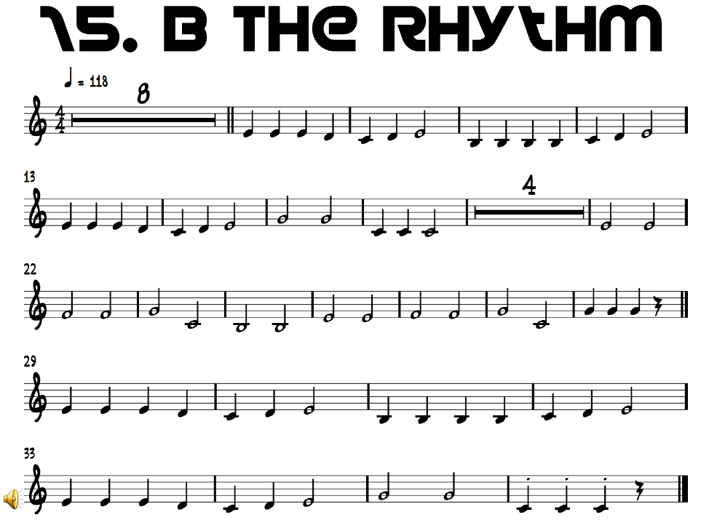

Slide 30
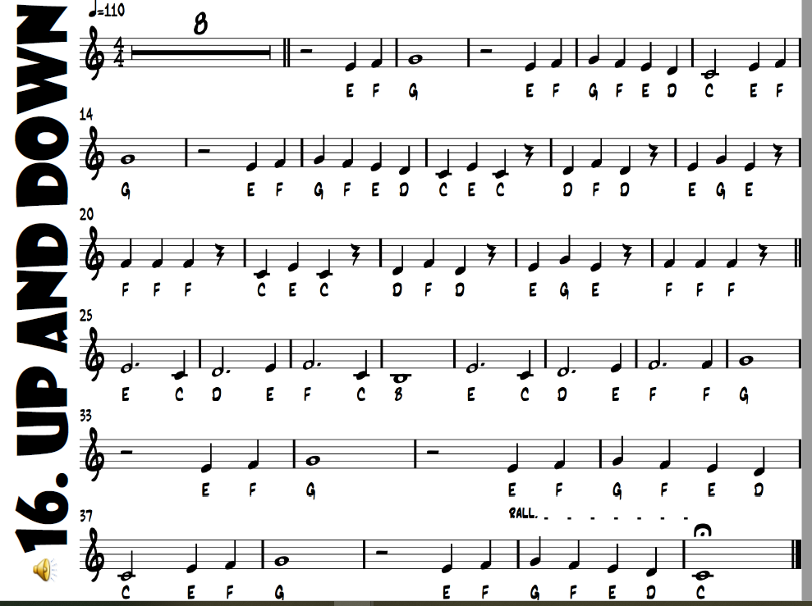

Slide 31
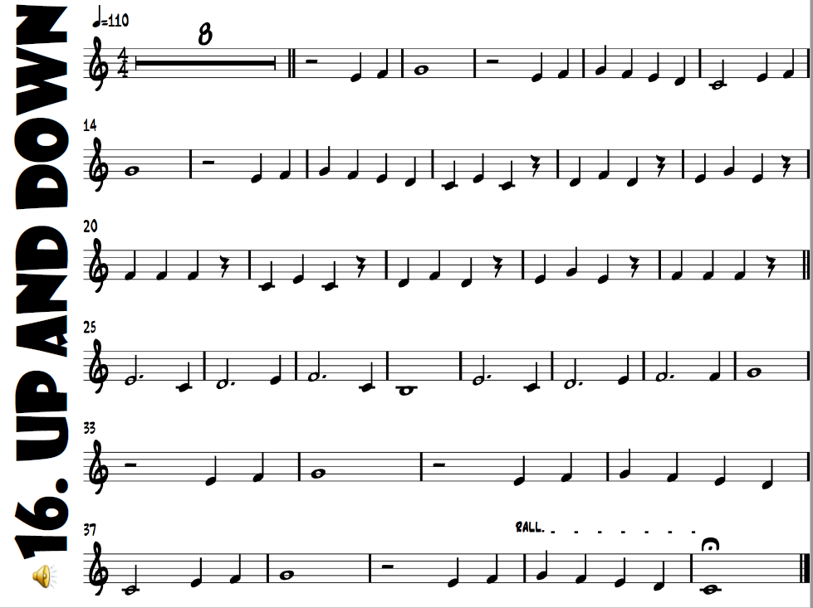

Slide 32
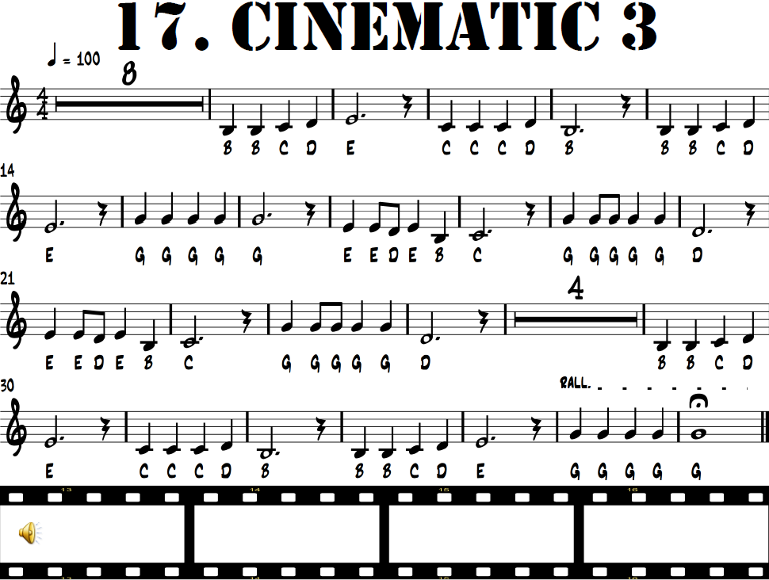

Slide 33
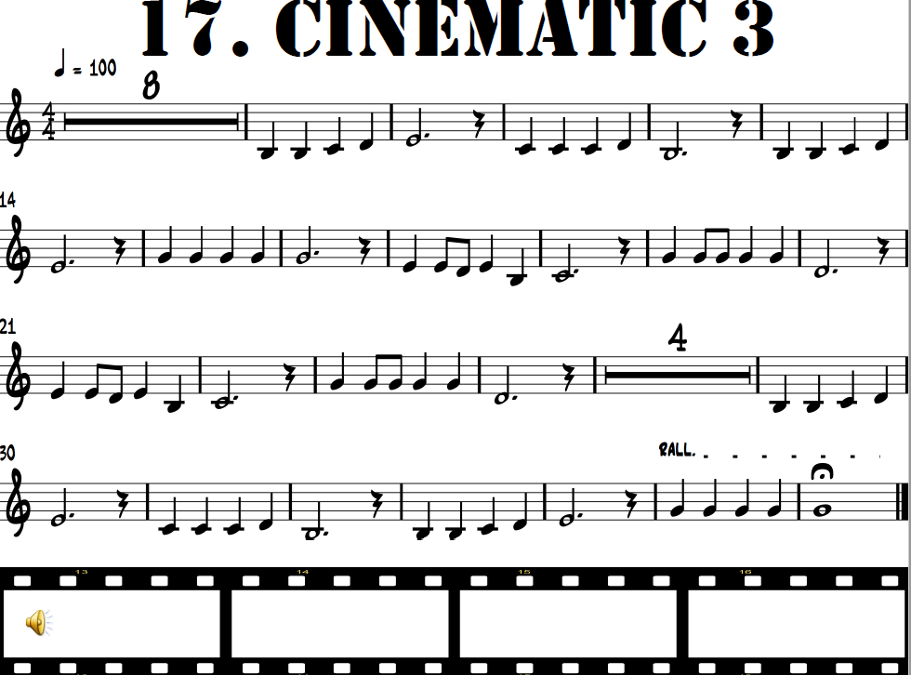

Slide 34
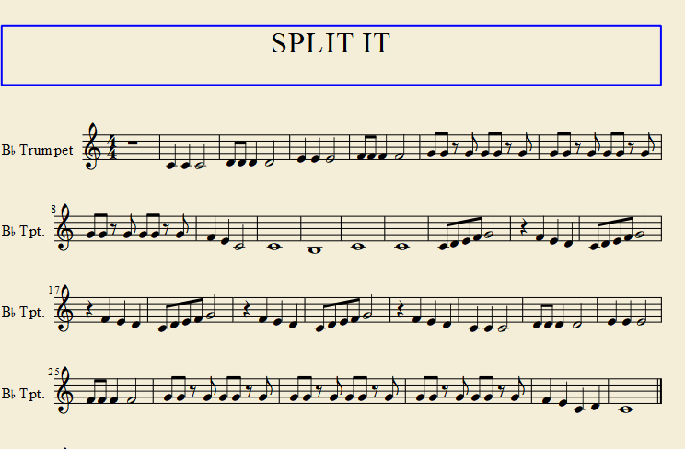
18
C C C D D D D E E E F F F F G G G G G G G G G G G G
G G G G G G F E C C B C C C D E F G F E D C D E F G
F E D C D E F G F E D C D E F G F E D C C C D D D D E E E
F F F F G G G GG G G G G G G G G G G G G G F E C D C

Slide 35
18

Slide 36
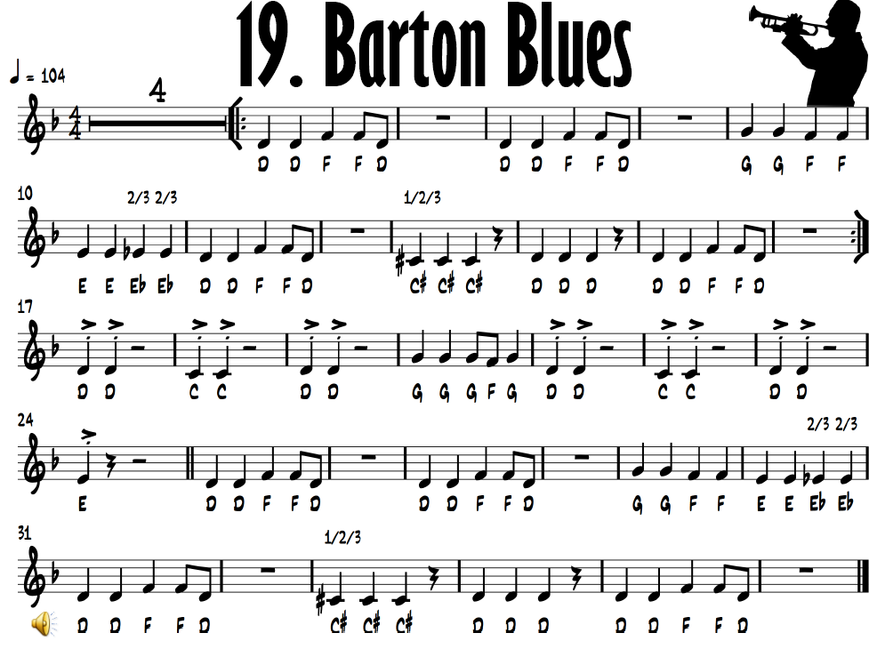

Slide 37
