Slide 1
Tuesday English Task Setter

Slide 2
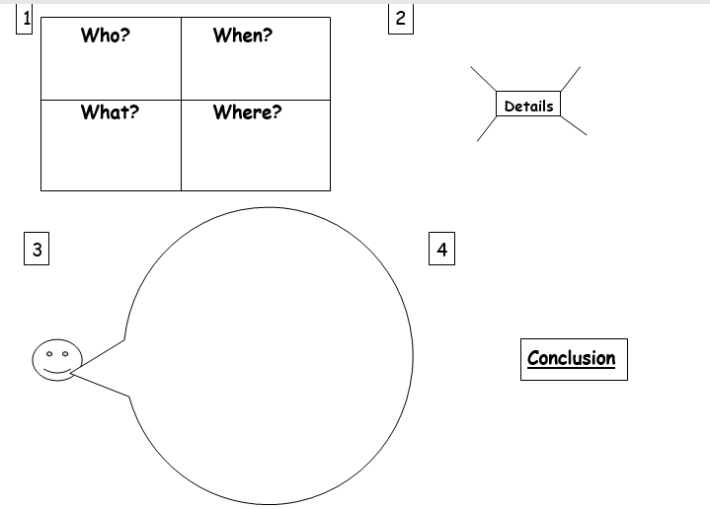
Last week we started to plan our newspaper report using the sheet below.

Slide 3
Today we are going to start to write paragraph 2. This is the main body of the newspaper article and the one that tells us what happened during the event.
Using the word mat attached can you write a paragraph describing the moon landing on 21st July 1969.
Use as much detail as you can.
Use the word mat provided and as many of the words within your paragraph as you can.

Slide 4
Don’t forget the basics.
Capital letters
Fully stops
Finger spaces
Adjectives
Can you include:
An adverb
Commas
Openers- firstly, next, then
Conjunctions- and, but, so

