Slide 1


Choose the level of difficulty that you think would be the best suited for your child.
© Classroom Secrets Limited 2019

Slide 2
Year 1 – Summer Block 4 – Place Value
Step 3: Comparing
Numbers 1
© Classroom Secrets Limited 2019

Slide 3
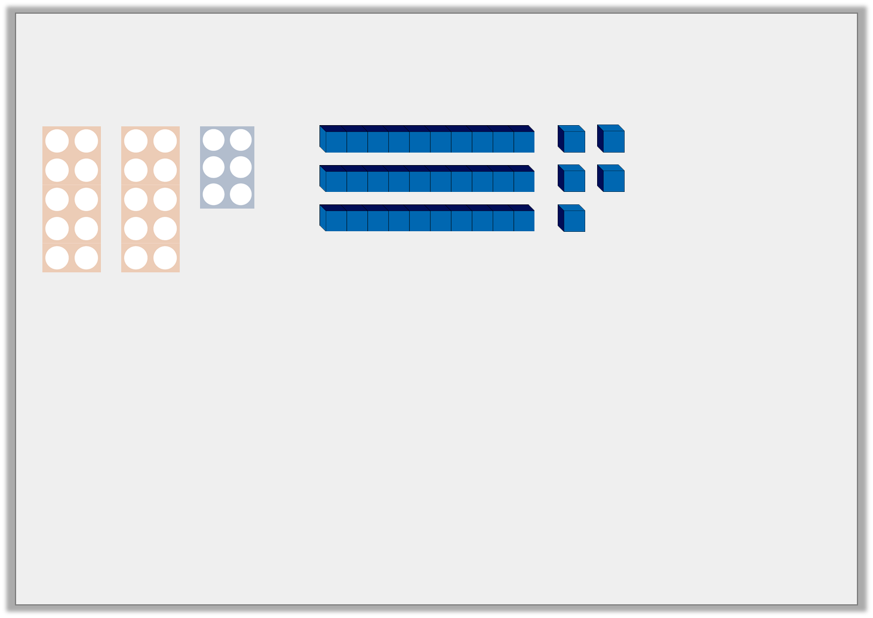




Introduction
Match the numbers to the diagrams.
Which number is the odd one out?
Tens | Ones
18 | 35 | 26 | 42
© Classroom Secrets Limited 2019

Slide 4
Introduction
Match the numbers to the diagrams.
Which number is the odd one out? 18
Tens | Ones
18 | 35 | 26 | 42
© Classroom Secrets Limited 2019

Slide 5
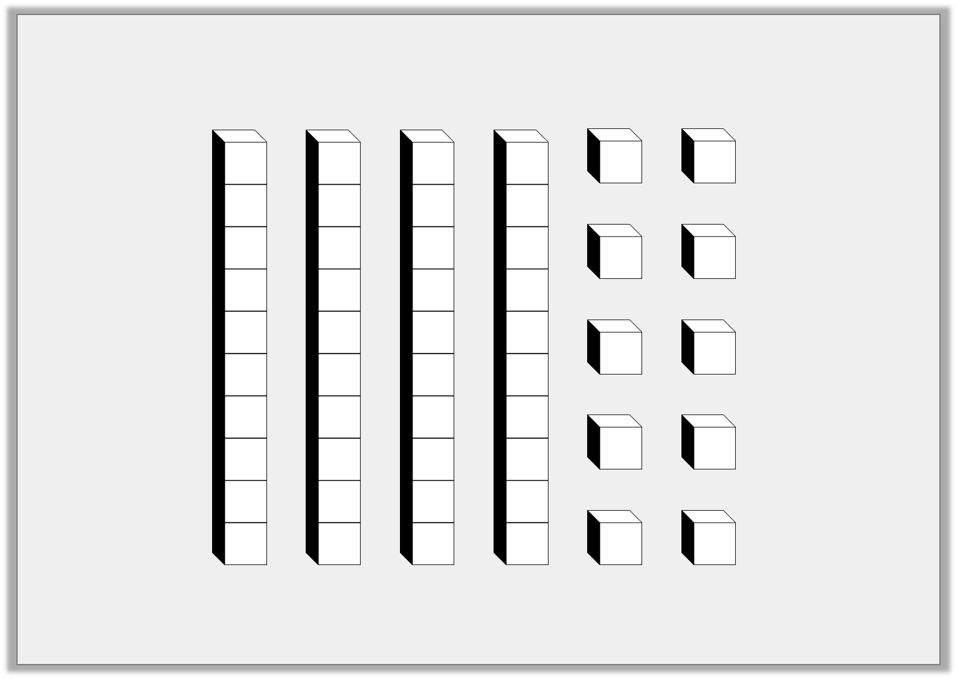
Varied Fluency 1
Colour the tens and ones to show a number which is less than 30.
© Classroom Secrets Limited 2019

Slide 6
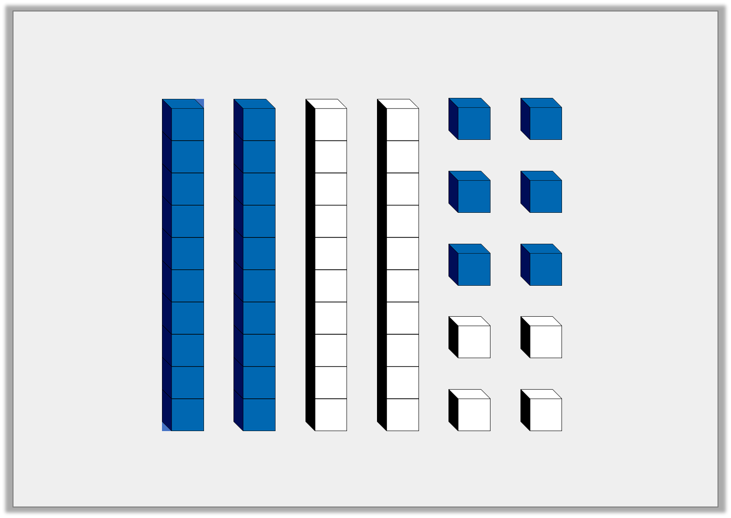
Varied Fluency 1
Colour the tens and ones to show a number which is less than 30.
Any number coloured between 11 and 29. For example 2 tens and 6 ones to show 26.
© Classroom Secrets Limited 2019

Slide 7
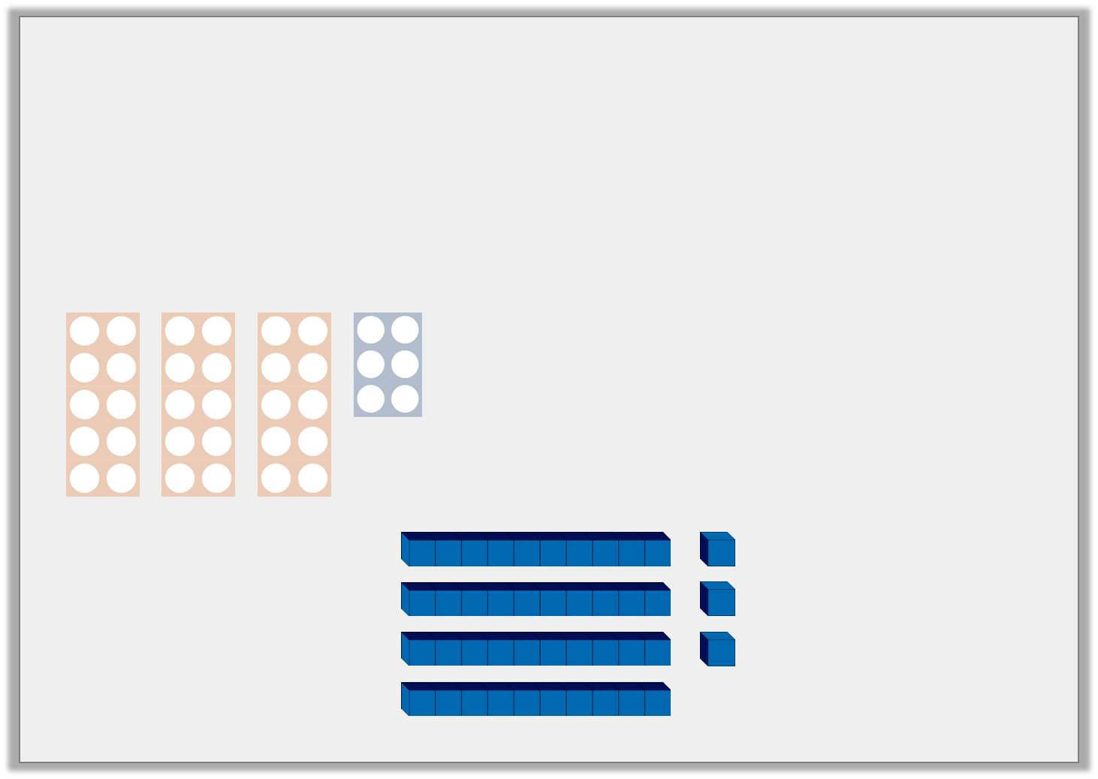


Varied Fluency 2
Circle the picture which matches the clue.
More than 30 but < 40.
© Classroom Secrets Limited 2019

Slide 8
Varied Fluency 2
Circle the picture which matches the clue.
More than 30 but < 40.
© Classroom Secrets Limited 2019

Slide 9
Varied Fluency 3
On the number track, write a number:
A) equal to 5 tens and 6 ones.
B) < 55 with 3 ones.
51 |  |  | 54 |  |  | 57
© Classroom Secrets Limited 2019

Slide 10
Varied Fluency 3
On the number track, write a number:
A) equal to 5 tens and 6 ones.
B) < 55 with 3 ones.
51 |  | B = 53 | 54 |  | A = 56 | 57
© Classroom Secrets Limited 2019

Slide 11
Problem Solving 1
Read the clues. Draw 2 possible answers in the grids.
I am less than 45 but more than 35. What numbers could I be?
Tens | Ones
Tens | Ones
© Classroom Secrets Limited 2019

Slide 12
Problem Solving 1
Read the clues. Draw 2 possible answers in the grids.
I am less than 45 but more than 35. What numbers could I be?
Any number from 36 to 44, e.g.
Tens | Ones
Tens | Ones
© Classroom Secrets Limited 2019

Slide 13
Problem Solving 2
Label the number line to show:
A number less than 30 but more than 20.
A number more than 30 with less than 6 ones.
20
40
© Classroom Secrets Limited 2019

Slide 14
Problem Solving 2
Label the number line to show:
A number less than 30 but more than 20.
Answers between 21 and 29
A number more than 30 with less than 6 ones.
Answers between 31 and 35.
Various possible answers, for example:
25
31
20
40
© Classroom Secrets Limited 2019

Slide 15
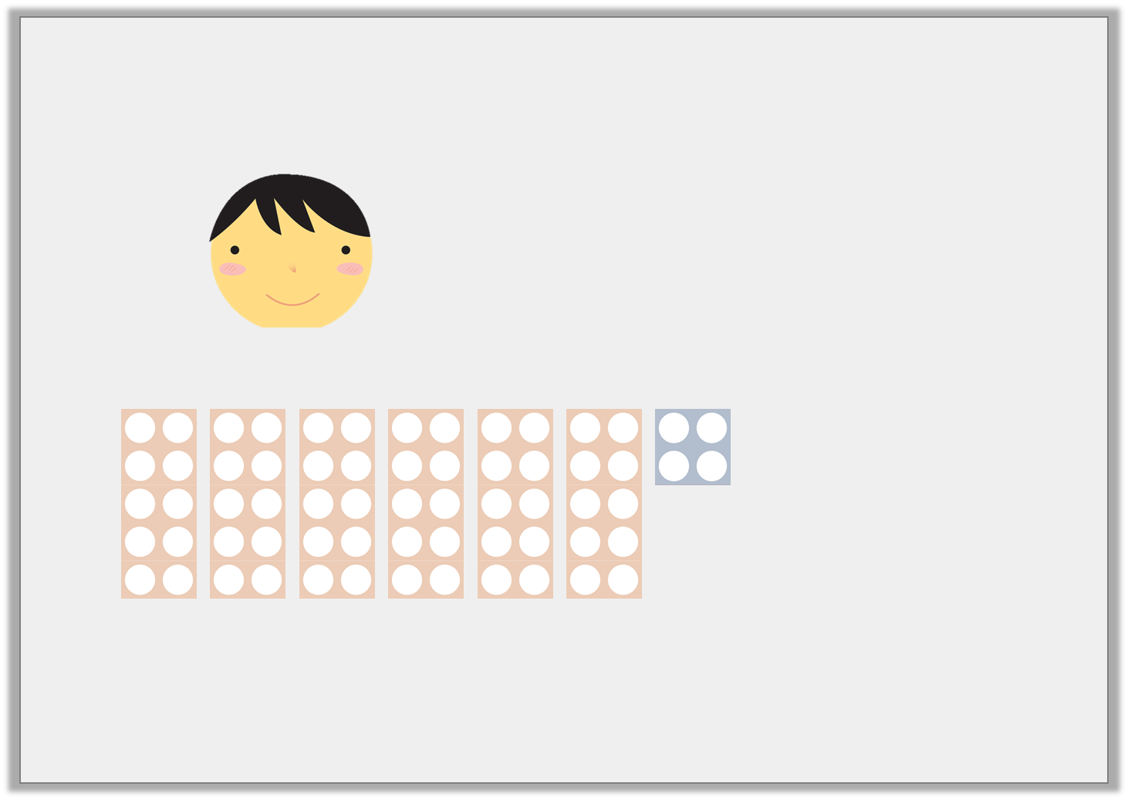
Reasoning 1
Rayyan says,
Is he correct? Explain why.
My number is equal to 6 tens and 4 ones and is > 65.
© Classroom Secrets Limited 2019

Slide 16
Reasoning 1
Rayyan says,
Is he correct? Explain why.
Rayyan’s number is ______ so he is incorrect because his number is ______ less than 65.
My number is equal to 6 tens and 4 ones and is > 65.
© Classroom Secrets Limited 2019

Slide 17
Reasoning 1
Rayyan says,
Is he correct? Explain why.
Rayyan’s number is ______ so he is incorrect because his number is ______ less than 65.
My number is equal to 6 tens and 4 ones and is > 65.
64
1
© Classroom Secrets Limited 2019

