Slide 1
Friday English
Can I edit and improve my fictional diary?

Slide 2
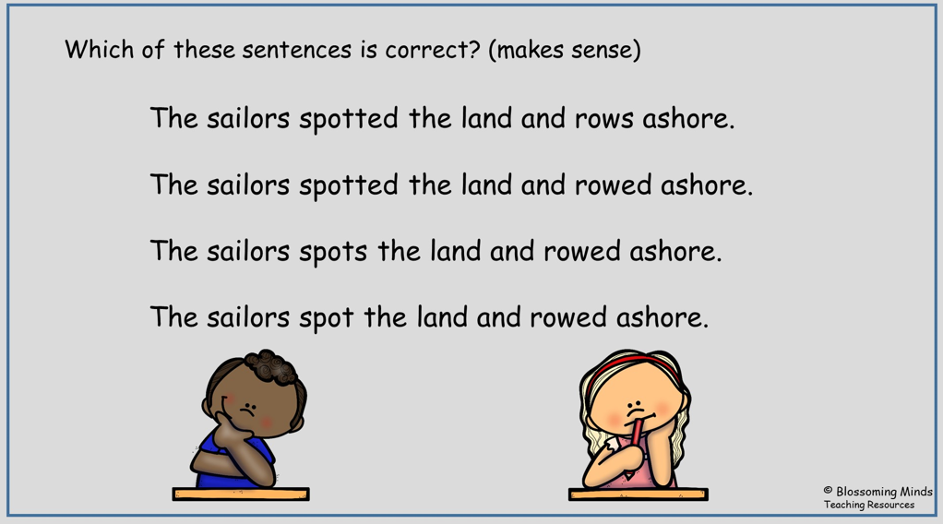
Warm up- how can we group these words?

Slide 3
Today we are going to look at our work (I have uploaded some examples of work from our bubble for you to read.)
You can magpie some ideas from those if you would like to.
I would like you to look at your work and see what you would like to improve.

Slide 4
How to edit
Read your work. Does it all make sense?
Have you described any nouns that you have written about?
Have you used interesting verbs?
Have you used commas?

