Slide 1

The activities that go with this PowerPoint are split into three different levels of ability. Choose the level that you think is the most appropriate for you child.
© Classroom Secrets Limited 2019

Slide 2


Year 1 – Summer Block 1 – Multiplication and Division
Step 6: Make Equal Groups - Grouping
© Classroom Secrets Limited 2018

Slide 3

Introduction
How many fish are there?
Can they be split into 2 equal groups?
Does it matter if the fish are different colours?

Slide 4

Introduction
How many fish are there? 11
Can they be split into 2 equal groups? No
Does it matter if the fish are different colours? No
There will be 1 tank of 5 fish and 1 tank of 6 fish.

Slide 5
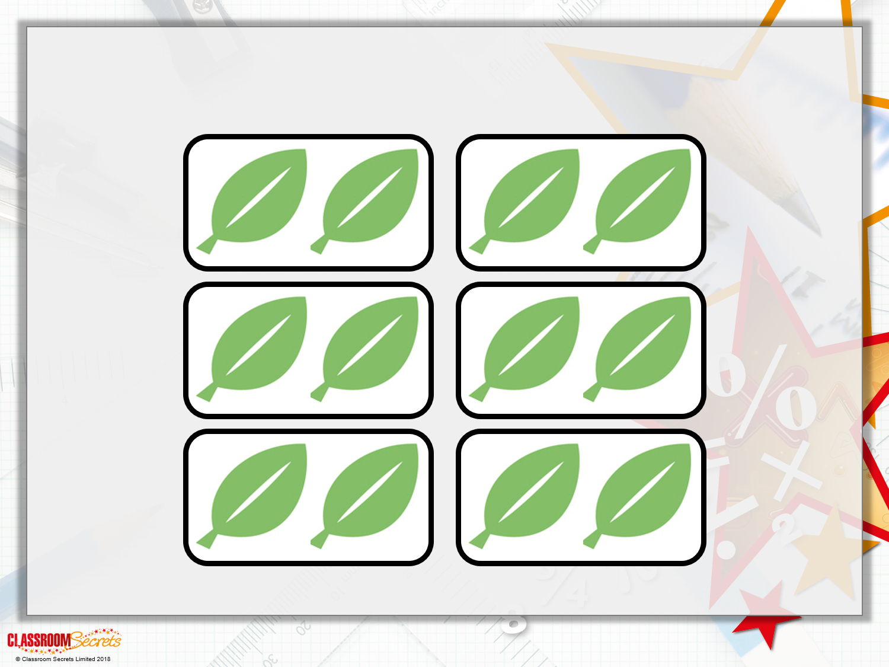
Varied Fluency 1
True or false? There are 6 equal groups of 2 leaves.

Slide 6
Varied Fluency 1
True or false? There are 6 equal groups of 2 leaves.
True

Slide 7
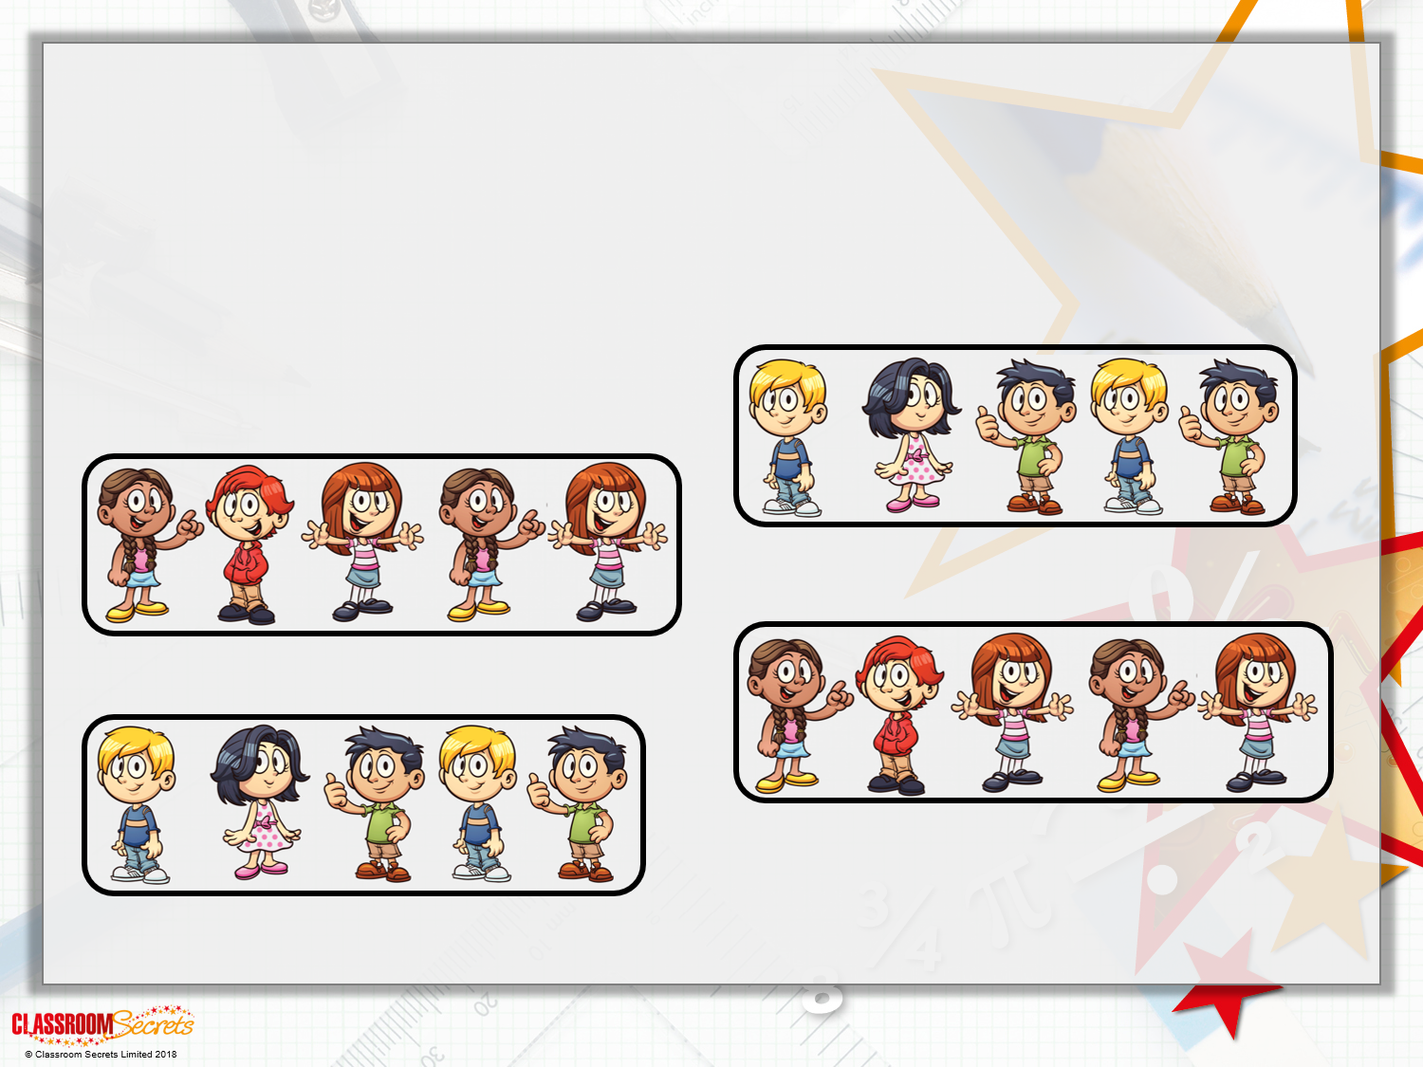
Varied Fluency 2
Fill in the blanks.
There are ______ equal groups of ______ children.

Slide 8
Varied Fluency 2
Fill in the blanks.
There are ______ equal groups of ______ children.
4
5

Slide 9
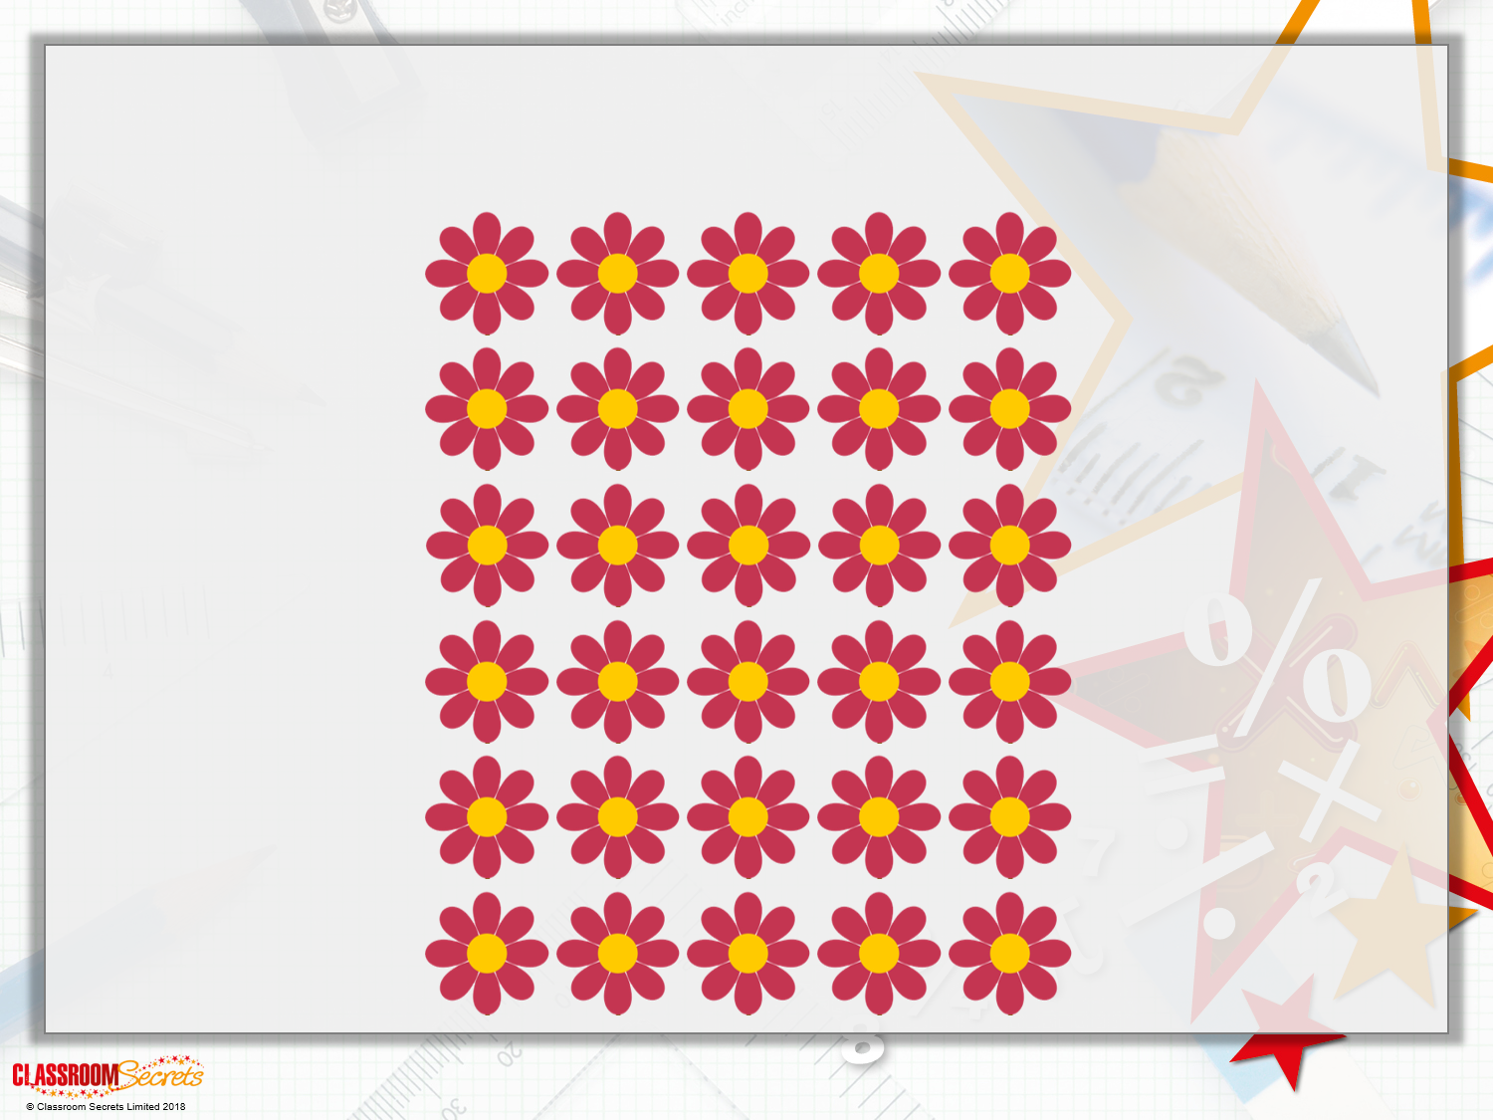
Varied Fluency 3
How many equal groups of 10 flowers can you make?

Slide 10
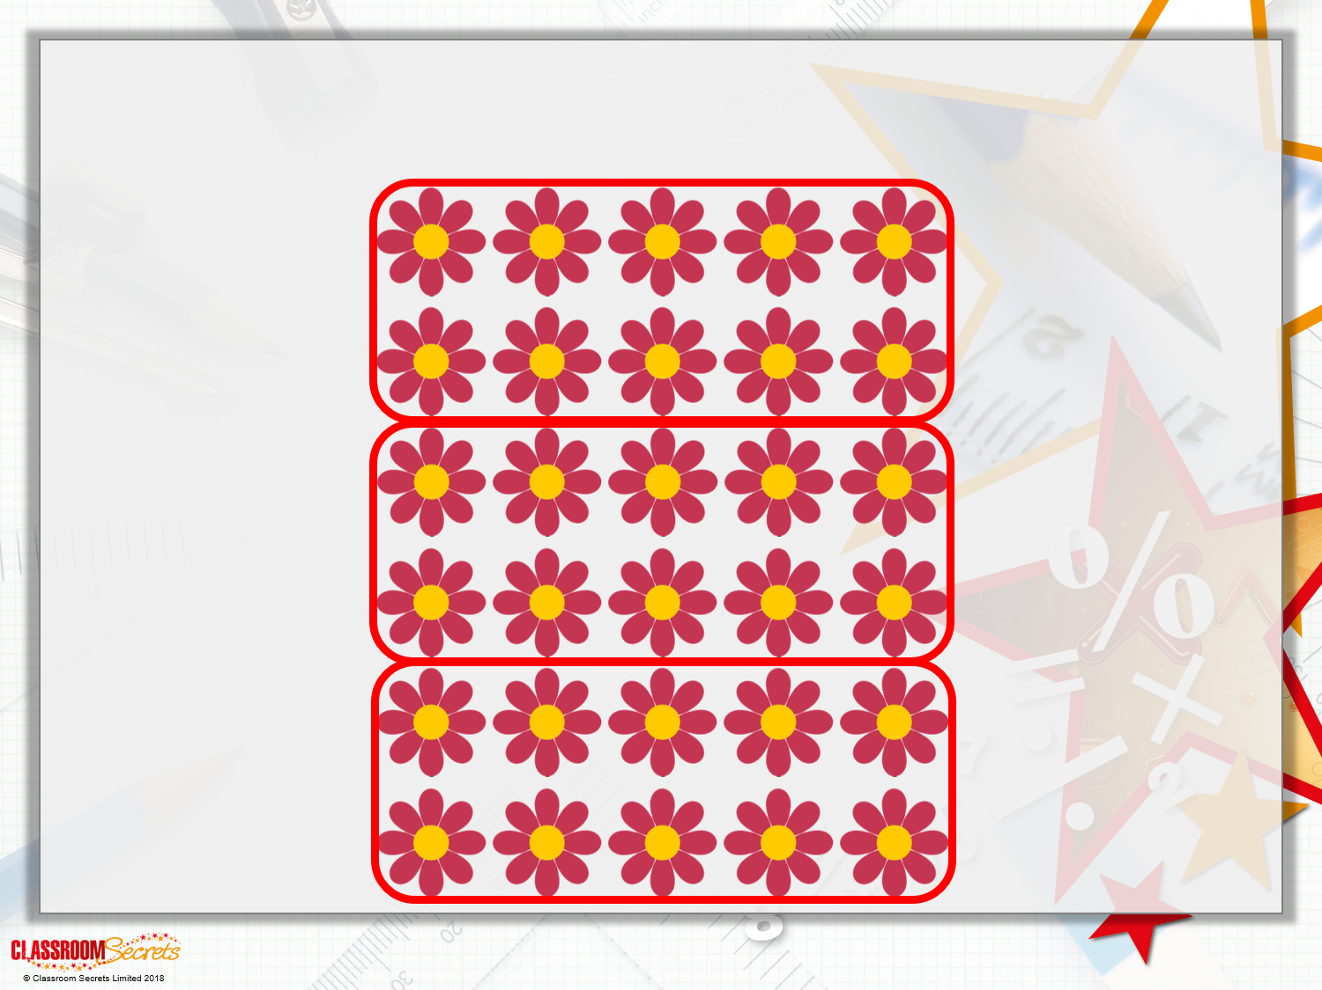
Varied Fluency 3
How many equal groups of 10 flowers can you make? 3

Slide 11
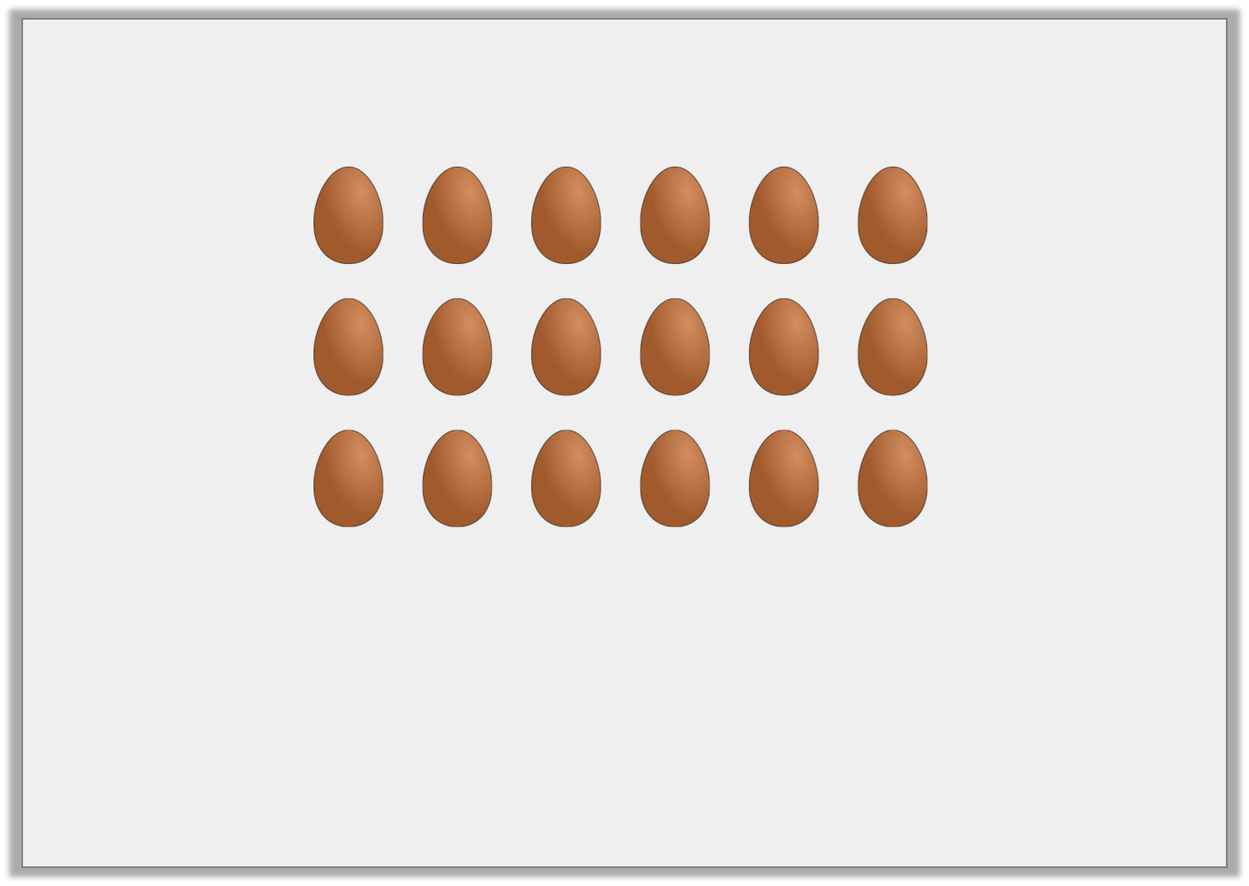
Varied Fluency 4
Circle the correct statement to match the image.
A. There are 4 equal groups of 5 |  | B. There are 2 equal groups of 6 |  | C. There are 3 equal groups of 6
© Classroom Secrets Limited 2018

Slide 12
Varied Fluency 4
Circle the correct statement to match the image.
A. There are 4 equal groups of 5 |  | B. There are 2 equal groups of 6 |  | C. There are 3 equal groups of 6
© Classroom Secrets Limited 2018

Slide 13
Problem Solving 1
Grace has 14 counters. She can group them into 7 equal groups of 2.
How could she group them to make 2 equal groups with 4 leftover?
She can make equal groups of with 4 leftover.
© Classroom Secrets Limited 2018

Slide 14
Problem Solving 1
Grace has 14 counters. She can group them into 7 equal groups of 2.
How could she group them to make 2 equal groups with 4 leftover?
She can make equal groups of with 4 leftover.
2
5
© Classroom Secrets Limited 2018

Slide 15
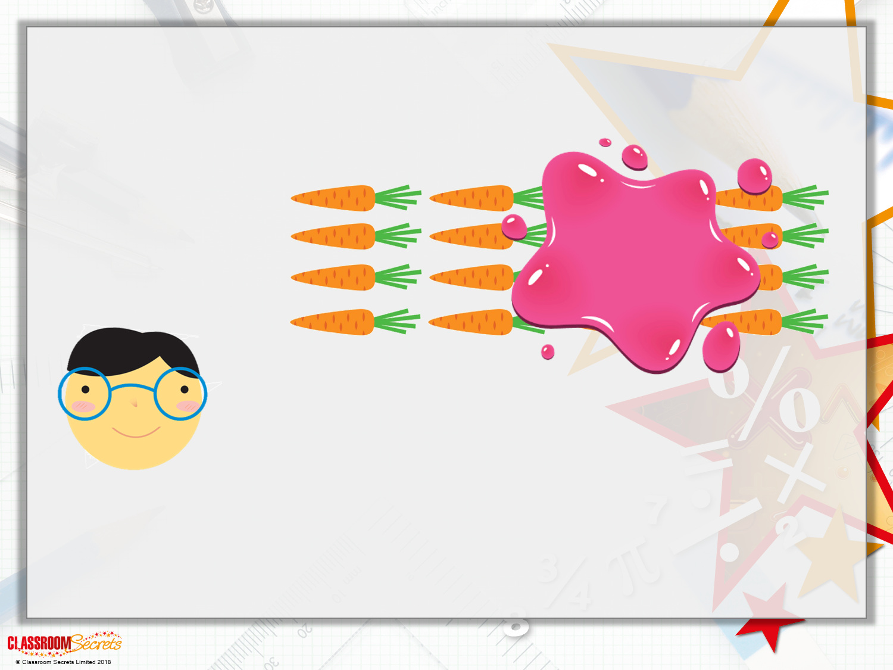
Problem Solving 2
Jaxon has fewer than 20 carrots. Some are hidden by the splat.
How many carrots could he have?
I can make equal groups of 2.

Slide 16
Problem Solving 2
Jaxon has fewer than 20 carrots. Some are hidden by the splat.
How many carrots could he have?
He could have 14, 16 or 18 carrots.
I can make equal groups of 2.

Slide 17
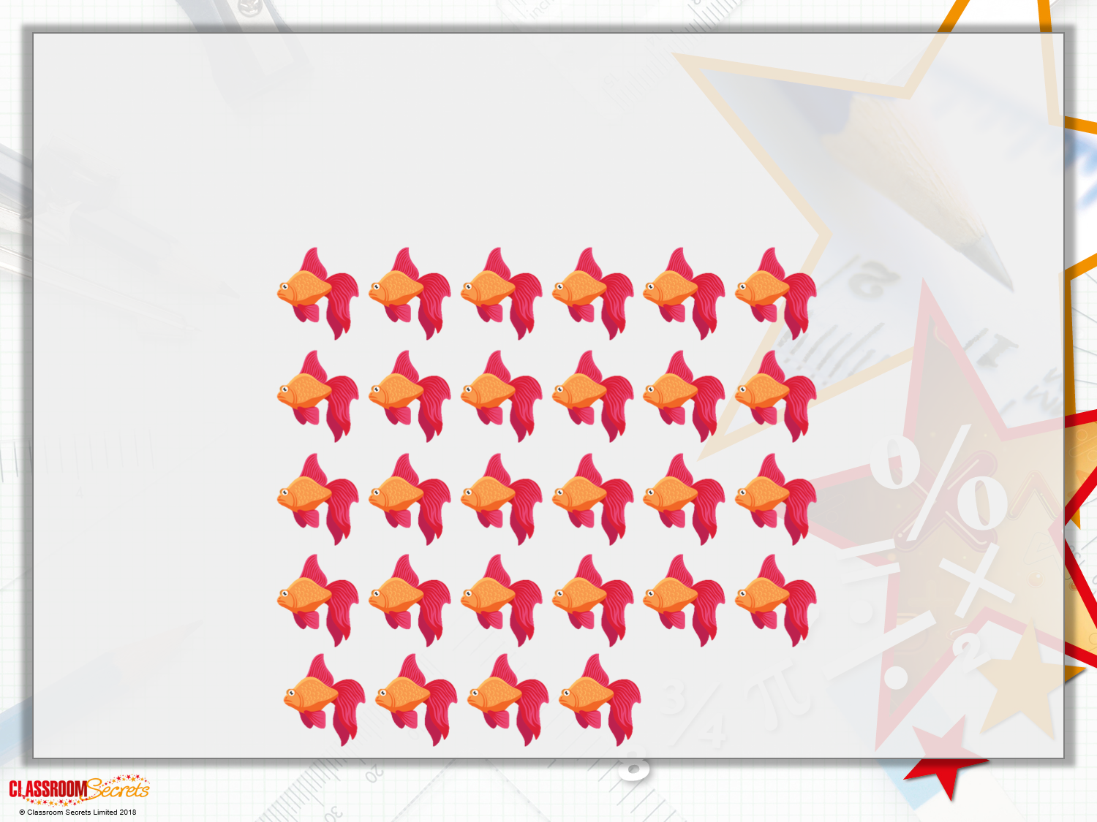
Reasoning 1
Charlie is grouping some fish to put into tanks.
He wants to make 6 equal groups of 5.
Does he have enough fish?

Slide 18
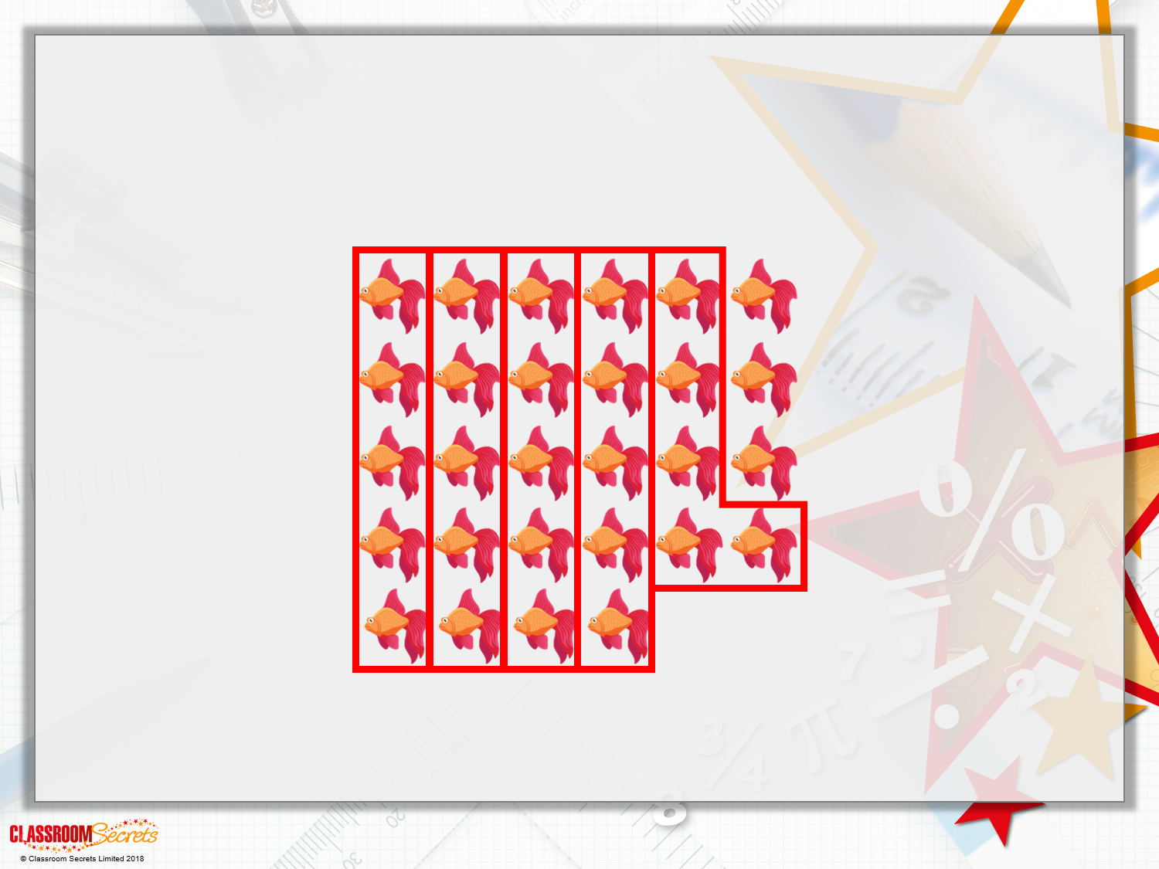
Reasoning 1
Charlie is grouping some fish to put into tanks.
He wants to make 6 equal groups of 5.
Does he have enough fish?
Charlie does not have enough fish to make 6 equal groups of 5. He can make 5 equal groups of 5 and he will have 3 leftover.

