Slide 1
Henry the Explorer
Today, we are going to start writing our diary entry as Henry and the journey he went on.
(Adults please speak to your child about the dangers of going on adventures by themselves)
Henry goes on a journey with his dog, Angus.
https://www.youtube.com/watch?v=hVV8LEJ4KIU

Slide 2
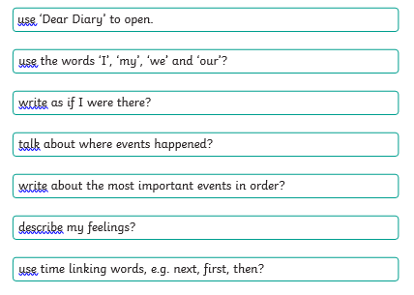
Today, we are going to start writing our diary entry as Henry and the journey he went on.
Can you remember what we must include in our diary entry?

Slide 3
Lets remind ourselves of some of the openers we used yesterday.
Some examples of these openers are:
‘first', 'next', 'after that', 'then,' and 'finally,’.
When you write an opener you must use a comma after it.
Did you use any others we could use?

Slide 4
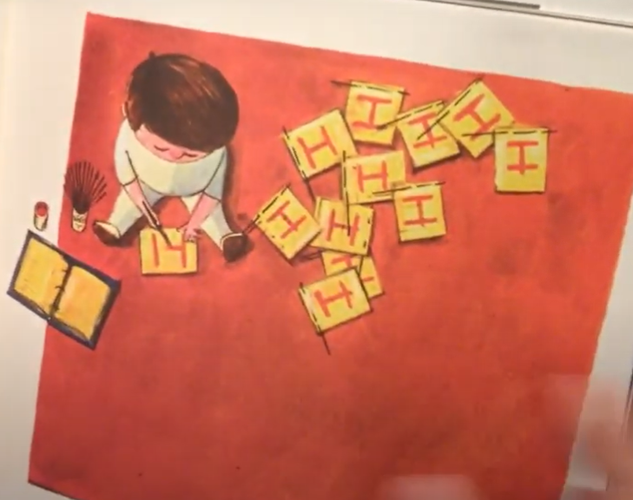
Task
Today we are going to start to write our diary entry as Henry and his exploration.
Remember you are Henry.
Write ‘I’, ‘we’, ‘our’ , ‘me’.
Use your checklist to make sure that you are including everything we need.

