Slide 1
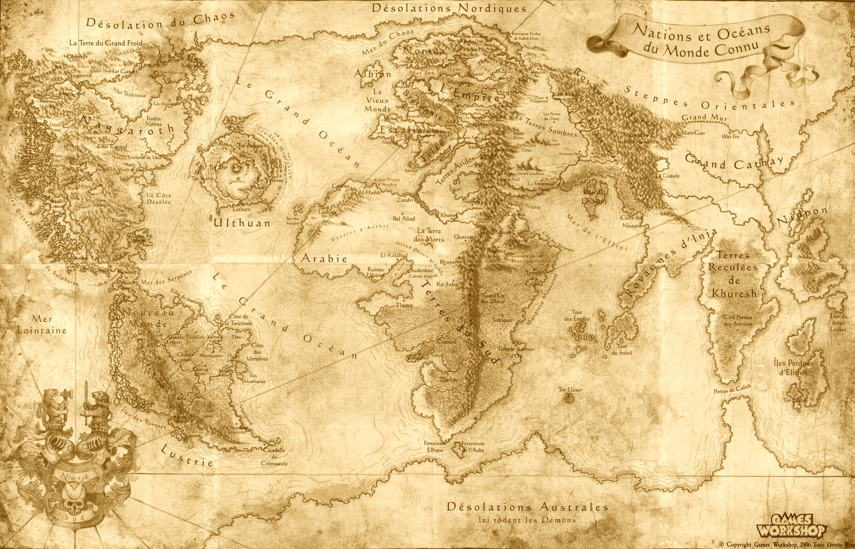
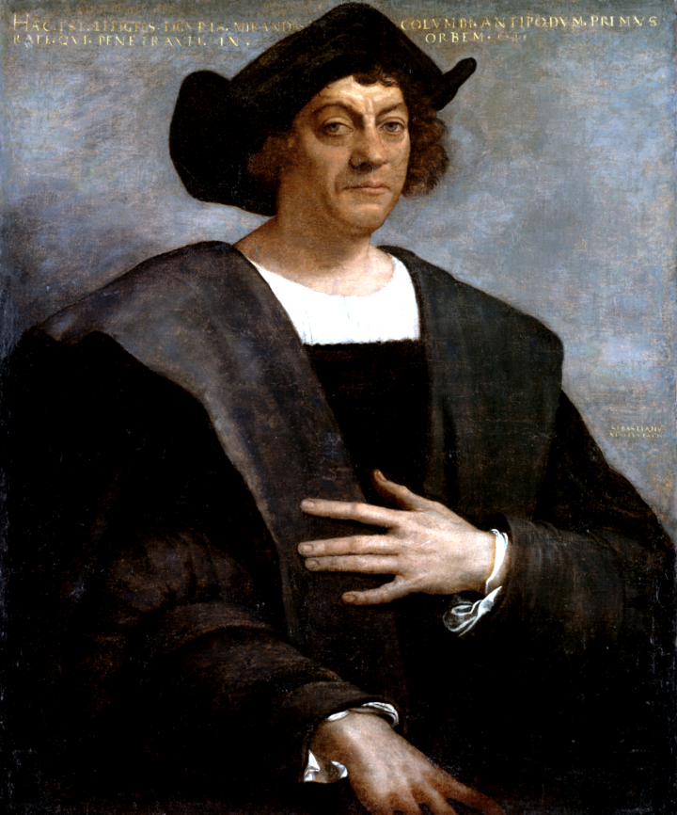
Christopher Columbus

Slide 2
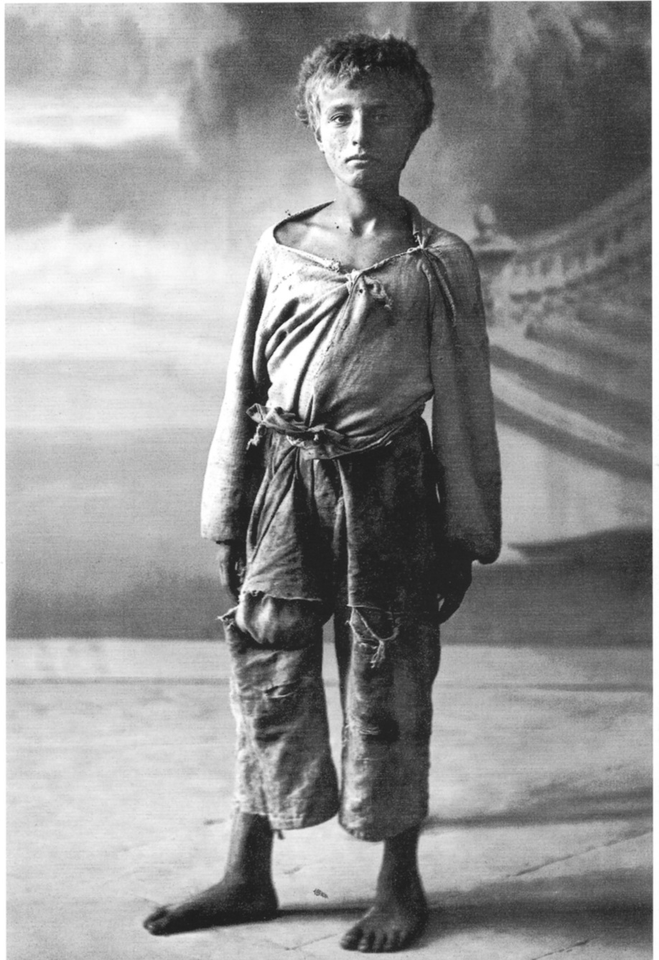
Christopher Columbus was born in Genoa, Italy in 1451. As a little boy he always wanted to be a sailor and explore the world. When he became a teenager he began sailing the seas and eventually made Portugal his home.

Slide 3
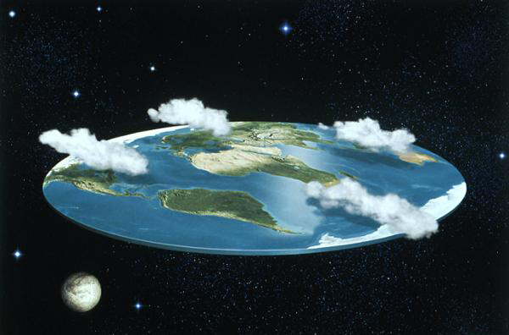
Columbus lived during the time of the Exploration age and people thought that the world was flat.
Columbus believed it was round.

Slide 4
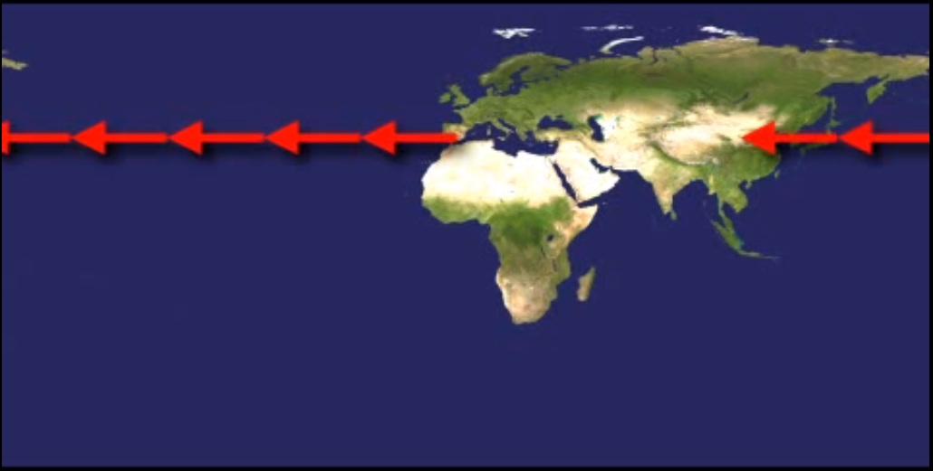
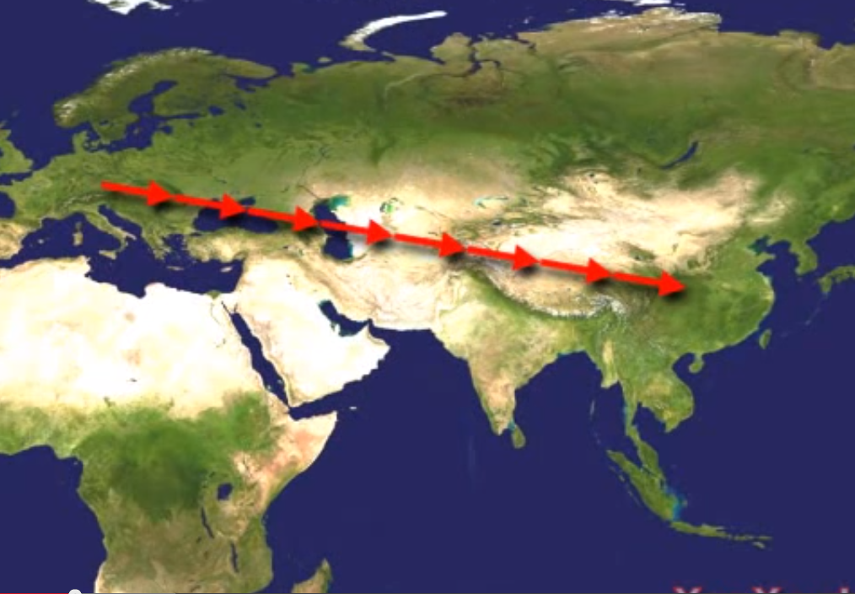
Columbus wanted to prove to everyone that the world was round by sailing west to get to East India.
People only used to sail east because they thought they would fall off the edge of the world.
S

Slide 5
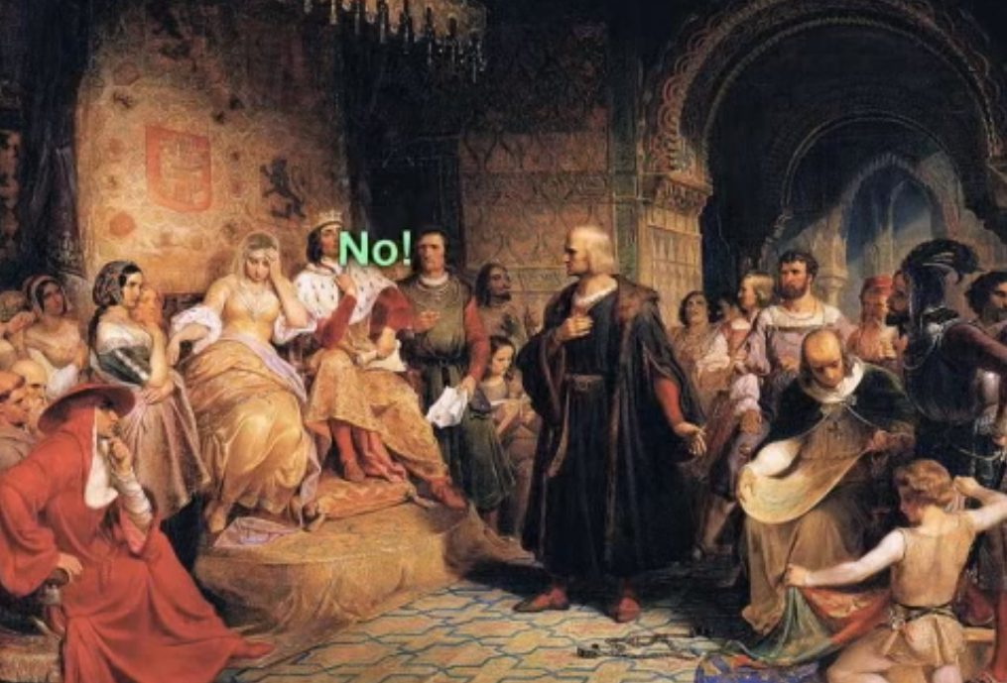
After some time, Columbus decided to ask the Kings of Portugal, France and England for money to sail west and in return he would give them spices and treasure that he would find in India.
But they laughed at him and said ‘No!’

Slide 6
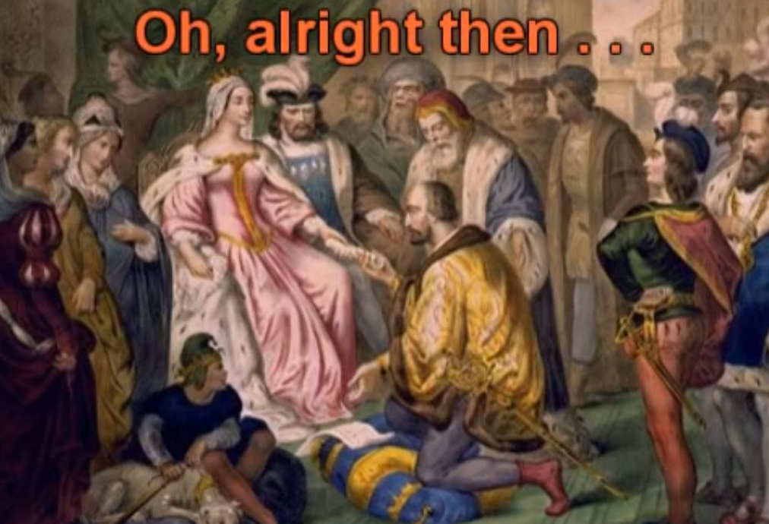
Next Columbus decided to go to the King and Queen of Spain. He explained to them that if they helped him travel west he would give them the treasure and spices that he would find.
They said ‘Yes’.

Slide 7
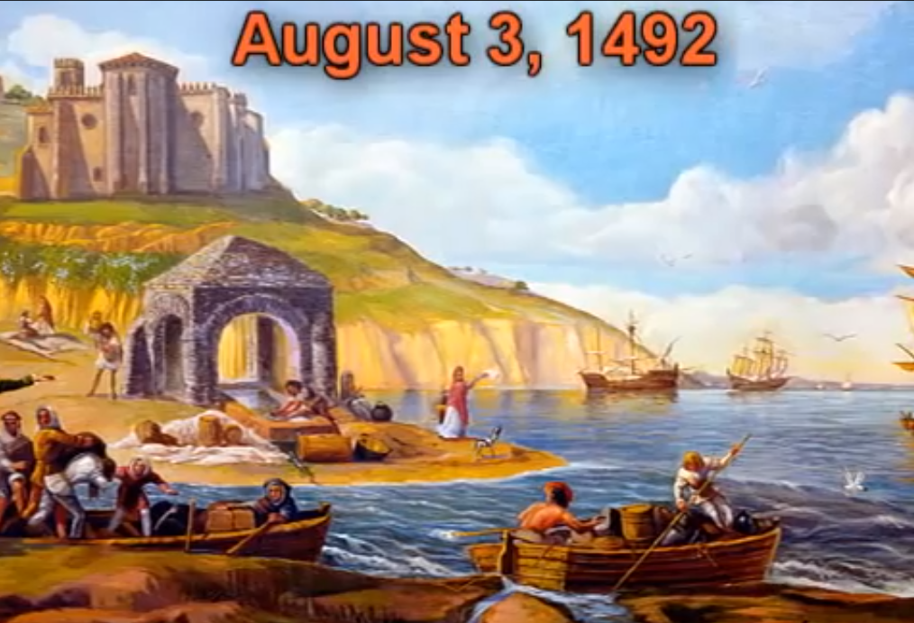
In 1492, Christopher Columbus and his crew were ready to sail west to India. People came to say good bye and farewell. Some people thought they would never return because they were sailing towards the edge of the world.

Slide 8
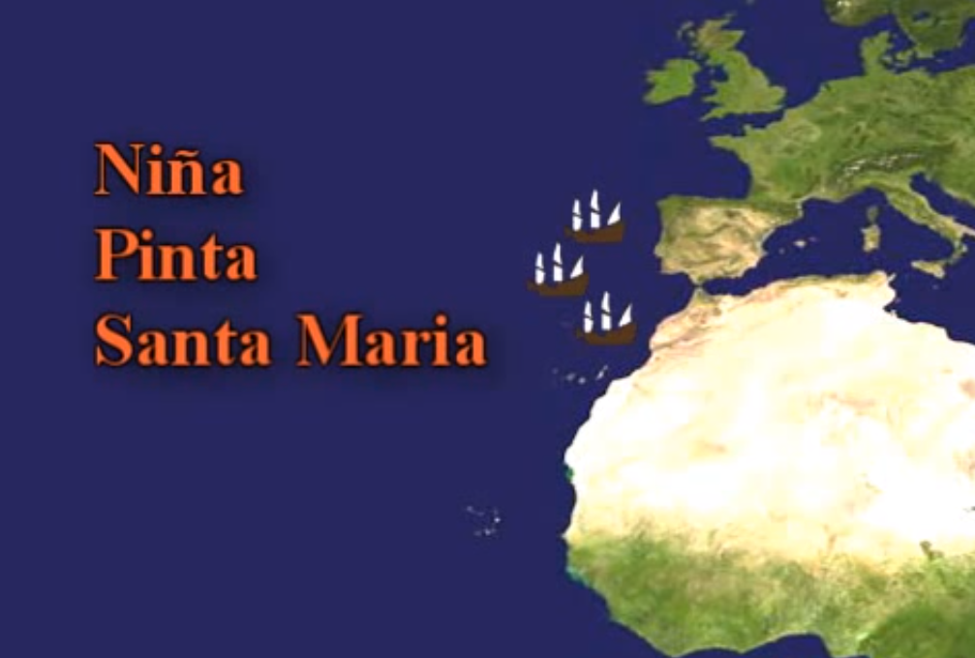
The Kind and Queen of Spain gave him three ships to sail in and asked him to bring back treasure and convert all the people there to Christianity.

Slide 9
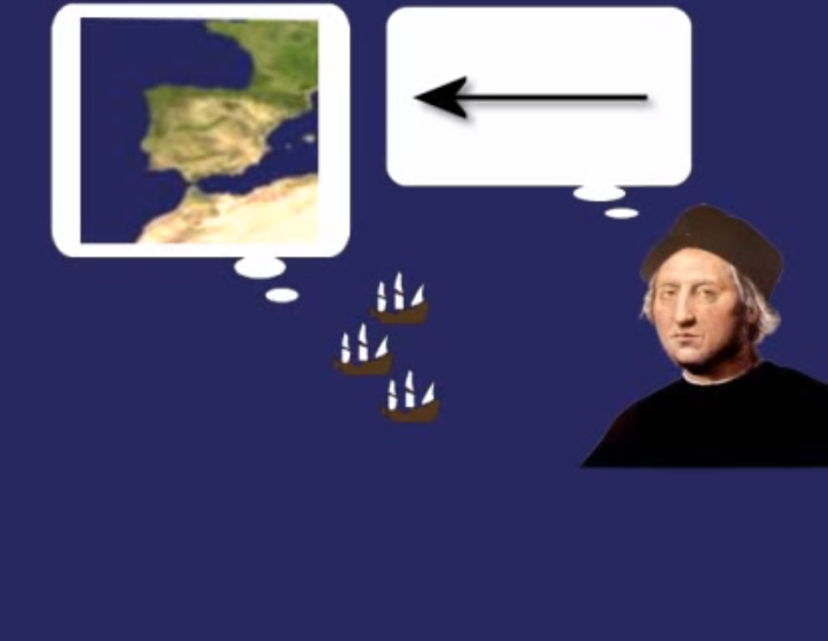
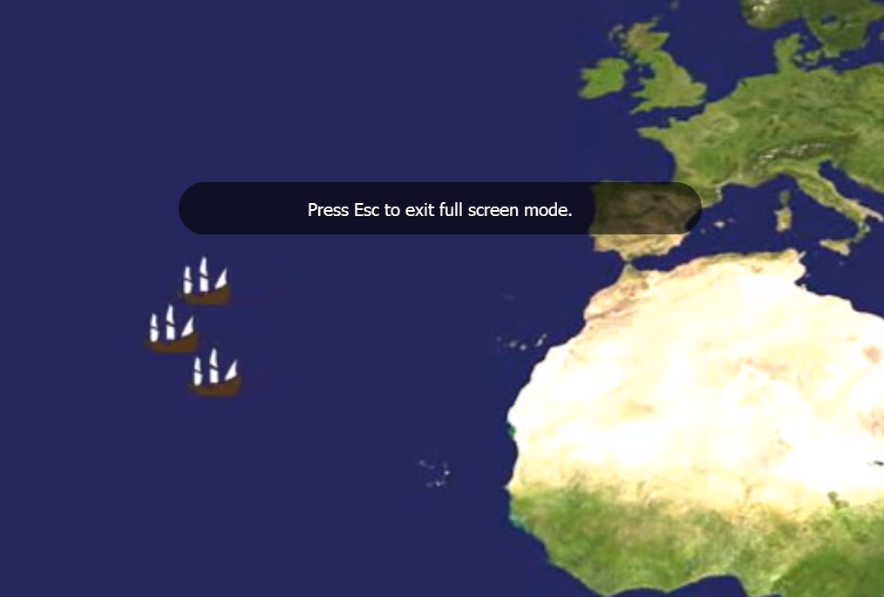
While Columbus was sailing West he was sure that they would reach India soon because he thought the world was small. He couldn’t wait to explore this new journey and show it back home to everyone he knew, especially the King and Queen of Spain.

Slide 10
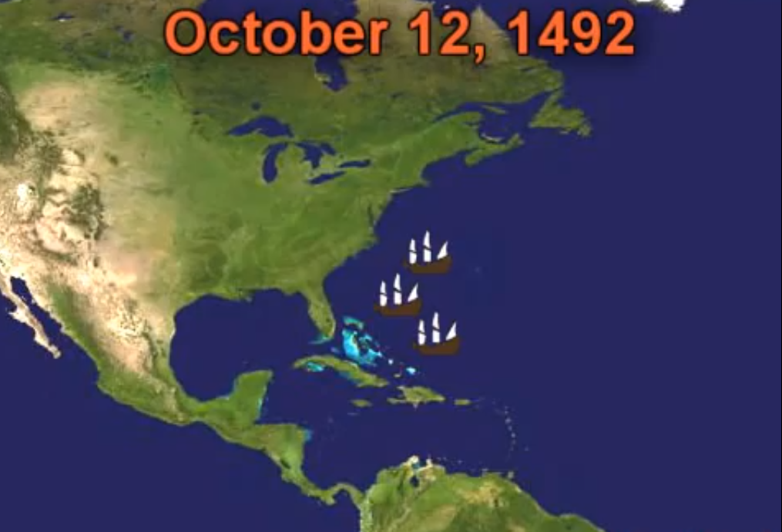
A few months later Columbus and his crew found some land and they believed it was India. Columbus was so happy that he had found a new and faster way to get to India.

Slide 11
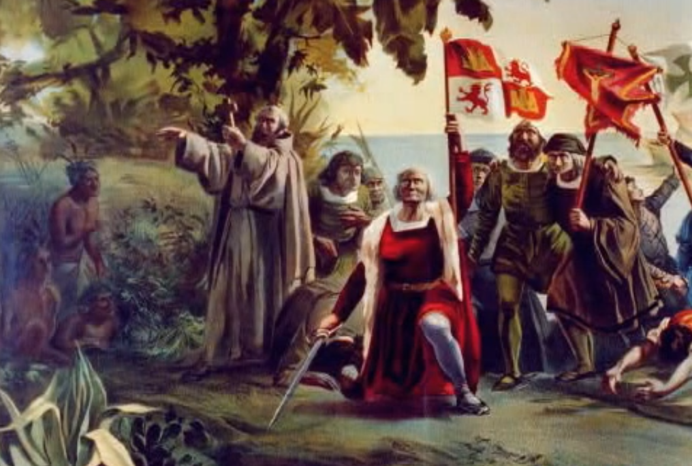
When they got to the land they met some people, who they thought were Indians. Columbus and his crew greeted them and asked to look around their land for treasure. He also taught them about Christianity.

Slide 12
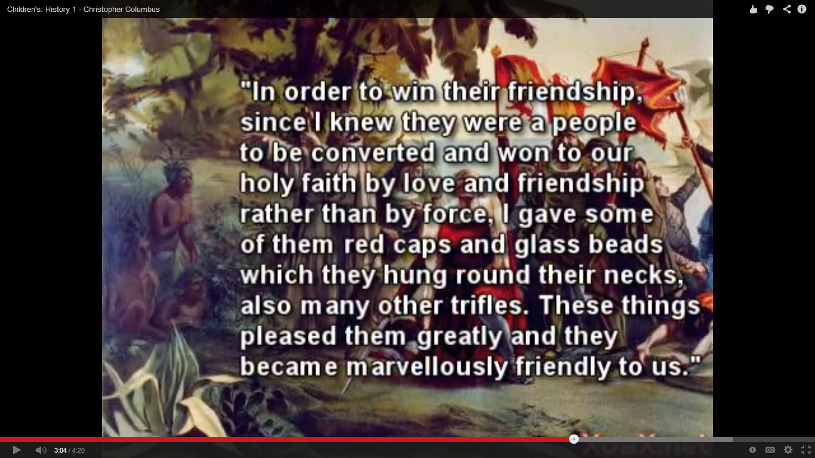

Slide 13
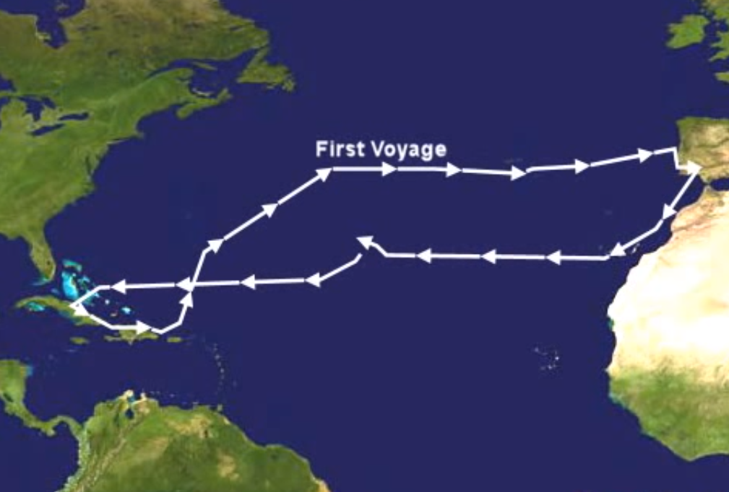
Columbus didn’t find any treasure there but was really excited to go back and tell everyone about the new way to India. So after a few weeks Columbus travelled back to Portugal and told them all about his voyage. He left some of his crew behind because two of the ships couldn’t sail anymore.

Slide 14
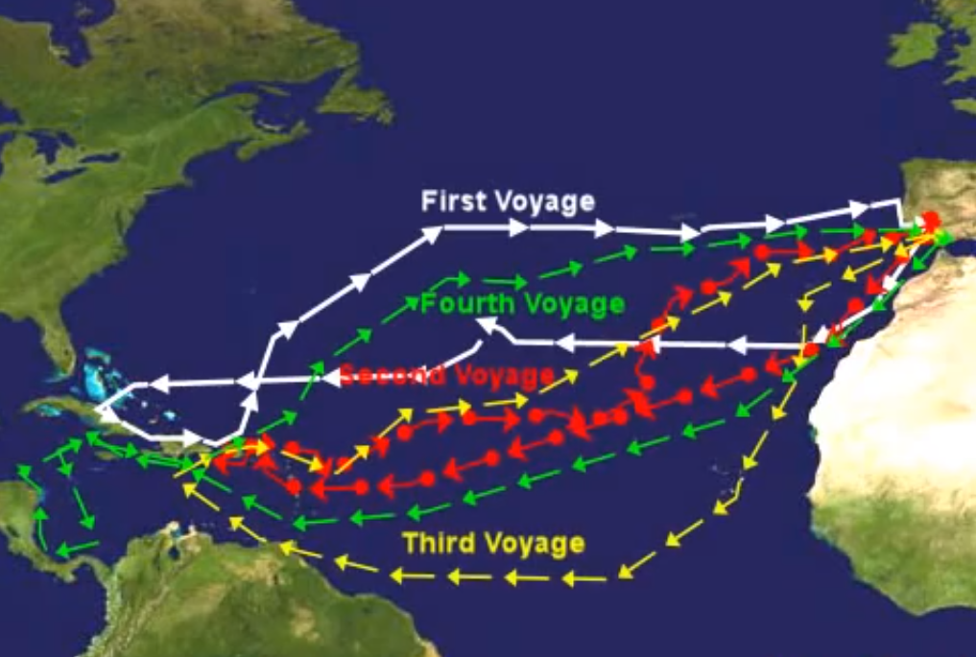
For the next few years Columbus travelled back to the land that he thought was India to find treasure, gold and spices. But each time he went back there was nothing.

Slide 15
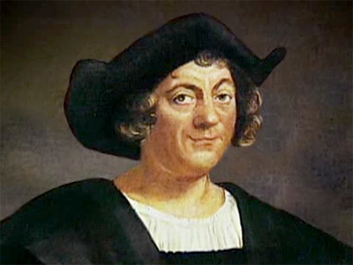
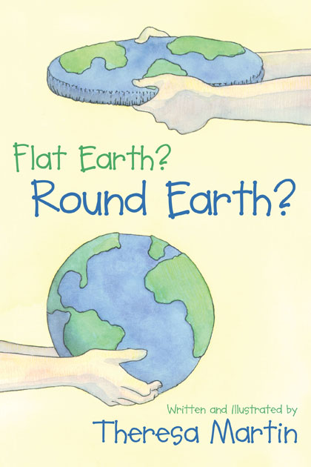
Finally, in 1506 Columbus died. He always believed that he had found a new route to India by travelling west. It was only after he had died did people realise that the land he had found wasn’t India but a new land called America.
Columbus did prove to everyone that the world was round.

