Slide 1
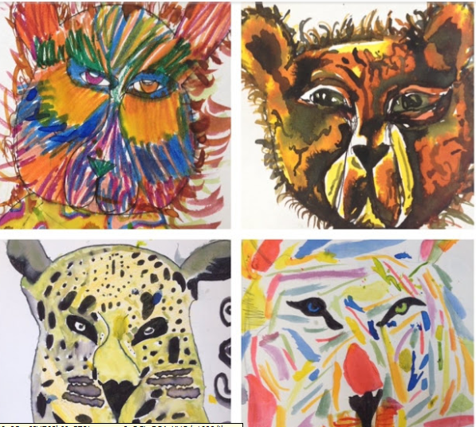
Drawing Animals
Many Zoos are offering virtual tours of their enclosures during the next few weeks. Find out about different animals and then choose one to draw.
These animals have been drawn using felt tip pens which have then been smudged gently with water and a brush.

Slide 2
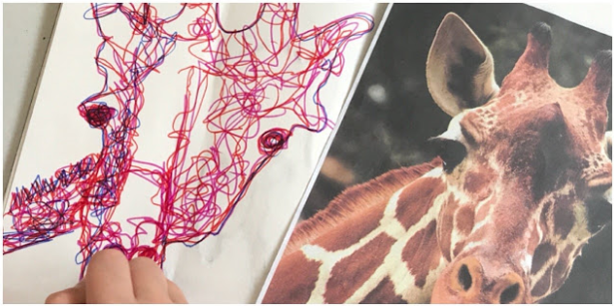
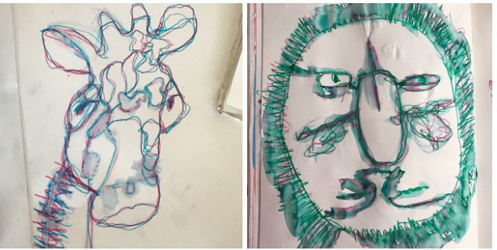

Slide 3
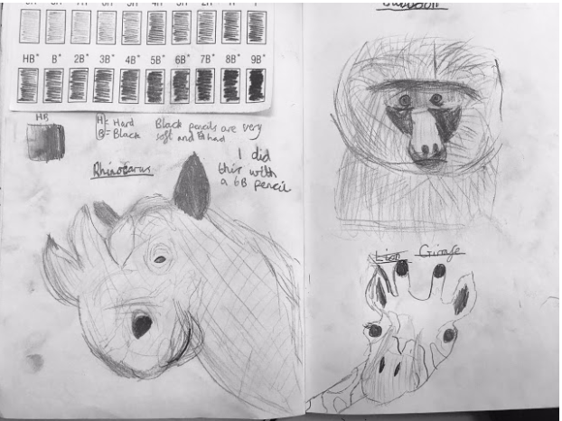
You could also draw using pencils. Can you add shading using a range of pencils? or by applying different pressure to the same pencil?

