Slide 1
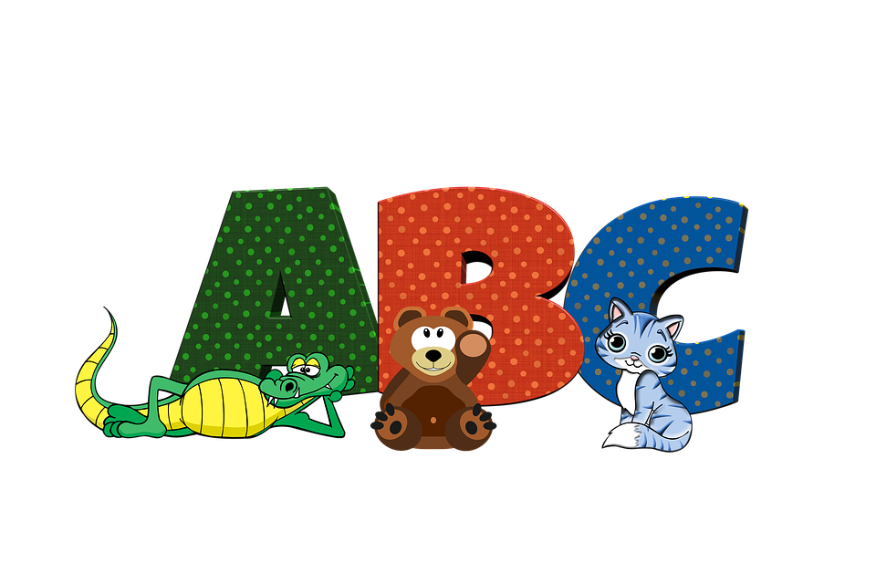
Mrs Pryce’s
Funny Phonics
segmenting/blending
air trigraph

Slide 2


air
air
h
air

Slide 3



air
2
p
air
f
air

Slide 4



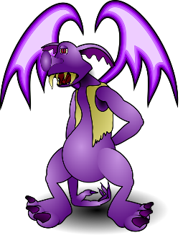
air
ch
air
l
air

Slide 5
air
hair
air
pair
fair
lair
chair
stairs
fairy
dairy
upstairs

