Slide 1
Henry the Explorer
Today I would like you to become the main character in the story.
(Adults please speak to your child about the dangers of going on adventures by themselves)
Henry goes on a journey with his dog, Angus.
https://www.youtube.com/watch?v=hVV8LEJ4KIU

Slide 2
Today we are going to pretend to be Henry.
We are going to look at how to put a diary entry together.
Can you draw a quick story map on the back of your worksheet to remind you of what happened during the story?
It could look something like this.

Slide 3
When we write a diary entry we need to write the events in order that they happened.
To do this we use openers.
Some examples of these openers are:
‘first', 'next', 'after that', 'then,' and 'finally,’.
When you write an opener you must use a comma after it.
Can you think of some others we could use?

Slide 4
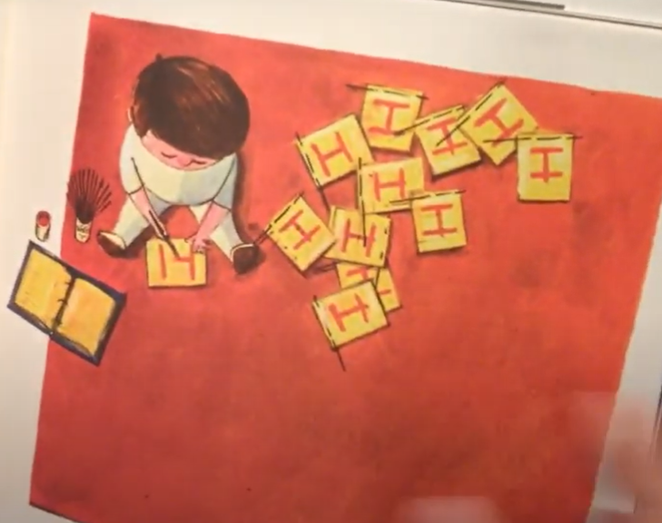
Task
Today we are going to create a skeleton frame that will help us when we come to write our final diary entries.
Look at your work sheet. The pictures on there are from the story. Can you cut out and order the pictures? Once you have done that can you write a short sentence next to it.
For example:
First, I got to work making some flags.

