Slide 1
Henry the Explorer
Today I would like you to listen to the start of a new story about a young explorer called Henry.
(Adults please speak to your child about the dangers of going on adventures by themselves)
Henry goes on a journey with his dog, Angus.
https://www.youtube.com/watch?v=hVV8LEJ4KIU

Slide 2
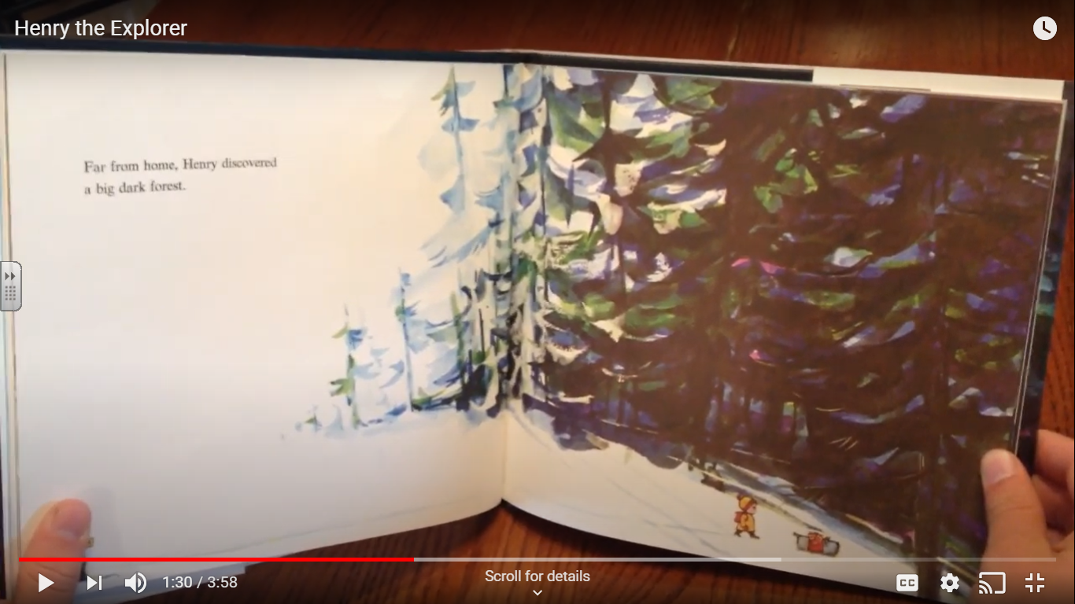
I would like you to listen to the story until you see this page on the screen. At that point I would like you to stop the video and look at today’s task on slide

Slide 3

Last week, we practised using adjectives and adverbs. Lets remind ourselves what they are.
An adjective
An adjective describes a noun. For example: Big, small, ugly, smelly. Look at the picture below. How many adjectives can you think of in 10 seconds?

Slide 4
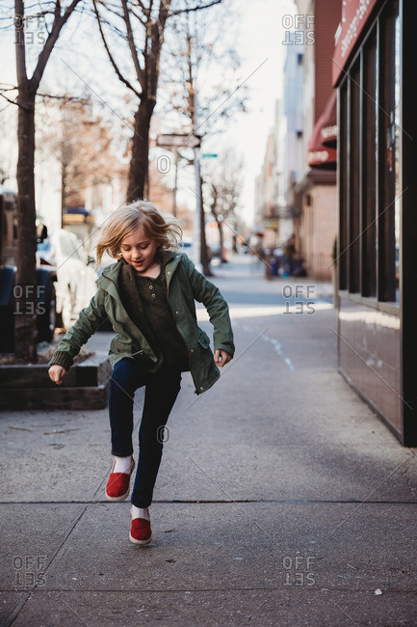
Adverbs
An adverb describes and action.
For example: quickly, slowly or carefully.
Look at the image below. What adverb(s) could you use to describe the action in the picture?

Slide 5
Today’s task
Today I would like you to look at the image below and write a short descriptive paragraph (a couple of sentences) to describe the forest that Henry is about to enter.
How did he enter it?
How did he feel when he entered?
Don’t forget about Angus the dog. Describe how he could have felt too.

Slide 6
