Slide 1
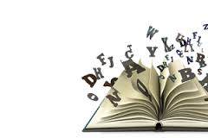
Moving you on as a …
READER!

Slide 2

Great Readers are able to…
Decode letters and sounds
Retrieve (find) information and key details
Explain the meaning of words
Summarise main ideas
Make and explain inferences
Predict what might happen
Discuss the author’s choice of words and phrases
Make comparisons
PEE!

Slide 3
Lesson 3
Comprehension
How to understand why the author has chosen certain words and phrases and for what effect…

Slide 4
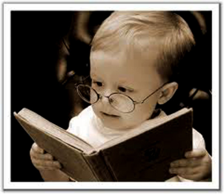
A Great Reader…
Is able to identify emotive language and comment on how effective it is
Skilful writers use emotive language that deliberately stirs up emotions in readers such as anger, guilt, sadness…

Slide 5
You do not always need to understand every word to sense the mood of a text and identify the emotions the writer wants to arouse.
Think of The Jabberwocky poem – we couldn’t understand a lot of the nonsense words but we kind of understood what was going on, especially with the mood.

Slide 6
Common Features of Emotive Language
Alliteration
  Words beginning with the same letter
Onomatopoeia
Words which echo their meaning in sound
Personification
Presenting things which are not human as if they are human

Slide 7
‘This Room’ by Imtiaz Dharker
This room is breaking out
of itself, cracking through
its own walls
in search of space, light,
empty air.
Crack!
Creaking, cracking, crying…
Can you find examples of personification, onomatopoeia & alliteration?
(Annotate the activity sheet.)

Slide 8
Can you think of onamatopoeic words for these sounds?
A doorbell sound
ding-dong
Footsteps on gravel
crunch
Paper moving
rustle
Breathing in heavily/quickly through your nose
sniff

Slide 9
Your Task…
Common Features of Emotive Language
Complete the table on the activity sheet with at least two examples each of alliteration, onomatopoeia and personification.

