Slide 1
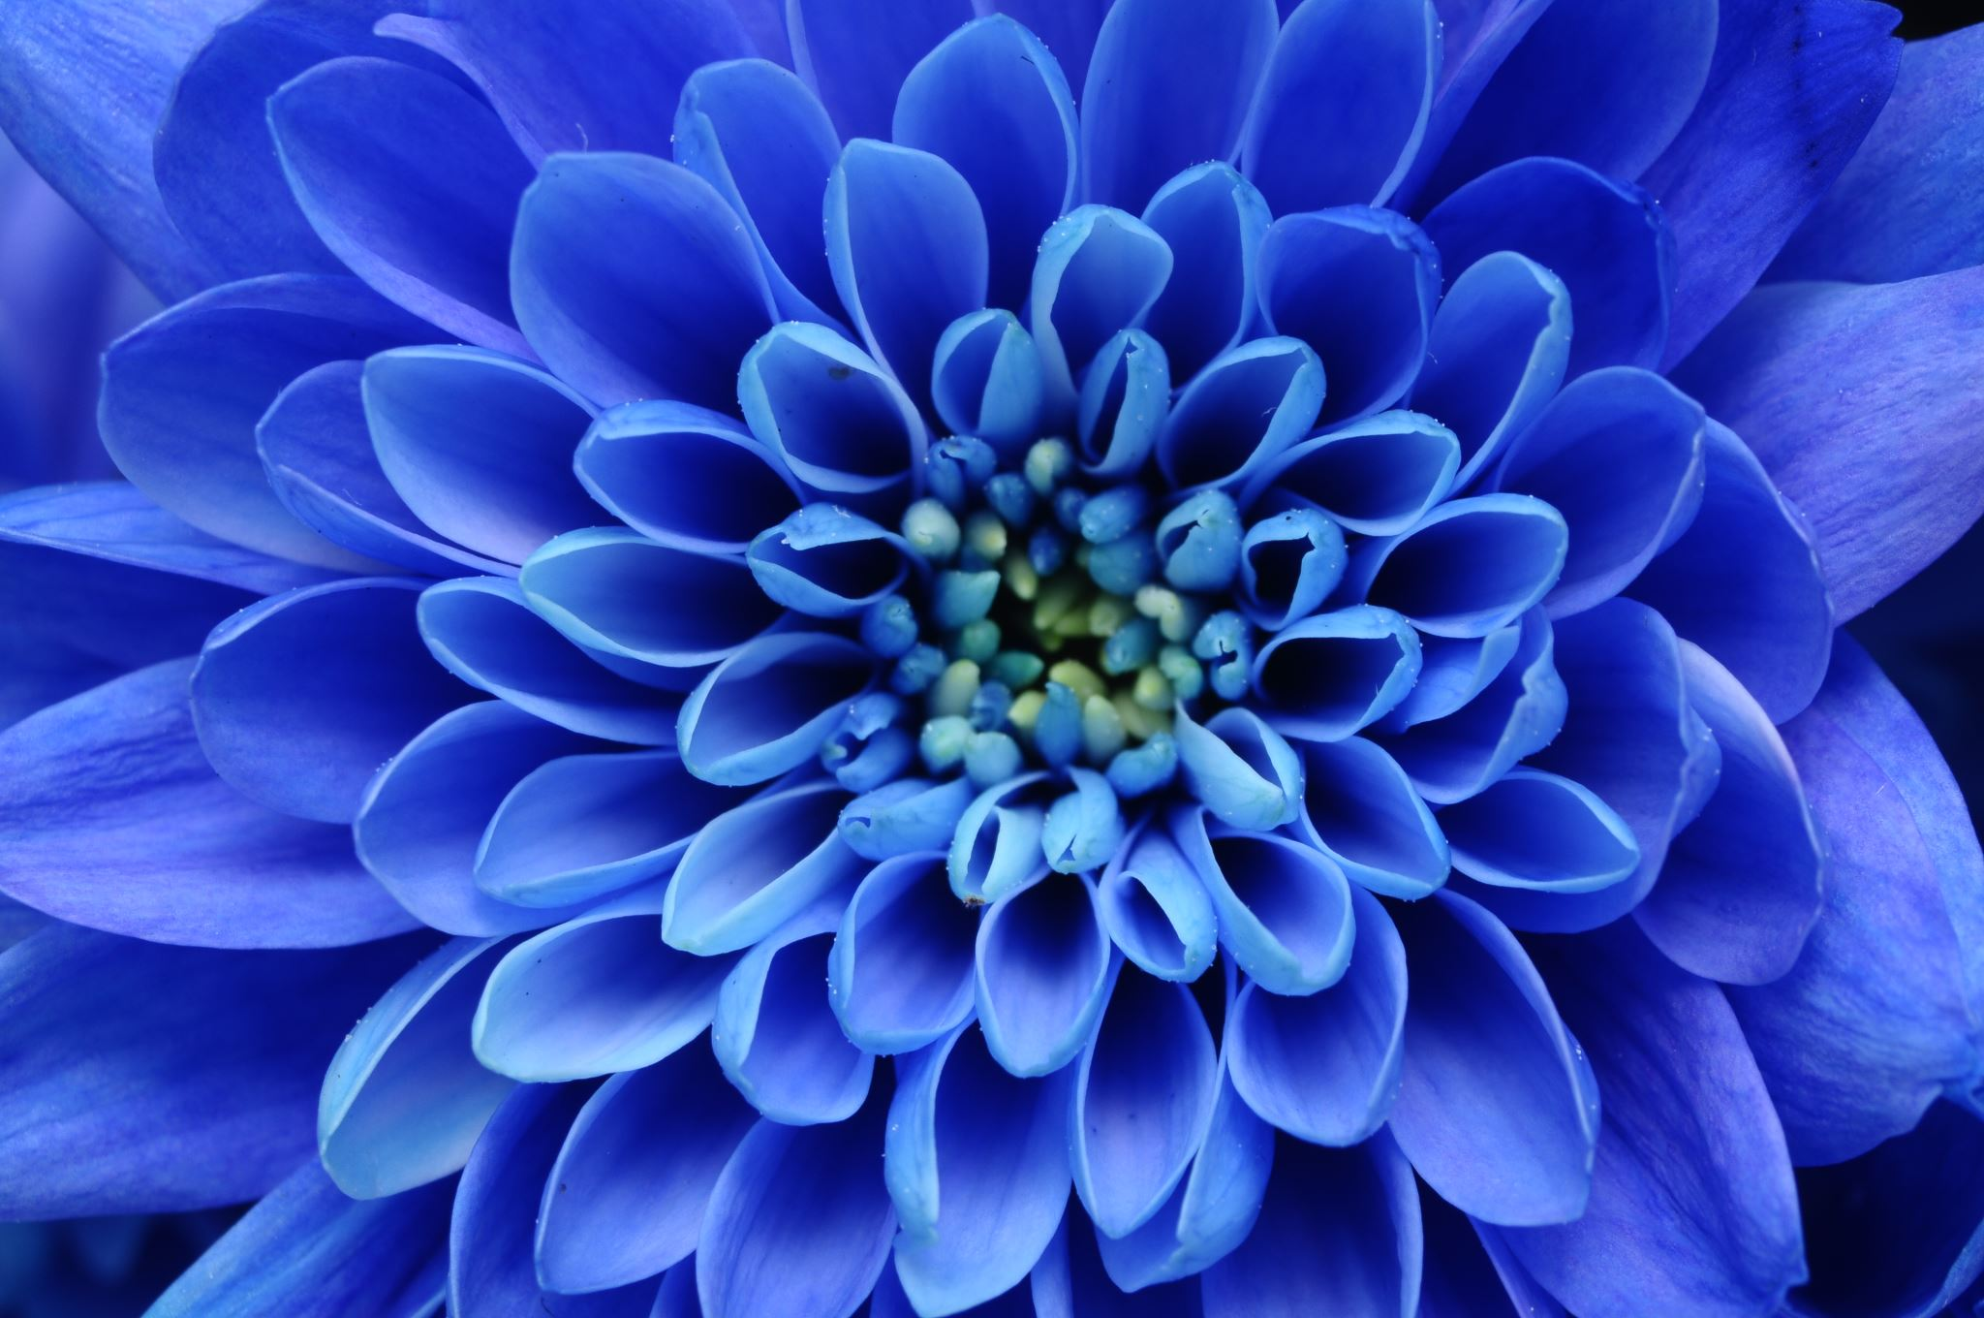



Living things and their habitats
For parents
Thank you for supporting your child’s learning in science.
Before the session:
Please read slide 2 so you know what your child is learning and what you need to get ready.
As an alternative to lined paper, slide 5 may be printed for your child to record on.
During the session:
Share the learning intentions on slide 2.
Support your child with the main activities on slides 3,4 & 5, as needed.
Slide 6 is a further, optional activity.
Slide 7 has a glossary of key terms.
Reviewing with your child:
Slide 8 gives an idea of what your child may produce.
Plant classification: characteristics of
flowering and non-flowering plants
Year 6
Age 10-11

Slide 2
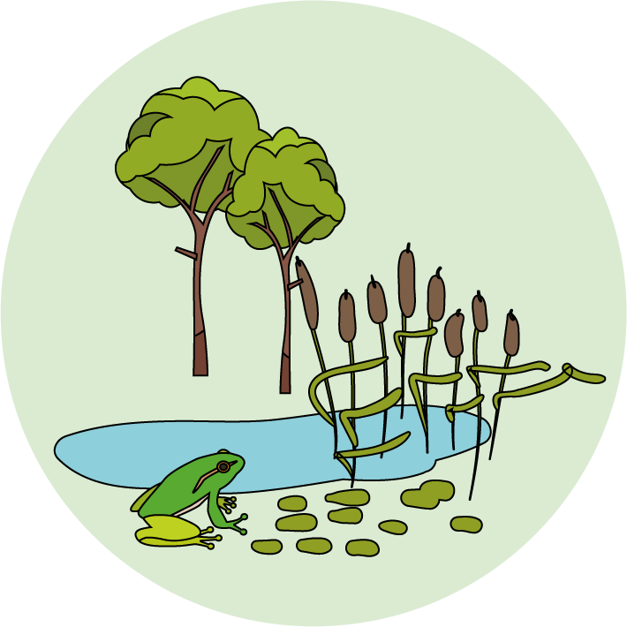

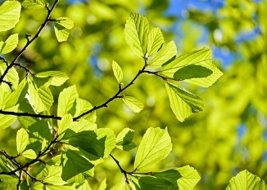
Living things and their habitats
Logo for section to sit inside roundel
Plant classification: characteristics of flowering and non-flowering plants
Key Learning
Plants can be divided broadly into two main groups: flowering plants and non-flowering plants.
Flowering plants reproduce with seeds which are protected by a flower or fruit.
Non-flowering plants include conifers, ferns, and mosses.
Activities (pages 3-5): 30 - 40 mins
Use lined paper, a ruler and a pencil.
Alternatively, print page 5 as a worksheet.
Find out more… (page 6): 30 – 60 mins
Find out more about your local trees.
I can…
Describe the characteristics of flowering and non-flowering plants.
Use a statement key to classify a group of plants.
2

Slide 3

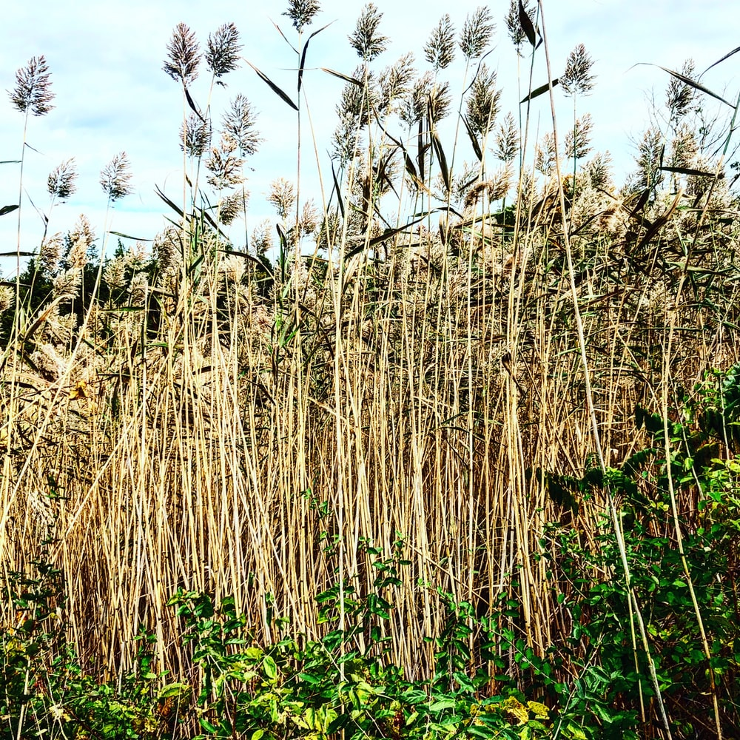
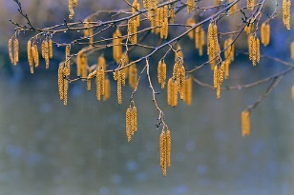
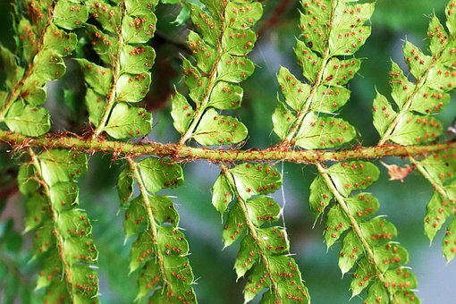
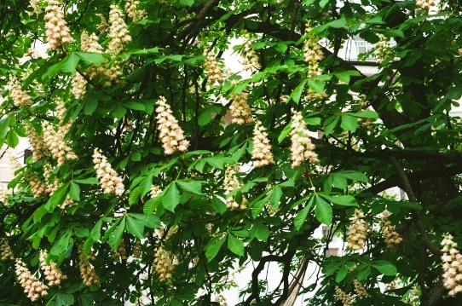
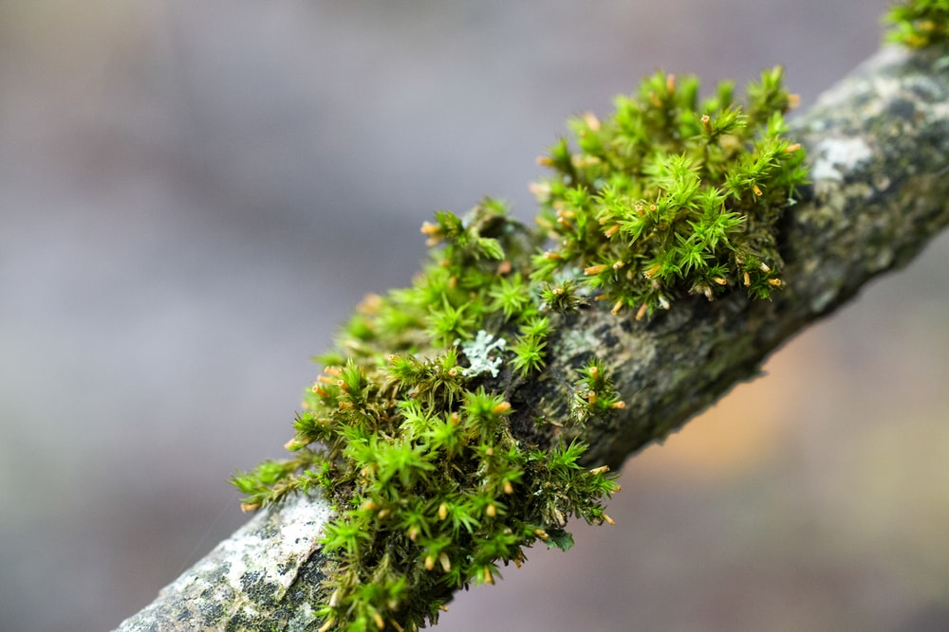
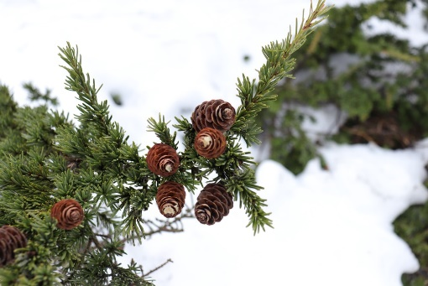
Explore, review, think, talk…
Logo for section to sit inside roundel
What do you already know about flowering and non-flowering plants?
(10 minutes)
Watch these two BBC clips about classifying plants.
https://www.bbc.co.uk/bitesize/clips/zsdkjxs
https://www.youtube.com/watch?v=cgVlrtGnG6s
Think about these questions as you watch:
  Which type of plants produce seeds?
  Which type of plants produce spores?
A Flowering plant reproduces with seeds which are protected by a flower or fruit.
https://www.dkfindout.com/uk/animals-and-nature/plants/flowering-plants/
https://www.woodlandtrust.org.uk/trees-woods-and-wildlife/plants/grasses-and-sedges/
Why are the flowers of some plants brightly coloured and those of other plants a dull green or brown?
Insect-pollinated plants usually have coloured petals. Many trees and grasses have dull, hanging flowers as they rely on the wind for pollination.
3

Slide 4
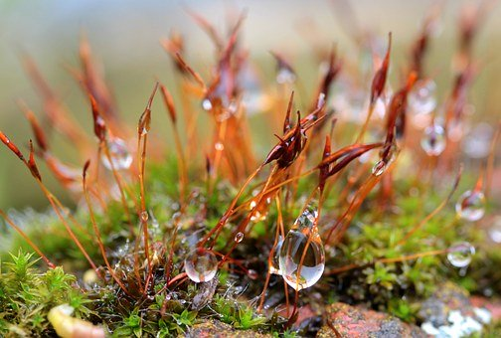
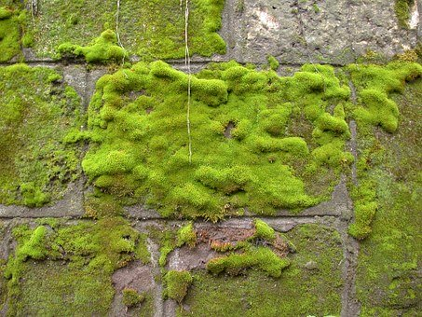
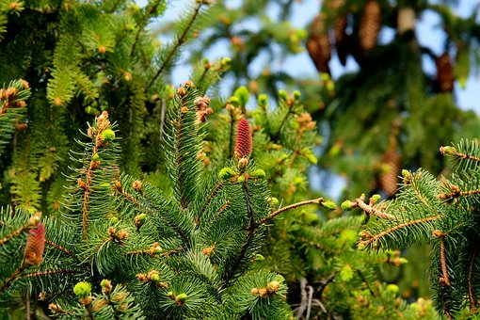
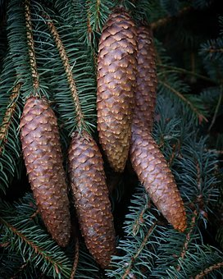
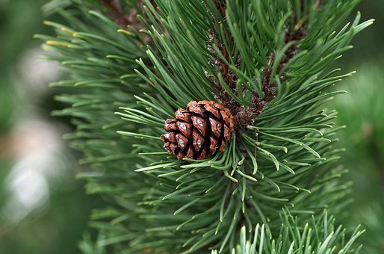
Non-flowering plants
Logo for section to sit inside roundel
Exploring the characteristics of conifers, ferns and mosses
(Page 4-5: 20-30 minutes)
Non-flowering plants include conifers, ferns, and mosses.
Conifers reproduce with seeds in cones.
They often have needle-shaped leaves.
Conifers include firs, pines, spruces and yews.
Many are evergreen and do not shed their leaves in winter.
Mosses and ferns reproduce with tiny spores rather than seeds.
Mosses often grow in shady, damp places and do not have true roots.
More details about conifers, ferns and mosses: https://www.dkfindout.com/uk/animals-and-nature/plants/non-flowering-plants/
https://www.woodlandtrust.org.uk/trees-woods-and-wildlife/plants/ferns/
4

Slide 5
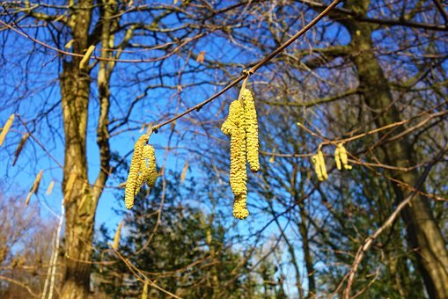
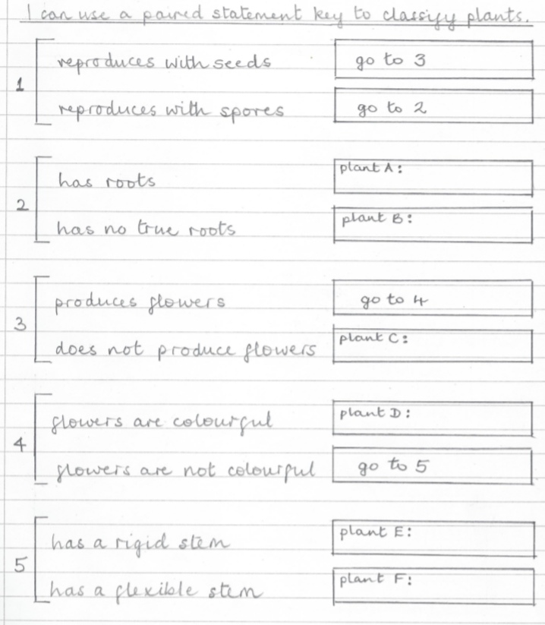
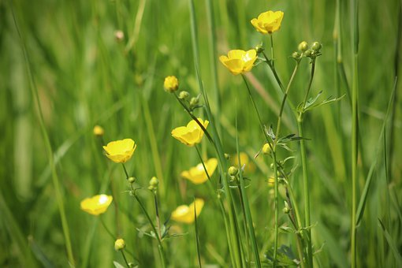
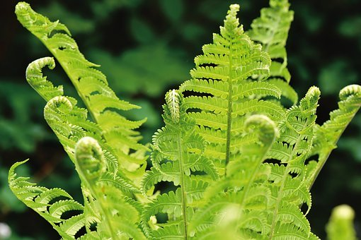
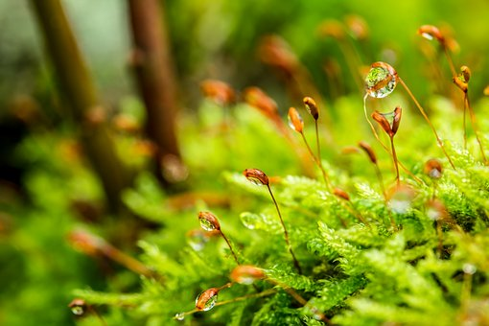
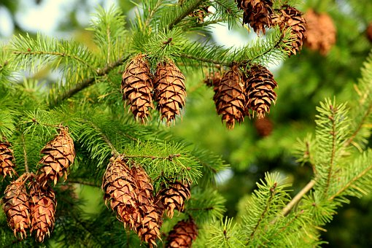
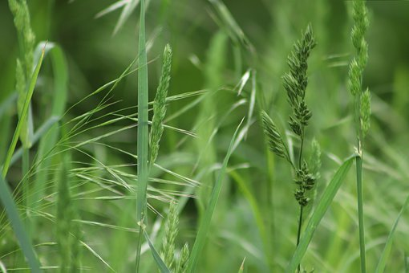
Use the key to classify these plants:
A paired-statement key is set out as a list. You start at number one on the list and work your way through the statements.
Identify plants A to F by looking at the pictures and using what you have learnt.
I can use a paired statement key to classify plants.
Hazel tree
Buttercup
Bracken
Moss
Hint: Some plants hold their seeds in cones.
Spruce tree
Hint: Wind pollinated plants do not have colourful flowers to attract insects.
Grass
5

Slide 6
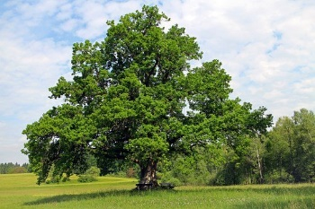
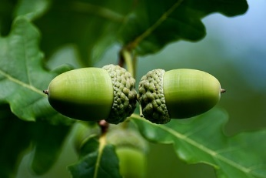
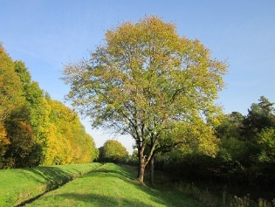
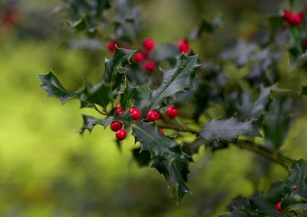
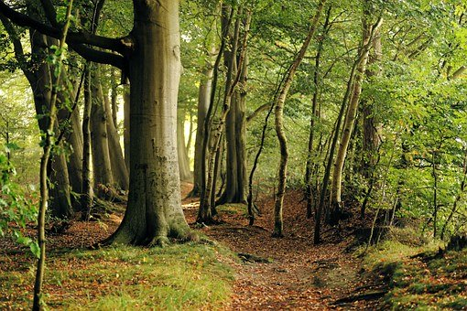
Find out more about your local trees
Logo for section to sit inside roundel
You may like to investigate the trees in your garden or nearby woodland
(30-60 minutes)
You may like to find out more about your local trees. The Woodland Trust website has a wide variety of information about trees in the UK. https://www.woodlandtrust.org.uk/trees-woods-and-wildlife/british-trees/how-to-identify-trees/
Alternatively, ‘Trees for Learning’ have three suggested activities for the Summer.
https://communityforest.org.uk/treesforlearning/download-ks2-activity-summer/
6

Slide 7
Glossary of terms
Characteristic: Characteristics are features of living things which help scientists classify them.
Classification: Classification is the method scientists use to group living things.
Flowering plant: A flowering plant reproduces with seeds which are protected by a flower or fruit.
Non-flowering plant: Non-flowering plants include conifers, ferns and mosses. Conifers reproduce with seeds in cones. Ferns and mosses reproduce with spores. Mosses do not have true roots.
Paired-statement key: A paired-statement key is set out as a list. You start at number one on the list and work your way through the statements until you reach the name of the living thing you are classifying.
Pollination: Pollination is the transfer of pollen from one flowering plant to another, usually carried by insects, animals or the wind.
7

Slide 8
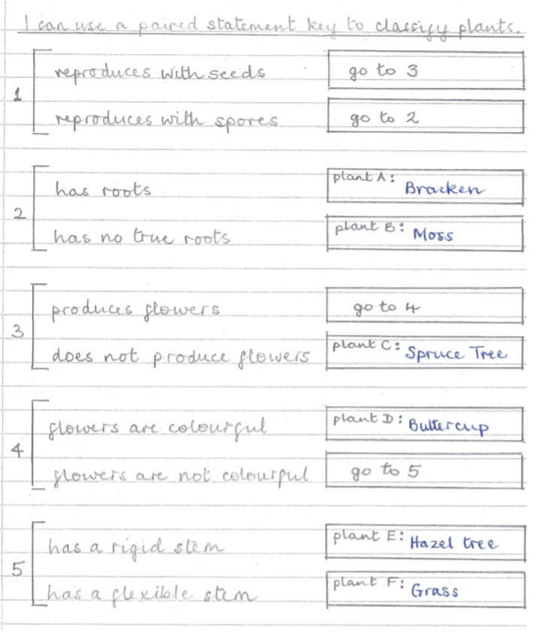
Possible learning outcome for reviewing your work.
I can use a paired statement key to classify plants.
Plant D: Buttercup.
It has brightly coloured petals that attract insects for pollination.
Plant A: Bracken. It is a fern. It reproduces with spores. It has roots, stems and leaves.
Amphibians include frogs, toads and newts. They have a smooth moist skin an
Plant B: Moss.
Moss reproduces with spores. It has no true roots and usually grows in damp, shady places.
Plant E: Hazel Tree. It has catkins as flowers which hang down so the pollen is carried by the wind.
Plant C: Spruce Tree.
It does not produce flowers. It has seeds contained in cones.
Plant F: Grass.
Grasses usually have dull green or brown flowers and stems which bend in the breeze.
8

