Slide 1


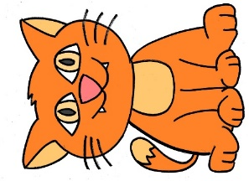
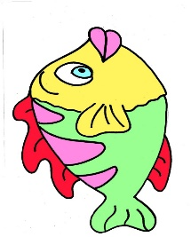
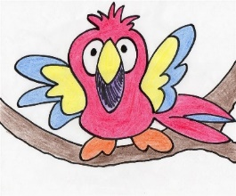
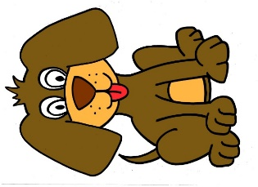
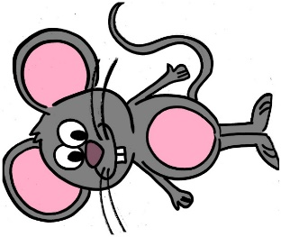
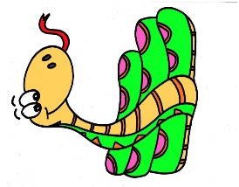
@Primary Languages Network 2020
Language “Hand” Hopscotch:“Likes”
We are going to play “language hopscotch”. First we will play the hopscotch game on the page using our hands.
Afterwards you can play the game in the playground, in your garden or with large pieces of paper to make the
hopscotch grid in a room in your house.
You need to turn the page so that you can see the pictures on the grid the right way up.
At the end of the game say a sentence using the verb “J’aime…” (I like…) and one of the animal nouns.
3
9
6
10
J’aime
1
7
4
Check the French.
Look at the answer page.
Play the game again.
Are you quicker?
Start
8
2
5
Say what
you see.
How quickly
do you
remember
the French?
Language Hopscotch “Likes”

Slide 2


Answers
J’aime
le serpent
le chat
bleu
la souris
l’oiseau
jaune
le chien
le poisson
rouge
Answers
I like
the snake
the cat
blue
the mouse
the bird
yellow
the dog
the fish
red
@Primary Languages Network 2020
Language Hopscotch “Likes”

