Slide 1
a b c d e f g h i j k l m n o p q r s t u v w x y z
A B C D E F G
H I J K L M N
O P Q R S T U
V W X Y Z

Slide 2
ar

Slide 3
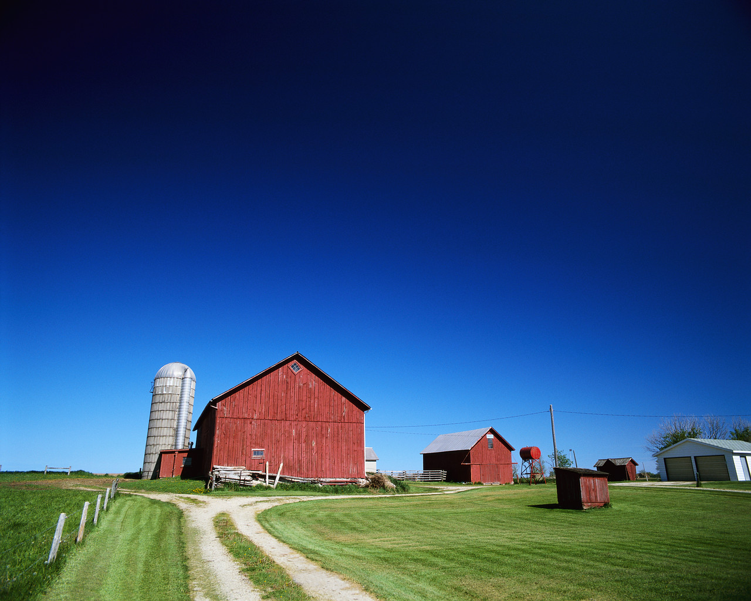
A place where animals may live.

Slide 4
farm

Slide 5
A vehicle that you can drive.

Slide 6
car

Slide 7
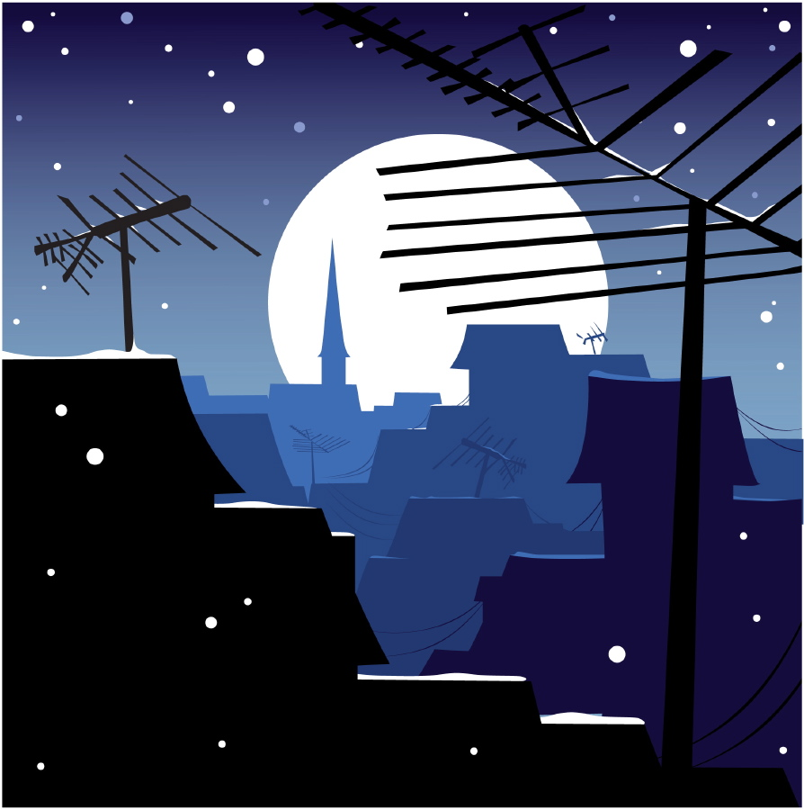
In the night time, it is ...

Slide 8
dark

Slide 9
A place where you can play on a swing or a slide.

Slide 10
park

Slide 11
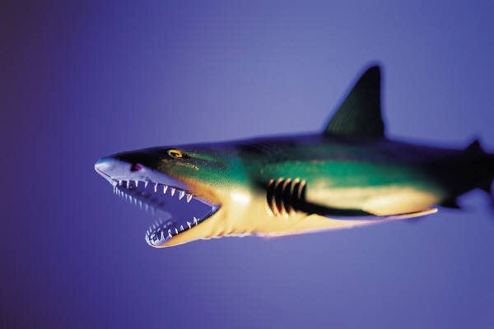
A scary fish that lives out to sea.

Slide 12
shark

Slide 13
A nice woolly covering that goes on the floor.

Slide 14
carpet

Slide 15
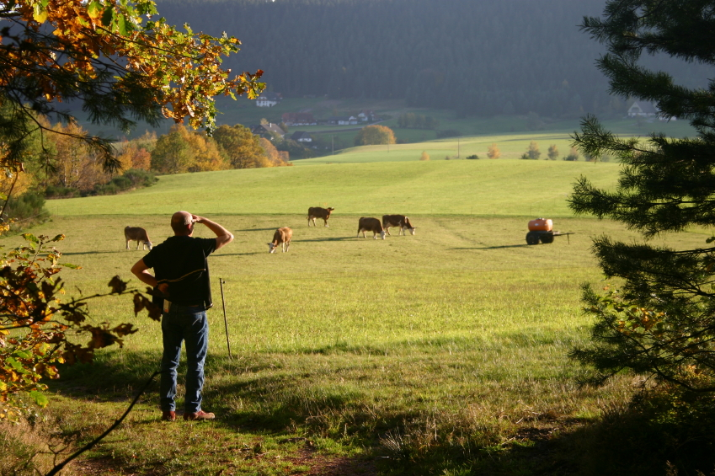
The person who looks after the animals on the farm.

Slide 16
farmer

Slide 17

Well done...you will go far!

