Slide 2
Before you start this quiz, ask an adult to fill a jug with 1 litre of water so you can estimate using that as your reference.
Be careful not to spill it though, we don’t want Mr. Moorcroft to get into trouble for asking you to do your maths with water.

Slide 3
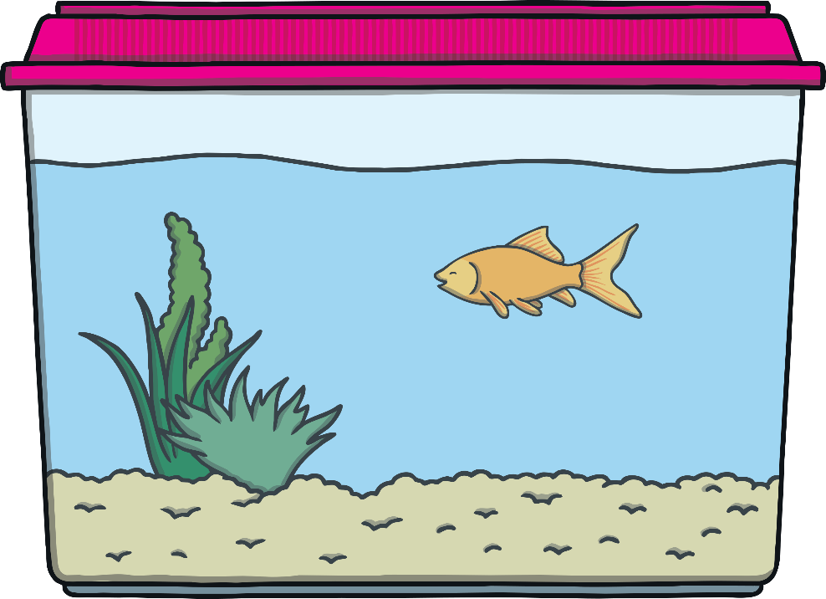
Are You Ready?
There are 5 questions in this quiz.
They are all to do with measuring capacity.
Each question is multiple choice.

Slide 4
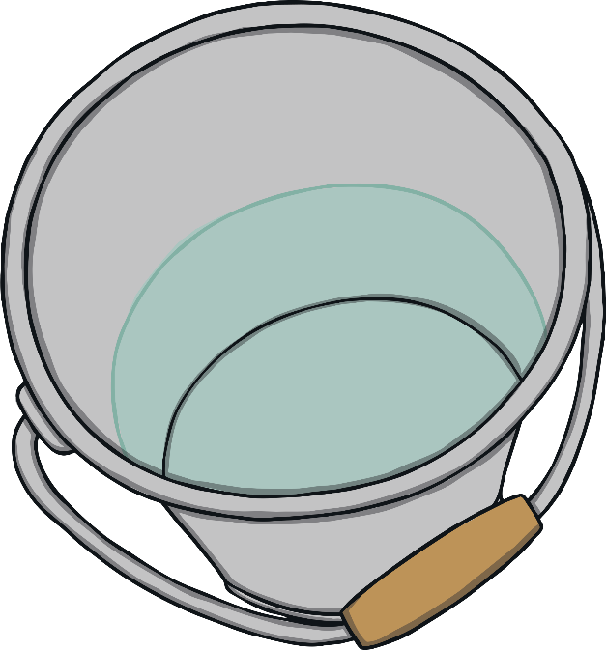
Question 1
It takes 10 cups of water to fill this bucket.
How many cups will it take for the bucket to be half full?
4 cups
7 cups
5 cups
9 cups
Half of 10 is 5. So to fill half the bucket, you need 5 cups of water.

Slide 5
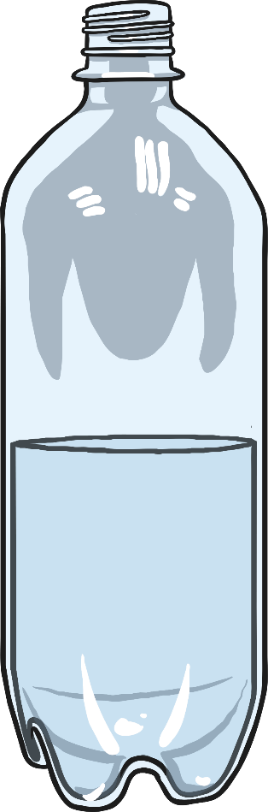
Question 2
How full is this bottle?
full
nearly full
half full
nearly empty
The water is half way up the bottle.

Slide 6
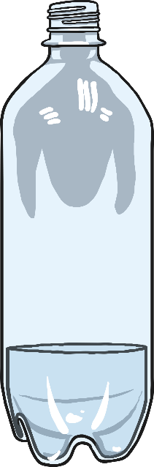
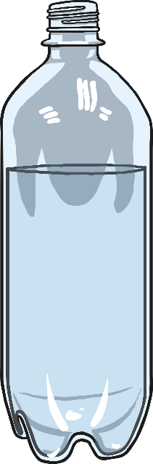
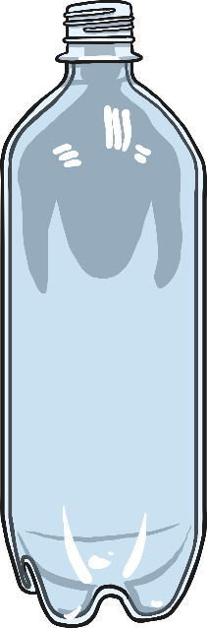
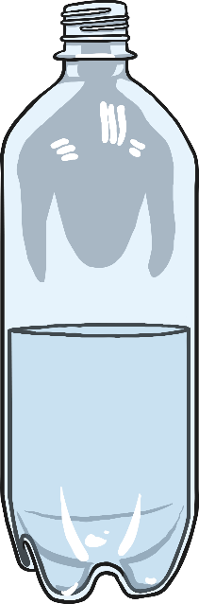
Question 3
Which bottle is nearly full?
a
b
c
d
Bottle b is nearly full.

Slide 7
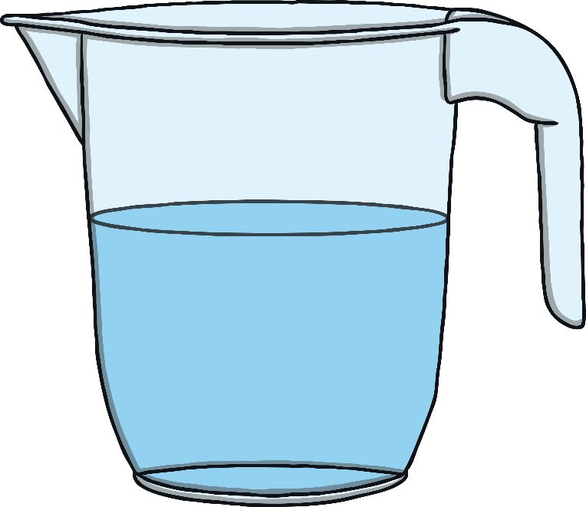
Question 4
This jug contains 4 litres of water when it is full.
Estimate how much water is in the jug.
1 litre
2 litres
3 litres
4 litres
The jug is approximately half full. Half of 4 is 2.

Slide 8

Question 5
This fish tank contains 11 litres when it is half full.
How much does it contain when it is full?
20 litres
21 litres
22 litres
24 litres
2 × 11 = 22 so the fish tank contains 22 litres when it is full.

