Slide 2
5
How many oceans
are there in the world?
Answer

Slide 3
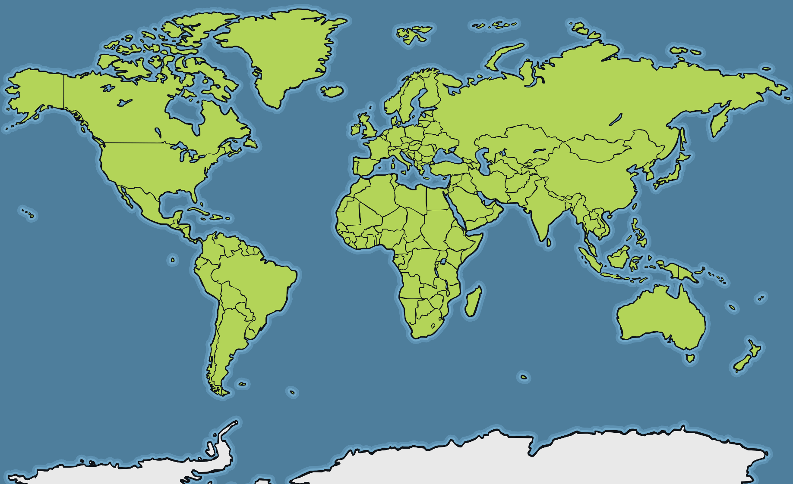
Which is the largest ocean?
The Pacific Ocean
Which is the largest ocean?
Answer

Slide 4
Which is the largest ocean?
The Arctic Ocean
Which is the smallest ocean?
Answer

Slide 5
Which is the largest ocean?
The Antarctic Ocean
Which ocean surrounds Antarctica?
Answer

Slide 6
Which is the largest ocean?
The Arctic Ocean
Which ocean is the furthest North?
Answer

Slide 7
Which is the largest ocean?
The Atlantic Ocean
Which ocean can be found between North America and Africa?
Answer

Slide 8
Which is the largest ocean?
The Pacific Ocean
Which ocean can be found between North America and Asia?
Answer

Slide 9
Which is the largest ocean?
The Southern Ocean
What is the other name for the Antarctic Ocean?
Answer

