Slide 1
Best Bet
/oo/
oo
ue
u-e
ew

Slide 2
oo
ue
u-e
ew

Slide 3
oo | ew | ue | u-e
glue
?
oo
ew
ue
u-e

Slide 4

oo | ew | ue | u-e
 |  | glue
pool
?
oo
ew
ue
u-e

Slide 5
oo | ew | ue | u-e
pool |  | glue
drrew
?
oo
ew
ue
u-e

Slide 6

oo | ew | ue | u-e
pool | drew | glue
screw
?
oo
ew
ue
u-e

Slide 7
oo | ew | ue | u-e
pool | drew | glue
 | screw
clue
?
oo
ew
ue
u-e

Slide 8

oo | ew | ue | u-e
pool | drew | glue
 | screw | clue
mushroom
?
oo
ew
ue
u-e

Slide 9

oo | ew | ue | u-e
pool | drew | glue
mushroom | screw | clue
rude
?
oo
ew
ue
u-e

Slide 10
oo | ew | ue | u-e
pool | drew | glue | rude
mushroom | screw | clue
 | crew
crrew
?
oo
ew
ue
u-e

Slide 11
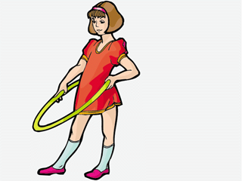
oo | ew | ue | u-e
pool | drew | glue | rude
mushroom | screw | clue
hoop
?
oo
ew
ue
u-e

Slide 12
oo | ew | ue | u-e
pool | drew | glue | rude
mushroom | screw | clue
hoop | crew
blew
?
oo
ew
ue
u-e

Slide 13

oo | ew | ue | u-e
pool | drew | glue | rude
mushroom | screw | clue
hoop | Crew
 | blew
spoon
?
oo
ew
ue
u-e

Slide 14

oo | ew | ue | u-e
pool | drew | glue | rude
mushroom | screw | clue
hoop | crew
spoon | blew
moon
?
oo
ew
ue
u-e

Slide 15
oo | ew | ue | u-e
pool | drew | glue | rude
mushroom | screw | clue
hoop | crew
spoon | blew
moon
prunes
?
oo
ew
ue
u-e

Slide 16
oo | ew | ue | u-e
pool | drew | glue | rude
mushroom | screw | clue | prune
hoop | crew
spoon | blew
moon
tissue
?
oo
ew
ue
u-e

Slide 17

oo | ew | ue | u-e
pool | drew | glue | rude
mushroom | screw | clue | prune
hoop | crew | tissue
spoon | blew
moon
broom
?
oo
ew
ue
u-e

Slide 18

oo | ew | ue | u-e
pool | drew | glue | rude
mushroom | screw | clue | prune
hoop | crew | tissue
spoon | blew
moon
broom
flew
?
oo
ew
ue
u-e

Slide 19
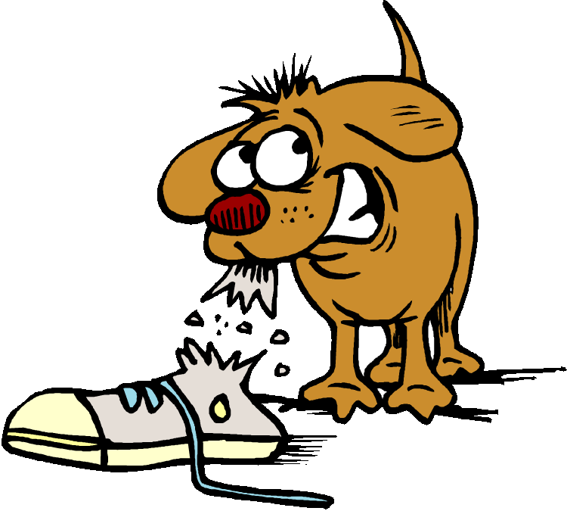
oo | ew | ue | u-e
pool | drew | glue | rude
mushroom | screw | clue | prune
hoop | crew | tissue
spoon | blew
moon | flew
broom
chew
?
oo
ew
ue
u-e

Slide 20
oo | ew | ue | u-e
pool | drew | glue | rude
mushroom | screw | clue | prune
hoop | crew | tissue
spoon | blew
moon | flew
broom | chew
blue
?
oo
ew
ue
u-e

Slide 21
oo | ew | ue | u-e
pool | drew | glue | rude
mushroom | screw | clue | prune
hoop | crew | tissue
spoon | blew | blue
moon | flew
broom | chew
Can you see any patterns in the words?
Can you think of any more words to put in the columns?
Which do you think is the best bet when the word ends with /oo/?

Slide 22
Here are some more words with unusual graphemes for the /oo/ phoneme:
to
soup
group
through
two
lose

