Slide 1
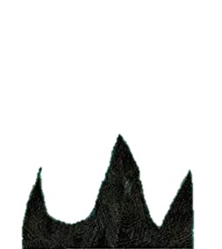

Indicating degrees of possibility and certainty
Using Modal Verbs
“It must be a cultural thing.”

Slide 2
Modal Verbs
Modal verbs express certainty, ability or obligation.
can
must
may
might
ought
shall
should
would
will
could

Slide 3
Modal Verbs
Modal verbs express certainty, ability or obligation.
can
must
may
might
ought
shall
should
would
will
could
Which modal verbs are to do with certainty?

Slide 4
Modal Verbs
Modal verbs express certainty, ability or obligation.
can
must
may
might
ought
shall
should
would
will
could
Which modal verbs are to do with ability?

Slide 5
Modal Verbs
Modal verbs express certainty, ability or obligation.
can
must
may
might
ought to
shall
should
would
will
could
Which modal verbs are to do with obligation?

Slide 6
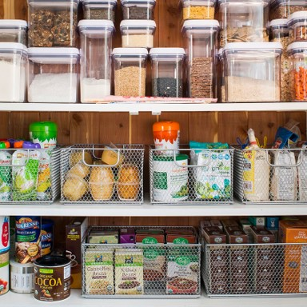
Modal Verbs
Modal verbs are placed before the verb they are modifying.
I thought I could hear someone in the pantry.
You might see him there if you open the door.
He should sleep in the room that we gave him.

Slide 7

Indicating Degrees of Certainty using Modal Verbs
He might have come from Outer Space.
He will have come from Outer Space.
He may have come from Outer Space.

Which sentence is most certain?

Slide 8
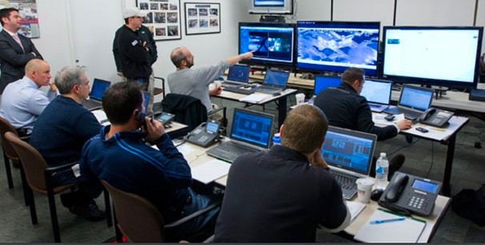
Indicating Degrees of Obligation using Modal Verbs
They should report him to the government.
They ought to report him to the government.
They must report him to the government.

Which sentence has the strongest degree of obligation?

Slide 9

Indicating Ability using Modal Verbs
I might understand his mission.
I would understand his mission.
I can understand his mission.
I must understand his mission.

Which sentence indicates ability?

Slide 10
Using Modal Verbs
Modal verbs are useful for expressing shades of meaning.
I could worry about our visitor but I will let him just get on.
It is worrying but I intend not to interfere.
I should tell someone now but I might wait a few more days.
I feel obliged to tell someone but it’s possible that I will wait a bit.
You can ask him to leave the pantry but must you risk upsetting him?
You are able to ask him but is it necessary?

Slide 11

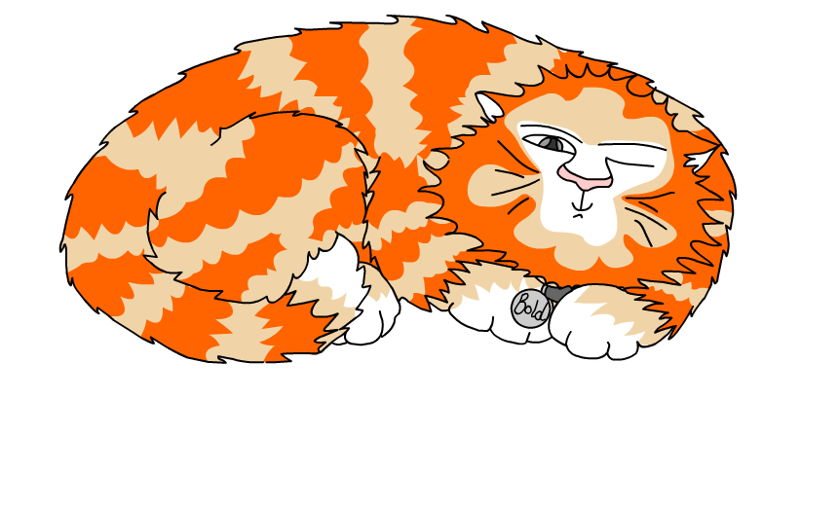
Explore more Hamilton Trust Learning Materials at https://wrht.org.uk/hamilton/ .

