Slide 1
ee
How many different spellings of the ee sound are there?

Slide 2
ee
ea
e
ie
Did you know them all?

Slide 3

ee | ea | e | ie
sweeping
?
ee
ea
e
ie

Slide 4
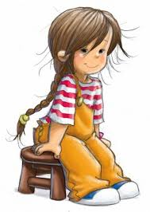
ee | ea | e | ie
sweep
What is she doing?
?
ee
ea
e
ie

Slide 5
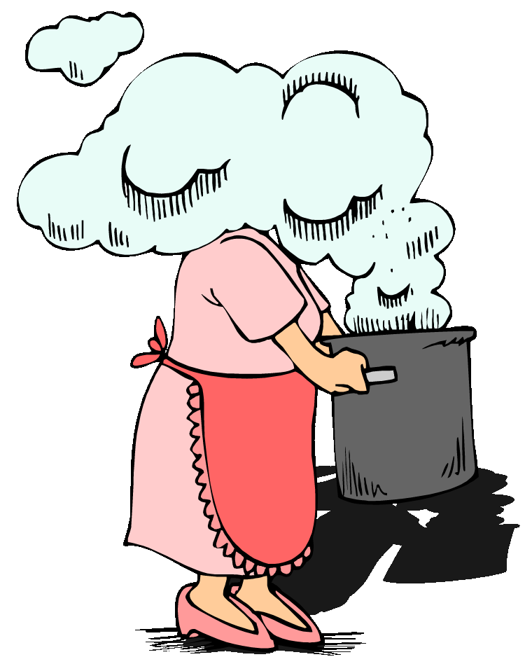
ee | ea | e | ie
sweep |  | she
steam
?
ee
ea
e
ie

Slide 6
ee | ea | e | ie
sweep | steam | she
chief
?
ee
ea
e
ie

Slide 7

ee | ea | e | ie
sweep | steam | she | chief
three
?
ee
ea
e
ie

Slide 8

ee | ea | e | ie
sweep | steam | she | chief
three
thief
?
ee
ea
e
ie

Slide 9
ee | ea | e | ie
sweep | steam | she | chief
three |  |  | thief
He has to be careful.
?
ee
ea
e
ie

Slide 10
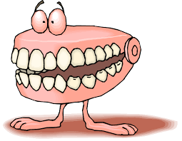
ee | ea | e | ie
sweep | steam | she | chief
three |  | be | thief
teeth
?
ee
ea
e
ie

Slide 11

ee | ea | e | ie
sweep | steam | she | chief
three |  | be | thief
teeth
read
?
ee
ea
e
ie

Slide 12

ee | ea | e | ie
sweep | steam | she | chief
three | read | be | thief
teeth
tree
?
ee
ea
e
ie

Slide 13
ee | ea | e | ie
sweep | steam | she | chief
three | read | be | thief
teeth
tree
What is he doing?
?
ee
ea
e
ie

Slide 14

ee | ea | e | ie
sweep | steam | she | chief
three | read | be | thief
teeth |  | he
tree
shield
?
ee
ea
e
ie

Slide 15

ee | ea | e | ie
sweep | steam | she | chief
three | read | be | thief
teeth |  | he | shield
tree
field
?
ee
ea
e
ie

Slide 16
ee | ea | e | ie
sweep | steam | she | chief
three | read | be | thief
teeth |  | he | shield
tree |  |  | field
clean
?
ee
ea
e
ie

Slide 17
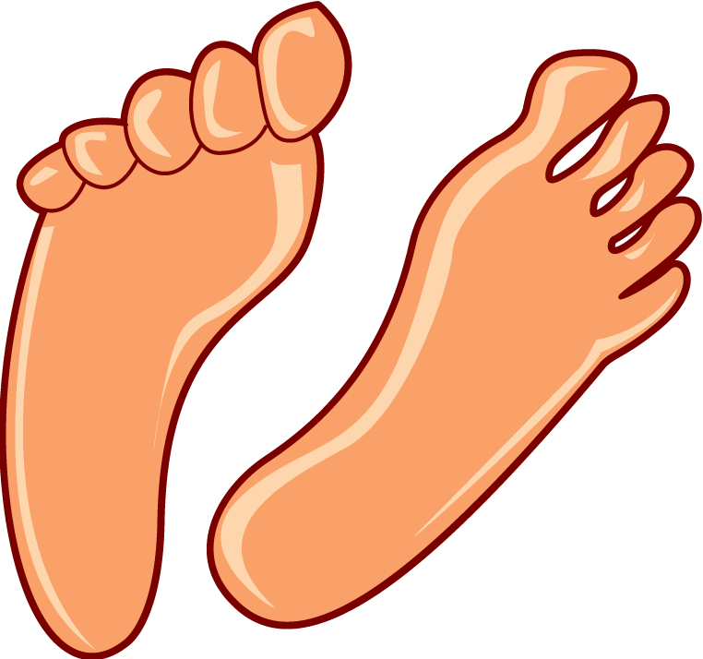
ee | ea | e | ie
sweep | steam | she | chief
three | read | be | thief
teeth | clean | he | shield
tree |  |  | field
feet
?
ee
ea
e
ie

Slide 18
ee | ea | e | ie
sweep | steam | she | chief
three | read | be | thief
teeth | clean | he | shield
tree |  |  | field
feet
beam
?
ee
ea
e
ie

Slide 19

ee | ea | e | ie
sweep | steam | she | chief
three | read | be | thief
teeth | clean | he | shield
tree | beam |  | field
feet
briefs
?
ee
ea
e
ie

Slide 20
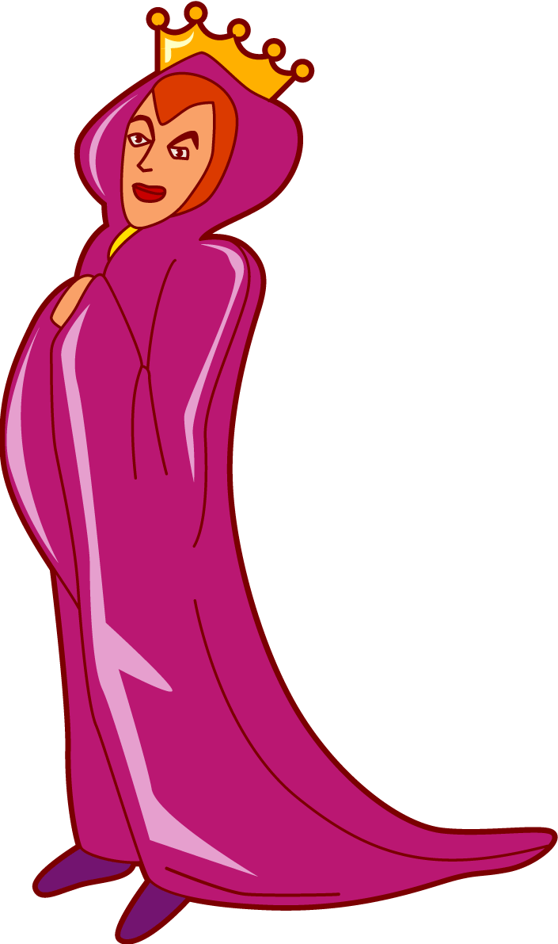
ee | ea | e | ie
sweep | steam | she | chief
three | read | be | thief
teeth | clean | he | shield
tree | beam |  | field
feet |  |  | briefs
queen
?
ee
ea
e
ie

Slide 21
ee | ea | e | ie
sweep | steam | she | chief
three | read | be | thief
teeth | clean | he | shield
tree | beam |  | field
feet |  |  | briefs
queen
Who scored a goal? Me!
?
ee
ea
e
ie

Slide 22

ee | ea | e | ie
sweep | steam | she | chief
three | read | be | thief
teeth | clean | he | shield
tree | beam | me | field
feet |  |  | briefs
queen
bee
?
ee
ea
e
ie

Slide 23
ee | ea | e | ie
sweep | steam | she | chief
three | read | be | thief
teeth | clean | he | shield
tree | beam | me | field
feet |  |  | briefs
queen
bee
team
?
ee
ea
e
ie

Slide 24

ee | ea | e | ie
sweep | steam | she | chief
three | read | be | thief
teeth | clean | he | shield
tree | beam | me | field
feet | team |  | briefs
queen
bee
flea
?
ee
ea
e
ie

Slide 25
ee | ea | e | ie
sweep | steam | she | chief
three | read | be | thief
teeth | clean | he | shield
tree | beam | me | field
feet | team |  | briefs
queen | flea
bee
We have won the match!
?
ee
ea
e
ie

Slide 26
ee | ea | e | ie
sweep | steam | she | chief
three | read | be | thief
teeth | clean | he | shield
tree | beam | me | field
feet | team | we | briefs
queen | flea
bee
Can you write a sentence with at least two different spellings of the ee sound? Eg Can you clean my feet? He is reading a book.

Slide 27
Here are some more words with unusual graphemes for the /ee/ phoneme:
these
people
Exit

