Slide 1
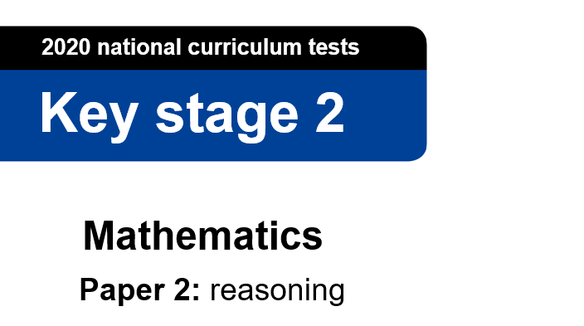
This is the Key Stage 2 Mathematics Paper 2: Reasoning. You will need a pencil to record your answers .
You must not use a calculator to answer any questions in this test.
You have as much time as you need to answer these questions.
Follow the instructions for each question.
Work as carefully as you can. If you need to do working out, you can use the space around the question.
Some questions have a method box. For these questions, you may get a mark for showing your method.
If you cannot do a question, go on to the next one. You can come back to it later.
If you finish before the end, go back and check your work.
The number in the bottom right corner of each page tells you the number of marks available for each question.
You CAN talk to each other.
You may now start the test.

Slide 2
Q1
Put the numbers in the correct positions in the Carroll diagram:
472 76 8,476 0.2
 | The number of pencils in Year 6. | The number of hairs on your head
The length of a piece of string, in cm
Your neighbour’s lucky number
[½ mark]

Slide 3
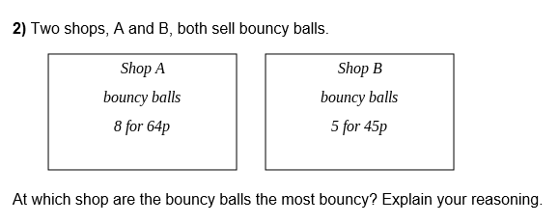
Q2
[12.5 marks]

Slide 4

Q3
[2 marks]

Slide 5

Q4
Mr B says the missing number is 100. Is he correct?
[4 x 100 marks]

Slide 6
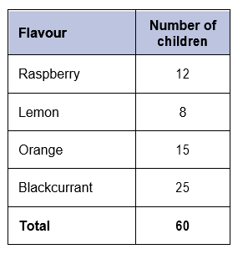
Q5
Mr B asked 60 children to choose their favourite flavour of jelly. These were his results.
a) What is your favourite flavour of jelly?
b) What is your family’s favourite flavour of jelly?
c) Does this change the results?
[0.111 marks]

Slide 7
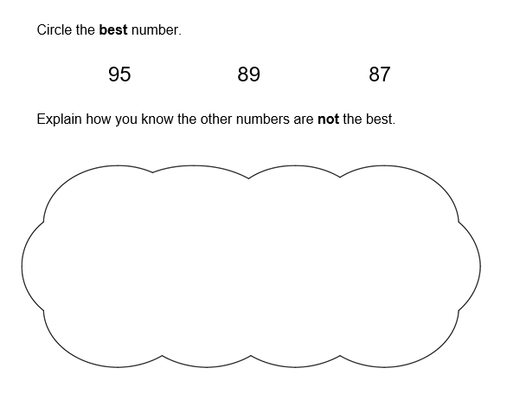
Q6
[958,987 marks]

Slide 8
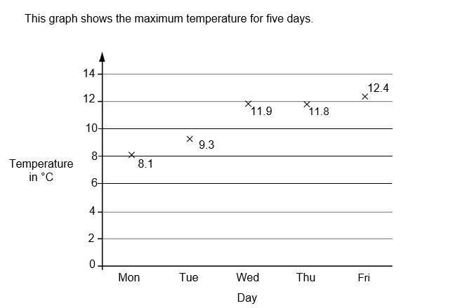
Q7
Has it been warmer or colder today?
[-11 marks]

Slide 9
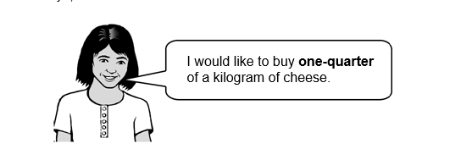
Q8
Amina is shopping. She says,
Why does Amina need so much cheese?
[0.25 marks]

Slide 10
Q9
a) What fraction of her daily allowance of chocolate has Mr B eaten?
b) How much has she got left to eat?
c) What is this as a percentage?
[2.5 marks]

Slide 11
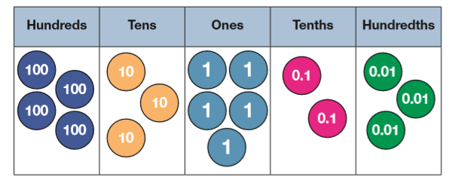
Q10
The school council have been saving money.
How much money have they saved?
[27 marks]

