Slide 1
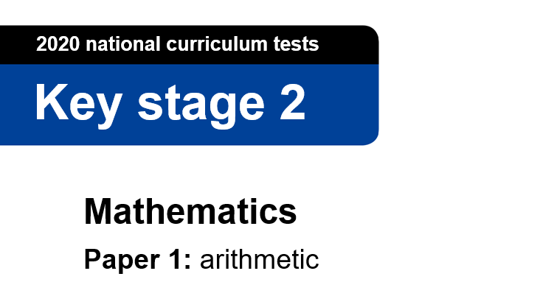
This is the Key Stage 2 Mathematics Paper 1: Arithmetic. You will need a pencil to record your answers .
This challenge is to be completed as part of your daily walk/exercise.
You must use a calculator to answer any questions in this test and you can work as a family team.
You have as much time as you need to complete this test. If you cannot do a question, don’t worry, go on to the next one. You can come back to it later if you have time.
If you finish before the end, go back and check your work.
In this test, long division and long multiplication questions are worth 2 marks each. You will be awarded 2 marks for a correct answer. You may get 1 mark for showing a formal method. All other questions are worth 1 mark each.
Remember to check your work carefully.
Remember, YOU CAN ask for help to answer any of the test questions.
You CAN talk to each other.
You MUST write on any bar codes, and at the edges of the page.
You may now start the test.

Slide 2
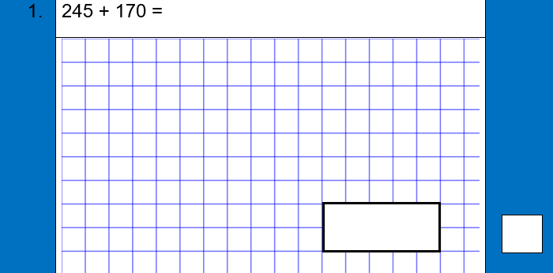
Thank you! #staysafe

Slide 3
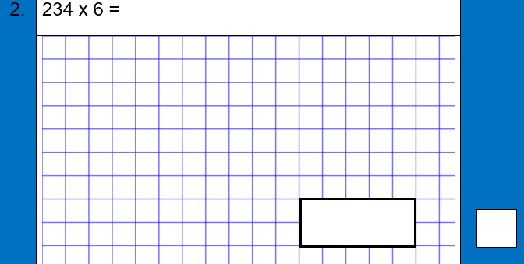
Thank you! #staysafe

Slide 4
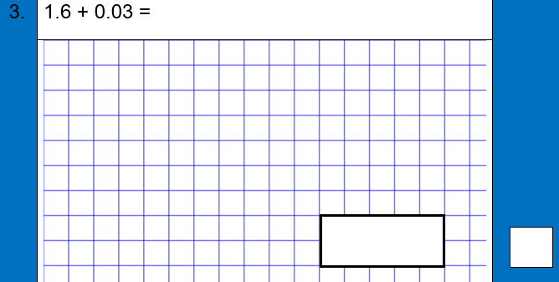
Thank you! #staysafe

Slide 5
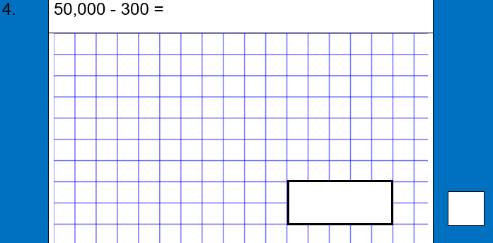
Thank you! #staysafe

Slide 6
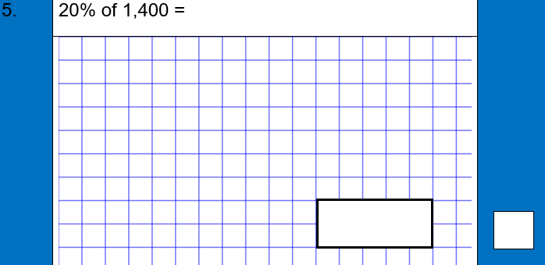
Thank you! #staysafe

Slide 7
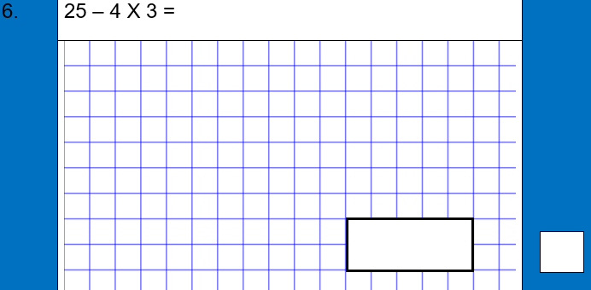
Thank you! #staysafe

Slide 8
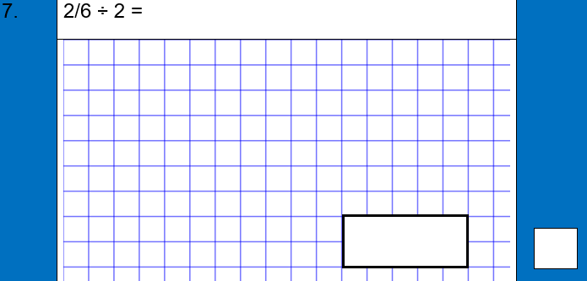
Thank you! #staysafe

Slide 9
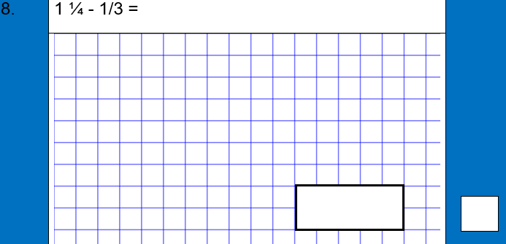
Thank you! #staysafe

Slide 10
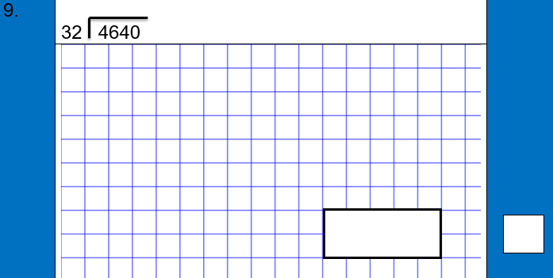
Thank you! #staysafe

Slide 11
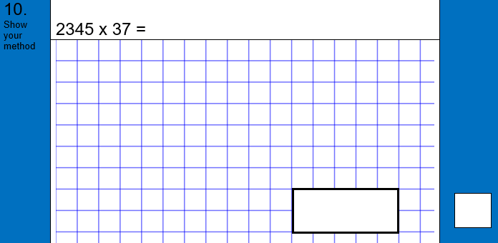
Thank you! #staysafe

Slide 12

Thank you! #staysafe

Slide 13
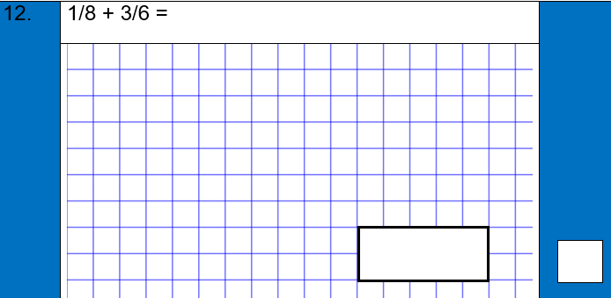
Thank you! #staysafe

Slide 14
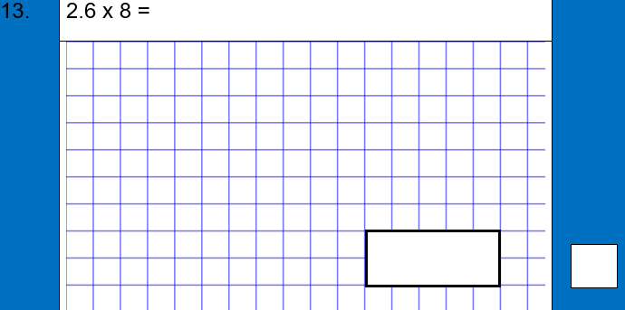
Thank you! #staysafe

Slide 15

Thank you! #staysafe

Slide 16

Thank you! #staysafe

