Slide 1
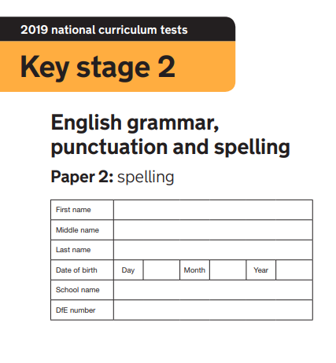
2020

Slide 2

Mr Badley and Mr Badley bought a __________ for their mum
Mr Badley wanted to be a __________
For lunch, Mr Badley and Mr Badley ate a __________
Mr Badley’s party was a really good __________!
The shop accepted Mr Badley’s __________ as payment
Mr Badley went fishing and caught a __________
Mr Badley and Mr Badley loved to play __________
Mr Badley and Mr Badley chased the car with a __________ in hand
Mr Badley’s gloves were made with natural __________
Mr Badley shouted __________ Mr Badley stole his shorts

Slide 3
Mr Badley __________ her homework
To be a real __________, Mr Badley had to work hard
Mr Badley ate her __________ with Mr Badley and Mr Badley at break
Mr Badley had __________ brothers and one sister
Mr Badley bought a new dog for Mr Badley; it was a __________
Mr Badley hit Mr Badley and Mr Badley __________ they all cried
Mr Badley told Mr Badley to __________
Mr Badley had not seen her __________ for 3 years
Mr Badley’s clock would not __________
Mr Badley’s class are __________

