Slide 1


Slide 2


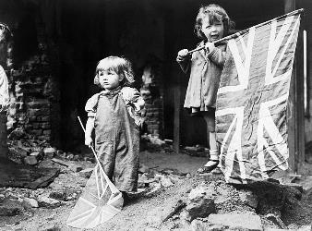
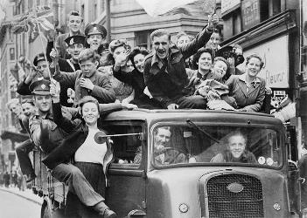
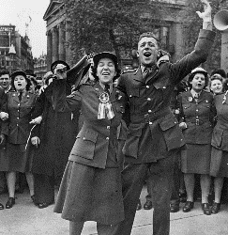
VE Day - 75 Years
The year 2020 marks 75 years since the original VE Day!
But what was VE day?
Here are some images of people
celebrating the first VE Day.

Slide 3
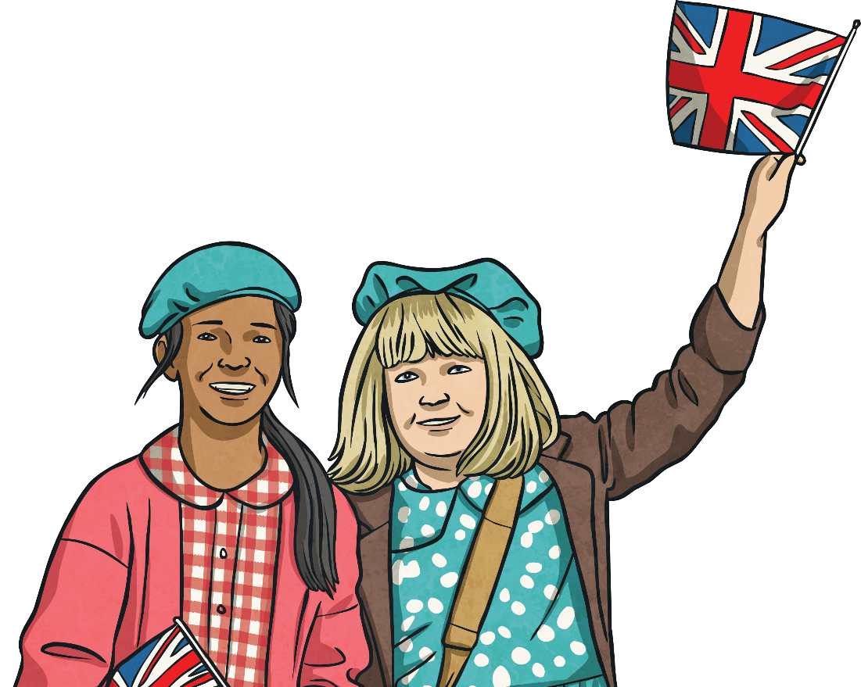
What is VE Day?
VE Day
Victory in Europe Day

Slide 4
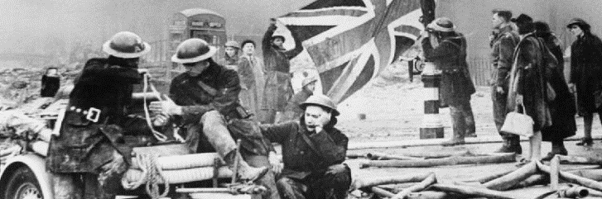
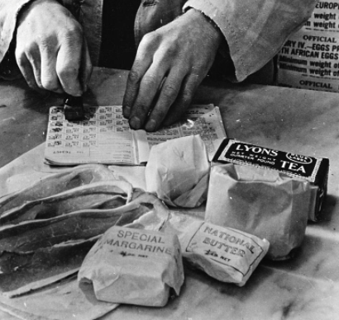
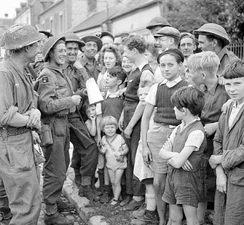
Second World War
Britain had been at war since September 1939.
The war had caused great hardships for the entire country.
Cities were badly bombed and many were killed. Buildings were destroyed and people were left homeless.
Food was rationed; before the war, Britain imported lots of its food from abroad. With German submarines manning the seas, importing food was too risky.
It was usually impossible for soldiers to visit home due to the war.

Slide 5
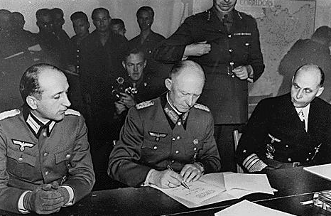
The End
On 7th May, at 2.41 a.m., in Reims in France, Germany surrendered.
This meant that the war in Europe was over.

Slide 6
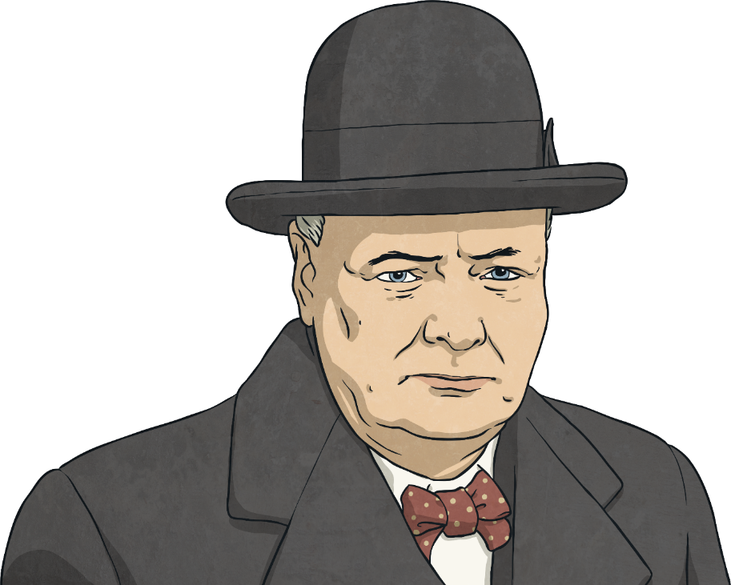
The News Spreads
Before long, the exciting news spread that the war in Europe was over. People ran out on the streets to celebrate and church bells were rung to spread the news.
In accordance with arrangements between the three great powers, tomorrow, Tuesday, will be treated as Victory in Europe Day and will be regarded as a holiday.

Slide 7
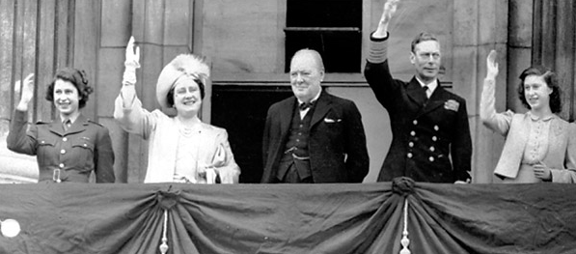
VE Day
The following day was one of great celebration.
Communities had street parties and churches held services of thanksgiving.

Slide 8
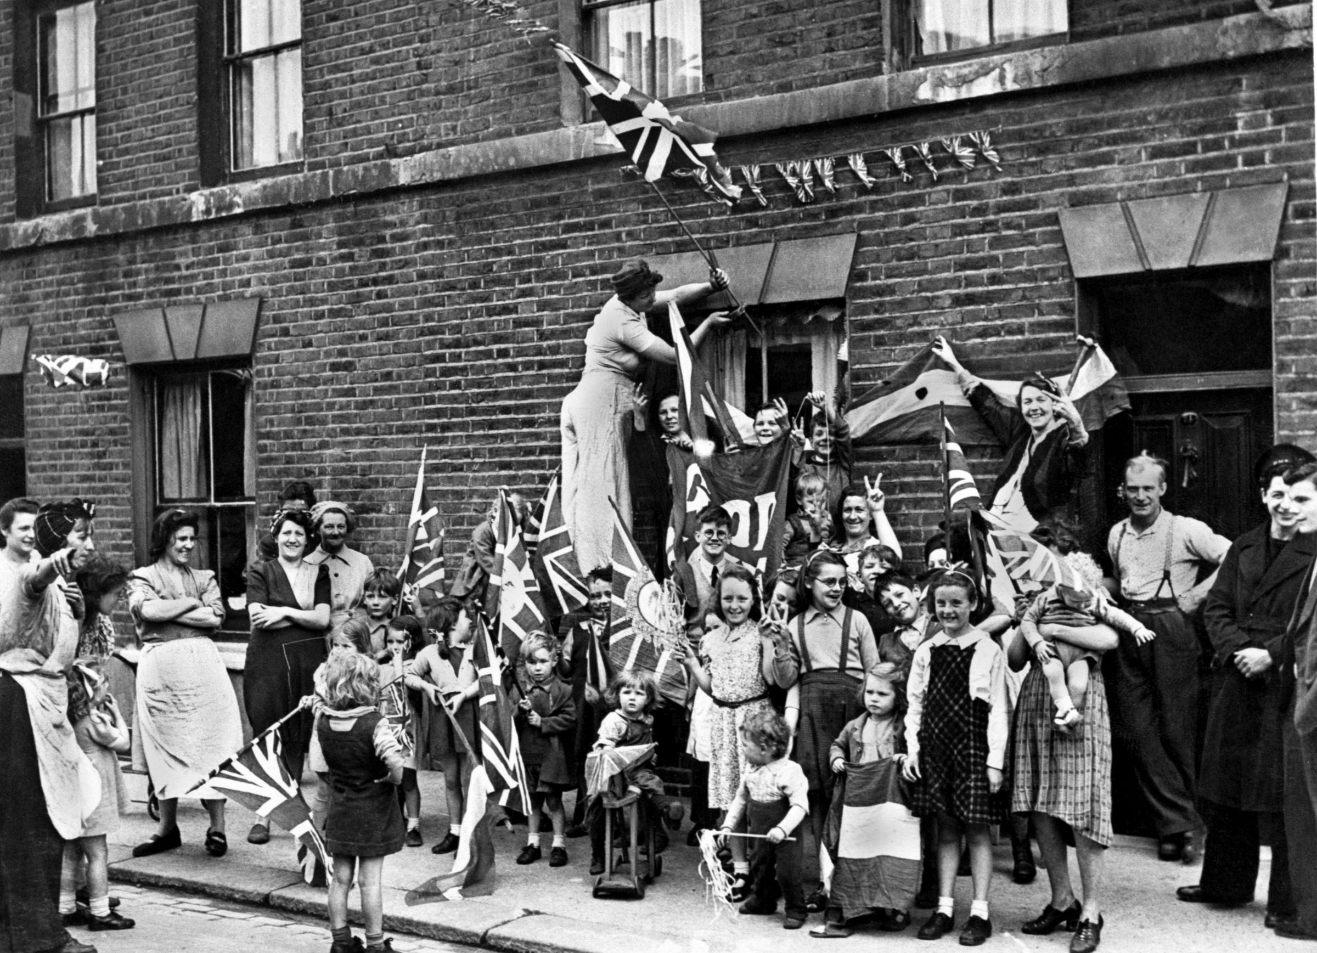
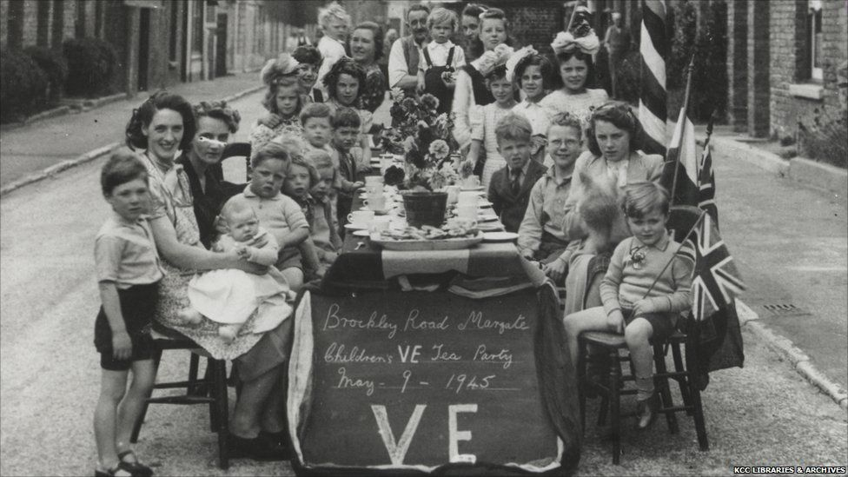
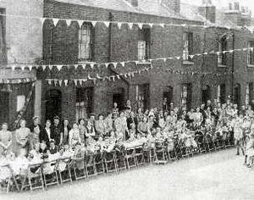
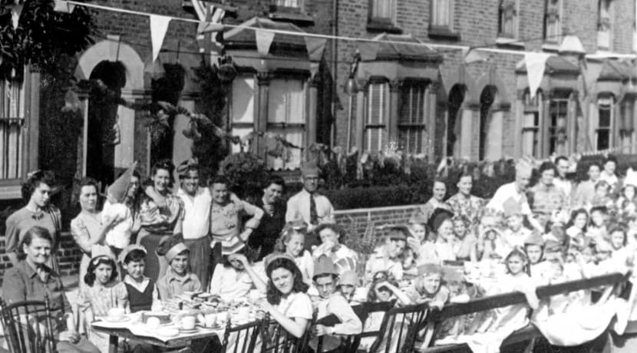
V.E. Day Street Parties

Slide 9



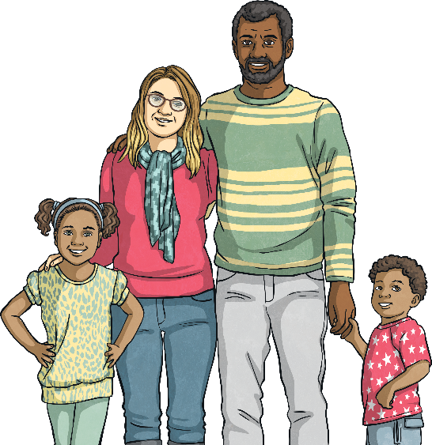

VE Day 2020
To celebrate 75 years since the original VE Day, the May Day Bank Holiday has been moved for the second time in history.
Although it's usually on a Monday, this year, the May Day Bank Holiday will be on Friday 8th May to coincide with the anniversary of VE Day.
The last time the May Day Bank Holiday was moved was also for VE Day - to celebrate its 50th Anniversary in 1995!

Slide 10
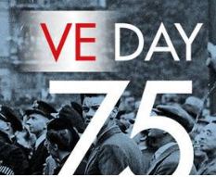
V.E. Day Reflection
On the 75th anniversary of VE. Day, let’s
Remember the bravery of the armed forces who fought in the war and also those who helped during the war, including the emergency services and families.

