Slide 1



The Keys Newsletter
Message from St Peter’s
25th February 2022
Dear Parent / Carer,
Welcome back to what was a stormy start to the week. Thankfully, the school wasn’t damaged in any way, and we were able to start without any disruption. We posted on Facebook that the school would open early for the children, so if you haven’t yet joined us on Facebook, please do.
I sent you a letter via school spider yesterday about the now updated guidance on Covid-19, there is also a copy on this newsletter and as you will see, the guidance hasn’t changed that much for schools.
It is always lovely to start the new term off with an Educational Visit, and this week, Year 3 visited Bolton Museum this has a wonderful Ancient Egypt department which is the subject Year 3 are learning about this half term. At St Peter’s we don’t have ‘school trips’, every visit has a purpose and should be connected to what children are learning at that particular time.
‘Inspiration and Aspiration Week’
In this newsletter you will see a page announcing our ‘Inspiration and Aspiration Week’ which will start on Monday 13th June. We are asking for volunteer parents to come into school and talk to children about their jobs and careers. We are looking to inspire children to think about what they could do in the future and hear about what it’s like to have careers such as a vet, joiner, electrician, judge or scientist the list is endless. The focus will be about resilience, self-belief, determination and to dispel myths about stereotypical jobs that are associated with gender. It is intended that this will be an annual event, with a different focus each year.
I understand that standing in front of a sea of young faces can sound daunting, but the children would love to listen to you, learn about your job, your experiences and ask questions and most of all, be inspired! If you think you can help, please contact the school via email.
Thanks to all those who supported our ‘Dress up with Digits day, we raised £234.00 for the NSPCC.
Kind regards
Mr Robinson
https://www.nspcc.org.uk/about-us/

Slide 2




Celebration & Congratulations
GROWTH MINDSET
STAR OF THE WEEK
Oskar YR
Alfie YR/1
Arne Y1/2
Sam Y2
Freya Y3
Harry Y4
Emma Y5
Skyla Y6
Finn YR
Millie YR/1
Melodie Y1/2
Noah Y2
Ava Y3
Daniel Y4
Elijah Y5
Katie Y6
HEADTEACHER’S AWARD
Freya Y3
Henry Y3
Marissa Y4
Zayan Y5
VALUES AWARD
Jack Y5
PTA NEWS
Readathon - The Readathon is back! After the success of last year’s Readathon we’re running one again this year in the run up to World Book Day. Sponsor forms were sent home before half term and we’re asking the children to be sponsored to read as many books as they can between now and World Book Day on 3rd March. The money raised will buy books for the school library. The PTA are able to claim back gift aid on donations so please ask sponsors to tick the gift aid box if they are able to. Usborne Books are giving us 60% on top of what we raise for free and on the back of the sponsorship forms there will be a local business pledge form for parents to distribute around Newton and their places of work if possible. The goal is £1000!
Bags2School - the next bag to school collection will take place on 10th March with a further one planned for the summer term. We collected a whopping 400kg of unwanted items last time! Bags have been sent home this week but you can always just use black bin bags if you need more. THANK YOU SO MUCH FOR ALL YOUR SUPPORT.

Slide 3

E-Safety
Phishing and Instagram Accounts being Hijacked
Although our children are too young to have Instagram accounts, it is worth noting this to keep adults and older siblings safe online. A concerningly new tactic is to send a message to an Instagram user stating that a recent posted photo contains copyright material. In order to appeal you have to click a link in the message, input your username/password and appeal the copyright claim. At each stage, the message and design is very much Instagram, but we hope you'll recognise this as a phishing scam. Once the offender has the user credentials, they hijack the account and demand money.

Slide 4



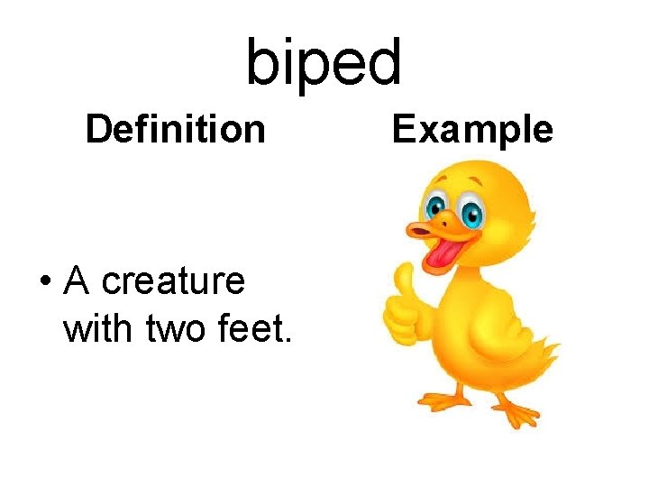
Thursday 3rd March is World Book Day 2022!
As a school, we will be looking at the book The Invisible by Tom Percival. It is wonderful but also impactful story about poverty, being thankful for what we have, and appreciating others' situations and needs. Each class will be reading the book and responding to it in a fashion appropriate to their age and writing abilities. We hope that if you're able to come in to visit school soon, you will see our responses to the story all over our corridor walls.
On World Book Day, and to help our children appreciate the needs of the characters in the book, we will be collecting for our local food bank. Please, if you can spare it, send in your child with a non-perishable food item (tinned food, packets of pasta or rice etc.) so that the children can be part of tangibly helping those in need.
We usually use World Book Day to dress up. We will be again aiming to develop our vocabulary by encouraging the children to dress up as a word they haven't come across before. This can be as extravagant as the DC Comics character The Riddler we saw one year teaching us the word 'quizzical', or it can be as simple as a particular favourite of mine from last year, 'biped' (which didn't require too much dressing up...). Please do not go to any expense buying a costume. Each class will be collating their group of words and playing all sorts of games to help the children learn and retain them.
Thank you for all your support.
David Badley
English and Science Co-ordinator, and Head of Outcomes

Slide 5
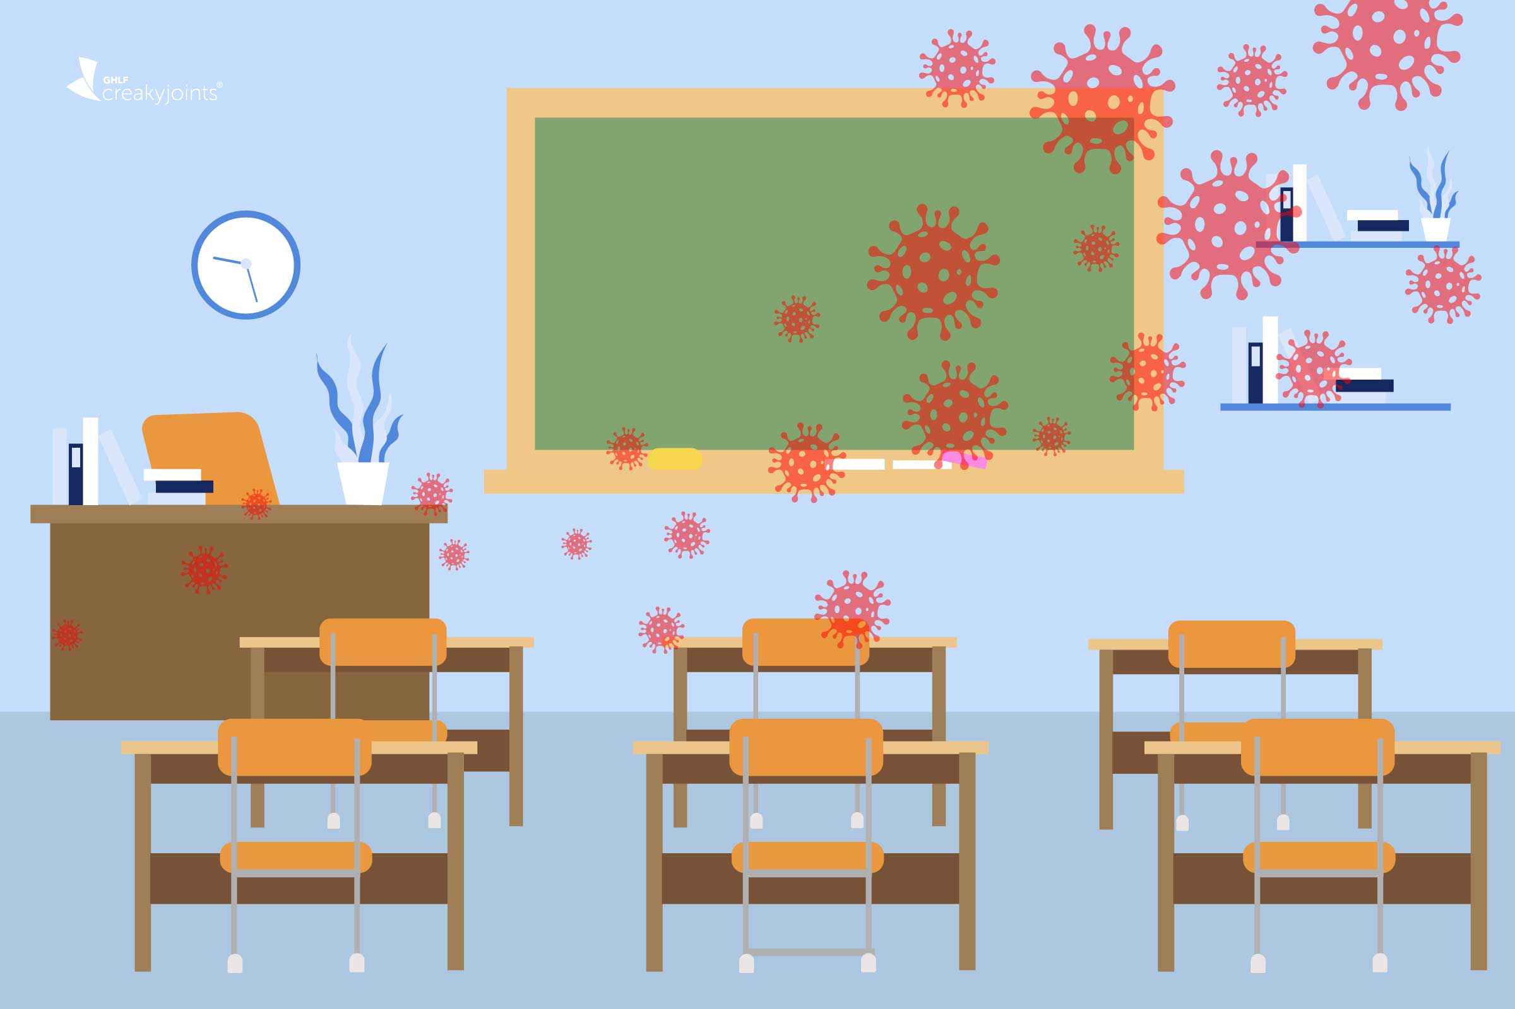
Living with Covid
Dear Parent / Carer,
Following the Government announcement about ‘Living with Covid’
a letter was emailed out to parents yesterday outlining the position for schools. As you will read, public health advice remains unchanged for schools, and we still need to be as vigilant as ever as we still have Covid cases in school.
A reminder that should you send a child in to school with Covid or symptoms of Covid, you risk the chance of their class friends, families and teachers having to isolate due to catching Covid. If a teacher has to isolate, then we will have to try to bring in a supply teacher to teach the children.
The guidance is as follows:
‘Should parents send their child to school if they think they have COVID-19?’
If a child has any of the main symptoms or a positive test result, the public health advice remains unchanged and it is to stay at home and avoid contact with other people.
Anyone with any of the main COVID-19 symptoms should order a test and is advised to stay at home while waiting for the result.
Adults and children who test positive will continue to be advised to stay at home and avoid contact with other people for at least 5 full days and then continue to follow the guidance until they have received 2 negative test results on consecutive days. Staff, children and young people who are contacts should attend school as usual. ‘
Department for Education: Feb 2022
Our procedures in school including high levels of ventilation, having an isolation room and constant cleaning. We will continue to send children home who have symptoms for you to then get tested. You can order PCR tests using the following link: Get a free PCR test to check if you have coronavirus (COVID-19) - GOV.UK (www.gov.uk)
As always, can I thank you for your continuing and unwavering support, understanding and co-operation during this time. It really is appreciated by all the St Peter’s Community.
Kind regards
Mr Robinson

Slide 6

Dinner Money
If your child wishes to change their lunch preference please advise the office via email giving a week’s notice. Payment is taken through the School Money Online Payment System.
Uniform
Uniform can be ordered direct from Touchline UK Liverpool Rd, Warrington, WA5 1AE, 01925 413777 sales@touchline-embroidery.com
We also have a small number of items on the School Money site under SHOP which you can pay for then contact school to arrange for them to be sent home with your child.
Absence
When reporting on the absence line, can we politely request that you leave a brief description of your child’s illness rather than just saying they are unwell. If your child has vomiting or diarrhoea please note that they should not return to school for a period of 48 hours after the last incident. This is a local authority policy
Applications for Holiday Leave must be submitted to school at least 4 weeks in advance. Forms can be found on the school website or requested from the school office. In accordance with Government and Local Authority policy, holidays taken during term time will only be authorised in exceptional circumstances.
Changes
It is very important that if you change contact numbers, emails or addresses that you advise us as soon as possible. Any changes must be sent into school via email.
Thank you
Office news
St Peter’s C.E. Primary School
Birley Street
Newton-le-Willows
WA12 9UR
01744 678630
stpeter@sthelens.org.uk
https://twitter.com/NLWStPeters
www.st-peters.st-helens.sch.uk
Contact Details
Covid-19
Can we please stress if you or your child show any symptoms of Covid-19 you must remain at home and get a test. The rest of the household can carry on but you need to do lateral flow tests on a daily basis https://www.nhs.uk/conditions/coronavirus-covid-19/check-if-you-have-coronavirus-symptoms/or by phoning 111
If you or your children have any symptoms you MUST take a PCR test not a Lateral Flow Test
To arrange a test call 119 or go to the website https://www.nhs.uk/ask-for-a-coronavirus-test
Further information is available on
https://www.gov.uk/government/publications/covid-19-stay-at-home-guidance/stay-at-home-guidance-for-households-with-possible-coronavirus-covid-19-infection

