Slide 1
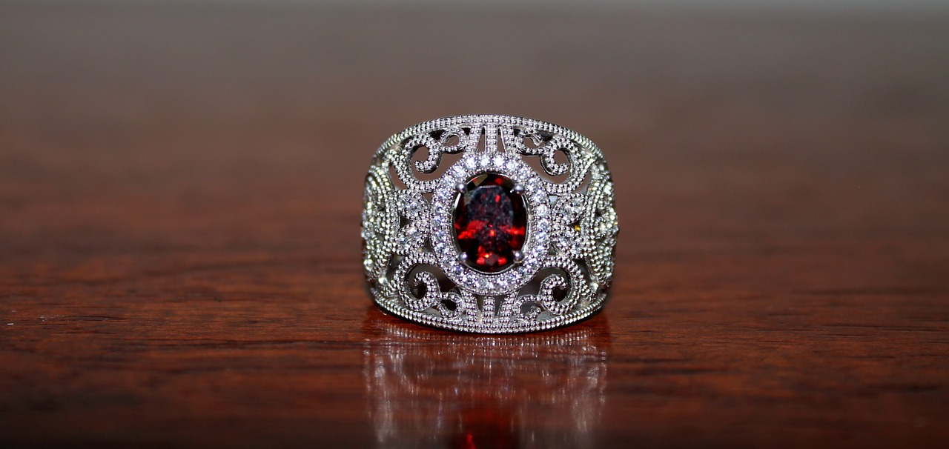

Expanded noun phrases to convey information concisely
Joseph Coelho’s Poetry

Slide 2
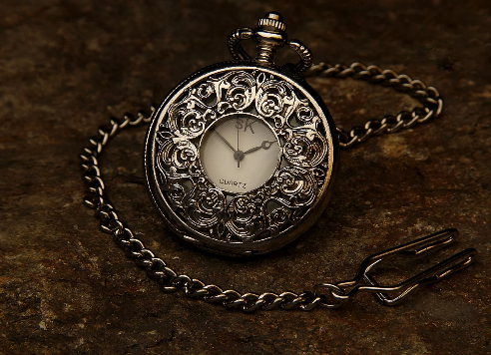
Making Words Work Harder
Poets tend to use less words than writers of prose.
They are often limited by features such as line length, rhythm and form.
Poets use less words so their words have to work harder!
Instead of writing,
I think that Golden Time is very valuable and each minute is like a precious jewel.
A poet might write,
Golden Time - jewelled minutes
These words are more powerful because the image is condensed into few words.

Slide 3

Nouns and Noun Phrases create Powerful Images
The precious, ruby ring was hidden.
You can check which words are part of the noun phrase by replacing them with a pronoun.
I found a rather unusual gem.
What is the head noun in each noun phrase?
The words in the noun phrase depend on the head noun and build on its meaning.
Which words make up the noun phrase?

Slide 4

How to build Noun Phrases
rocks
Add words before the head noun:
The rocks surrounded the beach.
The horribly craggy rocks surrounded the beach.
Add words after the noun:
The rocks, with sharp points and deep grooves, surrounded the beach.
The rocks, like ancient sleeping trolls, surrounded the beach.
Or you can do both at once:
The horribly craggy rocks, with a sharp points and deep grooves, surrounded the beach.

Slide 5
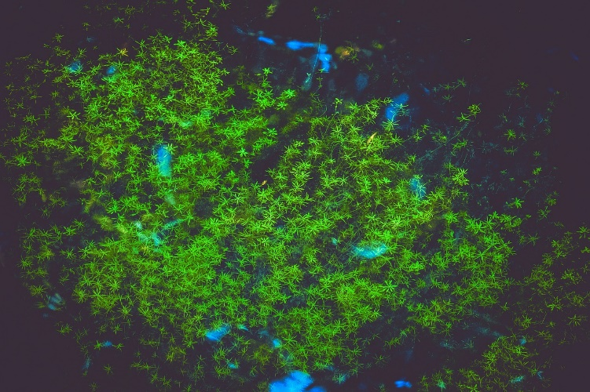
How to build Expanded Noun Phrases
Different types of words, phrases and clauses can all be used in an expanded noun phrase.
adverb
adjectives
determiner
The rather tangled slimy weeds tickled my toes.
weeds
The weeds like an underwater forest swaying in the waves tickled my toes.
Prepositional phrase
The weeds, which were creating dark shadows in the water, tickled my toes.
Relative clause

Slide 6
Expanded Noun Phrases
You can develop an expanded noun phrase by adding a prepositional phrase.
a diamond clock
noun phrase
a diamond clock in my imagination
a diamond clock
a diamond clock with gleaming hands
a diamond clock from my dreams
Try adding your own prepositional phrase.
The prepositional phrase modifies the noun…
and expands the image of the noun.
Prepositions
with, of, by, from, on, under, below, between, inside, next to, over, by, in

Slide 7
Expanded Noun Phrases
You can develop an expanded noun phrase by adding a relative clause.
a diamond clock
noun phrase
a diamond clock that counts each minute
a diamond clock
a diamond clock which lives in my head
a diamond clock whose numbers are magical
Try adding your own relative clause.
The relative clause modifies the noun…
and expands the image of the noun.
Relative Pronouns (& Relative Adverbs)
who, which, when, whose, that
(where, when)

Slide 8
Spotting Expanded Noun Phrases
Spiders have legs like my grandmother’s knitting needles .
The body is a beautiful black pearl that hangs from silk.
A web is an inescapable maze of torn net curtains.
them
it
them
The test: Which pronoun could replace each noun phrase? Does the sentence still work?
Identify the head nouns.
Which other words make up the noun phrase?
Hint: Can you replace them with a pronoun?
ANSWERS

Slide 9
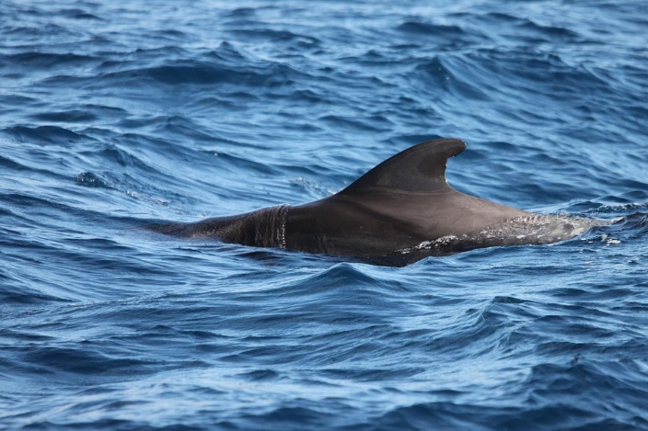
Noun Phrases to Convey Information Concisely
I held onto the fin.
I held onto a scarred fin.
I held onto a scarred, firm fin.
I held onto a scarred, firm fin of a breaching whale-shark.
What do we know about the fin?
It is one of a number of fins.
It is scarred.
It is firm.
It belongs to a whale-shark.
The shark is breaching.
There is a lot of information contained in this expanded noun phrase.

Slide 10
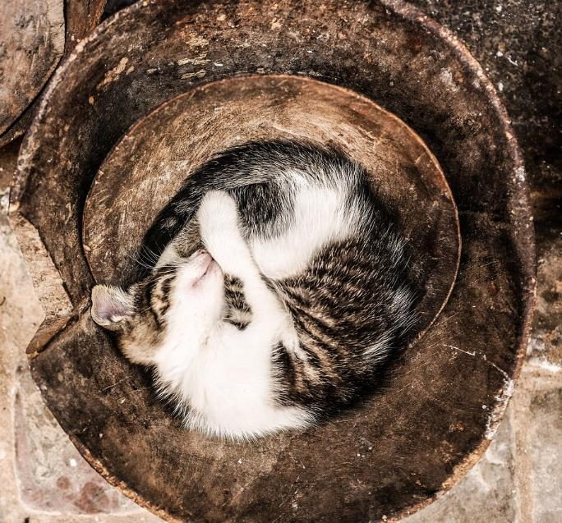
Noun Phrases to Convey Information Concisely
The cat is a cushion.
The cat is a warm purring cushion.
The cat is a tightly curled, warm purring cushion.
The cat is a tightly curled, warm purring cushion like a furry spiral.
Try combining this information to create an expanded noun phrase.
It purrs.
It is warm.
It curls round tightly.
It is like a spiral.
It is furry.
The information is concisely combined.

