Slide 1

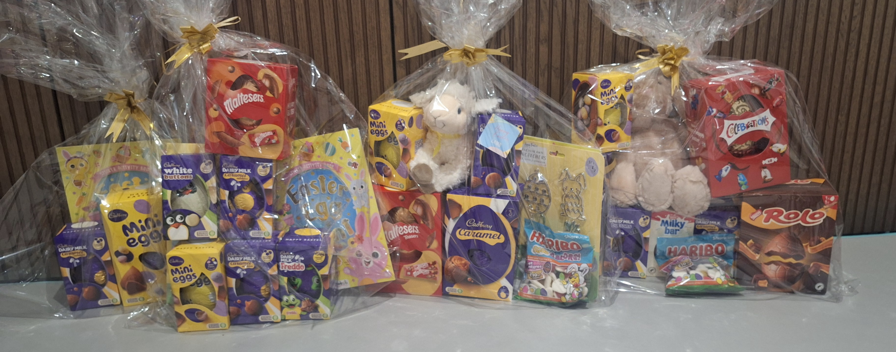
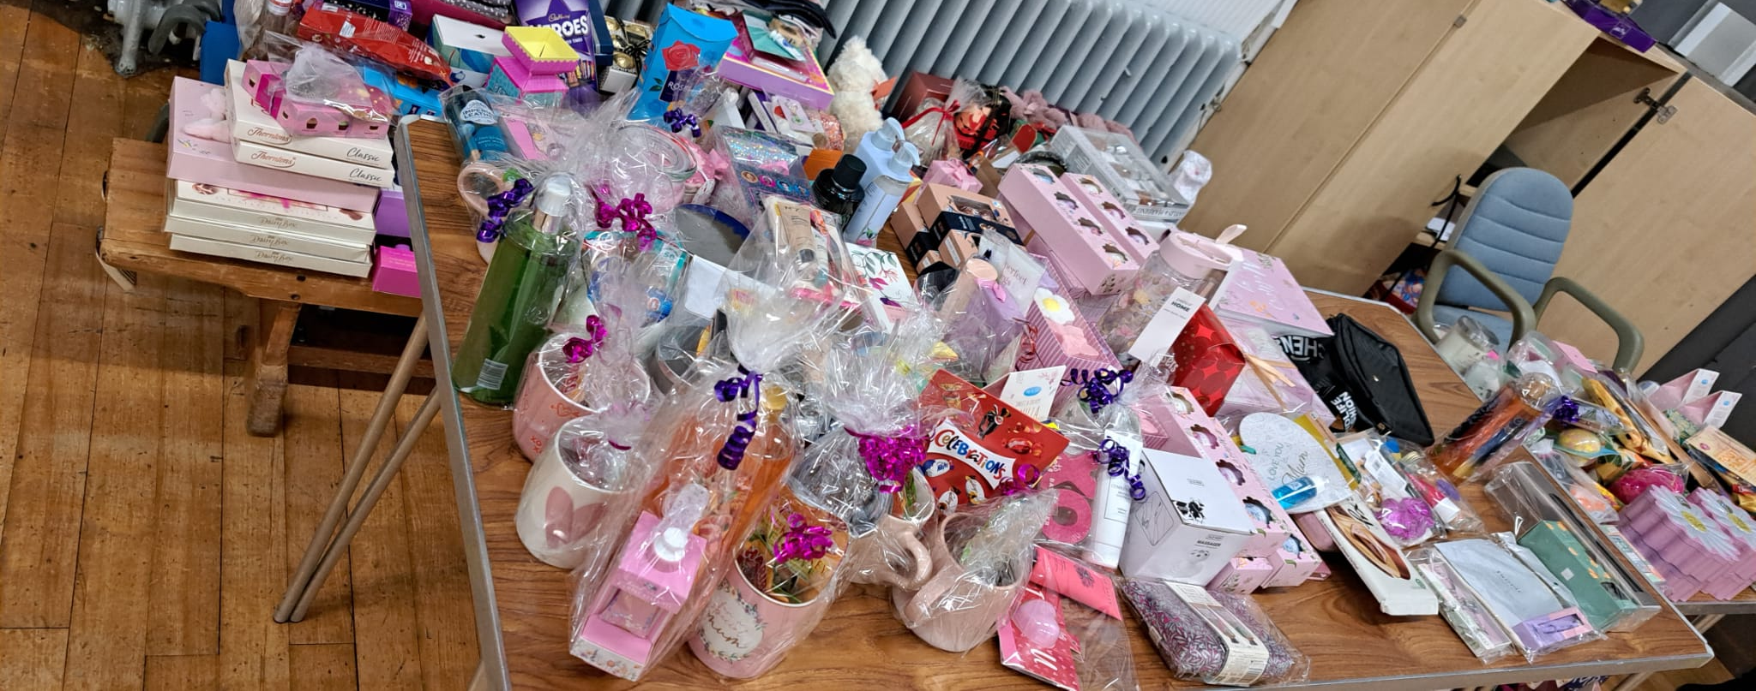
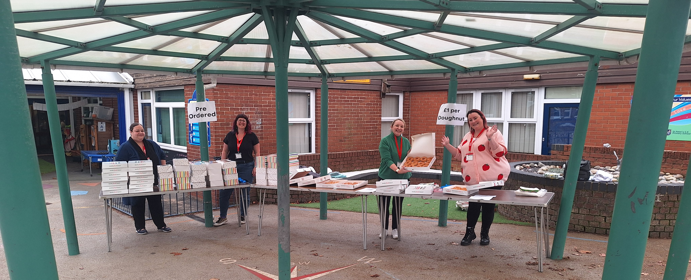
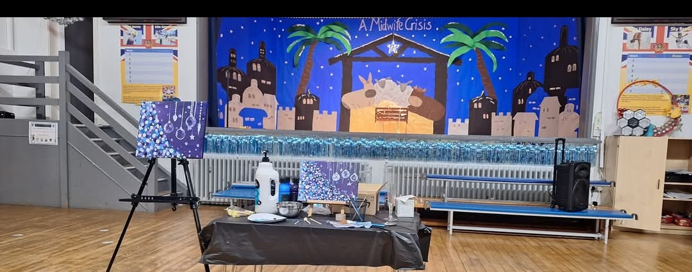
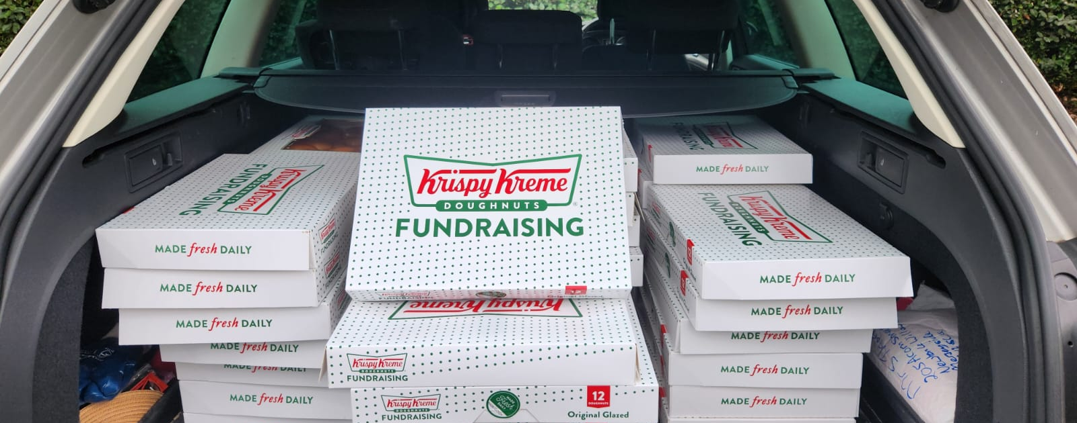
Easter raffle
Christmas raffle
Mother’s day shop
Paint ‘n’ Sip
Krispy Kreme doughnut fundraiser

Slide 2
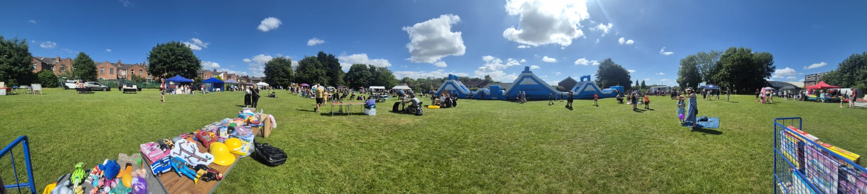
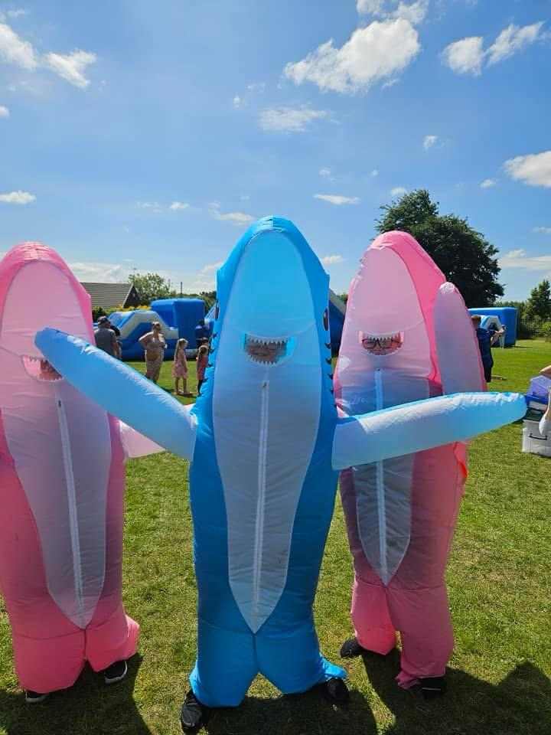
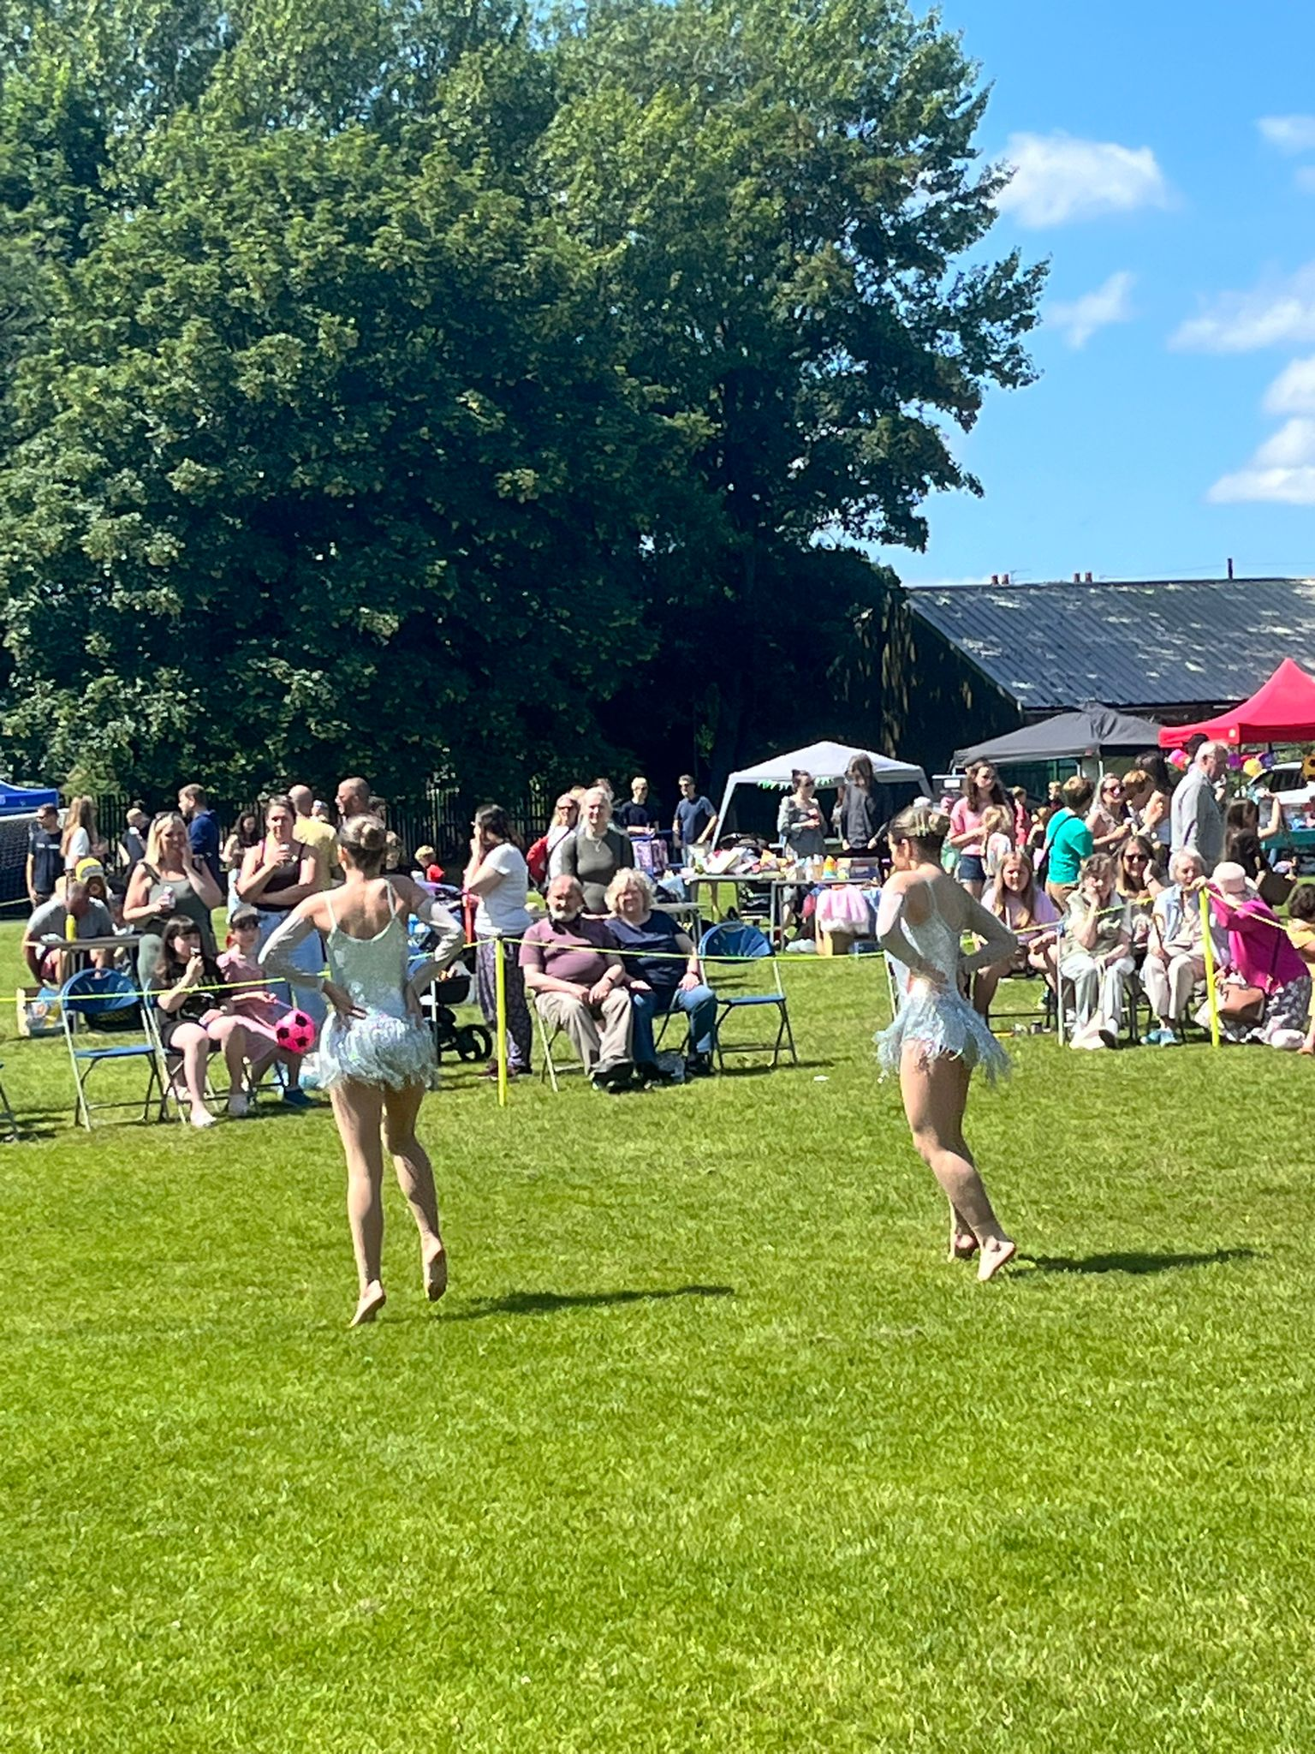
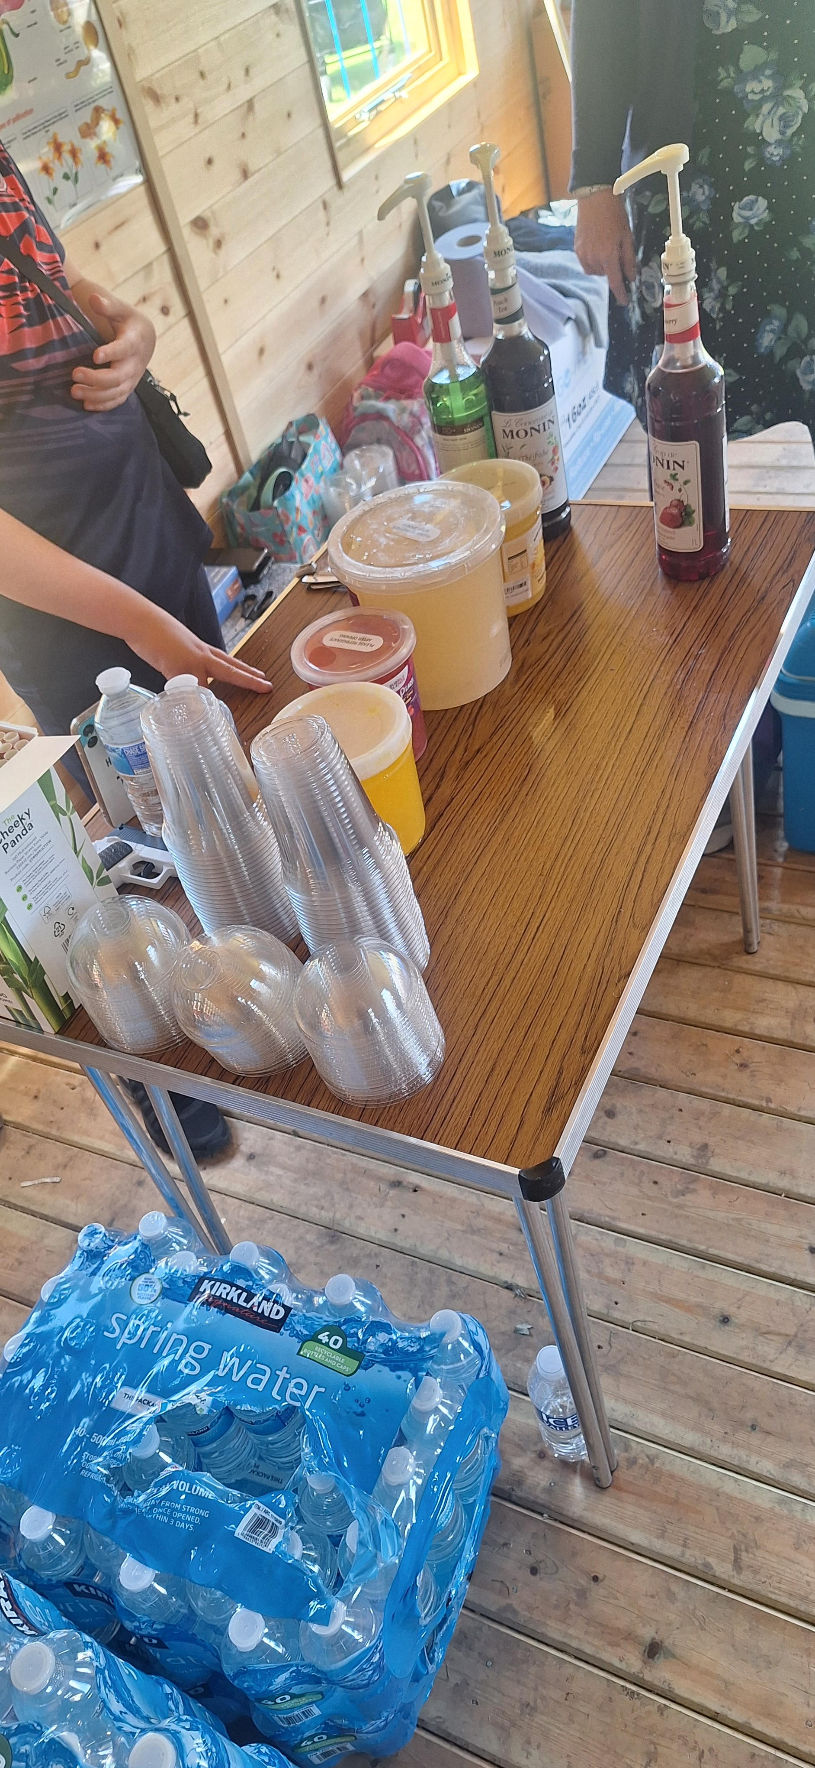
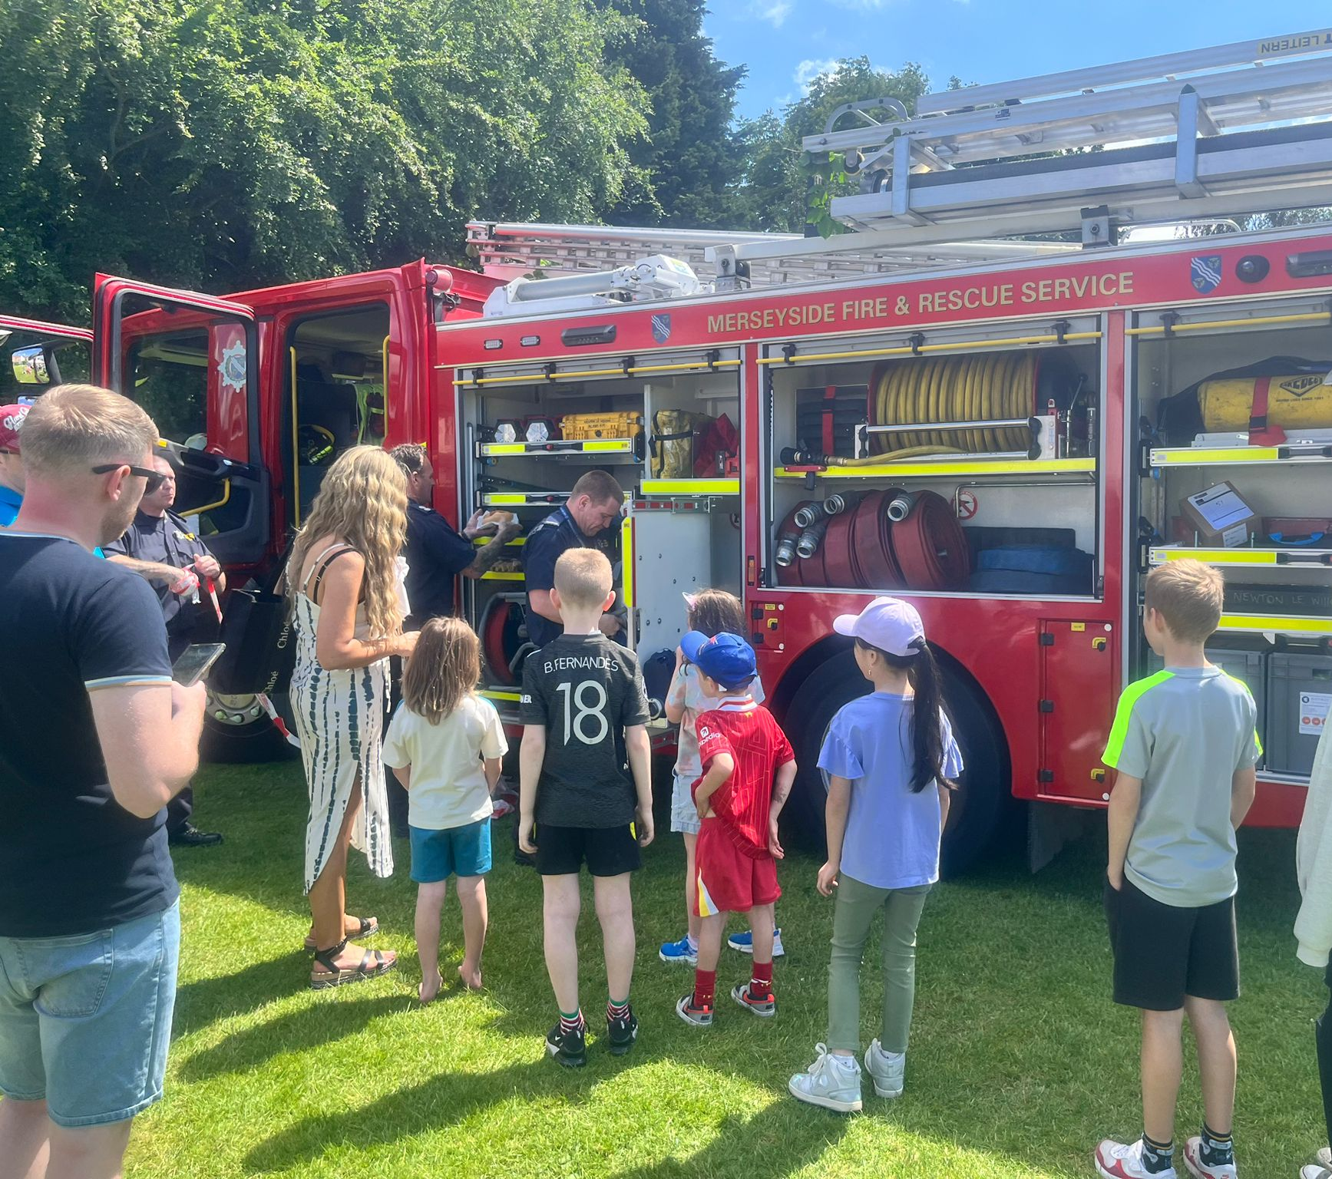
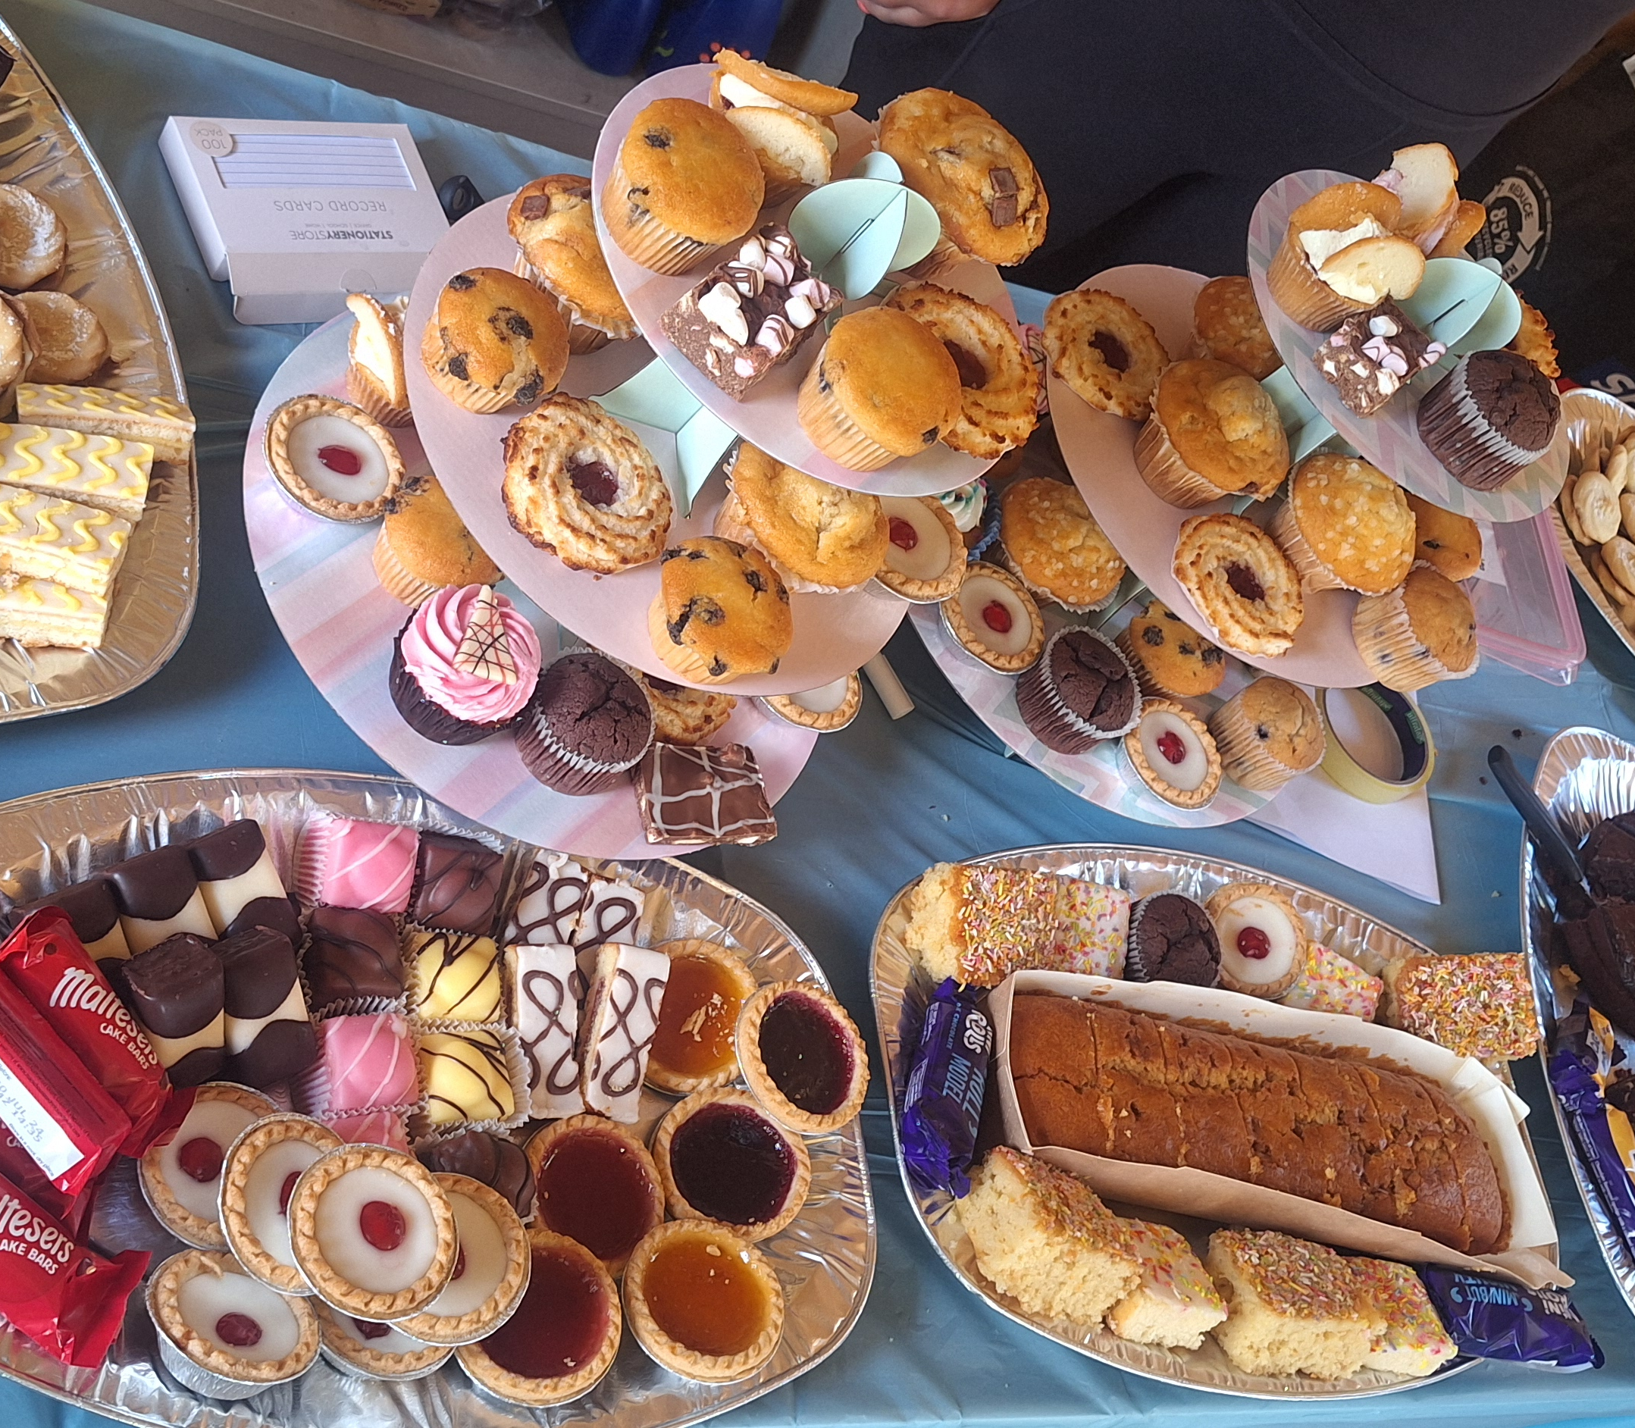
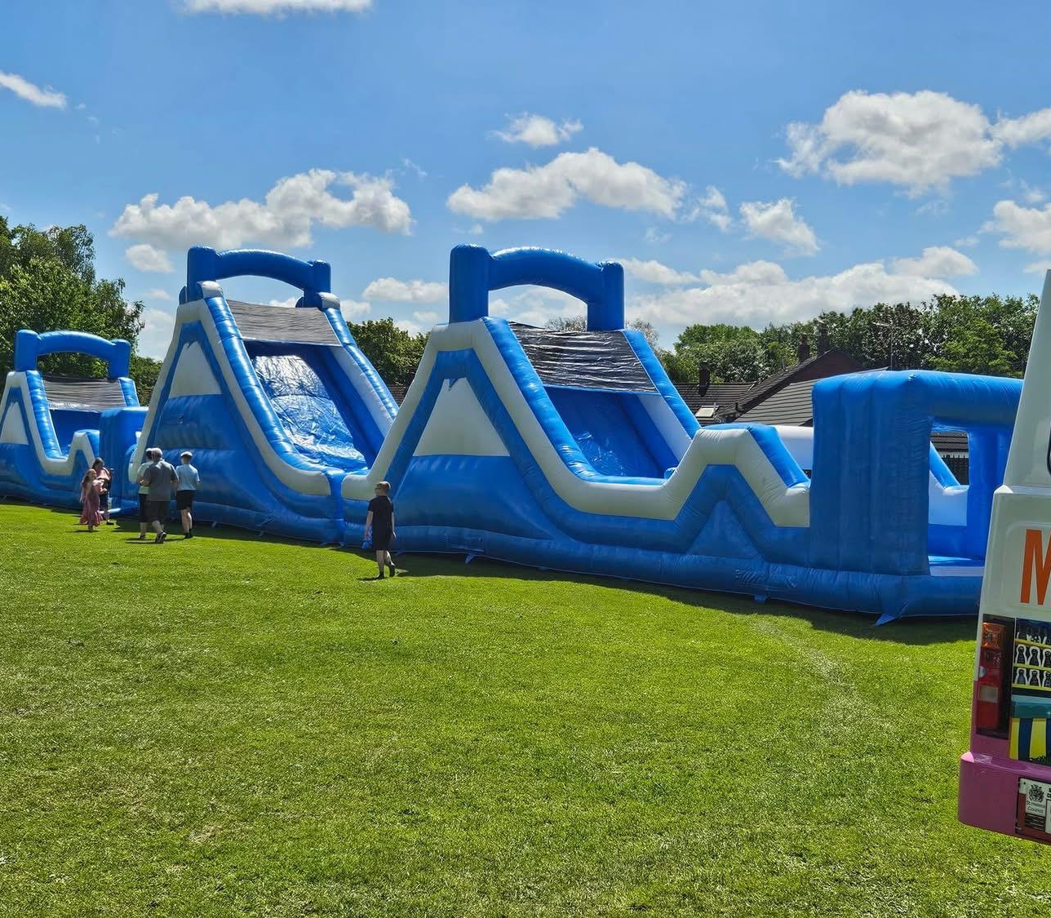
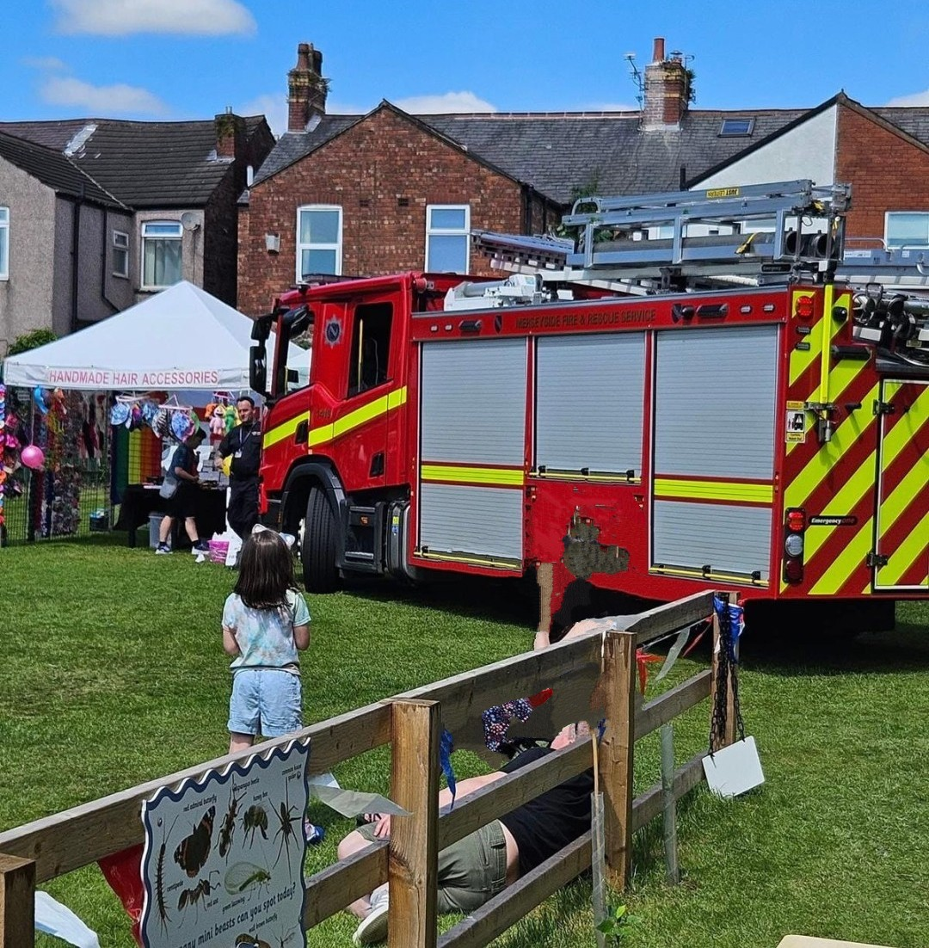
School Fair 2024

Slide 3



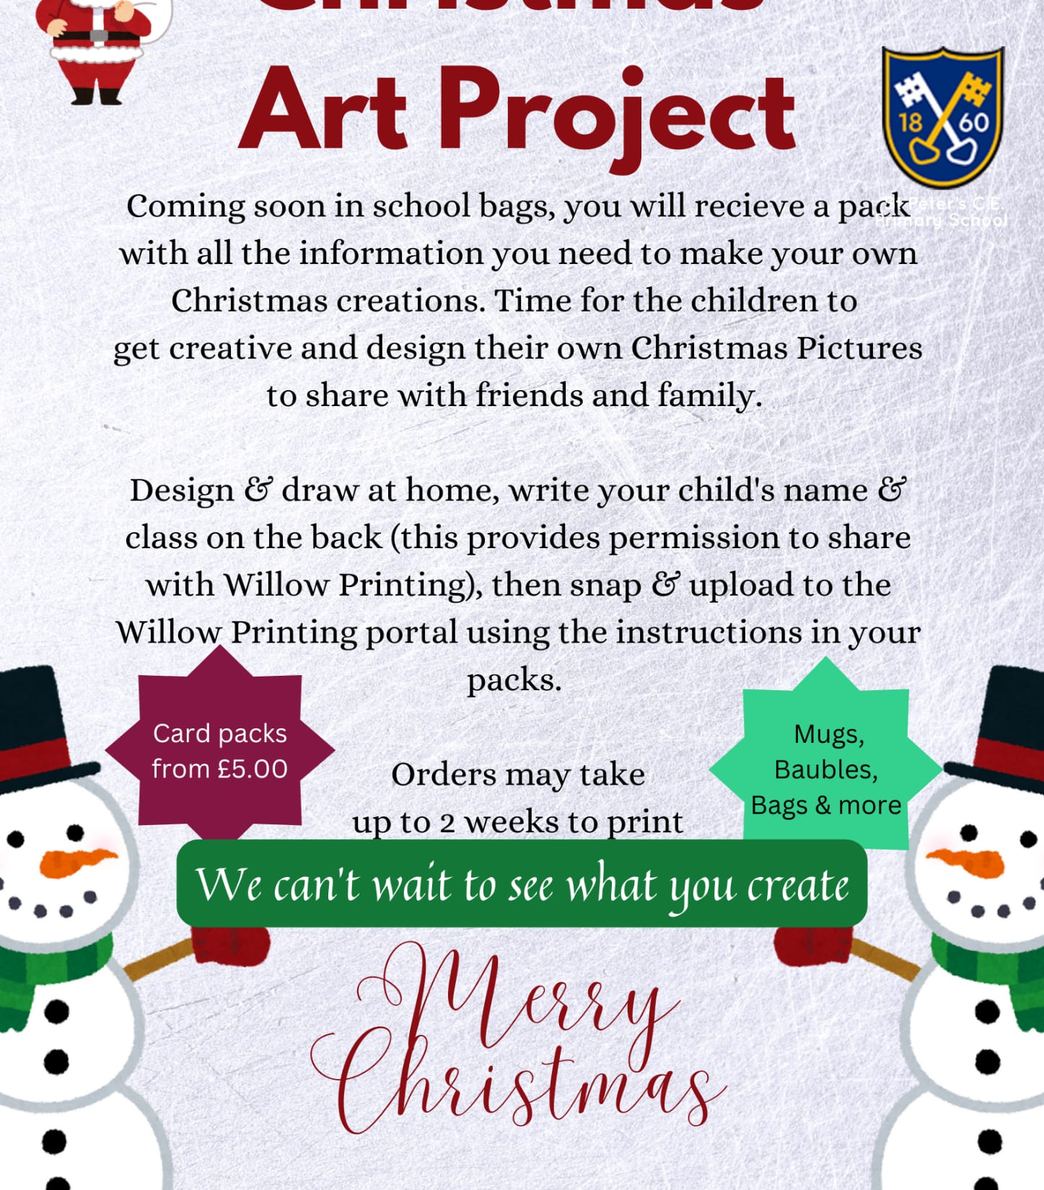


Events throughout the year 24/25

Slide 4

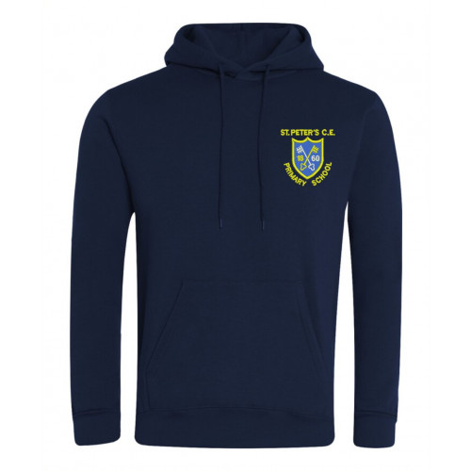
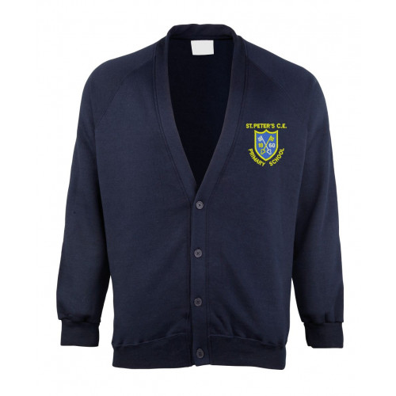
Pre Loved Uniform Eco Shop
The shop was established in 2023 and so far has raised £368.
Stock includes donated branded uniform from cardigans, PE hoodies, jumpers and polo shirts all £2 each
This has saved 193 items of uniform going to landfill.
All orders made via
www.pta-events.co.uk/stpeters-pta
Parents and carers have saved over £2500 in uniform costs

Slide 5



