Slide 1



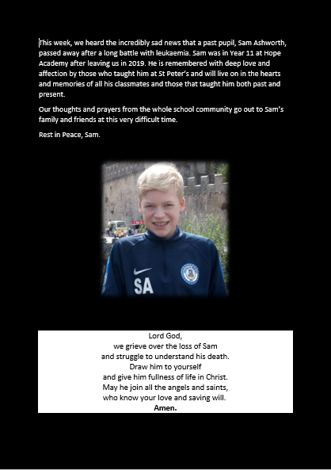
The Keys Newsletter
Messages from St Peter’s
13th October 2023
MESSAGE FROM THE HEAD TEACHER

Slide 2




STAR OF THE WEEK
Celebration & Congratulations
GROWTH MINDSET
Reception: Joseph S
Year 1: Roman R-B
Year 2: Oskar P-E
Year 3: Emily E
Year 4: James D
Year 5: Sophie Ed
Year 6: Rowan P
Reception: Audrey C
Year 1: Alan M
Year 2: Mia N
Year 3: Hassan R
Year 4: Charlie K
Year 5: Anna R
Year 6: Aoife O
VALUES AWARD
COURAGE AWARD
Year 1: Charlotte G
Year 2: Kaden Thorley
Year 3: Harrison D
Year 5: Niall B
Year 6: Athena G
Reception: Florence H
Year1:
Year 2:
Year 3: Henry L
Year 4: Charlotte L
Year 5: Annabelle S
Year 6: Evelyn M
HEADTEACHERS AWARD

Slide 3


WORLD MENTAL HEALTH DAY
Our #Helloyellow day on Tuesday was a great success! All of the children enjoyed a full day of fun activities focused on their wellbeing and mental health.
We raised a total of £233.40 which is being donated to Young Minds. Young Minds are a charity who help and support young people with their mental health.
We would like to thank Carla Agger at Jasmines Gifts and Balloons on the High Street for donating balloons to decorate our playground.
If your child is struggling please take a look at the Young Minds website for more information on how you can access support: www.youngminds.org.uk
We also have our Rainbow Team in school who provide support to our pupils if they have any worries. Please see further in this newsletter for more details on our Rainbow Team.

Slide 4

MENTAL HEALTH RESOURCES

Slide 5

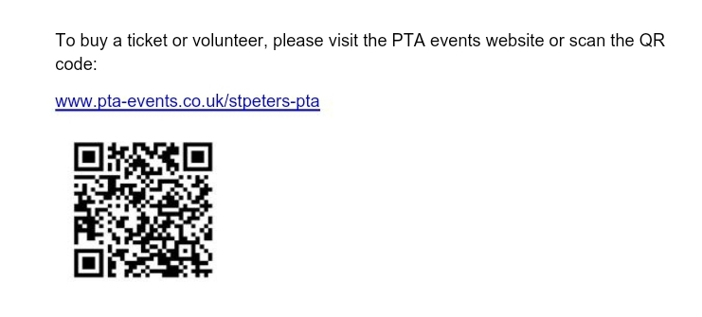
PTA NOTICE - NEON DISCO

Slide 6
PTA NOTICES
PTA AGM Announcement
Monday 16th October
7pm
In school
Everyone is invited to join us for the PTA’s Annual General Meeting where we will review the results for the year and appoint the Committee for the year ahead.
All Committee positions are open for re-election each year:
Chair
Secretary
Treasurer
For further information on the roles and applications or if you have any questions, please email:
stpeters_pta@yahoo.co.uk
The PTA holds fun events and raises funds for our school community. If you would like to volunteer, support with dedicated fund raising and planning for the Environmental Hub, be a PTA class representative or be the first to know the dates for this year’s events, please come along! Refreshments will be provided.

Slide 7

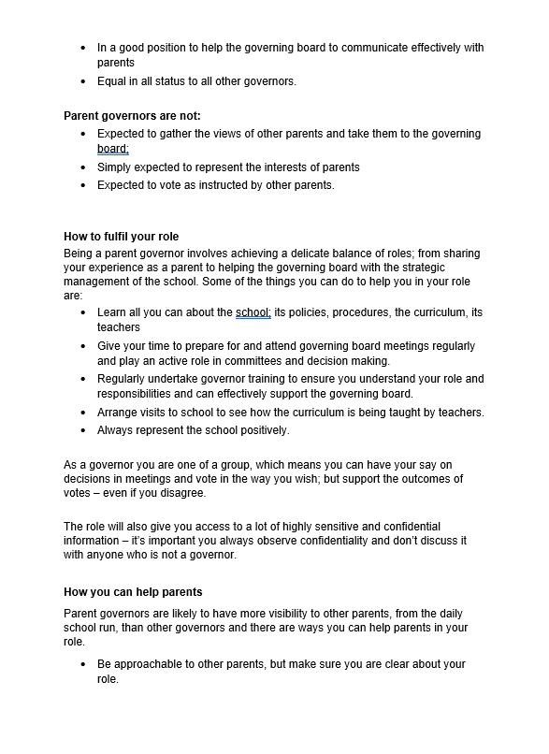
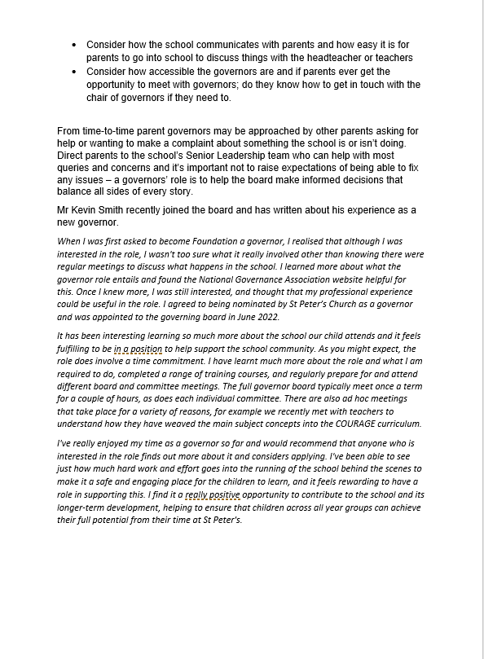
PARENT GOVERNOR VACANCY

Slide 8

COMMUNITY NOTICES

Slide 9


COMMUNITY NOTICES

Slide 10

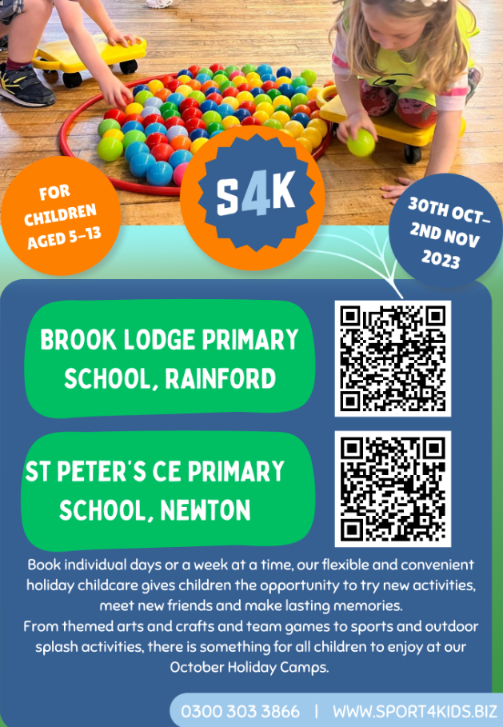


COMMUNITY NOTICES

Slide 11

DATES FOR YOUR DIARY
Monday 16th October 2023
5.00pm – Open Evening Tour
7.00pm – PTA AGM in school
Afterschool Sports Club: YEAR 5 & 6 (3.30pm – 4.30pm)
Girls Football After School Club: YEAR 3 & 4 (3.30pm – 4.30pm)
Tuesday 17th October 2023
Afterschool Sports Club: YEAR 4 (3.30pm – 4.30pm)
Wednesday 18th October 2023
Afterschool Sports Club: YEAR 2 ( 3.20pm-4.15pm)
STEM Club: YEAR 5 & 6 (3.30pm – 4.30pm) – CANCELLED UNTIL FURTHER NOTICE
Thursday 19th October 2023
Year 4 – Trip to Port Sunlight and Museum
3.55pm – Phonics Workshop EYFS
Afterschool Sports Club: YEAR 3 (3.30-4.30pm)
Kidslingo Afterschool Club (3.30pm-4.30pm)
Friday 13th October 2023
Afterschool Sports Club: YEAR 1 (3.20pm – 4.15pm)
PLEASE NOTE THE PLAYGROUND GATES WILL BE OPEN FROM 3.10pm EACH DAY.
Please note some of these dates may be subject to change.
.

Slide 12


SCHOOL OPEN DAY TOURS 2023-2024
Parent Open Tours will take place on the following dates:
Monday, 16th October 2023 at 5.00 pm
Wednesday 29th November 2023 at 5.00 pm
Please email school at stpeter@sthelens.org.uk to book a place.
THE RAINBOW TEAM

Slide 13
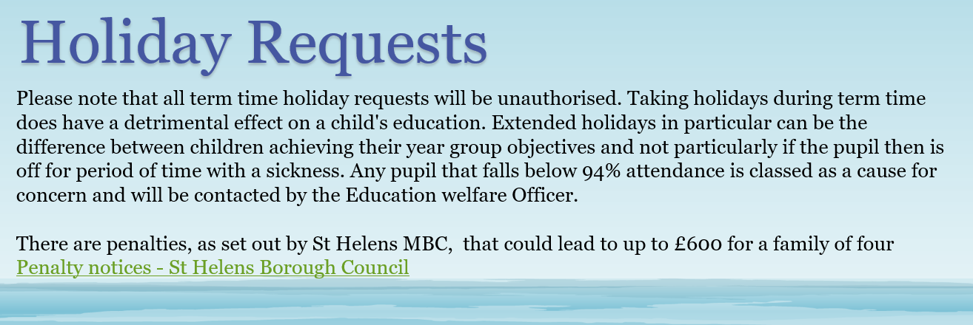
MEDICAL APPOINTMENTS
Please could we ask that you let the school office know in advance if your child has a medical appointment.
Could we also ask that you provide the office with a paper copy or phone screen shot of the appointment and inform us what time you will be collecting/dropping off your child on the day of appointment.
HOLIDAY REQUESTS

Slide 14

OFFICE NEWS
DINNER MONEY
If your child wishes to change their lunch preference please advise the office via email giving a week’s notice. Payment is taken through the School Money Online Payment System.
UNIFORM
Uniform can be ordered direct from Touchline UK Liverpool Rd, Warrington, WA5 1AE, 01925 413777
sales@touchline-embroidery.com
We also have a small number of items on the School Money site under SHOP which you can pay for then contact school to arrange for them to be sent home with your child.
ABSENCE
When reporting on the absence line, can we politely request that you leave a brief description of your child’s illness rather than just saying they are unwell. If your child has vomiting or diarrhoea please note that they should not return to school for a period of 48 hours after the last incident. This is a local authority policy
Applications for Holiday Leave must be submitted to school at least 4 weeks in advance. Forms can be found on the school website or requested from the school office. In accordance with Government and Local Authority policy, holidays taken during term time will only be authorised in exceptional circumstances.
CHANGES
It is very important that if you change contact numbers, emails or addresses that you advise us as soon as possible. Any changes must be sent into school via email.
Thank you
Contact Details
St Peter’s C.E. Primary School
Birley Street
Newton-le-Willows
WA12 9UR
01744 678630
stpeter@sthelens.org.uk
https://twitter.com/NLWStPeters
www.st-peters.st-helens.sch.uk

