Slide 1

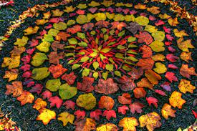
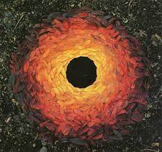


Year 1 Autumn Art. Andy Goldsworthy – Colour. Exploring Seasonal Changes.
Subject Specific Vocabulary |  | Sticky Knowledge | Key Moments in booklets
Similar | Looking almost but not exactly the same. | To know what we mean by ‘Harvest’. To know key facts about the artist Andy Goldsworthy. To know the different colours associated with Autumn. To know how to select relevant objects for a piece of artwork. | Artist Research pages – Andy Goldsworthy. Exploratory drawings of natural objects. Collages exploring autumn and associated colours. Photos of temporary sculptures made outside using natural objects.
Objects | Things that can be seen or touched. | To know that Elizabeth Catlett was an American and Mexican graphic artist and sculptor born in 1915 and died in 2012.
Colour | Objects of light seen with your eyes.
Autumn | A season of the year.
Arrange | Putting things into an order. |  | Skills
 |  |  | Skills
 |  |  | How to collect natural objects of a similar colour. How to arrange objects to create an effective composition. How to explore different colours in an artwork.
Create | To make or invent something new. |  | How to collect natural objects of a similar colour. How to arrange objects to create an effective composition. How to explore different colours in an artwork.
Sculpture | Forming solid objects out of clay, wood, metal, stone or natural materials. |  | To know what we mean by ‘Harvest’. To know key facts about the artist Andy Goldsworthy. To know the different colours associated with Autumn. To know how to select relevant objects for a piece of artwork.

Slide 2
Prior Knowledge | Prior Vocabulary | Curriculum Links
Safely use and explore a variety of materials, tools and techniques, experimenting with colour, design, texture and form |  | English – Harvest RE – Harvest

