Slide 1

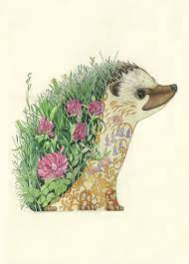
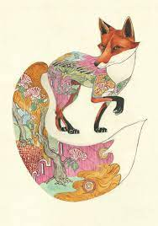


Year 1 Spring Art. Daniel Mackie – Drawing. Nocturnal animals.
Subject Specific Vocabulary |  | Sticky Knowledge | Key Moments in booklets
Colour | Looking at light through your eyes. | To know key facts about the artist Daniel Mackie and his artwork. To know how to select key features for a picture. To know about a variety of animals and their habitats. To know the visual characteristics of different animals and their habitats. | Artist Research pages – Daniel Mackie Experimental marks made using coloured pencils. Experimenting with drawing onto different surfaces with different colours. Observational drawings from photos of different animals and their habitats, picking out key elements. Experimenting with collage, using photos and cut out images of relevant habitats arranged into animal shapes.
Habitat | A place where an animal makes it home. | To know that Elizabeth Catlett was an American and Mexican graphic artist and sculptor born in 1915 and died in 2012.
Nature | Where plants and animals grow.
Size | How big or small something is.
Shape | The outline of something or someone.
Animal | A living creature.
 |  |  | Skills
Animal |  |  | How to hold a pencil to make different marks. How to make a variety of marks with a pencil such as stippling, scribbling, soft and hard. The effect made by drawing onto different materials. How to select key features for a drawing. How to incorporate colour into a drawing.

Slide 2
Prior Knowledge | Prior Vocabulary | Curriculum Links
Safely use and explore a variety of materials, tools and techniques, experimenting with colour, design, texture and form. |  | English- Nocturnal animals. PE- Animal shapes. Science- Night and day- winter animals/Animals and living things.

