Slide 1

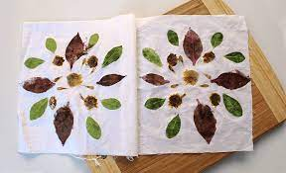
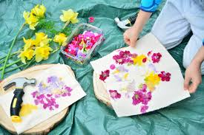


Year 1 Summer Art. Hapa Zome. Printing Natural Objects.
Subject Specific Vocabulary |  | Sticky Knowledge | Key Moments in booklets
Printing | To make more than one copy of something. | To know about Hapa Zome printing. To know how to make prints of objects. To know how to recognise texture. To know how to arrange objects in an effective way. | Hapa Zome research pages. Experimenting prints of natural objects using paint. Experimenting with printing onto different surfaces with different colours. Experimenting with Hapa Zome technique.
Texture | The feel of something. | To know that Elizabeth Catlett was an American and Mexican graphic artist and sculptor born in 1915 and died in 2012.
Relief | Adding onto a surface.
Multiple | More than one.
Natural ink | The liquid or colour from natural things.
Print | A copy from one thing to another.
 |  |  | Skills
 |  |  | To create prints of natural objects using paint. To create prints of plants and flowers using Hapa Zome technique. To create a relief print block using found natural objects. To think of the way to make a relief print.

Slide 2
Prior Knowledge | Prior Vocabulary | Curriculum Links
Safely use and explore a variety of materials, tools and techniques, experimenting with colour, design, texture and form. |  | Science- seasonal changes and plants.

