Slide 1

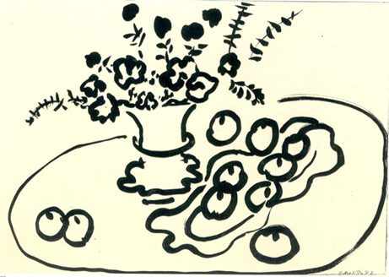

Year 2 Autumn Art Knowledge Mat Drawing Natural Objects – Henri Matisse.
Subject Specific Vocabulary |  | Sticky Knowledge | Key Moments in Sketchbooks
Objects | Something created in art. | Henri Matisse. To know a variety of marks that can be made with a pencil. To know a variety of marks that can be made with charcoal and chalk. To know the name of the artist Henri Matisse. To know that Matisse was a French artist born in 1869. To know that Matisse was known for both his use of colour and his fluid and original drawings. | Artist research pages. Exploring mark-making with pencils. Exploring mark-making with charcoal and chalk. Exploring drawing on different surfaces. Drawings of different still life groups of natural objects.
Curved | When a line becomes bent. | To know that Elizabeth Catlett was an American and Mexican graphic artist and sculptor born in 1915 and died in 2012.
Size | How big or small something is to compare to.
Round | A type of artwork to be on its own.
Fluid | The flow of pencils or paint on artwork. |  | Skills
 |  |  | How to make different marks with a pencil, charcoal and chalk. How to identify different shapes. How to draw a group of objects. How to consider shape and scale in a drawing. How to create a fluid drawing with one line. How to consider characteristics/ features carefully to create an accurate representation. How to use observational skills to create an accurate drawing.
Group | A collection of something. |  | How to make different marks with a pencil, charcoal and chalk. How to identify different shapes. How to draw a group of objects. How to consider shape and scale in a drawing. How to create a fluid drawing with one line. How to consider characteristics/ features carefully to create an accurate representation. How to use observational skills to create an accurate drawing.
Continuous line | A single and unbroken line used in drawing. | To recognise the artwork ‘The Sharecropper’.

Slide 2
Prior Knowledge | Prior Vocabulary | Curriculum Links
To know how to make different marks with fingers. To know how to hold a pencil. To know how to draw an enclosed shape with a pencil. To know how to make a representation of a subject using a pencil. | Draw, line, shape, mark, pencil, hold, | English – Harvest RE – Harvest Maths – key vocab

