Slide 1

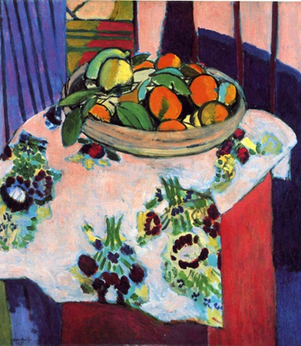



Year 2 Spring Art Knowledge Mat Printing and Collage – Henri Matisse.
Subject Specific Vocabulary |  | Sticky Knowledge | Key Moments in Sketchbooks
Primary | Colours that can not be created. | Henri Matisse. To know the difference between primary and secondary colours. To know how to mix secondary colours. To know which colours complement each other. To recognise the painting ‘Basket with Oranges’ by Matisse. To know how to create a relief print by drawing in foam. To understand that the print will be a mirror image of the design. To understand that printing is a great way to create multiples of the same image. | Artist research page. Exploring mark-making and printing. Exploring colour theory and mixing. Exploring printing on different surfaces. Prints combining 2 colours (background and foreground).
Secondary | Colours that can be made by mixing two primary colours together. | To know that Elizabeth Catlett was an American and Mexican graphic artist and sculptor born in 1915 and died in 2012.
Printing | To add paint to an object and use in a picture.
Print making | Adding lots of the same image on to surfaces.
Complimentary | Pairs of colours that blend or match other pairs of colours. |  | Skills
 |  |  | How to create a relief drawing on foam. How to print an image from a drawn design. How to create a print using two different colours (background and foreground). How to select colours that complement each other. How to identify and mix primary and secondary colours. How to print with control in order to create a clear image. How to reflect on your own and others artwork.
Design | An outline, plan or sketch. |  | How to create a relief drawing on foam. How to print an image from a drawn design. How to create a print using two different colours (background and foreground). How to select colours that complement each other. How to identify and mix primary and secondary colours. How to print with control in order to create a clear image. How to reflect on your own and others artwork.
Experiment | When you try a different way to produce artwork. | To recognise the artwork ‘The Sharecropper’.

Slide 2
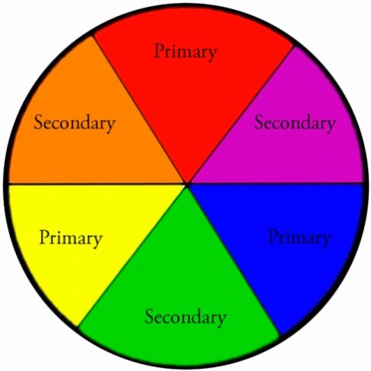
Prior Knowledge | Prior Vocabulary | Curriculum Links
To know how to make different marks with fingers. To know how to hold a pencil. To know how to draw an enclosed shape with a pencil. To know how to make a representation of a subject using a pencil. To know a variety of marks that can be made with a pencil. To know a variety of marks that can be made with charcoal and chalk. To know the name of the artist Henri Matisse. To know that Matisse was a French artist born in 1869. To know that Matisse was known for both his use of colour and his fluid and original drawings. | Draw, line, shape, mark, pencil, hold, objects, size, round, straight, curved, soft, hard, light, dark, group, fluid, continuous line. | Maths – shape

