Slide 1



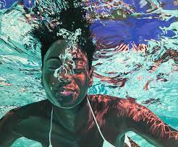
Year 3 Spring Art Knowledge Mat Colour – Expressing movement in water
Subject Specific Vocabulary |  | Sticky Knowledge | Key Moments in Sketchbooks
water | a colourless, transparent liquid | Samantha French To know how to create different tones of a colour, from the darkest to the lightest. To know that Samantha French is an artist who paints water. To know that French is an American artist who currently lives in New York. To know how to express movement in water using coloured pencils and paint. | Artist pages – exploring the work of Samantha French Exploring the different tones used to create movement in the water. Recreating a small section of one of Samantha French’s artworks. Recreating small sections of photographs of water using coloured pencils and/or paint.
movement | adding drama and interest to artwork | To know that Elizabeth Catlett was an American and Mexican graphic artist and sculptor born in 1915 and died in 2012.
reflection | when light bounces off an object
 |  |  | Skills
tone | the lightness or darkness of colour | To recognise the artwork ‘The Sharecropper’.
 |  |  | How to mix tertiary colours. How to create multiple shades of a colour. How to lighten a colour using white. How to darken a colour without using black. How to recreate a painting effect from a visual stimulus. How to express movement in water using paint.

Slide 2
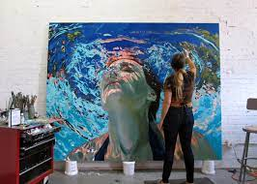
Prior Knowledge | Prior Vocabulary | Curriculum Links
To know the difference between primary and secondary colours. To know how to mix secondary colours. To know which colours complement each other. | Colour, primary, secondary, paint, mix, complementary, design, mark-making, mixing, experiment. | Science – characteristics of water.

